Slide 1
Discrete Mathematics Algorithms

Slide 2
3.1 Algorithms
When presented a problem, e.g., given a sequence of integers, find the larges one
Construct a model that translates the problem into a mathematical context
Discrete structures in such models include sets, sequences, functions, graphs, relations, etc.
A method is needed that will solve the problem (using a sequence of steps)
Algorithm: a sequence of steps

Slide 3
Algorithm
Algorithm: a finite set of precise instructions for performing a computation or for solving a problem
Example: describe an algorithm for finding the maximum (largest) value in a finite sequence of integers

Slide 4
Example
Perform the following steps
Set up temporary maximum equal to the first integer in the sequence
Compare the next integer in the sequence to the temporary maximum, and if it is larger than the temporary maximum, set the temporary maximum equal to this
Repeat the previous step if there are more integers in the sequence
Stop when there are no integers left in the sequence. The temporary maximum at this point is the largest integer in the sequence.

Slide 5
Pseudo code
Provide an intermediate step between English and real implementation using a particular programming language
procedure max(a₁, a₂, …, a_{n}: integers)
max := a₁
for i:=2 to n
if max < a_{i} then max:=a_{i}
{max is the largest element}

Slide 6
Prosperities of algorithm
Input: input values from a specified set
Output: for each set of input values, an algorithm produces output value from a specified set
Definiteness: steps must be defined precisely
Correctness: should produce the correct output values for each set of input values
Finiteness: should produce the desired output after a finite number of steps
Effectiveness: must be possible to perform each step exactly and in a finite amount of time
Generality: applicable for all problems of the desired form, not just a particular set of input values

Slide 7
Searching algorithms
Locate an element x in a list of distinct elements, a₁, a₂, …, a_{n}, or determine it is not in the list
Solution is the location of the term in the list that equals x, and is 0 if x is not in the list

Slide 8
Linear Search
procedure linear search(x:integer, a₁, a₂, …, a_{n}: distinct integers)
i := 1
while (i≤n and x≠a_{i})
i:=i+1
if i < n then location:=n
else location:=0
{location is the index of the term equal to x, or is 0 if x is not found}

Slide 9
Binary search
Given a sorted list, by comparing the element to be located to the middle term of the list
The list is split into two smaller sublists (of equal size or one has one fewer term)
Continue by restricting the search to the appropriate sublist
Search for 19 in the (sorted) list
1 2 3 5 6 7 8 10 12 13 15 16 18 19 20 22

Slide 10
Binary search
First split the list
1 2 3 5 6 7 8 10 12 13 15 16 18 19 20 22
Then compare 19 and the largest term in the first list, and determine to use the list
Continue
12 13 15 16 18 19 20 22
18 19 20 22
19 (down to one term)

Slide 11
Binary search
procedure binary search(x:integer, a₁, a₂, …, a_{n}: increasing integers)
i:=1 (left endpoint of search interval)
j:=1 (right end point of search interval)
while (i<j)
begin
m:=⌞(i+j)/2⌟
if x>a_{m} then i:=m+1
else j:=m
end
if x=a_{i} then location:=i
else location:=0
{location is the index of the term equal to x, or is 0 if x is not found}

Slide 12
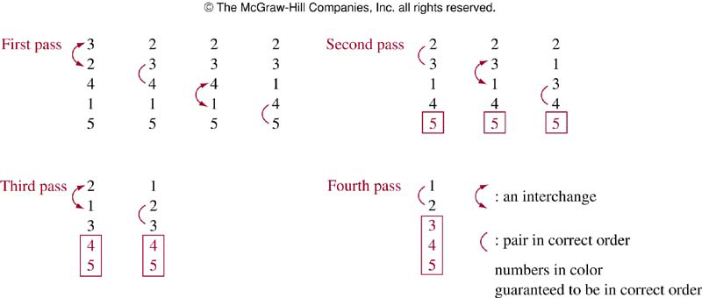
Sorting
Bubble sort: First pass guarantees the largest element is in correct position

Slide 13
Bubble sort
procedure bubble sort(a₁, a₂, …, a_{n}: real numbers with n≥2)
for i:=1 to n-1
for j:=1 to n-i
if a_{j}>a_{j+1} then interchange a_{j} and a_{j+1}
{a₁, a₂, …, a_{n} is in increasing order}

Slide 14
Insertion sort
Start with 2nd term
Larger than 1st term, insert after 1st term
Smaller than 1st term, insert before 1st term
At this moment, first 2 terms in the list are in correct positions
For 3rd term
Compare with all the elements in the list
Find the first element in the list that is not less than this element
For j-th term
Compare with the elements in the list
Find the first element in the list that is not less than this element

Slide 15
Example
Apply insertion sort to 3, 2, 4, 1, 5
First compare 3 and 2 → 2, 3, 4, 1, 5
Next, insert 3rd item, 4>2, 4>3 → 2, 3, 4, 1, 5
Next, insert 4th item, 1<2 → 1, 2, 3, 4, 5
Next, insert 5th item, 5>1, 5>2, 5>3, 5>4→1, 2, 3, 4, 5

Slide 16
Insertion sort
procedure insertion sort(a₁, a₂, …, a_{n}: real numbers with n≥2)
i:=1 (left endpoint of search interval)
j:=1 (right end point of search interval)
for j:=2 to n
begin
i:=1
while a_{j}>a_{i}
i:=i+1
m:=a_{j}
for k:=0 to j-i-1
a_{j-k}:= a_{j-k-1}
a_{i}:= m
end
{a₁ , a₂, …, a_{n} are sorted}

Slide 17
Greedy algorithm
Many algorithms are designed to solve optimization problems
Greedy algorithm:
Simple and naïve
Select the best choice at each step, instead of considering all sequences of steps
Once find a feasible solution
Either prove the solution is optimal or show a counterexample that the solution is non-optimal

Slide 18
Example
Given n cents change with quarters 25c, dimes 10c, nickels 5c and pennies 1c, and use the least total number of coins
Say, 67 cents
Greedy algorithm
First select a quarter (leaving 42 cents)
Second select a quarter (leaving 17 cents)
Select a dime (leaving 7 cents)
Select a nickel (leaving 2cnts)
Select a penny (leaving 1 cent)
Select a penny

Slide 19
Greedy change-making algorithm
procedure change(c₁, c₂, …, c_{n}: values of denominations of coins, where c₁>c₂>…>c_{n}; n: positive integer)
for i:=1 to r
while n≥c_{i} then
add a coin with value c_{i} to the change
n:=n- c_{i}
end

Slide 20
Example
Change of 30 cents
If we use only quarters, dimes, and pennies (no nickels)
Using greedy algorithm:
6 coins: 1 quarter, 5 pennies
Could use only 3 coins (3 dimes)

Slide 21
Lemma 1
If n is a positive integer, then n cents in change using quarters, dimes, nickels, and pennies using the fewest coins possible has at most two dimes, at most one nickel, at most 4 pennies, and cannot have two dimes and a nickel
The amount of change in dimes, nickels, and pennies cannot exceed 24 cents

Slide 22
Proof (Lemma)
Proof by contradiction
Show that if we had more than the specified number of coins of each type, we could replace them using fewer coins that have the same value
If we had 3 dimes, could replace with 1 quarter and 1 nickel
If we had 2 nickels, could replace them with 1 dime
If we had 5 pennies, could replace them with 1 nickel
If we had 2 dimes and 1 nickel, could replace them with 1 quarter
Because we could have at most 2 dimes, 1 nickel, and 4 pennies, but we cannot have two dimes and a nickel, it follows 24 cents is the most we can have

Slide 23
Theorem
Theorem: The greedy change-making algorithm produces change using the fewest coins possible
Proof by contradiction
Suppose that there is a positive integer n such that there is a way to make change for n cents using fewer coins (q’) than that of the greedy algorithm
Let the number of quarters be q’, and the number of quarters used in the greedy algorithm be q

Slide 24
Proof
First note q’ must be the same as q
Note the greedy algorithm uses the most quarters possible, so q’≤q
However, q’ ≮ q
If q’ < q, we would need to make up 25 cents from dimes, nickels, and pennies in the optimal way to make change
But this is impossible from Lemma 1

Slide 25
Proof
As there must be the same number of quarters in the two algorithms
The value of the dimes, nickels and pennies in these two algorithms must be the same, and their value is no more than 24 cents
Likewise, there must be the same number of dimes,
as the greedy algorithm used the most dimes possible
and by Lemma 1, when change is made using the fewest coins possible, at most 1 nickel and a most 4 pennies are used, so that the most dimes possible are also used in the optimal way to make change
Likewise, we have the same number of nickels, and finally the same number of pennies

Slide 26
The halting problem
One of the most famous theorems in computer science
There is a problem that cannot be solved using any procedure
That is, we will show there are unsolvable problems
The problem is the halting problem

Slide 27
The halting problem
It asks whether there is a procedure that does this:
It takes input as a computer program and input to the program, and
determines whether the program will eventually stop when run with the input
Useful to test certain things such as whether a program entered into an infinite loop

Slide 28
The halting problem
First note that we cannot simply run a program and observe what it does to determine whether it terminates when run with the given input
If the program halts, we have our answer
But if it is still running after any fixed length of time has elapsed, we do not know whether it will never halt or we just did not wait long enough for it to terminate

Slide 29
Turing’s proof
Halting problem is unsolvable
Proof by contradiction
The proof presented here is not completely rigorous
Proof: There is a program H can determine whether a program P and an input I will halt or not
The result : H(P,I) outputs the string “halt” as output if H determines P stops when given I
Otherwise, H(P,I) generates the string “loops forever” as output

Slide 30
Turing’s proof
When a procedure is coded, it is expressed as a string of characters and can be interpreted as a sequence of bits
A program can be used as data, and thus a program can be thought of as input to another program, or even itself
H can take a program P as both of its inputs（run
P with the input P）, which are a program and input to this program
H should be able to determine if P will halt when it is given a copy of itself as input

Slide 31
Turing’s proof
Construct a simple procedure K(P) that makes use of the output H(P,P) but does the opposite of H.
H(K,K) is a contradiction!!!
If the output of H(K,K) is “loops forever”, then K halts
IF the output of H(K,K) is “halt”, then K loops forever

Slide 32
contradiction!
Now use K as the input and put it into K
K enter P as the first part，it has a result HALT or not
then K get out from K with an oppersite result.
Example：
1. If K HALTs predicted by P, Then K cannot!!! because it loops!
2. If K Loops predicted by P, Then K HALTs!!!
NOT prodictable

Slide 33
void P(char *I);
bool H(char *P_code, char *I);

Slide 34
void K (char P_code) {
if (H(P_code, P_code))
{ while (true) { } // 死循环 }
else { return; // 立即停止运行 }
}
run H(K, K_code) ，you will see the contradiction！
小岛理发师悖论：他给并且只给那些不给自己理发的人理发.

Slide 35
3.2 Growth of Functions
Study number of operations used by algorithm
For example, given n elements
Study the number of comparisons used by the linear and binary search
Estimate the number of comparisons used by the bubble sort and insertion sort
Use big-O notation to study this irrespective of hardware

Slide 36
Big-O notation
Used extensively to estimate the number of operations in algorithm uses as its inputs grows
Determine whether it is practical to use a particular algorithm to solve a problem as the size of the input increases
Can compare with two algorithms and determine which is more efficient

Slide 37
Big-O notation
For instance, one algorithm uses 100n²+17n+4 operations and the other uses n³ operations
Can figure out which is more efficient with big-O notation
The first one is more efficient when n is large even though it uses more operations for smaller values of n, e.g., n=10
Related to big-Omega and big-Theta notations in algorithm design

Slide 38
Big-O notation
Let f and g be functions from the set of integers or the set of real numbers to the set of real numbers, we say f(x) is O(g(x)) if there are constants C and k such that
|f(x)| ≤ C |g(x)| whenever x > k
Read as f(x) is big-oh of g(x) or f（x）=O（g（x））

Slide 39
Big-O notation
The constants C and k are called witnesses to the relationship f(x) is O(g(x))
Need only one pair of witnesses to this relationship
To show f(x) is O(g(x)), need only one pair of constants C and k, s.t. |f(x)| ≤ C |g(x)|
When there is one pair of witnesses, there are infinitely many pairs of witness
If C and k are one pair, any pair C’ and k’ where C<C’ and k<k’, we have |f(x)|≤ C|g(x)|≤ C’|g(x)| when x>k’>k

Slide 40
Example
Show that f(x)=x²+2x+1 is O(x²)
We observe that we can estimate size of f(x) when x>1 because x²>x and x²>1,
0≤ x²+2x+1 ≤ x²+2x²+x²=4x²
when x>1. Thus, we can take C=4 and k=1 to show that f(x) is O(x²)
Alternatively, when x>2, 2x≤x² and 1≤x²
0≤ x²+2x+1 ≤ x²+x²+x²=3x²
so C=3, and k=2 are also witnesses to relation f(x) is O(x²)

Slide 41
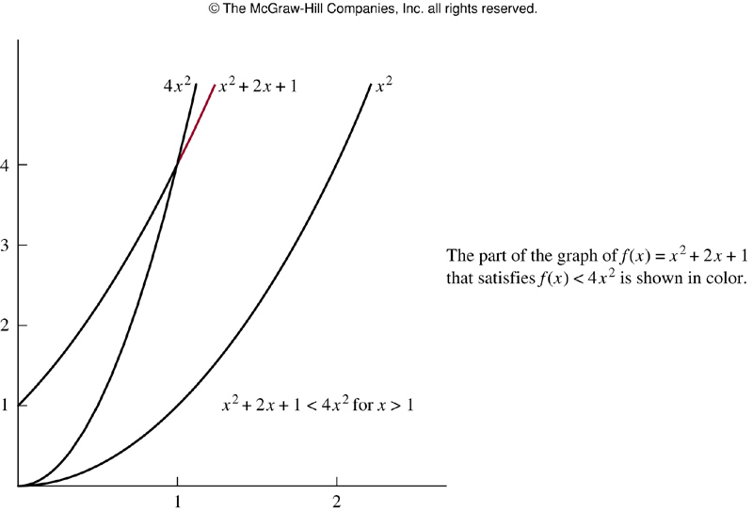
Example

Slide 42
Example
Observe that O(x²) can be replaced by any function with larger values than x²,
e.g., f(x)= x²+2x+1 is O(x³), f(x) is O(x²+x+7), O(x²+2x+1)
In this example, f(x)=x²+2x+1, g(x)=x², we say both of these big-O relationships are of the same order
Sometimes written as f(x)=O(g(x))
It is acceptable to write f(x) ∈ O(g(x)) as O(g(x)) represents the set of functions that are O(g(x))

Slide 43
Big-O notation
When f(x) is O(g(x)) and h(x) is a function that has larger absolute values than g(x) does for sufficient large value of x
It follows that f(x) is O(h(x))
|f(x)|≤C|g(x)| if x>k
and if |h(x)|>|g(x)| for all x>k, then
|f(x)|≤C|h(x)| if x>k
When big-O notation is used, f(x) is O(g(x)) ， O(g(x)) is chosen to be as small as possible

Slide 44
Example
Show that 7x² is O(x³)
When x>7, 7x²<x³, So let C=1 and k=7, we see 7x² is O(x³)
Alternatively, when x>1, 7x²<7x³ and so that C=7 and k=1, we have the relationship 7x² is O(x³)

Slide 45
Example
Show that n² is not O(n)
To show that n² is not O(n), we must show that no pair of constants C and k exist such that n²≤Cn when n>k
When n>0, we have n≤C to have n²≤Cn
But no matter what C and k are, the inequality n≤C cannot hold for all n with n>k
In particular, when n is larger than the max of k and C, it is not true n²≤Cn although n>k

Slide 46
Example
Previous example shows that 7x² is O(x³). Is it also true that x³ is also O(7x²)
To show that, x³≤7x² is equivalent to x≤7C whenever x>k
No C exists for which x≤7C for all x>k
Thus x³ is not O(7x²)

Slide 47
Some important big-O results
Let f(x)=a_{n}x^{n}+a_{n-1}x^{n-1}+…+a₁x+a₀, where a₀, a₁, …, a_{n-1}, a_{n} are all real numbers, then f(x) is O(x^{n})
Using the triangle inequality, if x>1

Slide 48
Example
Big-O notation of the sum of first n positive integers
1+2+…+n ≤n+n+…+n=n², O(n²) with C=1, k=1
Alternatively, O(n(n+1)/2)=O(n²)
Big_O notation of n!
n!=1∙2 ∙3 ∙ … n ≤n ∙ n ∙ n … n = n^{n}, O(n^{n}) with C=1 and k=1
log n!≤log n^{n}=n log n, log n! is O(nlog n) with C=1, k=1

Slide 49
Example
We know that n<2^{n} when n is a positive integer. Show that this implies n is O(2^{n}) and use this to show that log n is O(n)
n is O(2^{n}) by taking k=1 and C=1
Thus, log n<2n, so log n is O(n)
If we have logarithms to a different base b other than 2, we still have log_{b} n is O(n) as
log_{b}n = log n/log b < n/log b when n is a positive integer. Take C=1/log b and k=1

Slide 50
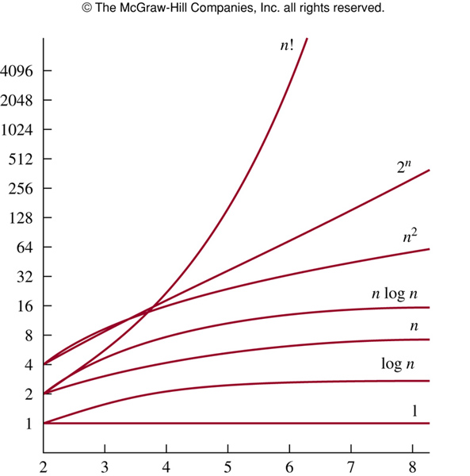
Growth of functions

Slide 51
Growth of combinations of functions
Many algorithms are made up of two or more separate subprocedures
The number of steps is the sum of the number of steps of these subprocedures

Slide 52
Theorems
Theorem 2: Suppose f₁(x) is O(g₁(x)) and f₂(x) is O(g₂(x)),
(f₁+f₂)(x) is O(max(|g₁(x)|, |g₂(x)|)
(f₁f₂)(x) is O(g₁(x)g₂(x))
|(f₁f₂)(x)|=|f₁(x)||f₂(x)|≤C₁|g₁(x)|C₂|g₂(x)|
≤C₁C₂|(g₁g₂)(x)|≤C|(g₁g₂)(x)| (C= C₁C₂, k=max(k₁,k₂))
Corollary: f₁(x) and f₂(x) are both O(g(x)), then (f₁+f₂)(x) is O(g(x))

Slide 53
Example
Big-O notation of f(n)=3n log(n!)+(n²+3)logn where n is a positive integer
We know log(n!) is O(nlog n), so the first part is O(n² log n)
As n²+3<2n² when n>2, it follows that n²+3 is O(n²), and the second part is O(n² log n)
So f(n) is O(n² log n)

Slide 54
Example
Big-O notation of f(x)=(x+1) log(x²+1) + 3 x²
Note (x+1) is O(x) and x²+1 ≤2x² when x>1
So, log x²+1 ≤ log(2x²)=log 2+ log x²=log 2+ 2 log x
≤ 3 log x if x >2
Thus, log x²+1 is O(log x)
The first part of f(x) is O(x log x)
Also, 3x² is O(x²)
So, f(x) is O(max(x log x, x²))=O(x²) as x log x ≤ x² for x >1

Slide 55
Big-Omega
Big-O notation does not provide a lower bound for the size of f(x) for large x
Let f and g be functions from the set of integers or the set of real numbers to the set of real numbers. We say f(x) is 𝛺(g(x)) if there are positive constants C and k s.t.
|f(x)|≥C|g(x)| when x>k
Read as f(x) is big-Omega of g(x)

Slide 56
Example
f(x)=8x³+5x²+7 is 𝛺(g(x)) where g(x)=x³
It is easy to see as f(x)= 8x³+5x²+7≥8x³ for all positive numbers x
This is equivalent to say g(x)=x³ is O(8x³+5x²+7)

Slide 57
Big-Theta notation
Want a reference function g(x) s.t. f(x) is O(g(x)) and f(x) is 𝛺(g(x))
Let f and g be functions from the set of integers or the set of real numbers to the set of real numbers. We say that f(x) is 𝛳(g(x)) if f(x) is O(g(x)) and f(x) is 𝛺(g(x))
When f(x) is 𝛳(g(x)) , we say f is big-Theta of g(x), and we also say f(x) is of order g(x)

Slide 58
Big Theta-notation
When f(x) is 𝛳(g(x)), g(x) is 𝛳(f(x))
f(x) is 𝛳(g(x)) if and only if f(x) is O(g(x)) and g(x) is O(f(x))

Slide 59
Example
Let f(n)=1+2+…+n. We know that f(n) is O(n²), to show that f(x) is of order n², we need to find C and k s.t. f(n)>Cn² for large n
f(n) is O(n²) and 𝛺(n²), thus f(n) is 𝛳(n²)

Slide 60
Big-Theta notation
We can show that f(x) is 𝛳(g(x)) if we can find positive real numbers C₁ and C₂ and a positive number k, s.t.
C₁|g(x)|≤|f(x)|≤C₂|g(x)|
when x>k
This shows f(x) is O(g(x)) and f(x) is 𝛺(g(x))

Slide 61
Example
Show that 3x²+8x log x is 𝛳(x²)
As 0 ≤ 8x log x≤8x², it follows that
3x²+8x logx ≤11x² for x>1
Consequently 3x²+8x logx is O(x²)
Clearly 3x²+8x logx is 𝛺(x²)
Consequently 3x²+8x logx is 𝛳(x²)

Slide 62
Polynomial
One useful fact is that the leading term of a polynomial determines its order
E.g., f(x)=3x⁵+x⁴+17x³+2 is of order x⁵
Let f(x)=a_{n}x^{n}+a_{n-1}x^{n-1}+…+a₁x+a₀, where a₀, a₁, …, a_{n-1}, a_{n} are all real numbers, then f(x) is of order x^{n}

Slide 63
3.3 Complexity of algorithms
Algorithm
Produce correct answer
Efficient
Efficiency
Execution time (time complexity)
Memory (space complexity)
Space complexity is related to data structure

Slide 64
Time complexity
Expressed in terms of number of operations when the input has a particular size
Not in terms of actual execution time
The operations can be comparison of integers, the addition of integers, the multiplication of integers, the division of integers, or any other basic operation
Worst case analysis

Slide 65
Example
procedure max(a₁, a₂, …, a_{n}: integers)
max := a₁
for i:=2 to n
if max < a_{i} then max:=a_{i}
{max is the largest element}
There are 2(n-1)+1=2n-1 comparisons, the time complexity is 𝛳(n) measured in terms of the number of comparisons
Notes:
（i and max with ai）comparison each round。 then i becomes n+1

Slide 66
Example
procedure linear search(x:integer, a₁, a₂, …, a_{n}: distinct integers)
i := 1
while (i≤n and x≠a_{i})
i:=i+1
if i < n then location:=n
else location:=0
{location is the index of the term equal to x, or is 0 if x is not found}
At most 2 comparisons per iteration, 2n+1 for the while loop and 1 more for if statement. At most 2n+2 comparisons are required

Slide 67
Binary search
procedure binary search(x:integer, a₁, a₂, …, a_{n}: increasing integers)
i:=1 (left endpoint of search interval)
j:=1 (right end point of search interval)
while (i<j)
begin
m:=⌞(i+j)/2⌟
if x>a_{m} then i:=m+1
else j:=m
end
if x=a_{i} then location:=i
else location:=0
{location is the index of the term equal to x, or is 0 if x is not found}

Slide 68
Time complexity of binary search
For simplicity, assume n=2^{k},k=log₂n
At each iteration, 2 comparisons are used
For example, 2 comparisons are used when the list has 2^{k-1} elements, 2 comparisons are used when the list has 2^{k-2}, …, 2 comparisons are used when the list has 2¹ elements
1 comparison is ued when the list has 1 element, and 1 more comparison is used to determine this term is x
Hence, at most 2k+2=2log₂n +2 comparisons are required
If n is not a power of 2, the list can be expanded to 2^{k+1}, and it requires at most 2 log n+2 comparisons
The time complexity is at most 𝛳(log n)

Slide 69
Average case complexity: number of operations x probability
Usually more complicated than worst-case analysis
For linear search, assume x is in the list
If x is at 1st term, 3 comparisons are needed (1 to determine the end of list, 1 to compare x and 1st term, one outside the loop)
If x is the 2nd term, 2 more comparisons are needed, so 5 comparisons are needed
In general, if x is the i-th term, 2 comparisons are used at each of the i-th step of the loop, and 1 outside the loop, so 2i+1 comparisons are used。
On average , (3+5+7+…+2n+1)/n=(2(1+2+3+…n)+n)/n=n+2, which is 𝛳(n)

Slide 70
Complexity analysis
Assume x is in the list
It is possible to do an average-case analysis when x may not be in the list
Although we have counted the comparisons needed to determine whether we have reached the end of a loop, these comparisons are often not counted
From this point, we will ignore such comparisons

Slide 71
Complexity of bubble sort
procedure bubble sort(a₁, a₂, …, a_{n}: real numbers with n≥2)
for i:=1 to n-1
for j:=1 to n-i
if a_{j}>a_{j+1} then interchange a_{j} and a_{j+1}
{a₁, a₂, …, a_{n} is in increasing order}
When the i-th pass begins, the i-1 largest elements are guaranteed to be in the correct positions
During this pass, n-i comparisons are used,
Thus from 2nd to (n-1)-th steps,
(n-1)+(n-2)+…+2+1=(n-1)n/2 comparisons are used
Time complexity is always 𝛳(n²)

Slide 72
Insertion sort
procedure insertion sort(a₁, a₂, …, a_{n}: real numbers with n≥2)
i:=1 (left endpoint of search interval)
j:=1 (right end point of search interval)
for j:=2 to n
begin
i:=1
while a_{j}>a_{i}
i:=i+1
m:=a_{j}
for k:=0 to j-i-1
a_{j-k}:= a_{j-k-1}
a_{i}:= m
end
{a₁ , a₂, …, a_{n} are sorted}

Slide 73
Complexity of insertion sort
Insert j-th element into the correct position among the first j-1 elements that have already been put in correct order
Use a linear search successively
In the worst case, j comparisons are required to insert the j-th element, thus
2+3+…+n=n(n+1)/2-1,
and time complexity is 𝛳(n²)

Slide 74
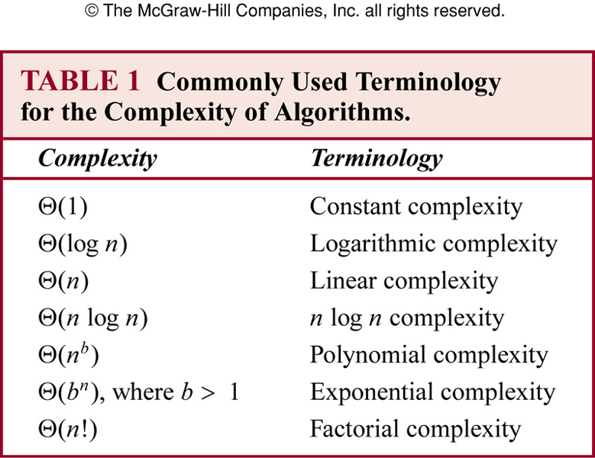
Understanding complexity

Slide 75
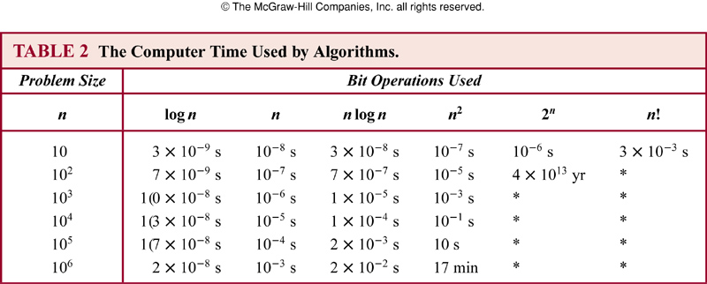
Scalability
Each bit operation takes 10⁻⁹ seconds

Slide 76
Tractable
A problem that is solvable by an algorithm with a polynomial worst-case complexity is called tractable
The algorithm will produce the solution for reasonably sized input in a relatively short time
Often the degree and coefficients are small
However, intractable problems may have low average-case time complexity, or can be solved with approximate solutions

Slide 77
Solvable problems
Some problems are solvable using an algorithm
Some problems are unsolvable (no algorithm exists for solving them), e.g., the halting problem
Many solvable problems are believed that no algorithm with polynomial worst-case time complexity solves them, but that a solution, if known, can be checked in polynomial time

Slide 78
P
problems that can be solved by an algorithm with polynomial worst-case time complexity.
considered to be easy problems.....

Slide 79
NP
NP (nondeterministic polynomial time)
currently no polynomial solution. but you can guess a solution.
NP: problems for which a solution can be checked in polynomial time.
more difficult than P
example: map coloring problem, satisfiability problem

Slide 80
NPC
NP-complete problems: if any of these problems can be solved by a polynomial worst-case time algorithm, then all problems in the class NP can be solved by polynomial worst cast time algorithms
definition:
1, it is a np problem
2. all other np problem can be Reducible （归约，可以理解为变得更难） to it

Slide 81
NP-complete problems
The satisfiability problem is an NP-complete problem
We can quickly verify that an assignment of truth values to the variables of a compound proposition makes it true
But no polynomial time algorithm has been discovered
It is generally accepted, though not proven, that no NP-complete problem can be solved in polynomial time (P versus NP problem)

Slide 82
NP-Hard
If ALL problems can be Reducible to a certain problem then this problem is a NP-Hard problem.
even you can guess a solution. it might not be verified in polynomial time......

Slide 83
P NP NPC ,NP-Hard
P is a subset of NP
if NP is a subset of P then P=NP
but...no proof for that
if ALL NP problems can be Reducible （归约，可以理解为变得更难） to a certain problem then this problem is a NPC problem.
If ALL problems can be Reducible to a certain problem then this problem is a NP-Hard problem.

Slide 84
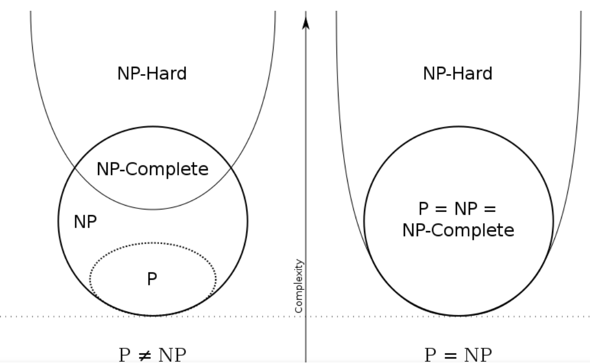
P<NP<NPC<NP-hard

Slide 85
homework
1. Devise an efficient algorithm for finding the second largest element in a sequence of n elements and determine the worst-case complexity of your algorithm.
2. The shaker sort (or bidirectional bubble sort) successively compares pairs of adjacent elements, exchanging them if they are out of order, and alternately passing through the list fromthe beginning to the end and then from the end to the beginning until no exchanges are needed. provide an example then calculate the worse case complexity.
Notes:
3s8,

