Slide 1


TREE
Discrete Mathmatics

Slide 2
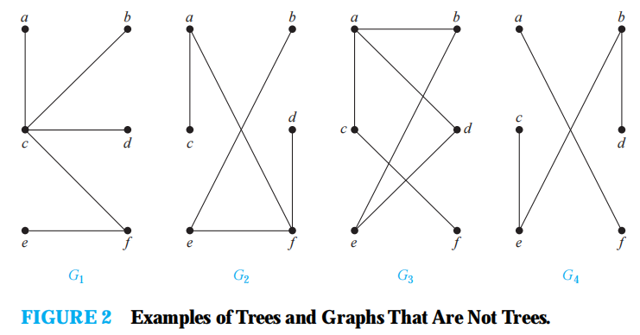
concept：
A tree is a connected undirected graph with no simple circuits.

Slide 3
Theorem 1
An undirected graph is a tree if and only if there is a unique simple path between any two of its vertices.
PROOF：
connected
no simple circuit

Slide 4
DEFINITION 2
A rooted tree is a tree in which one vertex has been designated as the root and every edge is directed away from the root.
root，parent，child，
siblings，ancestors，descendants
leaf, internal vertex, subtree

Slide 5
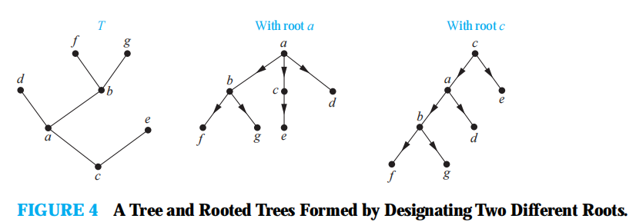
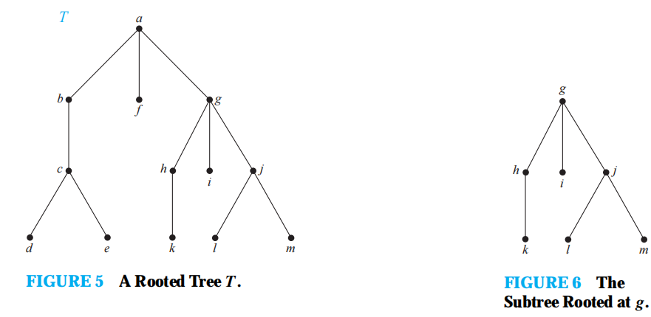

Slide 6
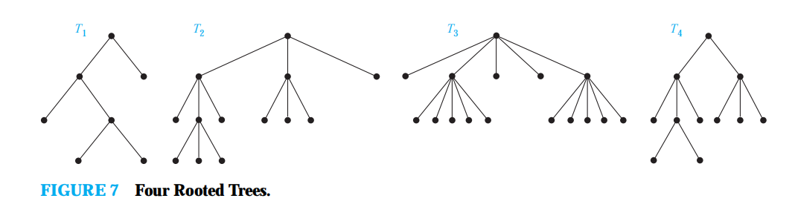
M-ary tree
A rooted tree is called an m-ary tree if every internal vertex has no more than m children. The tree is called a full m-ary tree if every internal vertex has exactly m children. An m-ary tree with m = 2 is called a binary tree.

Slide 7
Ordered tree
An ordered rooted tree is a rooted tree where the children of each internal vertex are ordered. Ordered rooted trees are drawn so that the children of each internal vertex are shown in order from left to right.
(Ordered) binary tree : left chlild, right child, left subtree, right subtree

Slide 8
Properties of Trees
THEOREM 2: A tree with n vertices has n − 1 edges
Proof: Induction
THEOREM 3: A full m-ary tree with i internal vertices contains
n = m*i + 1 vertices.
Proof: Every vertex, except the root, is the child of an internal vertex. Because each of the i internal vertices has m children, there are m*i vertices in the tree other than the root. Therefore,the tree contains n = m*i + 1 vertices.

Slide 9
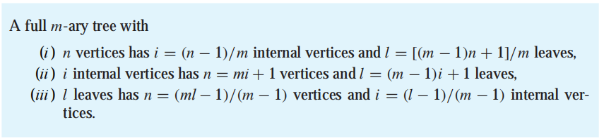
Therem 4: FULL m-ary tree with n nodes,i internal nodes and l leaves

Slide 10
BALANCED m-ARY TREES
“balanced” : the subtrees at each vertex contain paths of approximately the same length.
The level of a vertex v in a rooted tree is the length of the unique
path from the root to this vertex.
The level of the root is defined to be zero.
The height of a rooted tree is the maximum of the levels of vertices.
the height of a rooted tree is the length of the longest path from the root to any vertex.

Slide 11
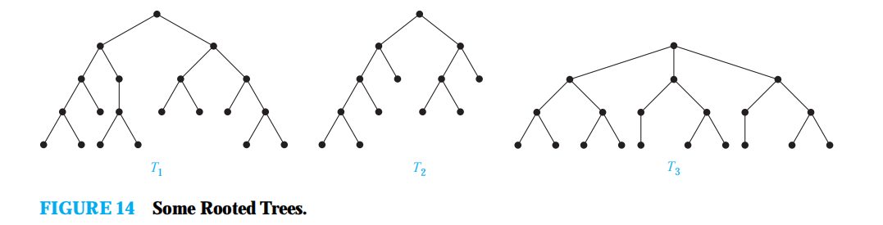
balanced? A rooted m-ary tree of height h is balanced if all leaves are at levels h or h − 1.

Slide 12
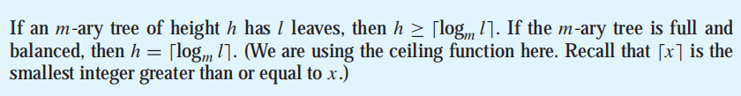
THEOREM 5
There are at most m^{h} leaves in an m-ary tree of height h.
COROLLARY 1

Slide 13
11.2 Applications of Trees
Binary Search Trees
Vertices are assigned keys so that the key of a vertex is both larger than the keys of all vertices in its left subtree and smaller than the keys of all vertices in its right subtree

Slide 14
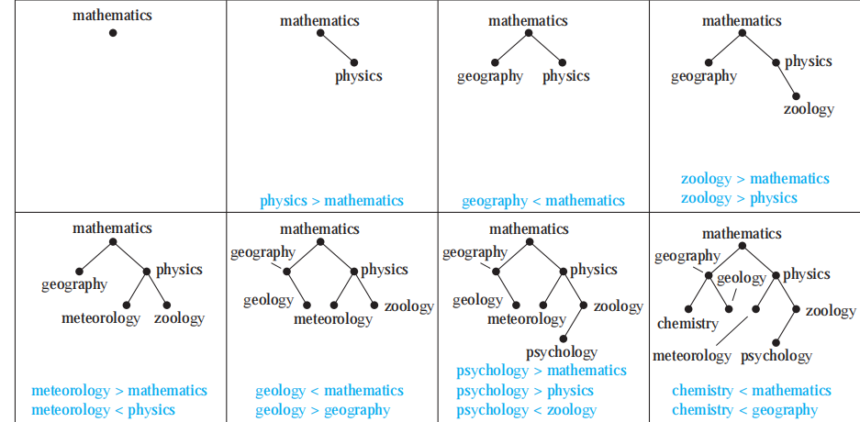
Binary Search Tree Example
Form a binary search tree for the words： mathematics, physics, geography, zoology, meteorology,
geology, psychology, and chemistry (using alphabetical order).

Slide 15
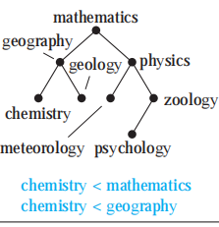
insert the word oceanography into the binary search tree in Example 1.

Slide 16
deleting a node in binary tree math, psychology, zoology

Slide 17
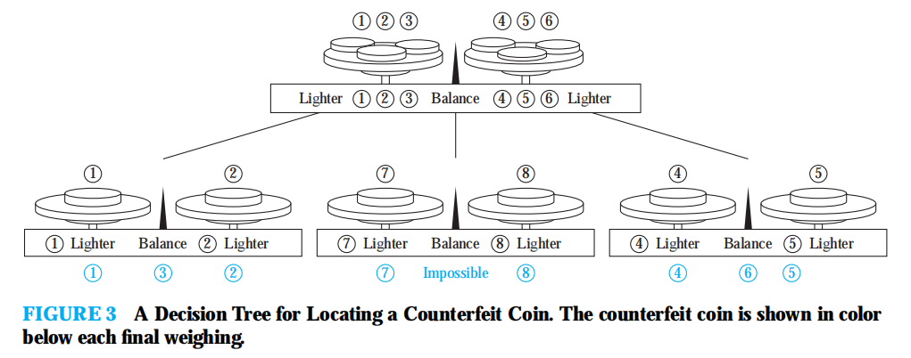
Decision Trees
A rooted tree in which each internal vertex corresponds to a decision, with a subtree at these vertices for each possible outcome of the decision, is called a decision tree.

Slide 18
binary sorting and complexity
a sorting algorithm based on binary comparisons can be represented by a binary decision tree in which each internal vertex represents a comparison of two elements. Each leaf represents one of the n! permutations of n elements.
The complexity of a sort based on binary comparisons is measured in terms of the number of such comparisons used. The largest number of comparisons ever needed is equal to the height of the decision tree. Because the height of a binary tree with n! leaves is at least Ceiling(log n!)

Slide 19
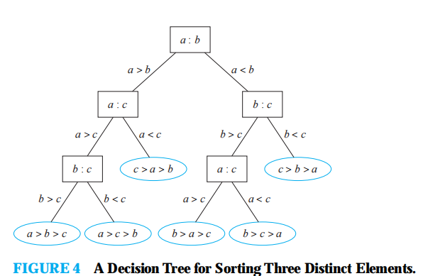

Slide 20
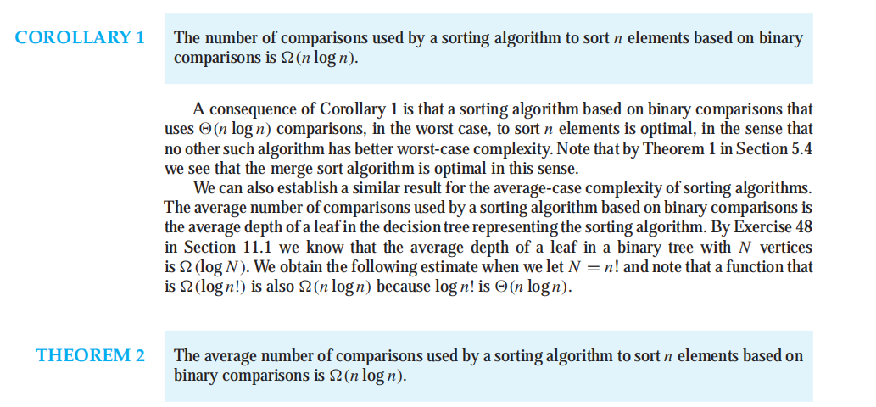
average case and worse case

Slide 21
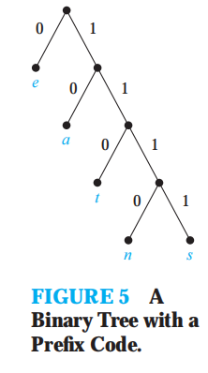
Prefix Codes
The bit string for a letter never occurs as the first part of the bit string or another letter. Codes with this property are called prefix codes.
A prefix code can be represented using a binary tree, where the characters are the labels of the leaves in the tree.

Slide 22
huffman coding
Use Huffman coding to encode the following symbols with the frequencies listed: A: 0.08, B:0.10, C: 0.12, D: 0.15, E: 0.20, F: 0.35. What is the average number of bits used to encode acharacter?
Solution: Figure 6 displays the steps used to encode these symbols. The encoding produced encodes A by 111, B by 110, C by 011, D by 010, E by 10, and F by 00. The average number of bits used to encode a symbol using this encoding is
3 · 0.08 + 3 · 0.10 + 3 · 0.12 + 3 · 0.15 + 2 · 0.20 + 2 · 0.35 = 2.45.

Slide 23
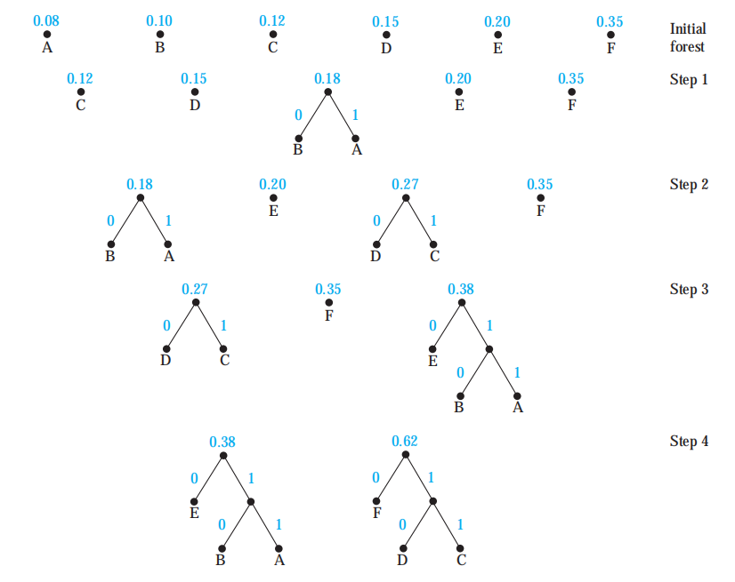
HUFFMAN CODING
data compression
A: 0.08, B:0.10,
C: 0.12, D: 0.15,
E: 0.20, F: 0.35

Slide 24
Game Tree
Each player knows the moves made by the other player and no element of chance enters into the game. We model such games using game trees; the vertices of these trees represent the positions that a game can be in as it progresses; the edges represent legal moves between these positions.

Slide 25
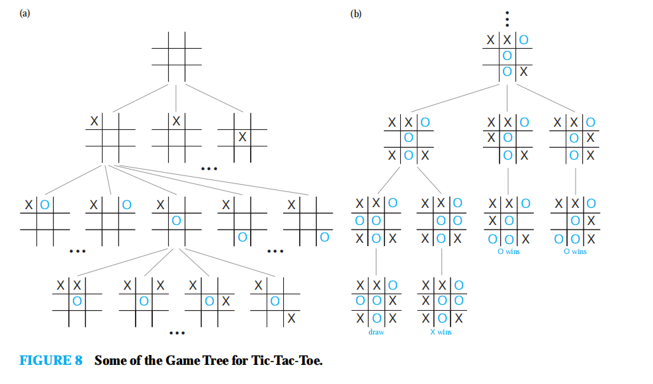

Slide 26
11.3 Tree Traversal
Universal Address Systems
Label all the vertices recursively:
1. Label the root with the integer 0. Then label its k children (at level 1) from left to right with 1, 2, 3,...,k.
2. For each vertex v at level n with label A, label its kv children, as they are drawn from left to right, with A.1, A.2, . . . , A.kv.
0 < 1 < 1.1 < 1.2 < 1.3 < 2 < 3 < 3.1 < 3.1.1 < 3.1.2 < 3.1.2.1 < 3.1.2.2 < 3.1.2.3 < 3.1.2.4 < 3.1.3 < 3.2 < 4 < 4.1 < 5 < 5.1 < 5.1.1 < 5.2 < 5.3

Slide 27
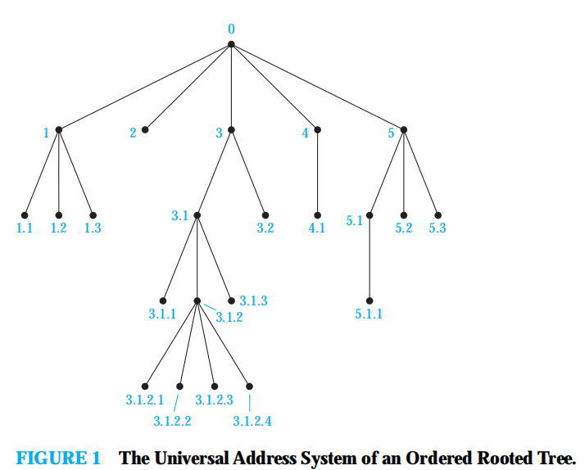

Slide 28
Traversal Algorithms
preorder traversal,
inorder traversal,
postorder traversal

Slide 29
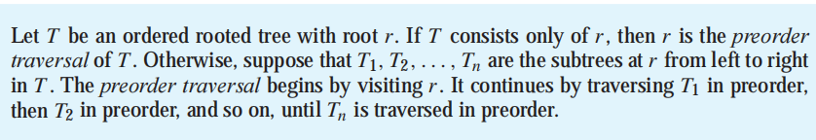
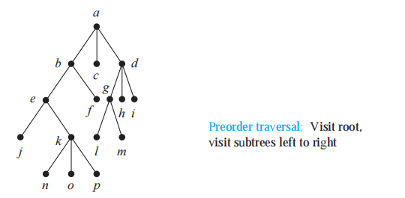


Slide 30
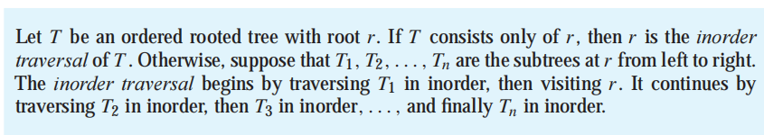
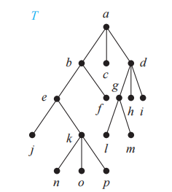


Slide 31
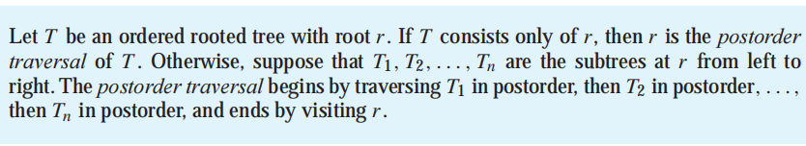
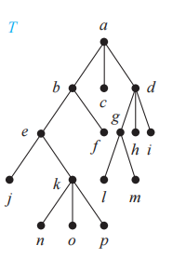


Slide 32
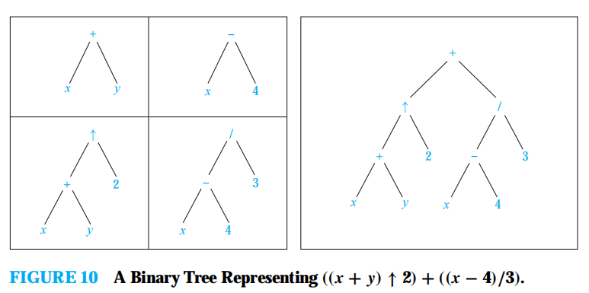
Infix, Prefix, and Postfix Notation
prefix: preorder
(polish notation).
postfix: postorder
An inorder traversal of the binary tree representing an expression produces the original expression. infix form.

Slide 33
prefix calculation
prefix : +↑+ x y 2 / − x 4 3.
we can evaluate an expression in prefix form by working from right to left. When we encounter an operator, we perform the corresponding operation with the two operands immediately to the right of this operand. Also, whenever an operation is performed, we consider the result a new operand.
postfix, from left to right

Slide 34
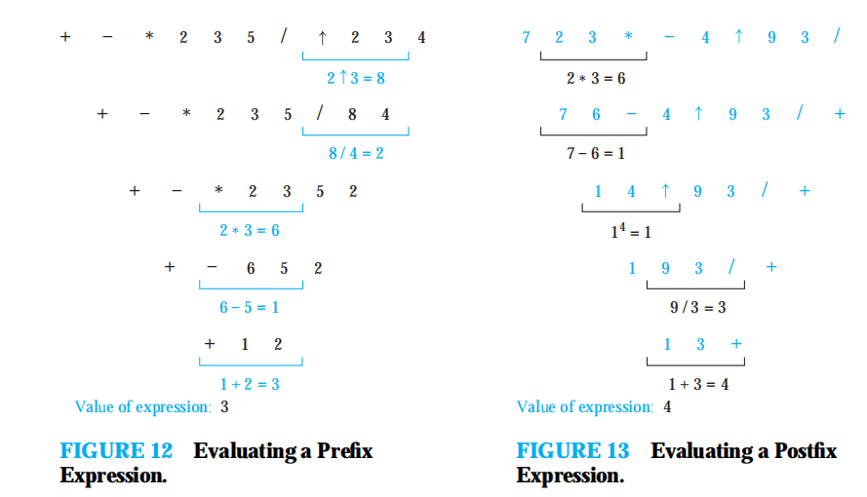

Slide 35
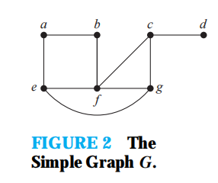
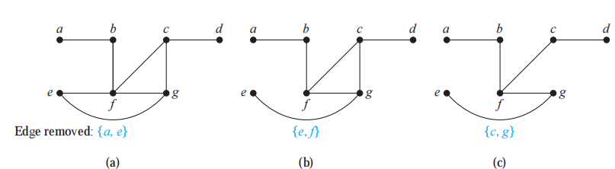
11.4 Spanning Trees
DEFINITION 1
Let G be a simple graph. A spanning tree of G is a subgraph of G that is a tree containing every vertex of G.

Slide 36
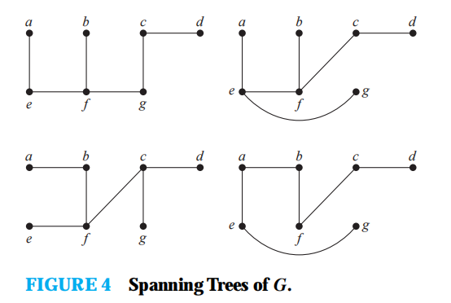
not unique! A simple graph is connected if and only if it has a spanning tree.
A simple graph is connected if and only if it has a spanning tree.

Slide 37
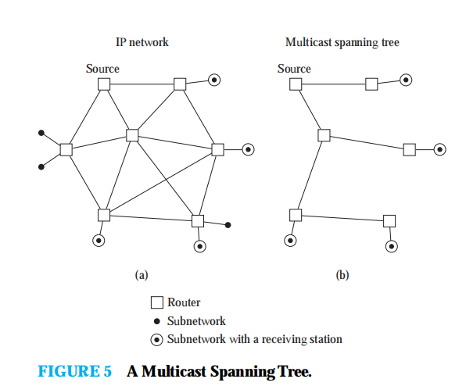
example : IP multicasting

Slide 38
Depth-First Search
We can build a spanning tree for a connected simple graph using depth-first search.
Arbitrarily choose a vertex of the graph as the root
Successively adding vertices and edges, where each new edge is incident with the last vertex in the path and a vertex not already in the path
If the path goes through all vertices of the graph, the tree consisting of this path is a spanning tree.
Move back to the next available vertex in the path that can form a new path starting at this vertex passing through vertices that were not already visited.

Slide 39
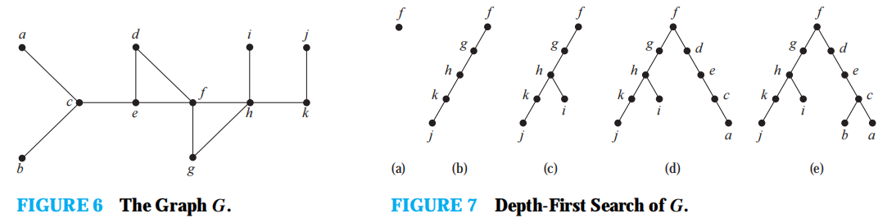
DFS: backtracking

Slide 40
Breadth-First Search
Arbitrarily choose a root from the vertices of the graph. Then add all edges incident to this vertex. The new vertices added at this stage become the vertices at level 1 in the spanning tree.
Arbitrarily order them. Next, for each vertex at level 1, visited in order,add each edge incident to this vertex to the tree as long as it does not produce a simple circuit.
Repeat then find a tree containing every vertex of the graph

Slide 41
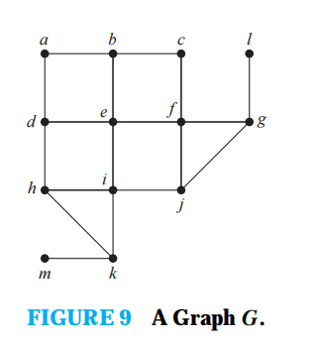
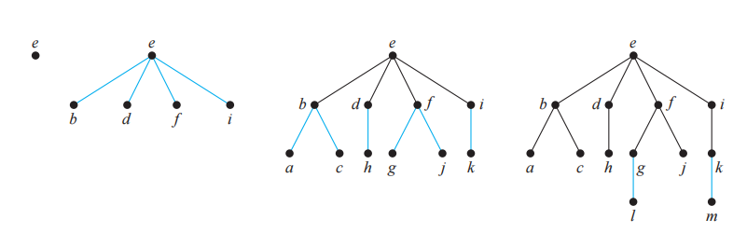

Slide 42
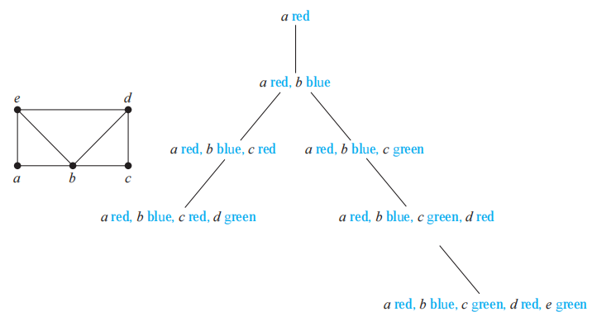
Backtracking Applications： coloring

Slide 43
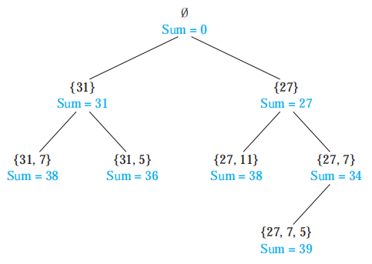
Sums of Subsets：{31, 27, 15, 11, 7, 5} with the sum equal to 39
Consider this problem. Given a set of positive integers x1, x2,...,xn, find a subset of this set of integers that has M as its sum. How can backtracking be used to solve this problem?

Slide 44
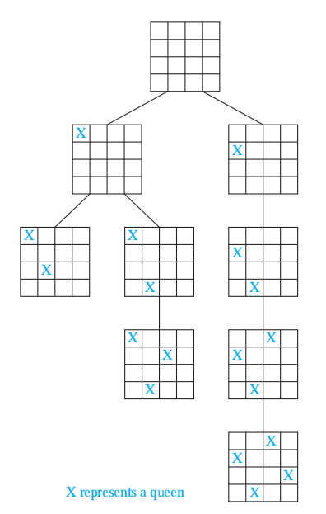
The n-Queens Problem

Slide 45
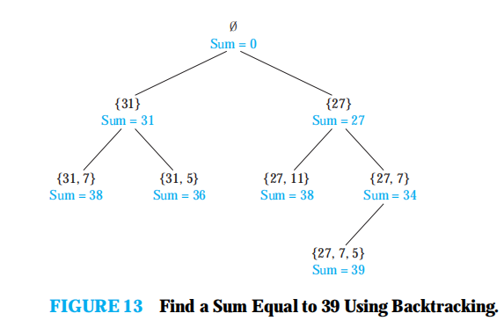
Sums of Subsets
Figure 13 displays a backtracking solution to the problem of finding a subset of {31, 27, 15, 11, 7, 5} with the sum equal to 39.

Slide 46
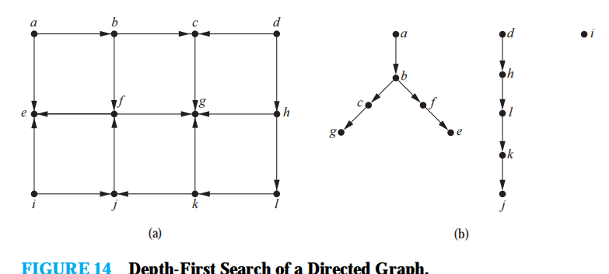
Depth-First Search in Directed Graphs

Slide 47
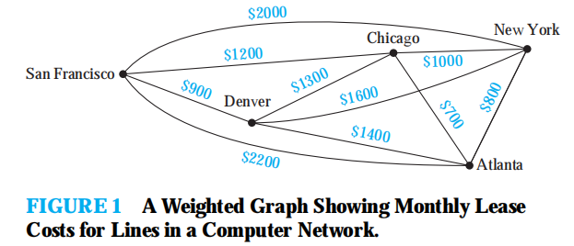
Finding a spanning tree so that the sum of the weights of the edges of the tree is minimized. Such a spanning tree is called a minimum spanning tree.

Slide 48
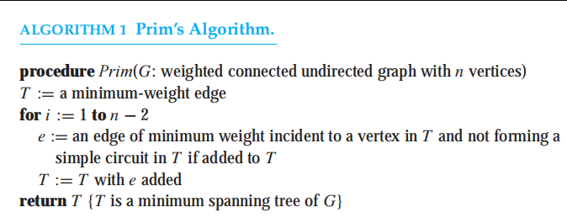
Prim

Slide 49
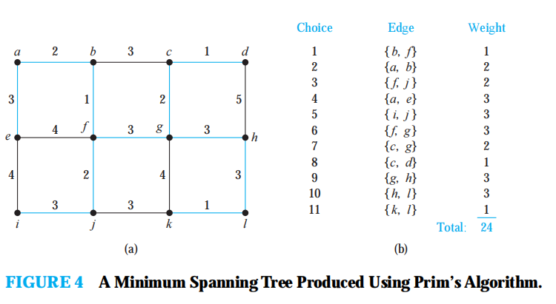
start with minimum edge ，keep drawing cycles to includes nodes。。。

Slide 50
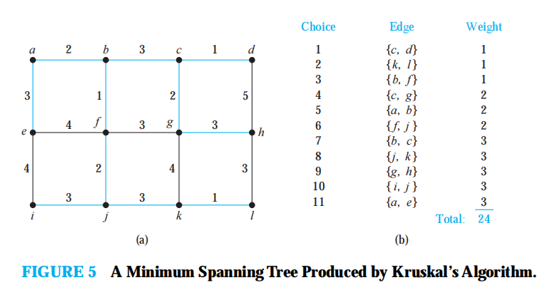
Kruscal： eyes on minimum edges

Slide 51
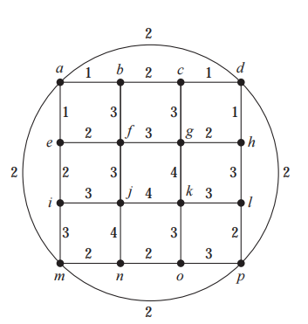
exercise： use both prim and kruscal
Notes:
11.5.4

