Slide 1
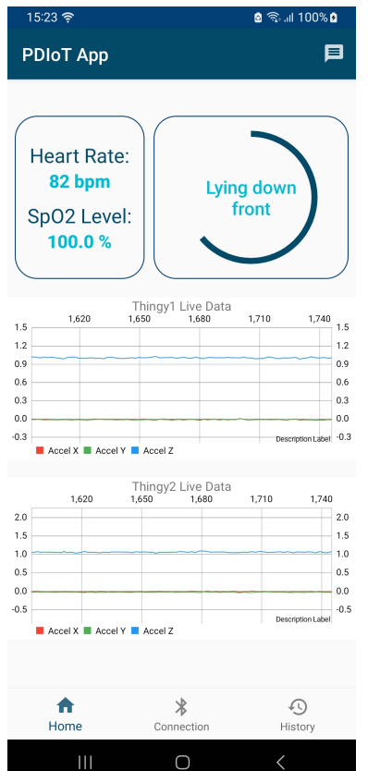
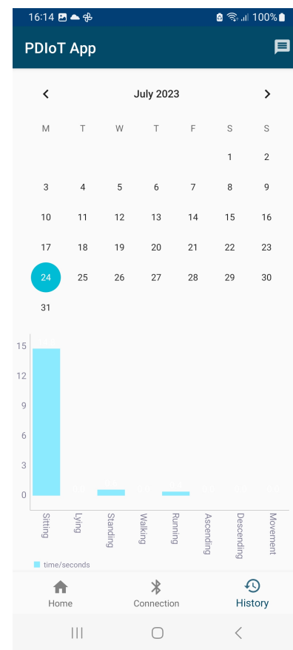
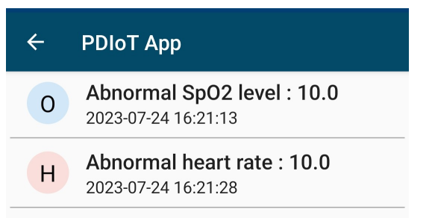
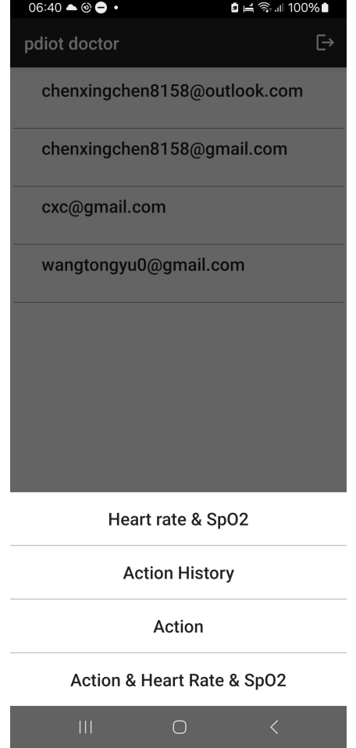
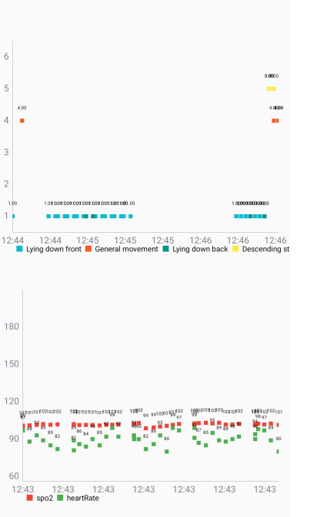
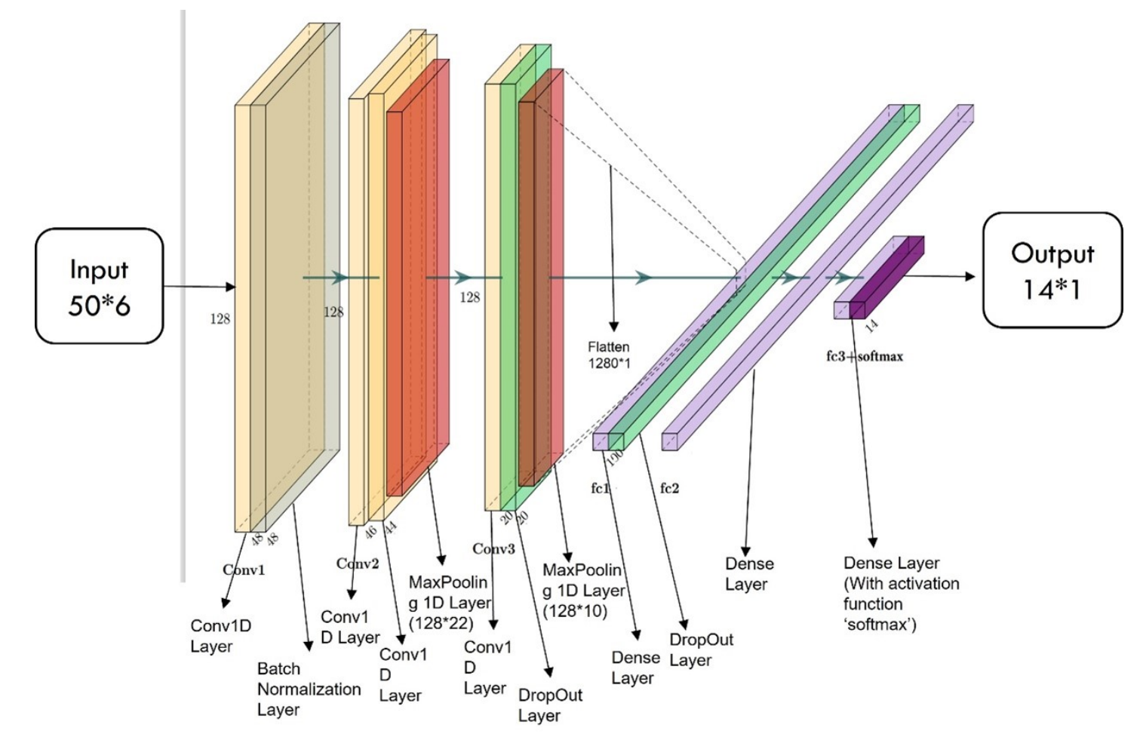
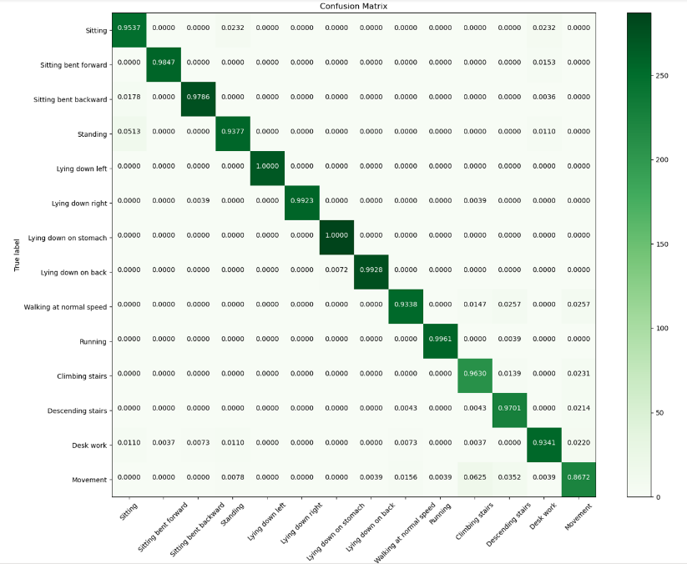
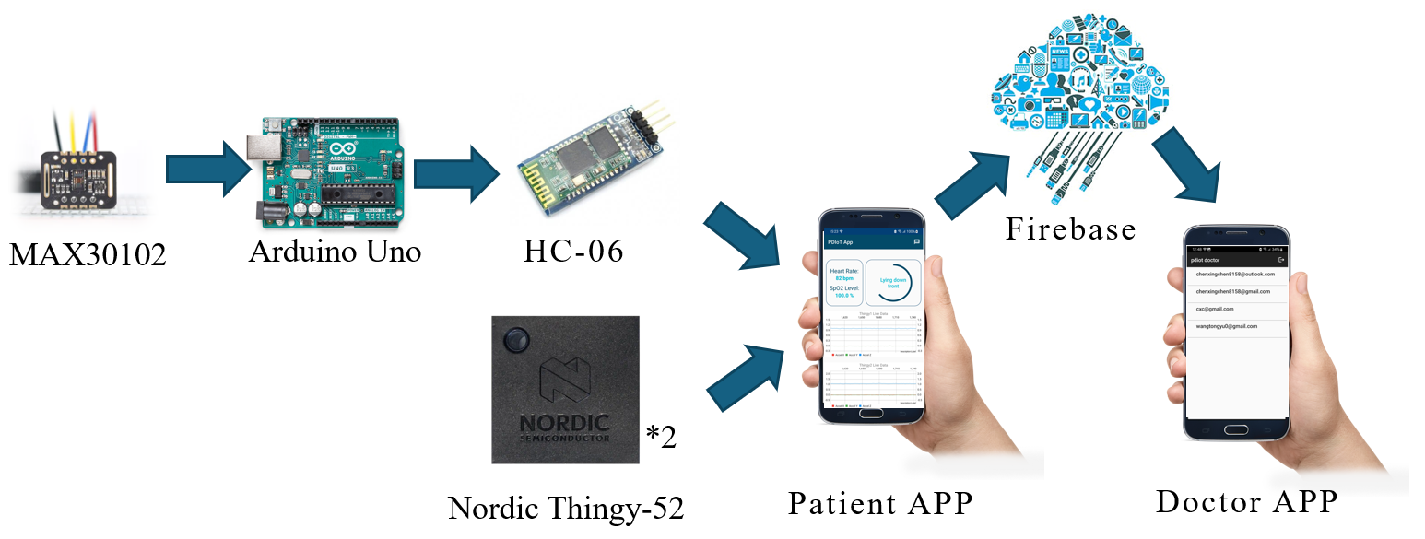
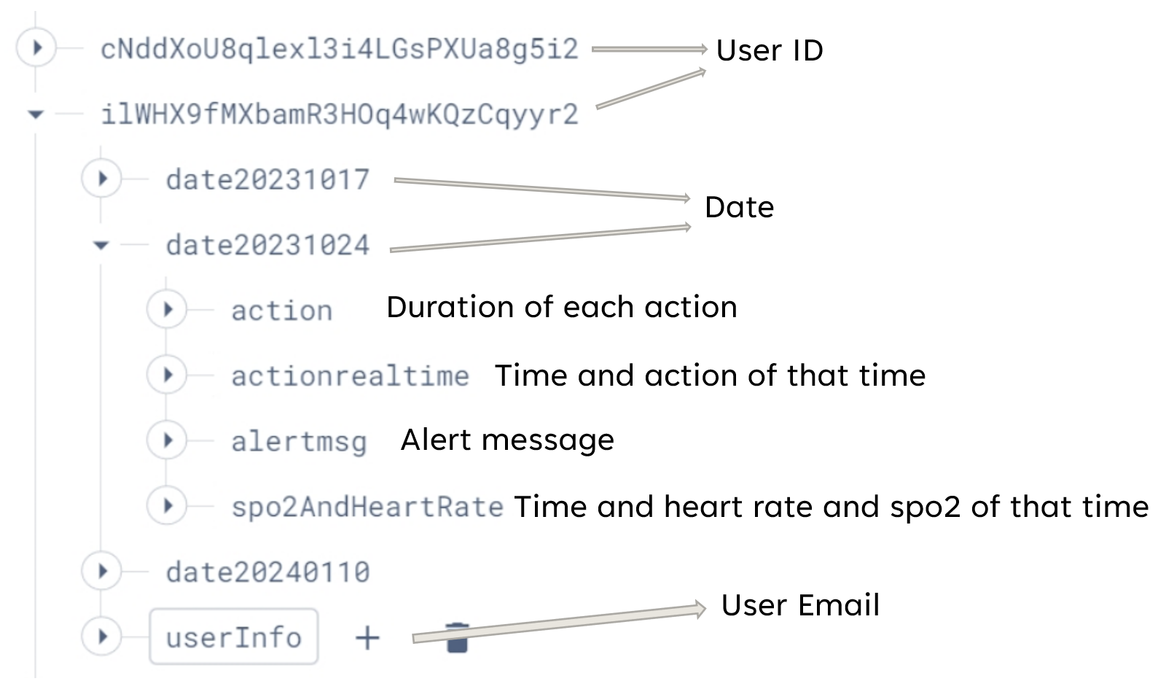
IoT for Health: An Integrated System for Monitoring Physiological Parameters and Activity Recognition
Xingchen CHEN
Dr. Jiabin JIA
Academic Year 2023 / 2024
Introduction
This project is mainly about developing an IoT system for personal health care that enables communication between the smartphone and external sensors via Bluetooth.
The system can measure key physiological parameters, including heart rate and blood oxygen saturation level (SpO2), and is able to recognise Human Activity.
The sensor information is made accessible through two Android applications, the app for patients and the app for doctors, through two Android applications, the app for patients and the app for doctors, they can bridge the gap between patients and their health data as well as engage health service providers.
Application Design
Patient App:
Login: Users log in via email/password or Google account.
Home Page: Displays real-time heart rate, SpO2, and activity recognition results. Sensor Connectivity: Users connect sensors through a dedicated page.
History: Reviews past activities with a bar chart showing activity duration.
Messages: Alerts for abnormal heart rate/SpO2 readings.
Background
The global shift towards an aging population, with elderly numbers rising to 22% by 2050, intensifies healthcare challenges in managing diseases like cardiovascular and respiratory conditions. This scenario underscores the need for innovative solutions, such as early detection through monitoring vital signs like heart rate and SpO2.
These indicators are influenced by physical activity and environmental factors. Human Activity Recognition (HAR) enhances the accuracy of these measurements by considering the user's activity
Doctor App:
Patient Data Viewing: Post-login, doctors access a list of patients by email and can select specific health data visualizations, including heart rate, SpO2 over time, activity data over time and activity duration.
Machine Learning Model
System Architecture
The whole system comprises three main components: hardware (sensors), mobile applications (Doctor and Patient apps), and cloud services (Firebase).
Sensors are connected to mobile phones(Patient app) via Bluetooth, including a MAX30102 sensor controlled by Arduino for heart rate and blood oxygen level measurements and two Thingy:52 motion sensors for human activity recognition.
The Patient app receives data from the sensors and displays the user’s physiological data. It then uploads the data to Firebase, which stores the physiological data of all users categorized by username, date, and data type.
Firebase serves as the central data repository, managing and storing patient data securely.
The Doctor app retrieves patient data from Firebase, displaying it in graphical formats such as bar charts and scatter plots, providing physicians with insights into patients’ physiological conditions.
This model is trained to identify and classify 14 human activities based on sensor data.
Data was procured from two thingy-52 sensors placed on the upper and lower body. Both sensors sampled accelerometer and gyroscope data at a frequency of 25Hz.
The sliding window approach is used to process the data with the window size set at 50.
The model mainly uses the convolutional neural network (CNN) model.
Database Design
To enable cross app data access, the data must be stored in the cloud.
The Firebase Realtime Database is a cloud-hosted NoSQL database provided by google with a complete set of APIs.
The data is structured as a JSON tree format.
Future Research
Looking to the future, this project lays the groundwork for numerous enhancements:
Incorporation of Additional Sensors: The integration of a wider array of sensors to capture a broader spectrum of physiological data.
Application of Machine Learning to New Data Streams: Leveraging machine learning algorithms to interpret the complex datasets provided by the new sensors, aiming for deeper insights into health patterns and anomalies.
Expansion to Cross-Platform Applications: Extending the system's compatibility beyond the Android platform to include other operating systems.
Conclusion
Integration of Activity with Heart Rate and SpO2 Data: This approach has enabled a more comprehensive analysis of health metrics. This approach empowers individuals by providing them with actionable insights into their health.
Development of Patient and Doctor Applications: For patients, it provides immediate access to health data, fostering engagement and proactive health management. For doctors, it streamifies access to patient data, enabling more informed and timely decision-making and efficient healthcare delivery.
References
[1] Hassan, A. U., Salihu, Y. O. and Musa, M. J.: ‘Real-time monitoring of heart beat rate and spo2 based on internet of things,’ in 2021 International Conference on Electrical, Computer and Energy Technologies (ICECET), pp. 1–4. doi: 10.1109/ICECET52533.2021.9698527.
[2] Soh, P. J., Vandenbosch, G. A., Mercuri, M. and Schreurs, D. M.-P., ‘Wearable wireless health monitoring: Current developments, challenges, and future trends,’ IEEE microwave magazine, vol. 16, no. 4, pp. 55–70, 2015. [3] Patel, S., Park, H., Bonato, P., Chan, L. and Rodgers, M., ‘A review of wearable sensors and systems with application in rehabilitation,’ Journal of neuroengineering and rehabilitation, vol. 9, no. 1, pp. 1–17, 2012.
[4] Lara, O. D. and Labrador, M. A., ‘A survey on human activity recognition using wearable sensors,’ IEEE communications surveys & tutorials, vol. 15, no. 3, pp. 1192–1209, 2012.

