Slide 1
Smartphone Interface for Peripheral Sensors
Phase 1 presentation
Xingchen Chen
S2269664

Slide 2
catalogue
1. Project Topic
1. Project Background
2. Sensor Selection
3. Sensor Implementation
4. Functionalities
5. System Architecture
6. Competing Products
7. Project Gantt Chart
8. Reference List

Slide 3
Project topic
The smartphone is becoming a powerful tool for personal assistance with the integration of multiple sensors.
However, each sensor has its own complexities and features, making it challenging to directly incorporate them into smartphones.
This project aims to develop an Android application that will enable communication between external sensors and smartphones via Bluetooth.

Slide 4
Background
IoT has numerous applications in healthcare, including remote monitoring of health parameters.
Heart rate and SpO2 are important indicators of cardiovascular and respiratory function but are affected by physical activity and environment.
Human activity recognition (HAR) can improve accuracy and has many other applications.
By combining HAR with biometric sensors, an IoT system can provide a comprehensive view of health status.

Slide 5
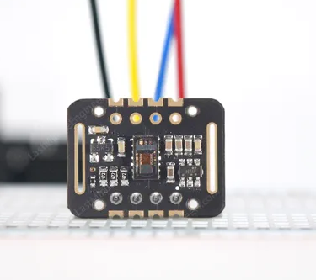

Sensor selection
MAX30102
Nordic Thingy:52
Nordic Thingy:52
MAX30102 sensor for heart rate and SpO2 measurement
Nordic Thingy-52 sensor with IMU for human activity recognition
Combination of these sensors enables comprehensive health monitoring

Slide 6
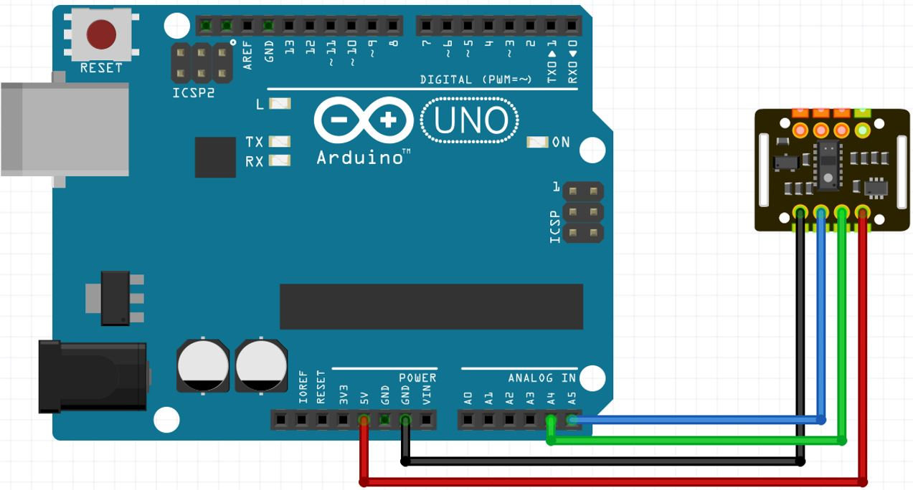
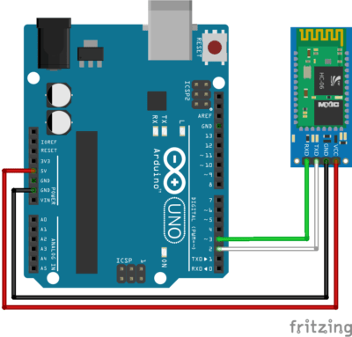
Sensor implementation
SPO2 Sensor Implementation:
Use Arduino control board to control the sensor
Wire the sensor and take readings from the serial port
Communicate with the phone using HC-06 Bluetooth module
Send and receive messages with general Bluetooth apps

Slide 7
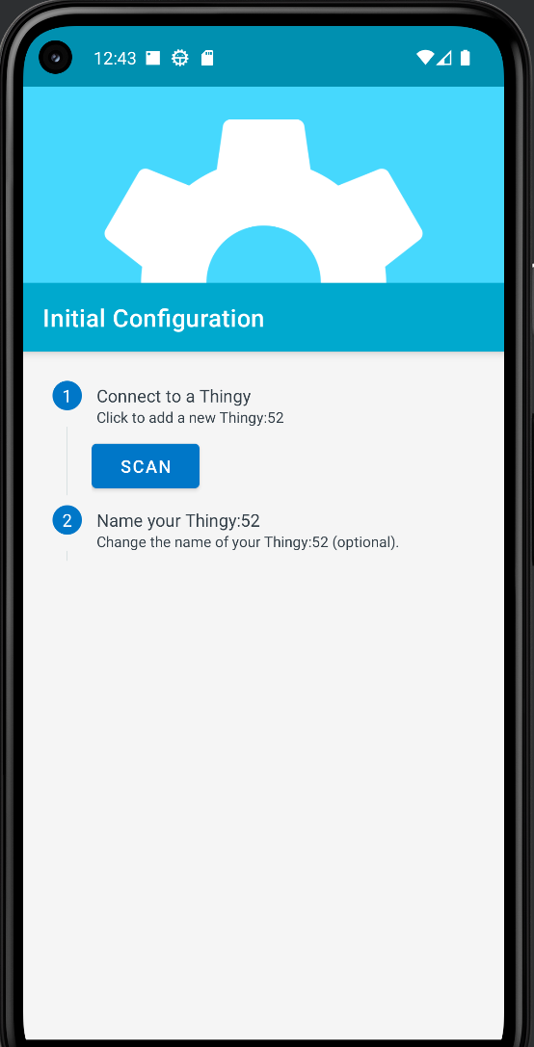
Sensor implementation
Thingy-52 Sensor Implementation:
The sensor already has Bluetooth built-in
Nordic company open sourced an Android app to communicate with the sensor.
Use 2 sensors to detect activities more accurately.

Slide 8
Functionalities
Monitoring SPO2 levels alone is important, but incorporating an IMU sensor can provide additional benefits beyond just measuring oxygen levels in the blood.
SPO2 levels may naturally drop slightly during sleep but should remain above 90%. Low SPO2 levels during sleep could indicate health issues such as sleep apnea.
SPO2 levels can also fluctuate during exercise, with normal levels ranging from 95% to 100%. If levels fall below 90%, it may suggest hypoxia.
The IMU sensor can track daily activity levels, detect falls, and help determine if you are getting enough exercise or sitting too much.
Combining SpO2 measurement with IMU data provides a more comprehensive understanding of overall health and physical activity levels.

Slide 9
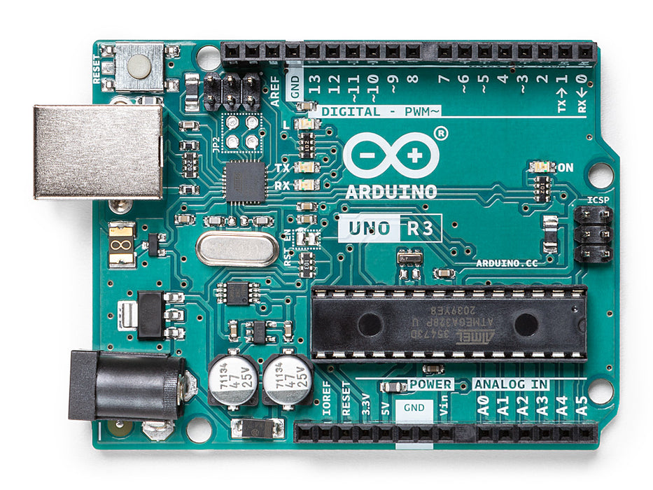
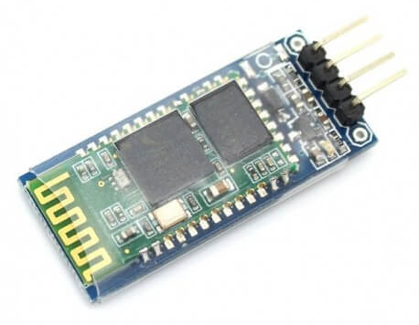

System architecture
MAX30102
Bluetooth module HC-06
Arduino Uno
Android APP
Nordic Thingy:52
Nordic Thingy:52

Slide 10
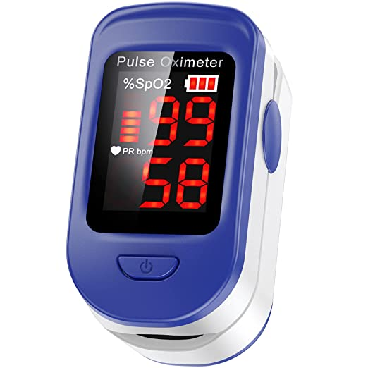
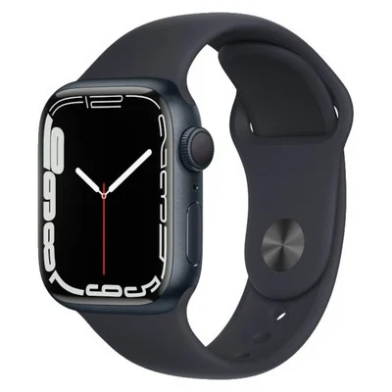
Competing products
Other IoT SPO2 projects
Limited functions
Cannot adjust based on activities
Expensive
cannot detect postures
Use IoT chip ESP8266
Not connected to mobile device.
Not flexible

Slide 11
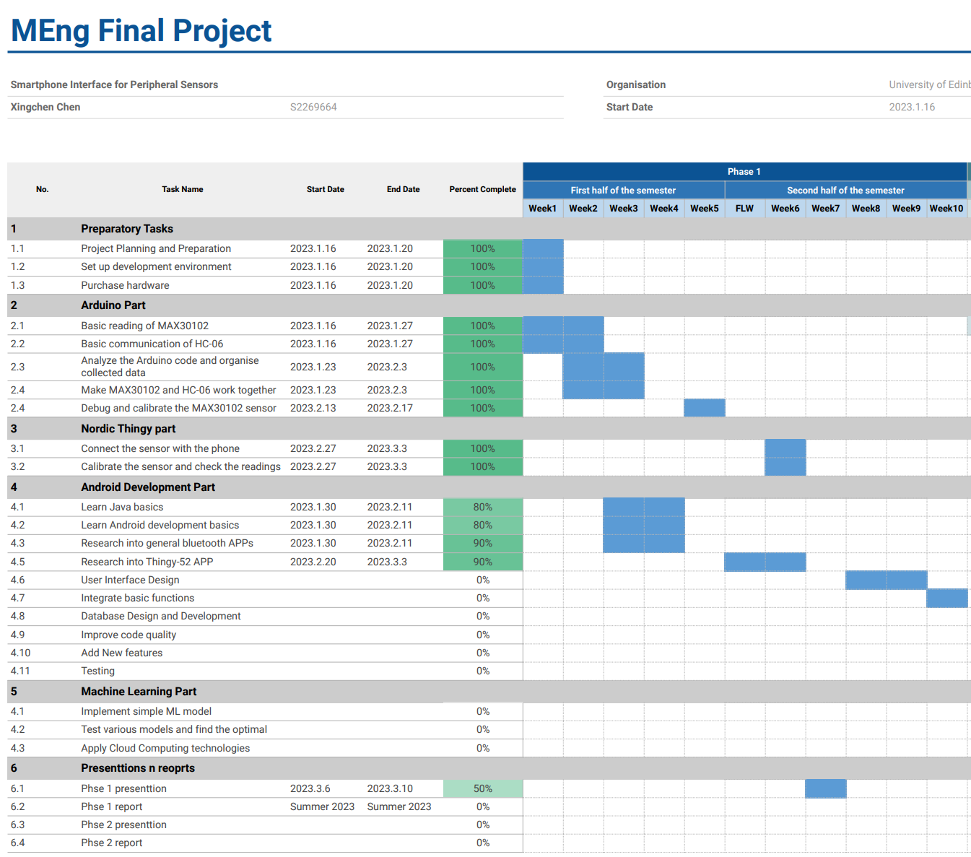
Project Gantt chart

Slide 12
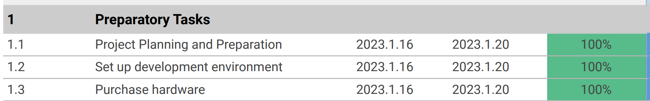

Slide 13
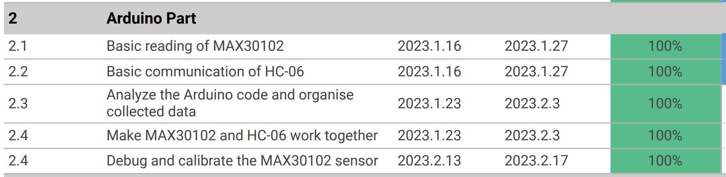

Slide 14
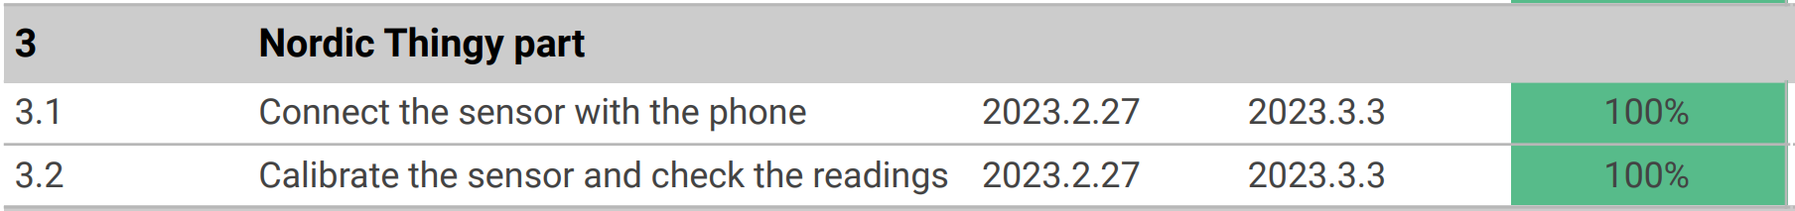

Slide 15
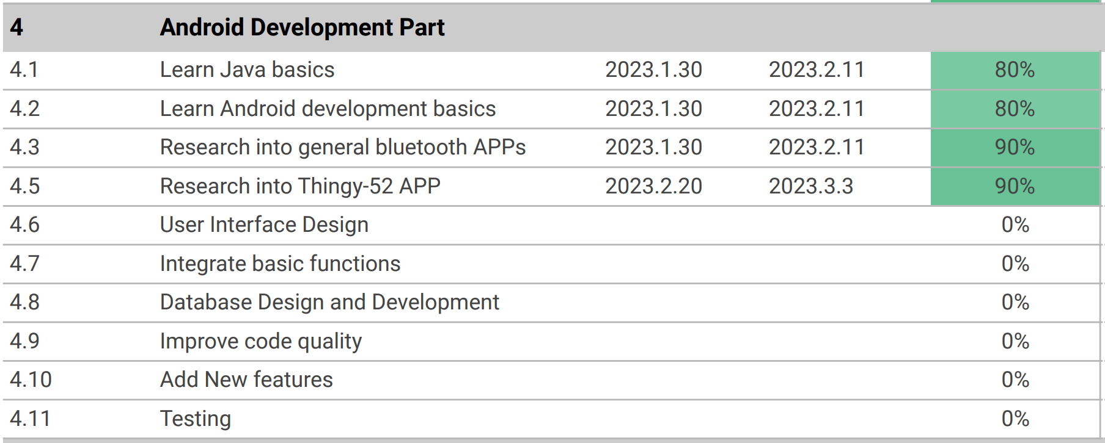

Slide 16
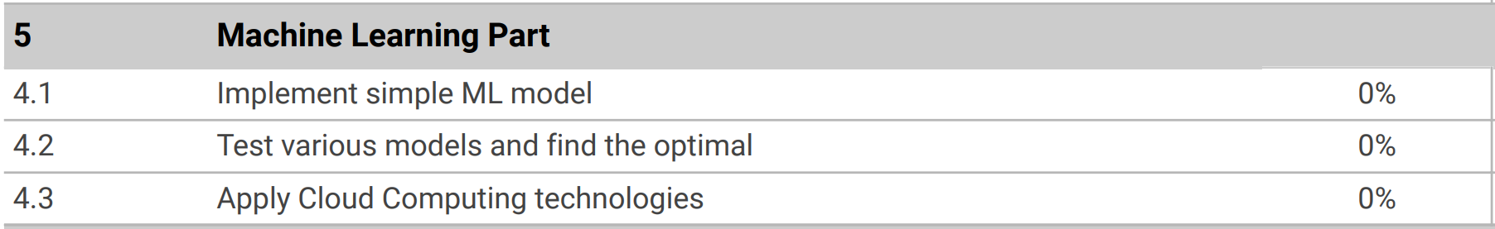

Slide 17
Reference list
https://store.arduino.cc/products/arduino-uno-rev3
https://lastminuteengineers.com/max30102-pulse-oximeter-heart-rate-sensor-arduino-tutorial/?utm_content=cmp-true
https://www.nordicsemi.com/Products/Development-hardware/Nordic-Thingy-52
https://www.aranacorp.com/en/arduino-and-bluetooth-module-hc-06/
What is SpO2 and why does it matter? - Android Authority
Understanding What Is a Normal Spo2 Level and How It Changes during Sleep and Exercise (cablesandsensors.com)
What should your spo2 be when sleeping? – Studybuff
Understanding What Is a Normal Spo2 Level and How It Changes during Sleep and Exercise (cablesandsensors.com)
Deep Learning Models for Human Activity Recognition - MachineLearningMastery.com

Slide 18
THANK YOU
Xingchen Chen

Slide 21
Competitors

Slide 22
PRESENTATION TITLE
Mirjam Nilsson

Slide 24
AGENDA
Introduction
Primary goals
Areas of growth
Timeline
Summary

Slide 25
INTRODUCTION
At Contoso, we empower organizations to foster collaborative thinking to further drive workplace innovation. By closing the loop and leveraging agile frameworks, we help business grow organically and foster a consumer-first mindset.​

Slide 27
PRIMARY GOALS
Annual revenue growth

Slide 28
QUARTERLY PERFORMANCE

Slide 29
AREAS OF GROWTH
​ | CATEGORY 1 | CATEGORY 2 | CATEGORY 3​ | CATEGORY 4​
Q1 | 4.5​ | 2.3​ | 1.7​ | 5​.0
Q2 | 3.2​ | 5.1​ | 4.4​ | 3​.0
Q3 | 2.1​ | 1.7​ | 2.5​ | 2.8​
Q4 | 4.5​ | 2.2​ | 1.7​ | 7.0

Slide 30
BUSINESS OPPORTUNITIES ARE LIKE BUSES. THERE'S ALWAYS ANOTHER ONE COMING.​
Richard Branson

Slide 31
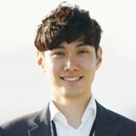



MEET OUR TEAM
TAKUMA HAYASHI
MIRJAM NILSSON
FLORA BERGGREN
RAJESH SANTOSHI
President
Chief Executive Officer
Chief Operations Officer
VP Marketing

Slide 33








MEET OUR TEAM
TAKUMA HAYASHI
MIRJAM NILSSON
RAJESH SANTOSHI
RAJESH SANTOSHI
President
Chief Executive Officer
Chief Operations Officer
VP Marketing
GRAHAM BARNES
ROWAN MURPHY
ELIZABETH MOORE
ROBIN KLINE
VP Product
SEO Strategist
Product Designer
Content Developer

Slide 34
PLAN FOR PRODUCT LAUNCH
Deploy strategic networks with compelling e-business needs
PLANNING
Synergize scalable e-commerce
MARKETING
Disseminate standardized metrics
DESIGN
Coordinate e-business applications
Foster holistically superior methodologies
LAUNCH
STRATEGY

Slide 35
TIMELINE
Q1
Synergize scalable e-commerce
Q2
Coordinate e-business applications
Q3
Deploy strategic networks with compelling e-business needs
Q4
Disseminate standardized metrics

Slide 36
AREAS OF FOCUS
B2B MARKET SCENARIOS
CLOUD-BASED OPPORTUNITIES
Develop winning strategies to keep ahead of the competition
​Capitalize on low hanging fruit to identify a ballpark value
​Visualize customer directed convergence​
Iterative approaches to corporate strategy
​Establish a management framework from the inside​

Slide 37
HOW WE GET THERE
ROI
NICHE MARKETS
SUPPLY CHAINS
Envision multimedia-based expertise and cross-media growth strategies​
​Engage worldwide methodologies with web-enabled technologies​
Pursue scalable customer service through sustainable strategies​
Engage top-line web services with cutting-edge deliverables​​​
Cultivate one-to-one customer service with robust ideas​
Maximize timely deliverables for real-time schemas​

Slide 38
SUMMARY
At Contoso, we believe in giving 110%. By using our next-generation data architecture, we help organizations virtually manage agile workflows. We thrive because of our market knowledge and great team behind our product. As our CEO says, "Efficiencies will come from proactively transforming how we do business."​

