Slide 1
Identification of Traffic Accident Liability

Slide 2
Outlines
Submission Related
Framework
Accident Scenario Generation
Scenario Generator
Data Bridge
Liability Identification Model
Rough Filter
Re Filter
Fine Filter

Slide 3
Submission Related
Goal:
2025.2 ASE(International Conference on Automated Software Engineering)
Topic:
How to generate the accident scenario more efficiently?
Scenario generation related
How to identify the participants’ liability in a traffic accident?
No/Few previous researches about this topic.
Process:
Accident Scenario Generation
20% done.
Rough Filter
Law break Monitor
10% done.

Slide 4
Framework
Scenario Generator
Rough Filter
Re
Filter
Fine Filter
.json
Scenario Parser
Principle Parser
Trace
Output
Complex cases
Final Liability
Traffic Law Script
STL
Law break Monitor
Fault Judgement
Simple cases
Liability Identification Model
Notes:
是否尽到应尽责任、如何定义避让
如何定义一些相关的哲学类问题
1、cdm目前的缺点
2、

Slide 5
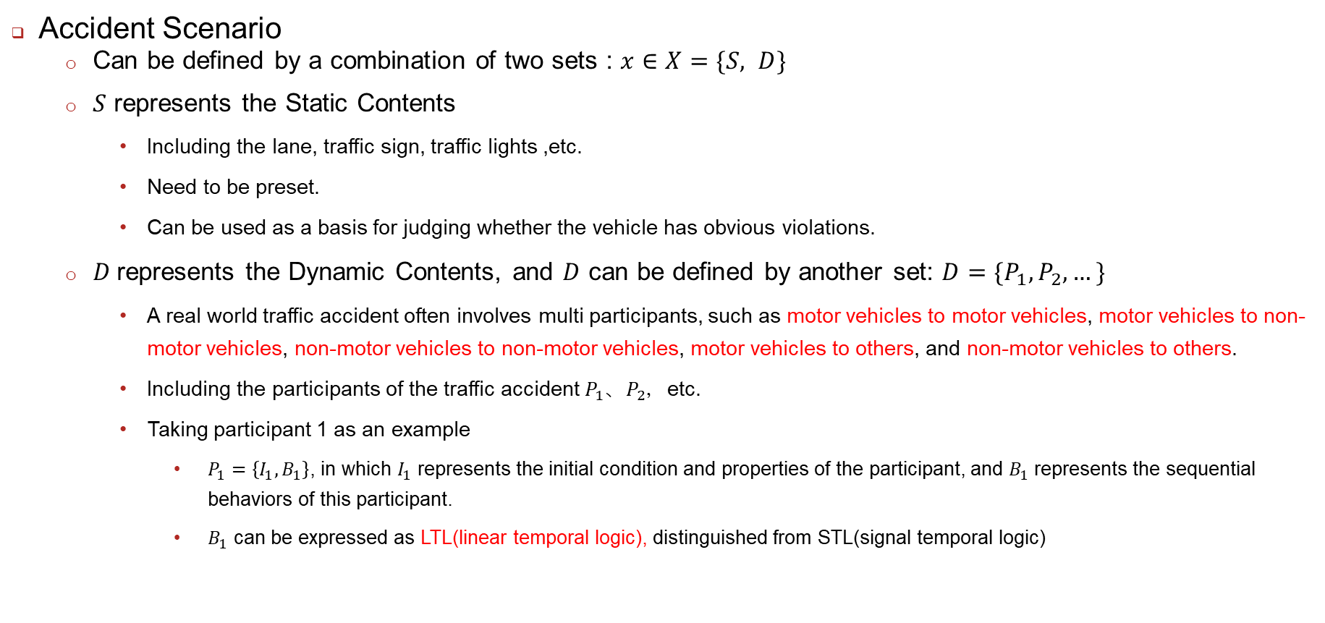
Accident Scenario Generator
Accident Scenario
Can be defined by a combination of two sets : $x∈X=\{S, D\}$
$S$ represents the Static Contents
Including the lane, traffic sign, traffic lights ,etc.
Need to be preset.
Can be used as a basis for judging whether the vehicle has obvious violations.
$D$represents the Dynamic Contents, and $D$ can be defined by another set: $D=\{P_{1},P_{2}, …\}$
A real world traffic accident often involves multi participants, such as motor vehicles to motor vehicles, motor vehicles to non-motor vehicles, non-motor vehicles to non-motor vehicles, motor vehicles to others, and non-motor vehicles to others.
Including the participants of the traffic accident $P_{1}、P_{2}，$etc.
Taking participant 1 as an example
$P_{1}=\left\{I_{1},B_{1}\right\}$, in which $I_{1}$ represents the initial condition and properties of the participant, and $B_{1}$ represents the sequential behaviors of this participant.
$B_{1}$ can be expressed as LTL(linear temporal logic), distinguished from STL(signal temporal logic)

Slide 6
Responsibility Attribution Model
Rough Filter:
Rough Filter is also called ‘Violation Filter’.
Rough Filter is used to filter participants for illegal acts:
If both participants break the law or none of them break the law, both participants are responsible for the accident.
If one participant violates the law and the other one does not violate the law, the participant who violates the law is fully responsible for the accident, and the other one is not responsible for the accident.
Rough Filter consist of two parts: Scenario Parser and Law break Monitor.
Scenario Parser can process the original scenario and output the processed data.
Law break Monitor can determine whether the input data(processed by Scenario Parser) is illegal or not.
In Law break Monitor, the related traffic laws are firstly abstracted into STL language.

Slide 7
Responsibility Attribution Model
Re Filter:
Rough Filter is also called ‘Violation Filter’.
Rough Filter is used to filter participants for illegal acts:
If both participants break the law or none of them break the law, both participants are responsible for the accident.
If one participant violates the law and the other one does not violate the law, the participant who violates the law is fully responsible for the accident, and the other one is not responsible for the accident.
We can also abstract the dataset into STL language. Then we can use the knowledge to guide AVs behaviors and run AVs on the simulators in order to finish a knowledge-based generation. The knowledge also can constrain the generated scenarios.
We can directly sample from the dataset.

Slide 8
Responsibility Attribution Model
Fine Filter:
Rough Filter is also called ‘Violation Filter’.
Rough Filter is used to filter participants for illegal acts:
If both participants break the law or none of them break the law, both participants are responsible for the accident.
If one participant violates the law and the other one does not violate the law, the participant who violates the law is fully responsible for the accident, and the other one is not responsible for the accident.
We can also abstract the dataset into STL language. Then we can use the knowledge to guide AVs behaviors and run AVs on the simulators in order to finish a knowledge-based generation. The knowledge also can constrain the generated scenarios.
We can directly sample from the dataset.

Slide 9
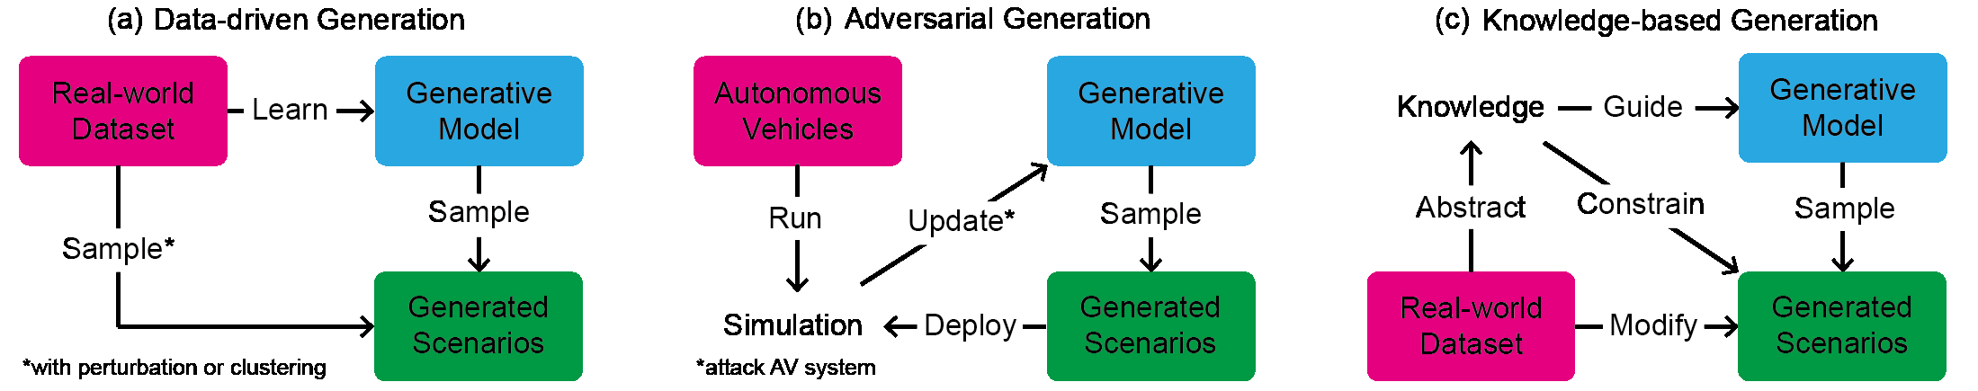
Definition of Accident Scenario
According to the paper: A Survey on Safety-Critical Driving Scenario Generation – A Methodological Perspective
What method should we use to generate scenario?
Date Driven Generation
Adversarial Generation
Knowledge-Based Generation
Or combination?
What metrics should we use to ensure that the resulting scenario is an accident?
The traffic rules can be expressed as STL(signal temporal logic), and we can take the violations of the syntax as our metrics.

Slide 10
Accident Scenario Generator
Accident Scenario Generator:
We can use machine learning method, let generative model learning features from real-world accidents dataset and automated generate accident scenarios.
We can also abstract the dataset into STL language. Then we can use the knowledge to guide AVs behaviors and run AVs on the simulators in order to finish a knowledge-based generation. The knowledge also can constrain the generated scenarios.
We can directly sample from the dataset.
Directly Sample
Real-world Accidents Dataset
Learn
Generative Model
Sample
Generated Accident Scenarios
Guide AVs
Abstract
Traffic Rule Knowledge(STL)
Constrain
Accident Scenario Generator

Slide 11
Responsibilities Division Model

Slide 12
Thank You!
September 9, 2024

