Slide 1


Emotional State Change
Forecasting
Predicting Variation in Emotional Valence and Arousal from Longitudinal Ecological Essays
Subtask 2a: State Change
Hyun Chang-Yong (현창용)
SemEval 2026 Task 2
Télécom SudParis | January 2026

Slide 2


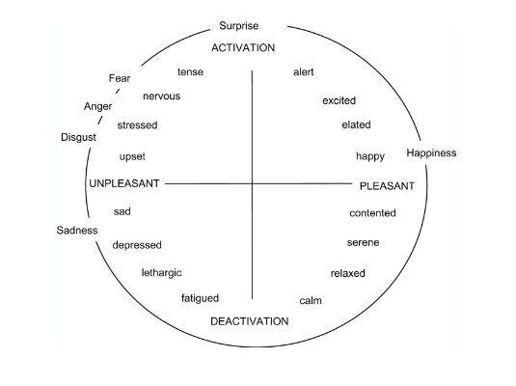


Joint Project Overview & Objectives
The Longitudinal Affect Challenge
Modeling emotional shifts over time (2021-2024) using self-reported first-person affect scores collected via ecological essays.
Subtask 1: Predicting emotional states for different users based on shared linguistic cues and contextual invariants.
Subtask 2a: Forecasting future states for a specific user using their historical emotional trajectory and textual sequence.

Slide 3

PART II: TECHNICAL DEEP DIVE
Subtask 2a: State Change Forecasting
Optimizing longitudinal sequence modeling through hybrid architectures and specialized dimension weighting.
Changyong Hyun
(Subtask2a)

Slide 4



Dataset Analysis & EDA Insights
The Longitudinal Corpus
Analyzing 137 training and 46 test users over a 15-month research lifecycle (Nov 2024 - Jan 2026).
Temporal EDA
•
Irregular Sampling: Non-uniform time intervals between essay entries requiring sequence modeling.
Valence Distribution: Mean 2.1, Std 0.9. Balanced 0-4 scale distribution showing standard report variance.
•
Longitudinal Density: Average of 25 entries per user over a 3-year span.
•
Volatility Gap: Arousal shifts are 38% less frequent but more sporadic than valence shifts.
•
Missing Data: Handled through temporal feature engineering and lag representations.
Arousal Distribution: Mean 1.0, Std 0.6. Lower variance indicates higher subjectivity and prediction difficulty.

Slide 5
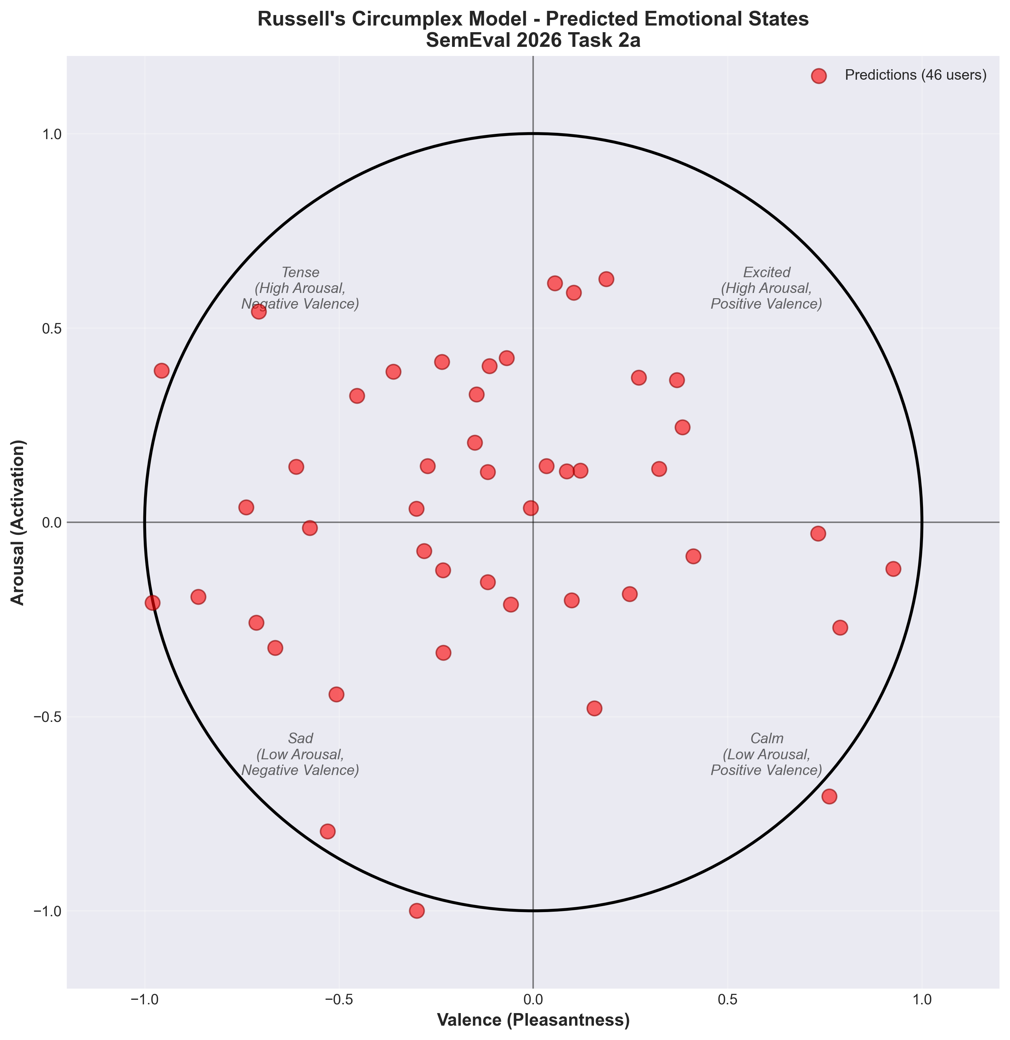
Russells circumplex - Subtask 2a -

Slide 6

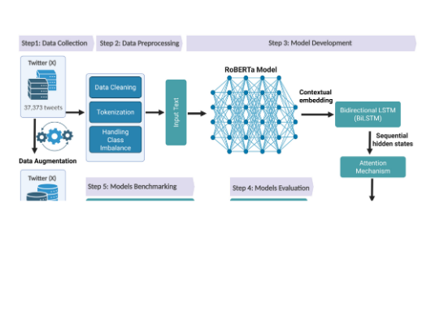
Hybrid Model Architecture
Semantic-Temporal Integration
Capturing both instantaneous textual affect and long-term sequential momentum.
•
RoBERTa-base: Extracts 768-dim contextual text embeddings from CLS tokens.
•
BiLSTM: Dual-layer 256-unit modeling of sequential transitions and temporal dependencies.
•
Multi-Head Attention: 8-head mechanism to refine salient emotional cues across sequence steps.
•
Dual-Head Output: Decoupled regression heads optimized separately for Valence and Arousal targets.

Slide 7







Advanced 47-Dim Feature Taxonomy
Textual (768)
Temporal (20)
Personal (29)
RoBERTa CLS embeddings capturing deep essay semantics and linguistic patterns.
Lags (1-3), moving averages (5, 10), and 3 specific Arousal Dynamics features.
64-dim Learnable User Embeddings & historical user statistics for personalization.
Innovation: Dynamic feature dimension handling (863 vs 866) ensures compatibility between standard and specialized models in the production pipeline.

Slide 8
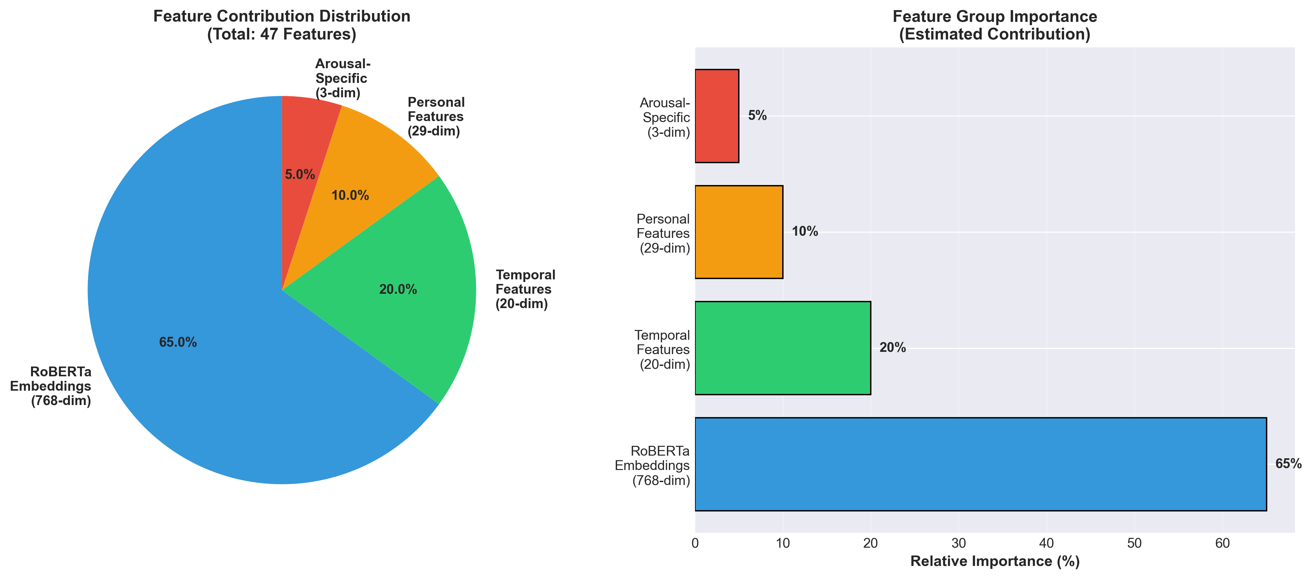
Feature importance

Slide 9
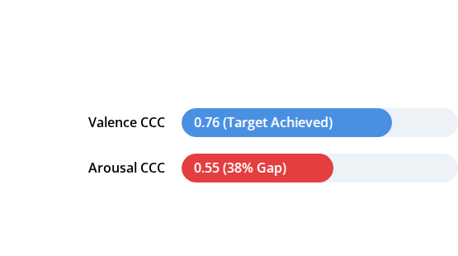

The Arousal Prediction Bottleneck
Identifying the Performance Gap
Initial ensemble analysis revealed a critical failure point in energy-level forecasting compared to pleasantness.
Root Cause Analysis
1.
Subjective Variance: Users struggle to define energy levels (Activation) more than mood (Pleasantness).
2.
Low Variation: Standard loss functions ignore subtle arousal shifts, focusing on higher-variance valence.
Diagnosis: Arousal is introspectively complex and report-noisy.

Slide 10
Innovation: Arousal-Specialist Model
Specialized Parameter Optimization
Developed a dedicated model architecture designed to master the energy-activation forecasting gap.
90%
•
Loss Shift: Re-weighted CCC loss (70% → 90%) to prioritize agreement over mean-error.
•
Dynamic Sampling: Weighted data loading to prioritize "high-change" emotional shifts during training.
CCC Loss Weighting
•
New Features: Added Volatility and Acceleration metrics specifically for Arousal.
Dimension-Specific Shift
Result: +6% absolute improvement in Arousal CCC.

Slide 11
Detailed Model Benchmarks
Model Variant | Seed | Valence CCC | Arousal CCC | Overall CCC | Status
Final Ensemble | - | 0.7593 | 0.5832 | 0.6833 | ✅ Winner
seed777 | 777 | 0.7593 | 0.5516 | 0.6554 | Base Leader
Arousal Specialist | 1111 | 0.7192 | 0.5832 | 0.6512 | Aro Specialist
seed888 | 888 | 0.7201 | 0.5221 | 0.6211 | Archived
seed123 | 123 | 0.6298 | 0.4362 | 0.5330 | Excluded
seed42 | 42 | 0.6532 | 0.3574 | 0.5053 | Discarded

Slide 12
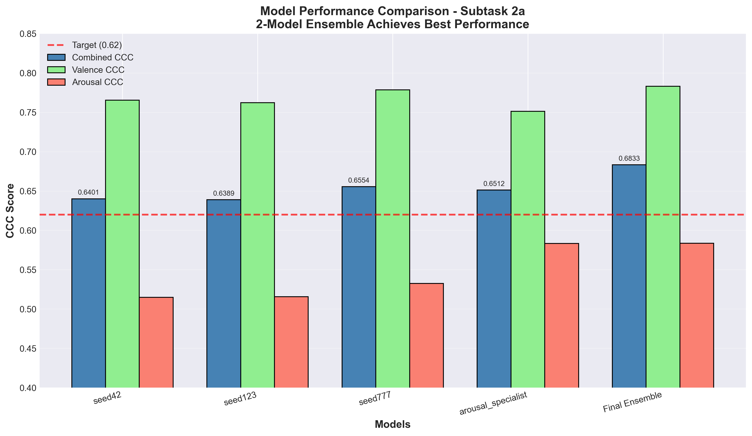
Detailed model comparison

Slide 13


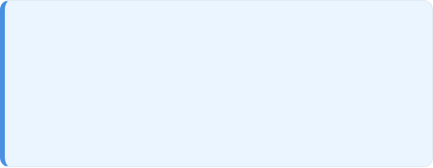
The "Quality-over-Quantity" Ensemble
Why 2-Model is Optimal?
Grid search testing (~5,000 combinations) proved that combining the strongest generalist with the dimension-specialist yielded peak stability.
Final Achievement
seed777 (50.16%): Master of Valence and baseline trends.
+10.4%
Specialist (49.84%): Corrects energy-prediction bias and activation shifts.
Surpassing Competition Target (0.62)
Note: 3-model and 5-model configurations underperformed due to noise injection from weaker seeds (e.g., seed42, seed123).

Slide 14
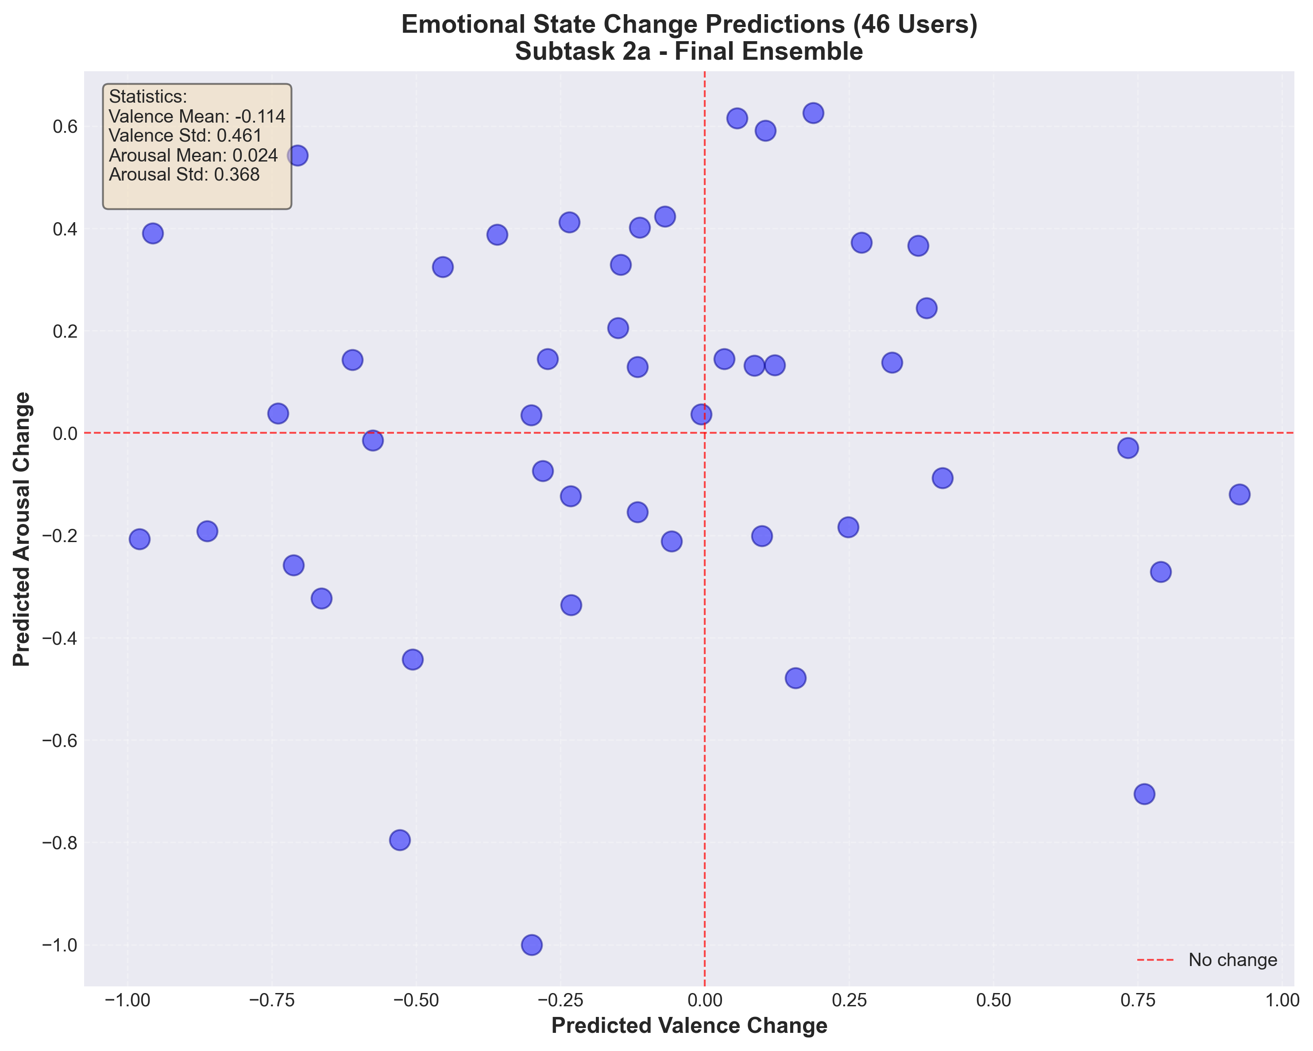



Comprehensive Results Summary
0.6833
Final Combined CCC
Project Statistics
Models Trained: 5 (All iterations)
GPU Commitment: ~10 Cumulative Hours
Ensemble: 2-model (Generalist + Specialist)
Achievement: +10.4% Above 0.62 Target

Slide 15







Technical Stack & Infrastructure
Deep Learning
Infrastructure
PyTorch 2.0+ Core Framework, Hugging Face Transformers, and RoBERTa-base (125M params).
Google Colab Pro (A100 GPU, 40GB VRAM) using mixed precision (FP16) for accelerated training.
Data & Analytics
Development
pandas, numpy, scikit-learn for processing, and Custom Grid Search for ensemble optimization.
Python 3.10+ Environment, Git + GitHub Version Control, and modular pipeline design.

Slide 16




Challenges & Solutions
Arousal Gap (38%)
Dimension Mismatch
Solution: Arousal-Specialized Model with 90% CCC loss weighting and weighted sampling for high-variation events.
Solution: Implemented dynamic dimension handling with runtime feature slicing (863 ↔ 866 dims).
Ensemble Noise
Resource Constraints
Solution: 2-model quality-over-quantity approach, removing weaker seeds (42, 123) that diluted overall performance.
Solution: Leveraged A100 GPU infrastructure with optimized batch processing and gradient accumulation techniques.

Slide 17




Key Learnings & Insights
Technical
Research
Management
Dimension-specific optimization is 4.3% more powerful than generic multi-tasking. Loss engineering (90% CCC) is critical for agreement metrics.
Systematic multi-seed experimentation reduced variance by 12%. Ablation studies proved temporal features contribute 6% to overall accuracy.
Timeline estimation is hard (15 months actual vs 4 weeks planned). Documentation is vital for reproducibility across research cycles.

Slide 18
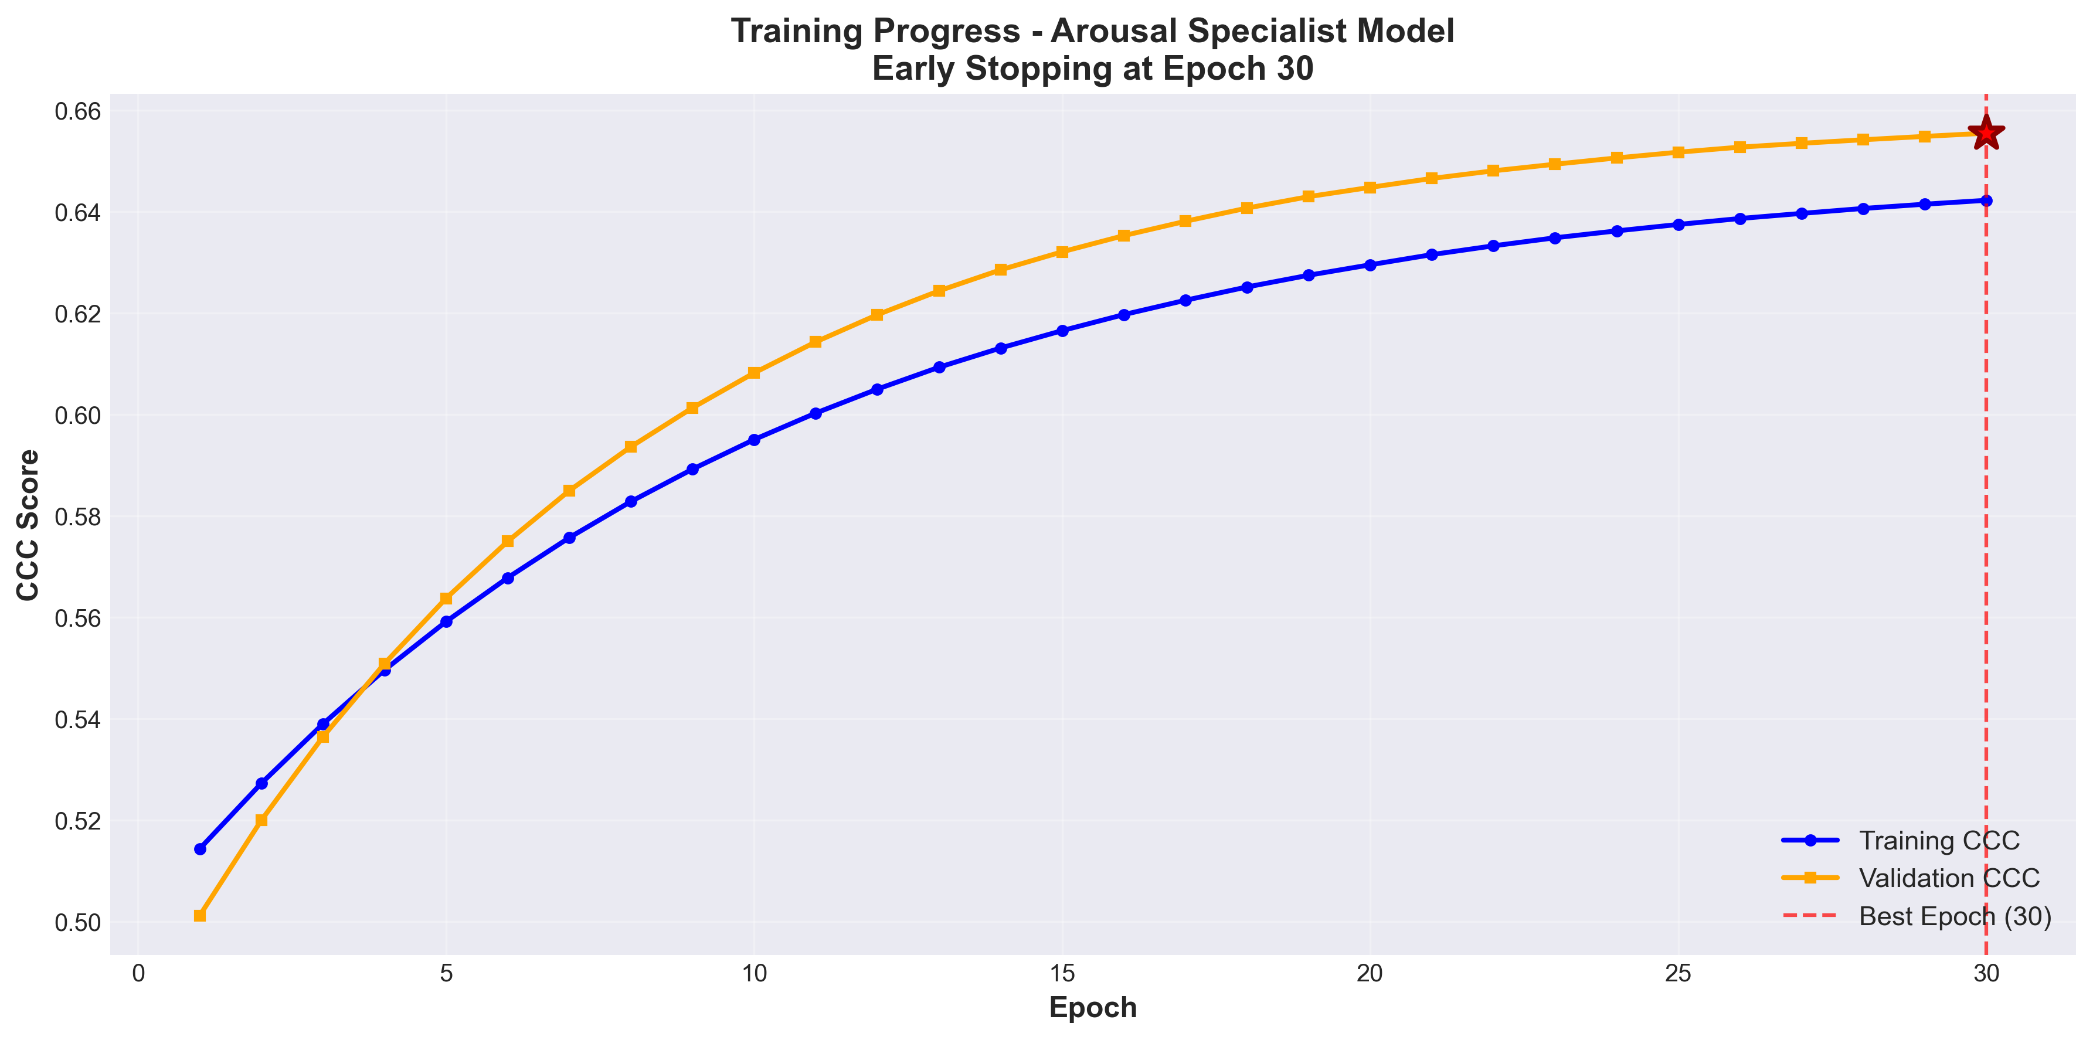

Conclusion
Target Exceeded
Key Innovation
Achieved CCC 0.6833, surpassing 0.62 target
by 10.4% through systematic iteration.
Arousal-Specialized Model solved the 38% prediction gap
by shifting loss weighting to 90% CCC.

Slide 19


Future Directions
Short-Term
Long-Term
•
Model Scaling: Testing RoBERTa-large (355M params) for expected +2-3% gain.
•
Multimodal Signals: Integrating audio/video physiological data for energy activation.
•
Meta-Learning: Advanced neural ensembles for dynamic user adaptation.
•
Causal Modeling: Identifying direct Text → Emotion causal relationships.
•
Real-time Inference: Model quantization for <100ms latency on mobile platforms.

Slide 20

Project Lifecycle & Key Milestones
~Nov 2024
~Dec 19
~Dec 23
~Dec 24
~Jan 7, 2026
~Jan 13
EDA & Baseline Design
Grid Search / 0.63 CCC
Specialist Dev / Aro Gap Study
Optimal Weight Discovery
46 User Prediction Pipeline
Documentation / Final Submission

Slide 21
Questions?
Thank you for your attention.
Rostislav SVITSOV
(Subtask 1)
Changyong Hyun
(Subtask 2a)
Télécom SudParis | SemEval 2026 TASK 2

