Slide 1

Page de garde
NLP PRESENTATION – TD4
GROUP 2 : Jérémy, Colin, Adrien, Gabrielle and Aurore
TEACHER : Anne BRETONNIERE
October 2020 – IA option – Cergy (France)
Notes:
Aurore

Slide 2
Page de garde
TABLE OF CONTENTS
INTRODUCTION
DATA PREPARATION
ML ALGORITHMS
CONCLUSION
Notes:
Aurore

Slide 3
Exercise wording – Exercise purpose
Choose a public DATASET
Run 2 different PREPROCESSING
Use 4 different MACHINE LEARNING ALGORITHMS to predict
Display the CONFUSION MATRIX
Display and compare
the RESULTS
(accuracy, recall and F1 score)
Exercise wording
Notes:
Aurore

Slide 4

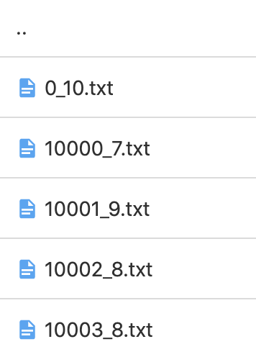
Data presentation
LARGE MOVIE REVIEW DATASET
Data presentation
POSITIVE REVIEWS
NEGATIVE REVIEWS
50 000 data
SOURCE : http://ai.stanford.edu/~amaas/data/sentiment/?fbclid=IwAR0qUMQ8s4b-Jrjdv87zE5QQQpLllgwC_e8zyAM6ofgjbFan8rnqvkSXweI
Notes:
Aurore

Slide 5
Page de garde
TABLE OF CONTENTS
INTRODUCTION
DATA PREPARATION
ML ALGORITHMS
CONCLUSION
Notes:
Aurore - Gabrielle

Slide 6
Preprocessing
Remove the upper cases
(ABC → abc)
Remove the punctuation and special characters
(no !?.,”$£/)
Remove isolated letters and numbers
Remove “English stop words” + ‘movie’ + html balises
Preprocessing
Remove upper nouns and verbs
Lemmatization
(feet → foot)
Notes:
GAb

Slide 7
Preprocessing - results
I have to t2ell you I’ve been a FAN of S%tar Trek TNG since I was a kid.
Preprocessing
Remove upper nouns and verbs
Lemmatization
(feet → foot)
tell ive fan star trek tng since wa kid
since kid
Notes:
Gab

Slide 8

Bag Of Words
Content
“This is the first movie review”
“This movie review is the second movie review”
“And this is the third one.”
“Is this the first movie review”
Bag of words
Preprocessing
and | first | is | movie | one | second | …
0 | 1 | 0 | 1 | 0 | 0 | …
0 | 0 | 1 | 2 | 0 | 1 | …
1 | 0 | 1 | 0 | 1 | 0 | …
0 | 1 | 1 | 1 | 0 | 0 | …
Too many feature values to be applicable
Notes:
Adrien

Slide 9
Bag Of Words
Preprocessing
Vocabulary subset
Content
“This is the first movie review”
“This movie review is the second movie review”
“And this is the third one.”
“Is this the first movie review”
Word | Occurrences
Is | 4
Movie | 4
Review | 4
The | 4
This | 4
First | 2
And | 1
One | 1
Second | 1
Third | 1
Bag of words
Is | Movie | Review | The
1 | 1 | 1 | 1
1 | 2 | 2 | 1
1 | 0 | 0 | 1
1 | 1 | 1 | 1
Notes:
Adrien

Slide 10
Page de garde
TABLE OF CONTENTS
INTRODUCTION
DATA PREPARATION
ML ALGORITHMS
CONCLUSION
Notes:
Adrien – Jérémy

Slide 11


KNN – global overview
K = 3 ➔
K = 7 ➔
Algorithms overview
K-cross validation
Results
Carefully choose K = the number of neighbors
Notes:
Jérémy

Slide 12

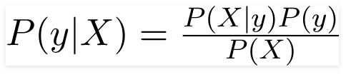
Naives Bayes – global overview
Bayes theorem:
Class prior probability
X: data
y: class
Likelihood
Algorithms overview
Predictor prior probability
Posterior probability
(not calculated)
$$\text{P}\text{(}\text{y}\text{|}\text{X}\text{) > }\text{P}\text{(}\overline{y}\text{|}\text{X}\text{)}$$
Prediction = y
Notes:
Gabrielle

Slide 13
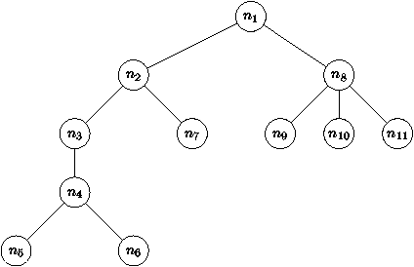
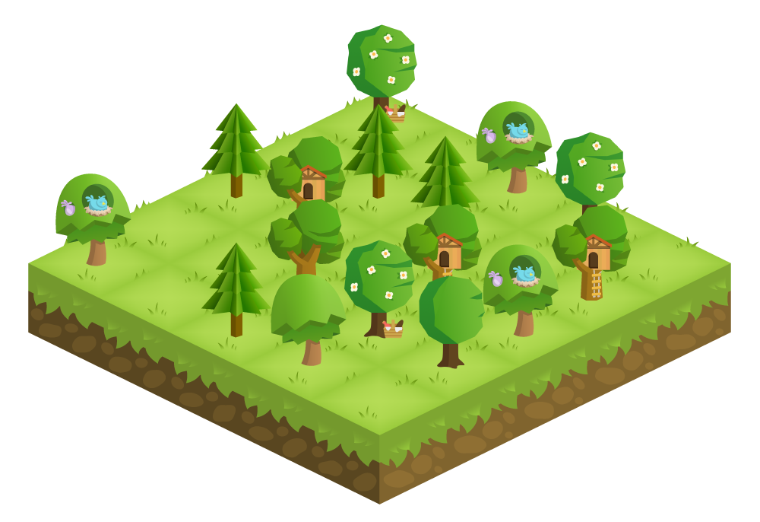
Random Forest– global overview
X % of the trees have predicted YES
Y % of the trees have predicted NO
Each tree is a
decision tree
If Y > X
Algorithms overview
=
NO
Notes:
Colin

Slide 14
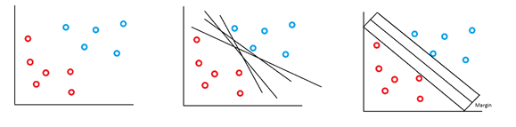
SVM – global overview
2 classes
Algorithms overview
Find the best hyperplan
Find the largest separation
Notes:
Adrien
Find the best line to split the training set.
Maximize the margins = better accuracy

Slide 15
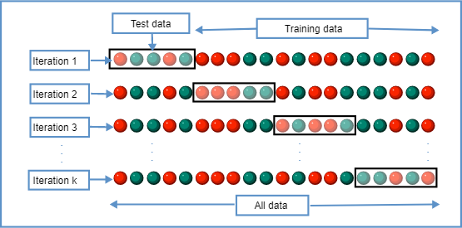
K-cross validation
K-cross validation
Notes:
Aurore

Slide 16
Results
Preprocessing 1 (lemmatization)
Algorithm | Accuracy | Precision | Recall | F1 Score | Time
Naive Bayes | 0.815 | 0.816 | 0.812 | 0.814 | 2.794s
RF Classifier | 0.822 | 0.825 | 0.818 | 0.822 | 60.440s
SV Classifier | 0.851 | 0.842 | 0.866 | 0.854 | 32.652s
Preprocessing 2
(upper nouns and verbs)
Algorithm | Accuracy | Precision | Recall | F1 Score | Time
Naive Bayes | 0.800 | 0.812 | 0.781 | 0.796 | 8.394s
RF Classifier | 0.812 | 0.816 | 0.806 | 0.811 | 86.345s
SV Classifier | 0.842 | 0.830 | 0.860 | 0.845 | 39.228s
Results
KNN Training time > 30mn
Notes:
Colin

Slide 17
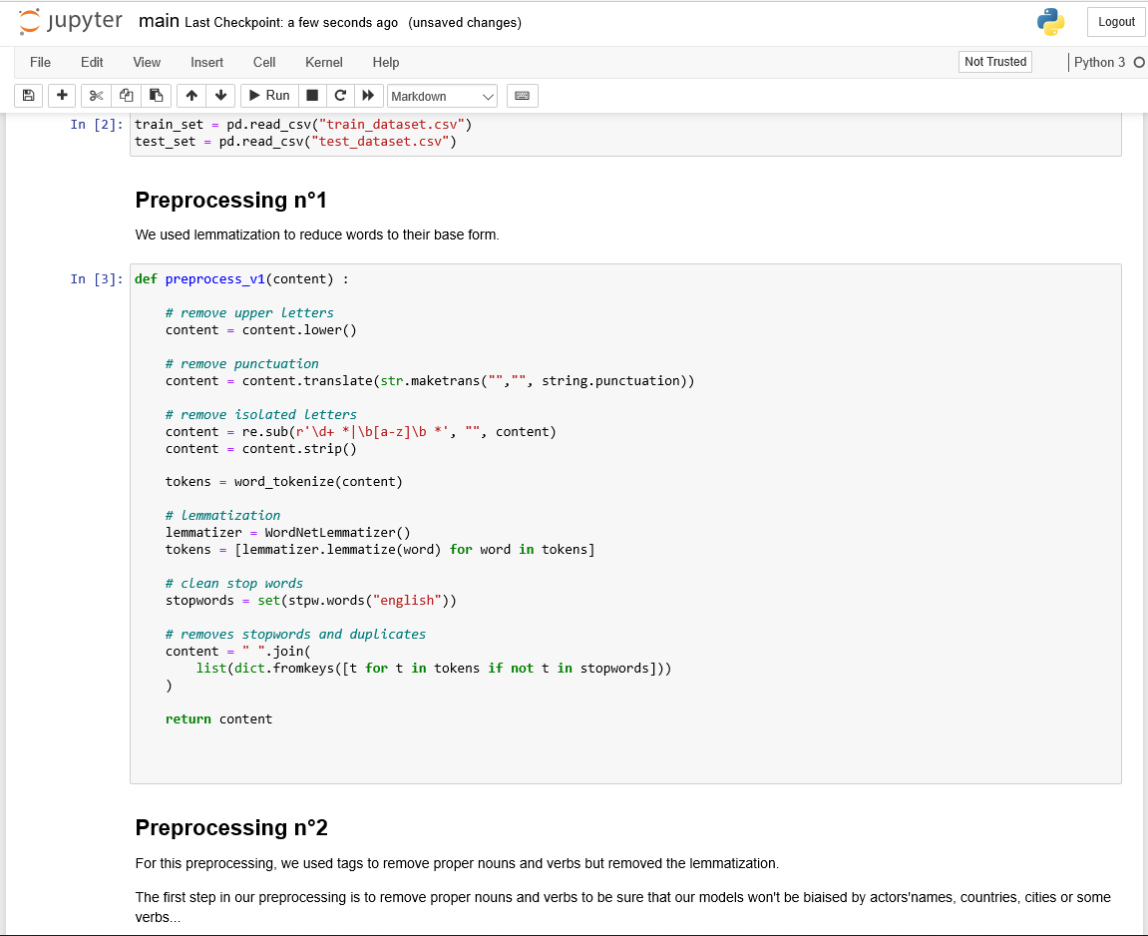

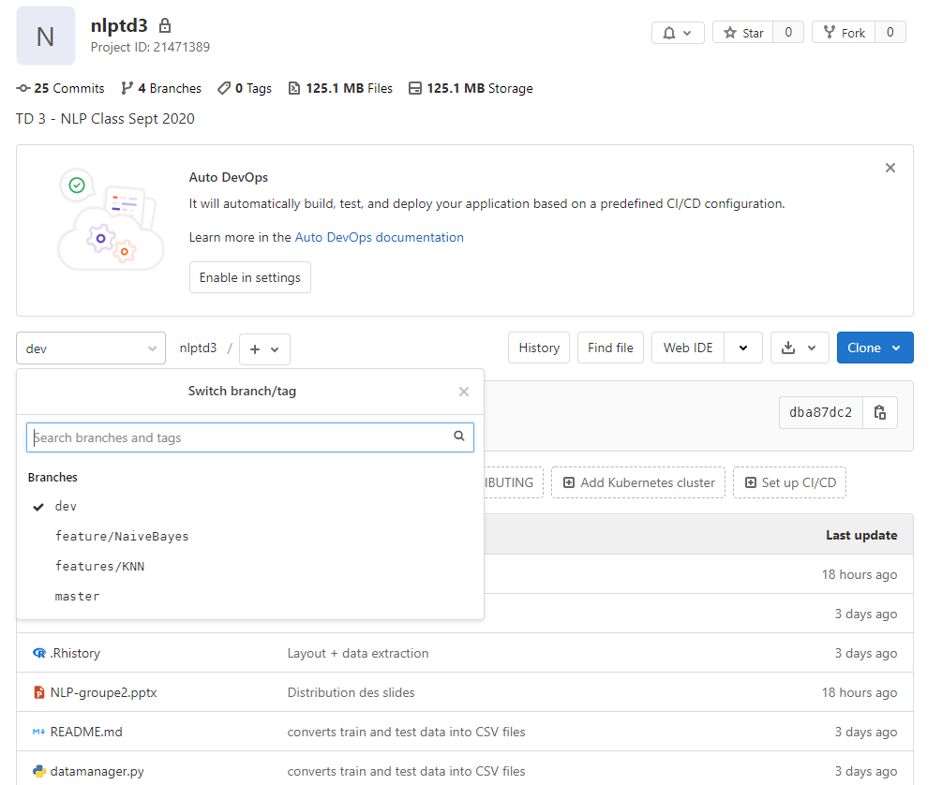

Implementation
LINK
Notes:
Colin

Slide 18
Page de garde
TABLE OF CONTENTS
INTRODUCTION
DATA PREPARATION
ML ALGORITHMS
CONCLUSION
Notes:
Colin - jerem

Slide 19


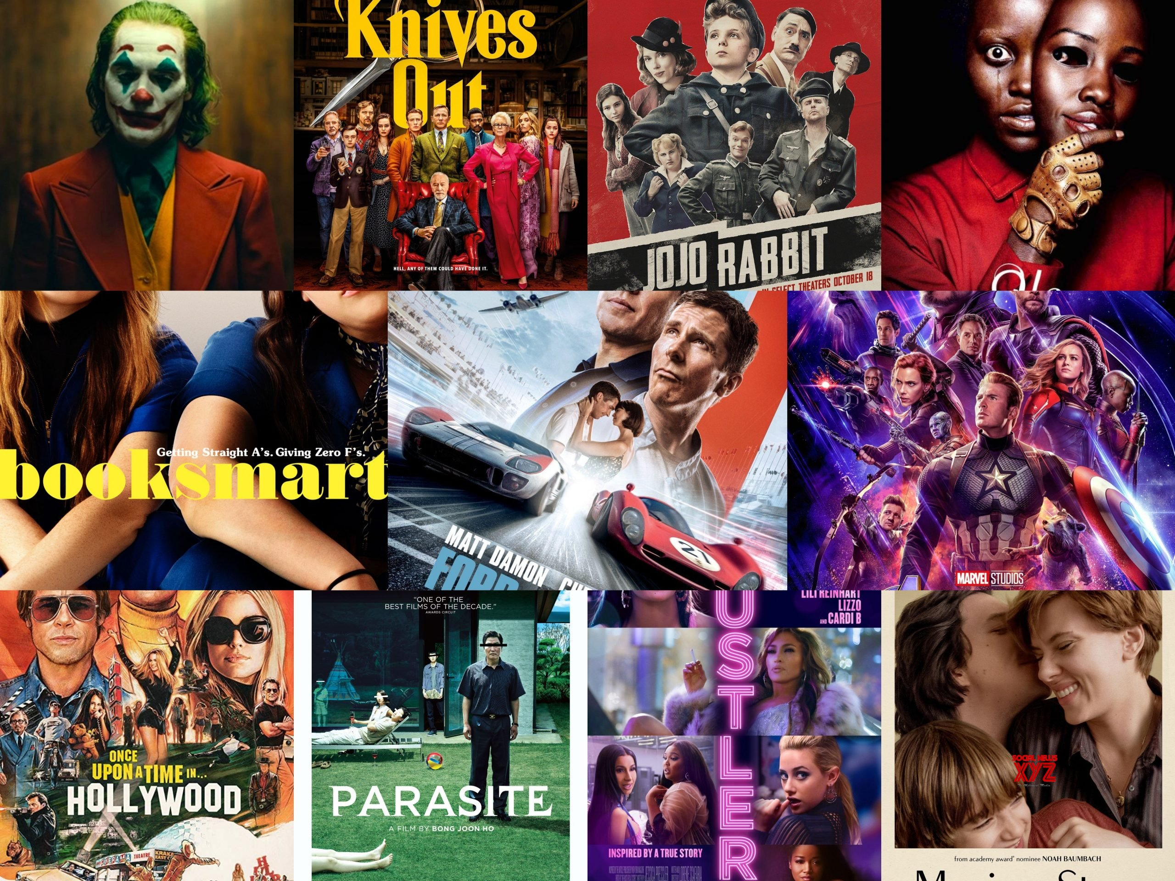
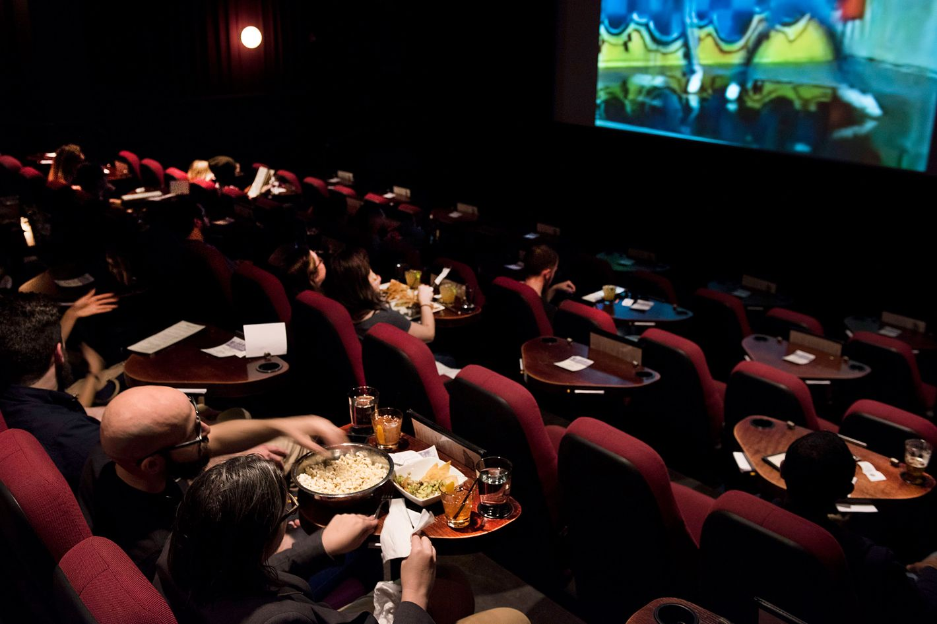
How to use our work ?
18

Slide 20
REFERENCES AND LINKS
Source dataset (1) : https://lionbridge.ai/datasets/the-best-25-datasets-for-natural-language-processing/?fbclid=IwAR13t1i7E43fYBipTjYQwMOSBadjdONsGRZvzImaLHlgLA_Yeq6FsW0Vkok
Source dataset (2) : http://ai.stanford.edu/~amaas/data/sentiment/?fbclid=IwAR0qUMQ8s4b-Jrjdv87zE5QQQpLllgwC_e8zyAM6ofgjbFan8rnqvkSXweI
Scikit Learn documentation : https://scikit-learn.org/stable/
Teacher’s lesson
Notes:
Jerem

Slide 21
Page de garde
Thank you ! Questions ?
GROUP 2 : Jérémy, Colin, Adrien, Gabrielle et Aurore
TEACHER : Anne BRETONNIERE
October 2020 – IA option – Cergy (France)
Notes:
Jerem

