Slide 1

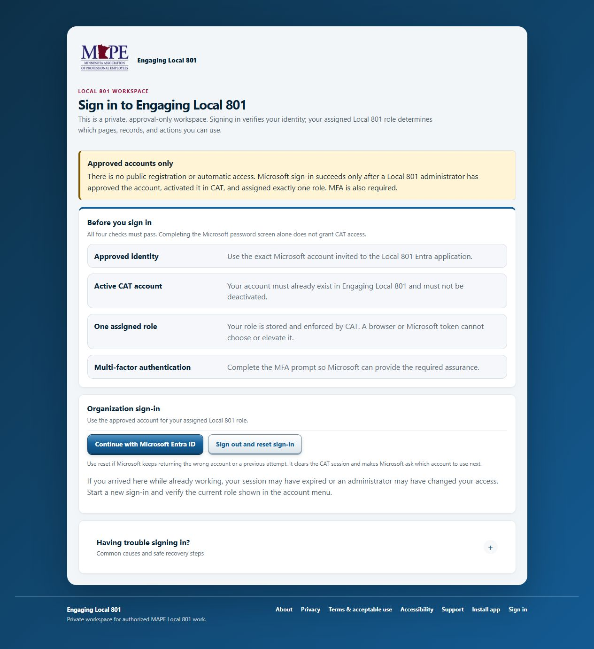
Engaging
Local 801
New user training
Sign in safely. Find your work. Record one clean outreach cycle.
MAPE Local 801 • 2026
Notes:
Welcome the group and set a practical expectation: this session is about doing the everyday work correctly, not memorizing every page.
[Sources]
- Screenshot: https://cat.cyang.io/sign-in (captured 2026-08-25)
- Internal: apps/local801-engage/src/lib/access.ts
[/Sources]

Slide 2
NEW USER TRAINING
What you should be able to do
1
Sign in
2
Find the work
Use the invited Microsoft account and complete MFA.
Move from Member outreach to the right person and task.
3
Leave a clean record
4
Know when to stop
Record the conversation, readiness, and next step.
Verify uncertain saves and ask for help without exposing data.
The rule throughout: work from the current CAT record. Do not guess what happened.
Engaging Local 801
02
Notes:
Read the four outcomes aloud. Tell learners that the last one matters as much as the first three: a careful pause is better than a duplicate or exposed record.
[Sources]
- Internal: apps/local801-engage/src/app/(workspace)/outreach/[personId]/page.tsx
- Internal: apps/local801-engage/src/app/support/page.tsx
[/Sources]

Slide 3
SIGN-IN
Access has four checks
1
Approved identity
Use the exact personal Microsoft account named in the invitation.
2
Active CAT account
An administrator must have created and activated the CAT user.
3
One assigned role
Your role controls which pages and records you can use.
4
Microsoft MFA
Complete the verification prompt in the same sign-in session.
If Microsoft keeps choosing the wrong account, use Sign out and reset sign-in.
Engaging Local 801
03
Notes:
Pause on the first check. For most users, CAT expects a personal Microsoft account created with or linked to the invited email. A successful Microsoft sign-in does not by itself grant CAT access.
[Sources]
- Screenshot: https://cat.cyang.io/sign-in (captured 2026-08-25)
- Internal: apps/local801-engage/src/lib/access.ts
[/Sources]

Slide 4
ACCESS
Your role shapes the workspace
Most users start here
CAT
LCAT
801 Administrator
Local Administrator
System Owner
Assigned outreach, follow-ups, documents
Team assignments and authorized reports
Programs and operational administration
Users, roles, access, and settings
Protected owner-level administration
Missing menu? It may be outside your role. Ask an administrator to review access—do not borrow another account.
Engaging Local 801
04
Notes:
Explain the role ladder without promising that everyone will see every page. Emphasize least privilege: access should match the person's current Local 801 responsibility.
[Sources]
- Internal: apps/local801-engage/src/lib/access.ts
- Internal: apps/local801-engage/src/components/app-shell.tsx
[/Sources]

Slide 5
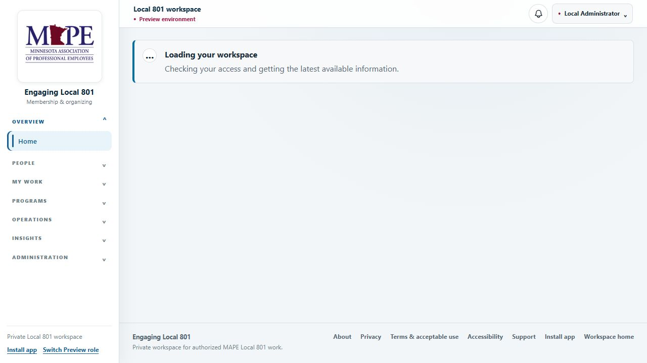
NAVIGATION
Find your way around
START WITH
Member outreach
Your practical working list: who needs attention and what is due.
USE DIRECTORY FOR
Finding a person
Search and open a record when the work did not start from your outreach list.
Your account menu also shows your current role.
Engaging Local 801
05
Notes:
Walk learners around the screen, but keep the tour short. The useful distinction is Member outreach for active work and Directory for finding someone. The preview contains no member database.
[Sources]
- Internal: apps/local801-engage/src/components/app-shell.tsx
- Internal: apps/local801-engage/src/app/(workspace)/outreach/page.tsx
- Internal: apps/local801-engage/src/app/(workspace)/directory/page.tsx
[/Sources]

Slide 6
OUTREACH
The everyday outreach rhythm
1
2
3
4
5
Open
Review
Contact
Record
Follow up
Start from Member outreach and choose the person.
Read the current record, assignment, and last contact.
Use only the contact methods available to your role.
Save what happened and update action readiness.
Set the next step, then verify the refreshed record.
A conversation is not finished in CAT until the record and next step are clear.
Engaging Local 801
06
Notes:
This is the core training slide. Ask a learner to repeat the five steps in their own words. The sequence should feel like a work habit, not a software checklist.
[Sources]
- Internal: apps/local801-engage/src/app/(workspace)/outreach/page.tsx
- Internal: apps/local801-engage/src/app/(workspace)/outreach/[personId]/page.tsx
[/Sources]

Slide 7
OUTREACH
Record the conversation while it is fresh
Method
Phone, text, email, in person, or another approved method
Context
Connect the conversation to the right assignment or action
Outcome
Contacted, left message, no answer, wrong contact, or the closest accurate result
Note
Write a short factual note another authorized user can understand
When
Use the actual date and time of the contact
Visibility
Choose only the audience that needs the note
Useful note: “Reached member. Asked for a call Thursday after 5:30.”
Engaging Local 801
07
Notes:
Demonstrate the fields in the live application if a synthetic record is available. The sample note is restrained and actionable; it does not repeat contact details or add speculation.
[Sources]
- Internal: apps/local801-engage/src/app/(workspace)/outreach/[personId]/page.tsx
[/Sources]

Slide 8
NEXT STEP
Leave the next user a clear record
ACTION READINESS
FOLLOW-UP
What is the member's current response?
Who owns the next step, and when is it due?
Willing
Give the follow-up a specific purpose.
Considering
Assign it to the person who will do it.
Declined
Use a realistic date and time.
Completed
Then refresh once. Confirm the conversation, readiness, and follow-up each appear once.
Engaging Local 801
08
Notes:
Readiness is the member's response to a defined action, not a general opinion of the member. A follow-up should make the next action obvious to the person who owns it.
[Sources]
- Internal: apps/local801-engage/src/app/(workspace)/outreach/[personId]/page.tsx
- Internal: apps/local801-engage/src/app/(workspace)/follow-ups/page.tsx
[/Sources]

Slide 9
MY WORK
Three views, three different jobs
PERSONAL QUEUE
PROMISED NEXT STEPS
CALENDAR AND WORKLOAD
To Do
Follow-ups
Work planner
What do I need to finish?
Who needs a return contact, and when?
How does the work fit across days and assignments?
Check it first.
Keep the promise.
Balance the week.
They overlap on purpose. Use the view that answers the question you have right now.
Engaging Local 801
09
Notes:
New users often treat these pages as duplicates. Give each one a question: To Do is personal completion, Follow-ups is the return-contact promise, and Work planner is the calendar view.
[Sources]
- Internal: apps/local801-engage/src/app/(workspace)/tasks/page.tsx
- Internal: apps/local801-engage/src/app/(workspace)/follow-ups/page.tsx
- Internal: apps/local801-engage/src/app/(workspace)/work-planner/page.tsx
[/Sources]

Slide 10
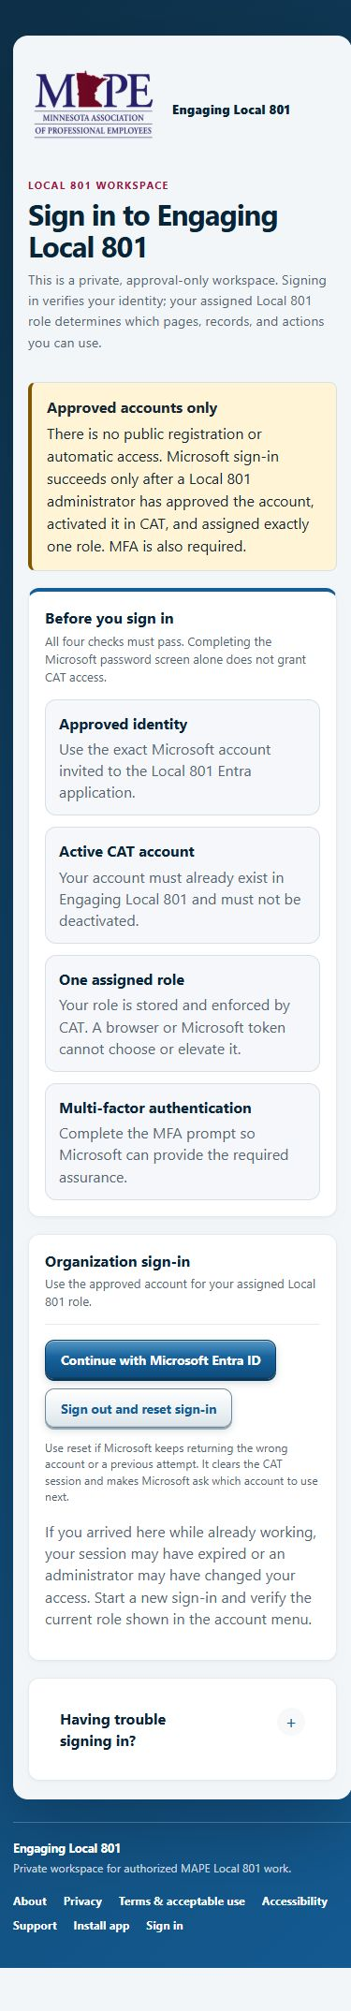
MOBILE
On a phone, Field view starts automatically
Field view keeps the next action close
Contact the member.
Record what happened.
Update readiness.
Add a follow-up.
Return to the refreshed list.
Want the full layout? Choose Use standard view. CAT respects that choice for the rest of the browser session.
Field view is online only—it does not store member contact details for offline use.
Engaging Local 801
10
Notes:
Field view is the default on screens 720 pixels wide or smaller unless the user has chosen standard view during that session. Show the opt-out and make clear that it is respected.
[Sources]
- Internal: apps/local801-engage/src/components/field-view-provider.tsx
- Internal: apps/local801-engage/src/app/(workspace)/outreach/page.tsx
[/Sources]

Slide 11
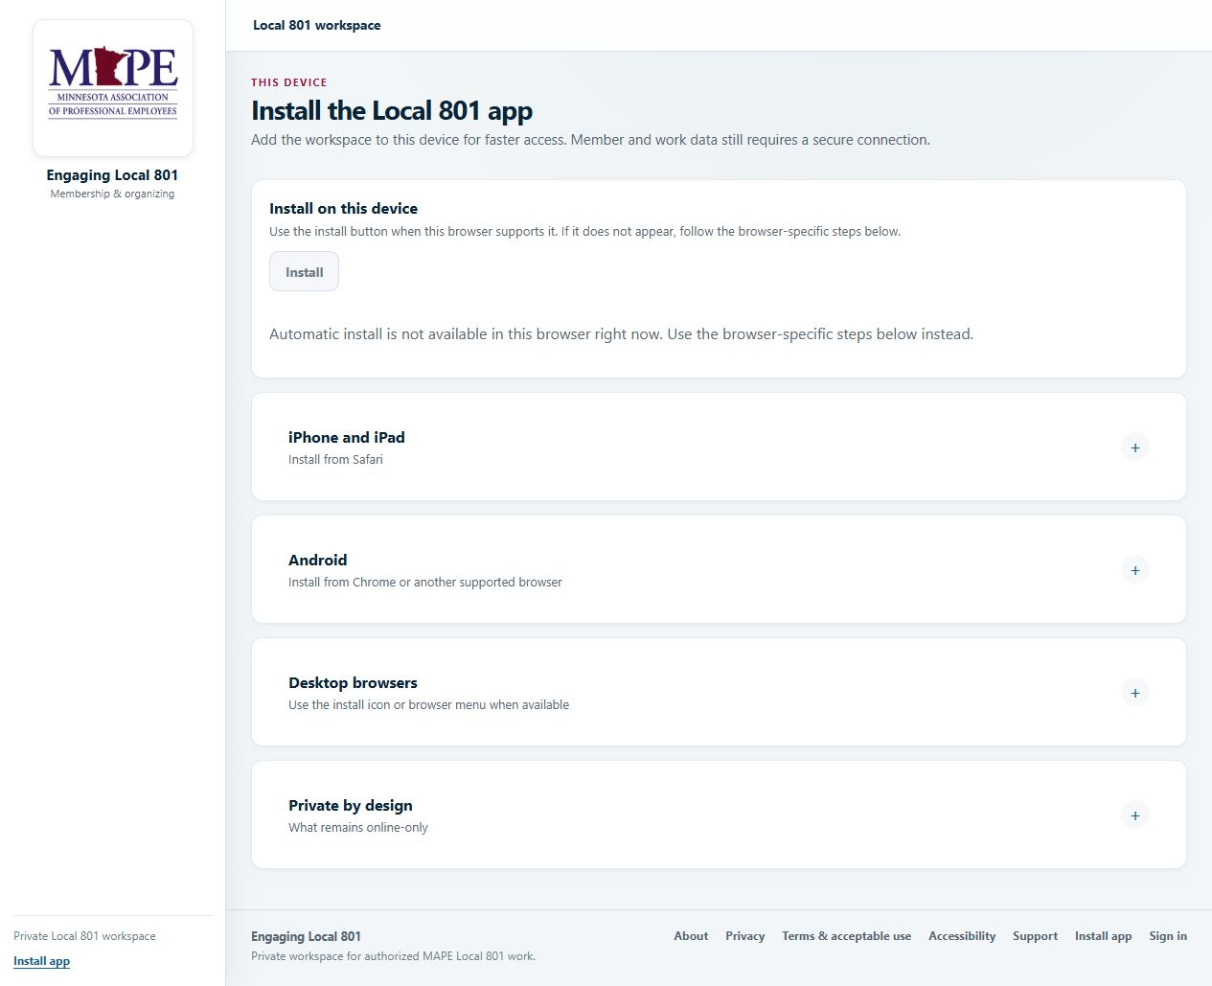
DOCUMENTS & INSTALL
Keep the shortcut convenient—and the information protected
DOCUMENTS
Choose the narrowest audience that needs the file.
Check the filename and content before upload.
Wait for approval when CAT requires it.
INSTALL SHORTCUT
The Install app page gives device-specific steps. The shortcut is convenient, but CAT still needs a secure connection and an approved account.
Engaging Local 801
11
Notes:
Do not present the installed shortcut as offline access. It opens CAT more conveniently; member and work data still require a secure connection. Remind users not to copy documents to personal storage.
[Sources]
- Screenshot: https://cat.cyang.io/install (captured 2026-08-25)
- Internal: apps/local801-engage/src/app/(workspace)/documents/page.tsx
[/Sources]

Slide 12
PROTECTED INFORMATION
Good judgment still matters after access is granted
Do
Do not
Use CAT only for approved Local 801 work.
Do not share your account.
Use the narrowest note visibility and document audience.
Do not move rosters or documents to personal storage.
Lock the device when you step away.
Do not put member details in support messages.
Report a lost device or unexpected role promptly.
Do not guess when protected information is unavailable.
If a page says information is unavailable, CAT is failing closed. Check your connection and role; do not substitute an old spreadsheet.
Engaging Local 801
12
Notes:
This slide is about habits, not fear. Access controls reduce risk, but once information is visible, the user still controls where it goes and who can see it.
[Sources]
- Internal: apps/local801-engage/src/app/(workspace)/documents/page.tsx
- Internal: apps/local801-engage/src/app/support/page.tsx
[/Sources]

Slide 13
ROLE-SPECIFIC
If you administer CAT
Skip this section if it is not your job. These pages appear only when your role has the related permission.
Programs
Membership operations
Administration
Action catalog
Membership
Team & Access
Campaigns
Data issues
Reports
CAT Actions
Contact updates
Audit Activity
Data imports
Settings
Administrative work should match a confirmed request, the correct record, and the least access needed.
Engaging Local 801
13
Notes:
This is a map, not a license to act. Administrators should still verify the request, the exact record, and the expected result before changing access or applying roster changes.
[Sources]
- Internal: apps/local801-engage/src/lib/access.ts
- Internal: apps/local801-engage/src/components/app-shell.tsx
[/Sources]

Slide 14
MEMBERSHIP OPERATIONS
Data issues are resolved deliberately
1
Review the issue
Confirm the row and the problem CAT identified.
2
Use the best match
An exact active work-email match always wins.
3
Choose the outcome
Fix a record, attach the row, create a new employee, or remove the import row.
4
Confirm and verify
An administrator confirms attachments and checks the final state.
Uploading or reviewing a file does not change the roster. Apply only the exact reviewed changes. Absence from a file is not a drop or deletion.
Engaging Local 801
14
Notes:
Work email is the strongest match and must not be overridden. If no exact match exists, CAT may rank possible employees using names and workplace details, but an administrator confirms the attachment. Stop before applying roster changes unless the review and authority are explicit.
[Sources]
- Internal: apps/local801-engage/src/app/(workspace)/data-quality/page.tsx
- Internal: apps/local801-engage/src/app/(workspace)/imports/page.tsx
[/Sources]

Slide 15
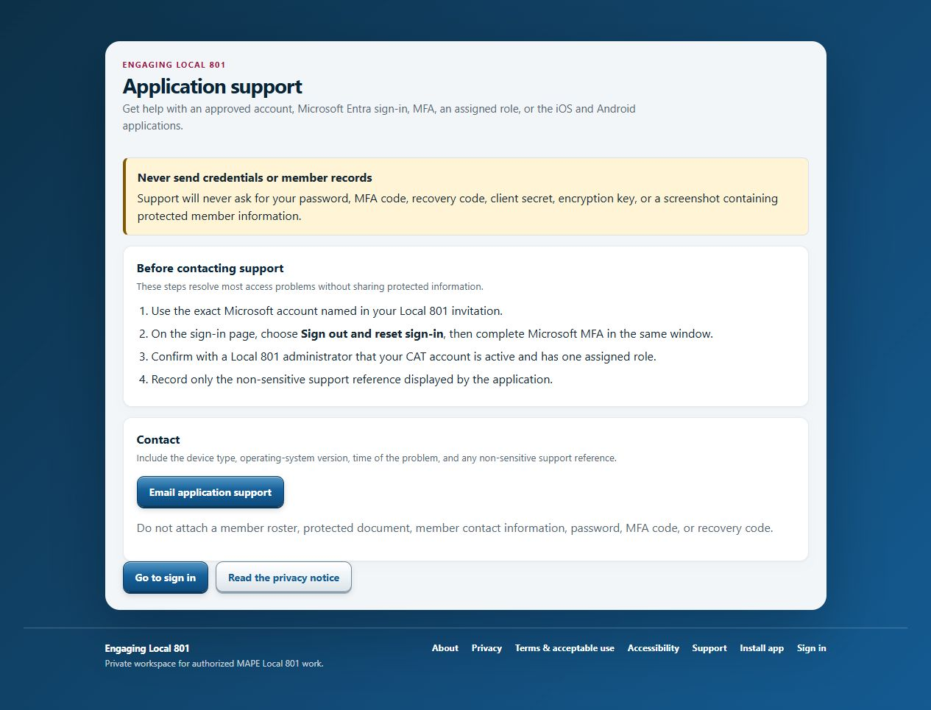
SUPPORT
Get help without exposing member information
BEFORE CONTACTING SUPPORT
Write down the non-sensitive support reference.
Note the device, browser or app, and approximate time.
Explain what you expected and what happened in one or two sentences.
Remove names, contact details, passwords, MFA codes, and recovery codes.
For an uncertain save: check the current record first. Retry only if the change is missing.
Engaging Local 801
15
Notes:
Use the public Support page as the recovery checklist. Support needs a concise description and the non-sensitive reference, not a roster or screenshot of protected contact information.
[Sources]
- Screenshot: https://cat.cyang.io/support (captured 2026-08-25)
- Internal: apps/local801-engage/src/app/support/page.tsx
[/Sources]

Slide 16
READY FOR LIVE WORK
Practice one clean outreach record
1
Open a synthetic person with an open follow-up.
Before live work
2
Review the record and available contact methods.
Sign-in and MFA work
3
Record a conversation with a short factual note.
Role matches the assignment
4
Set Considering for one action and create the next follow-up.
One complete synthetic cycle
Safe support habits
5
Refresh and confirm each item appears once.
Work from the current record. Keep notes useful. Verify uncertain saves.
Engaging Local 801
16
Notes:
Run this practice with synthetic data only. The learner should be able to explain what was saved, who can see it, and what they would do if the save result were unclear.
[Sources]
- Internal: apps/local801-engage/src/app/(workspace)/outreach/[personId]/page.tsx
- Internal: apps/local801-engage/src/app/(workspace)/follow-ups/page.tsx
[/Sources]

