Slide 1
SONIC PLAYER
Modern Music Streaming Application
by CYBER · HACKER · Studio

Slide 2
Features
✦ YouTube Music Search — millions of tracks with 20-200 results
✦ Smart AI Recommendations — based on your listening history
✦ YouTube Playlists — browse channels as playlists
✦ 7 Visualizer Modes — Bars, Wave, Circle, Fire, Aurora, Plasma, Rings
✦ Offline Downloads — save and play without internet
✦ Playlists with Album Art — organized with thumbnails
✦ Synced Lyrics — auto-scrolling LRC support
✦ Real-time Audio Visualizer — react to sound

Slide 3
Tech Stack
✦ Frontend: Next.js 16 + React 18 + TypeScript
✦ Styling: Tailwind CSS 4 + Radix UI + Framer Motion
✦ State Management: Zustand 5
✦ Backend: FastAPI (Python) + Uvicorn
✦ Streaming: yt-dlp + FFmpeg with smart caching
✦ Lyrics: syncedlyrics LRC
✦ Audio Engine: Dual-element pre-buffering for seamless playback

Slide 4
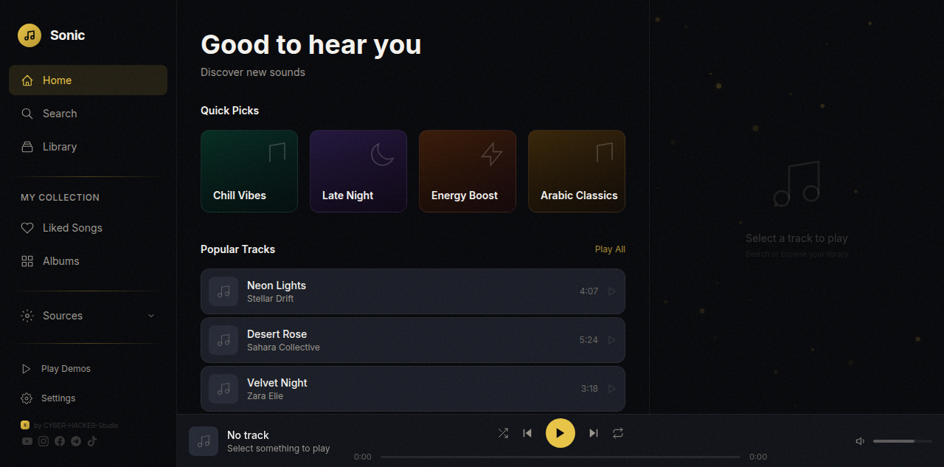
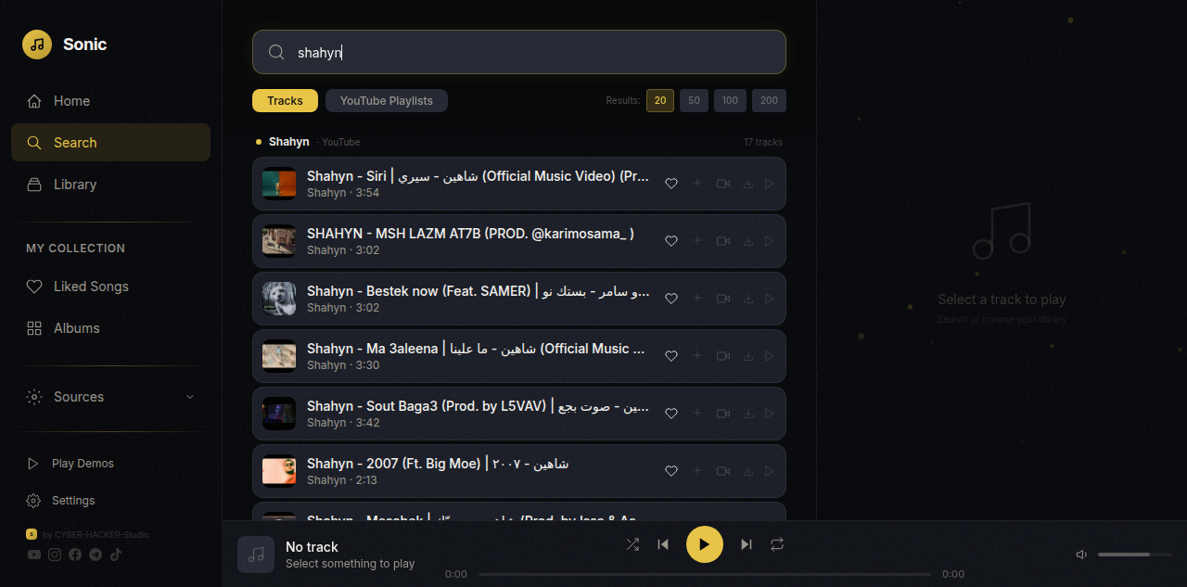
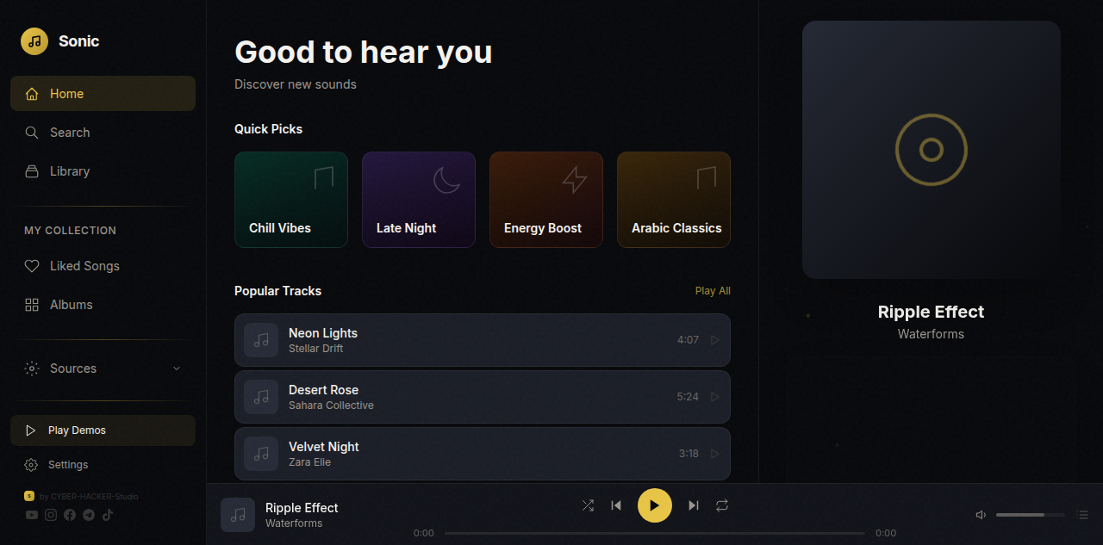
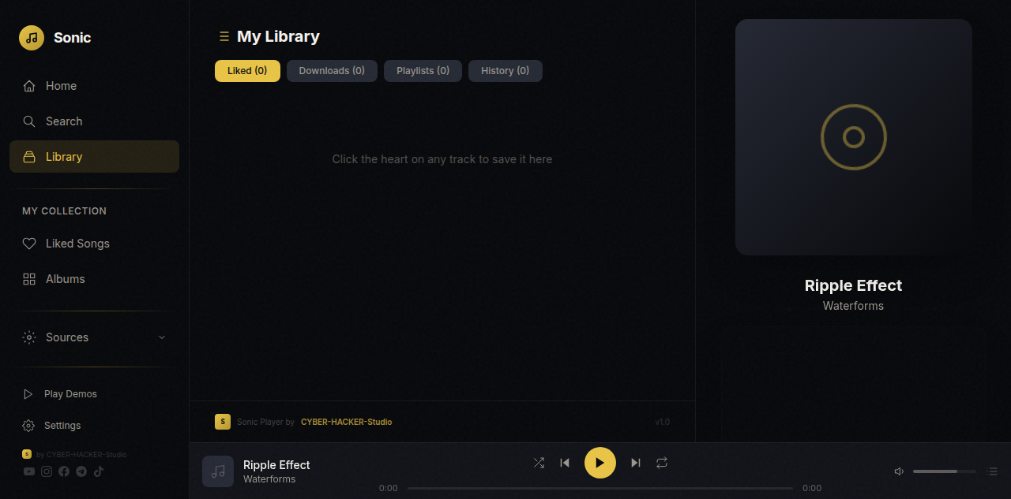
Screenshots

Slide 5
7 Visualizer Modes
Bars
Wave
Circle
Fire
Classic frequency bars with smooth gradients
Lissajous-style oscilloscope wave
Radial frequency spokes with center pulse
Bottom-up flame bars with glowing particles
Aurora
Plasma
Rings
Northern lights flowing layers
Real-time per-pixel colorful plasma
Concentric pulsing rings with glow

Slide 6
SONIC PLAYER
Open Source · Free · Premium
github.com/CYBER-HACKER-Studio
CYBER · HACKER · Studio

