Slide 1
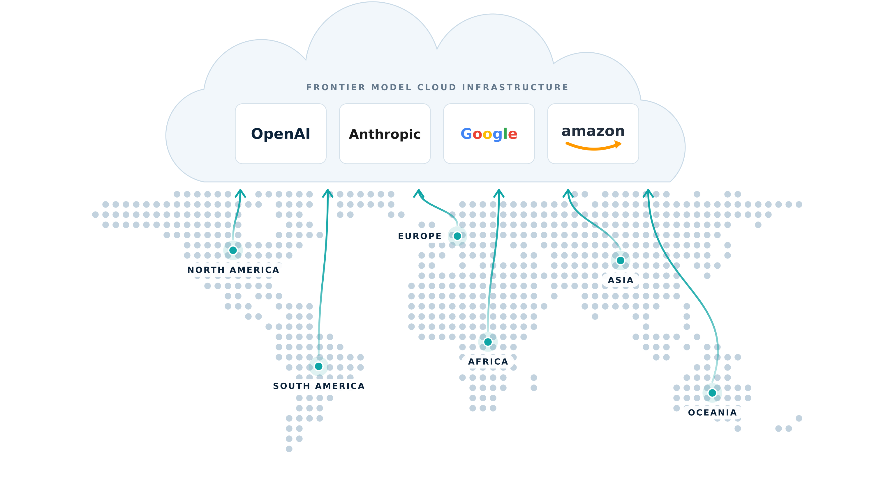


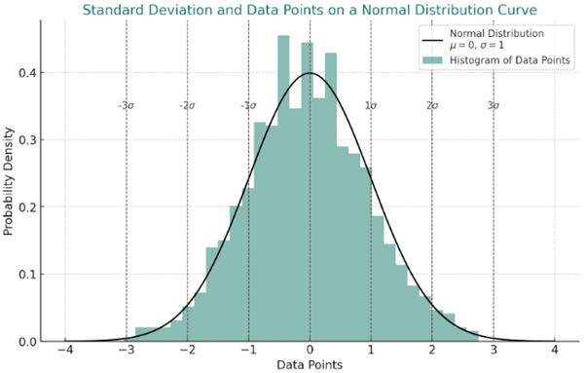
GLOBAL DEPLOYMENT
Global Echo Server Location Obfuscation
Amazon RDS
LLM ECHO
LLM ECHO
LLM ECHO
LLM ECHO
ENGLISH
PROMPT
IS INTERESTING
FRENCH

