Slide 1
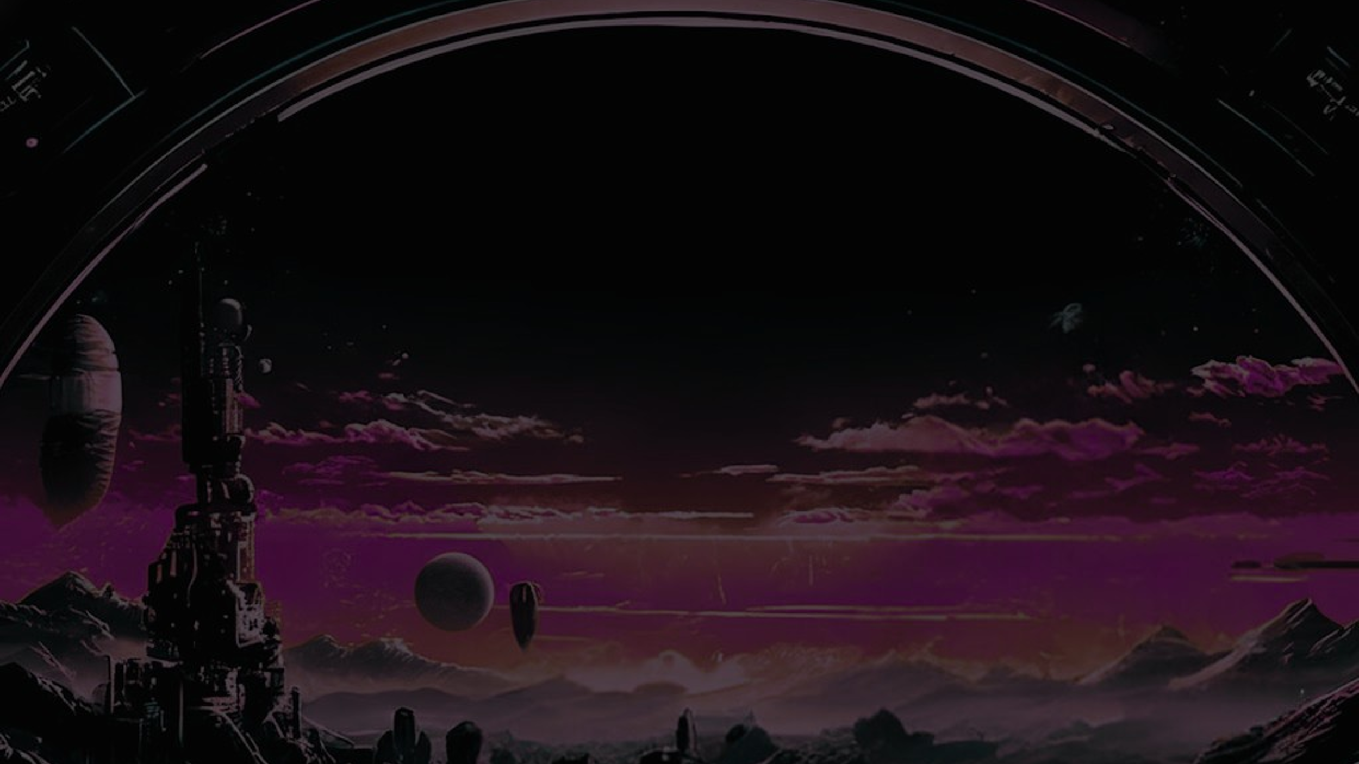





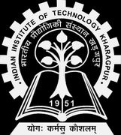


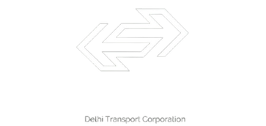
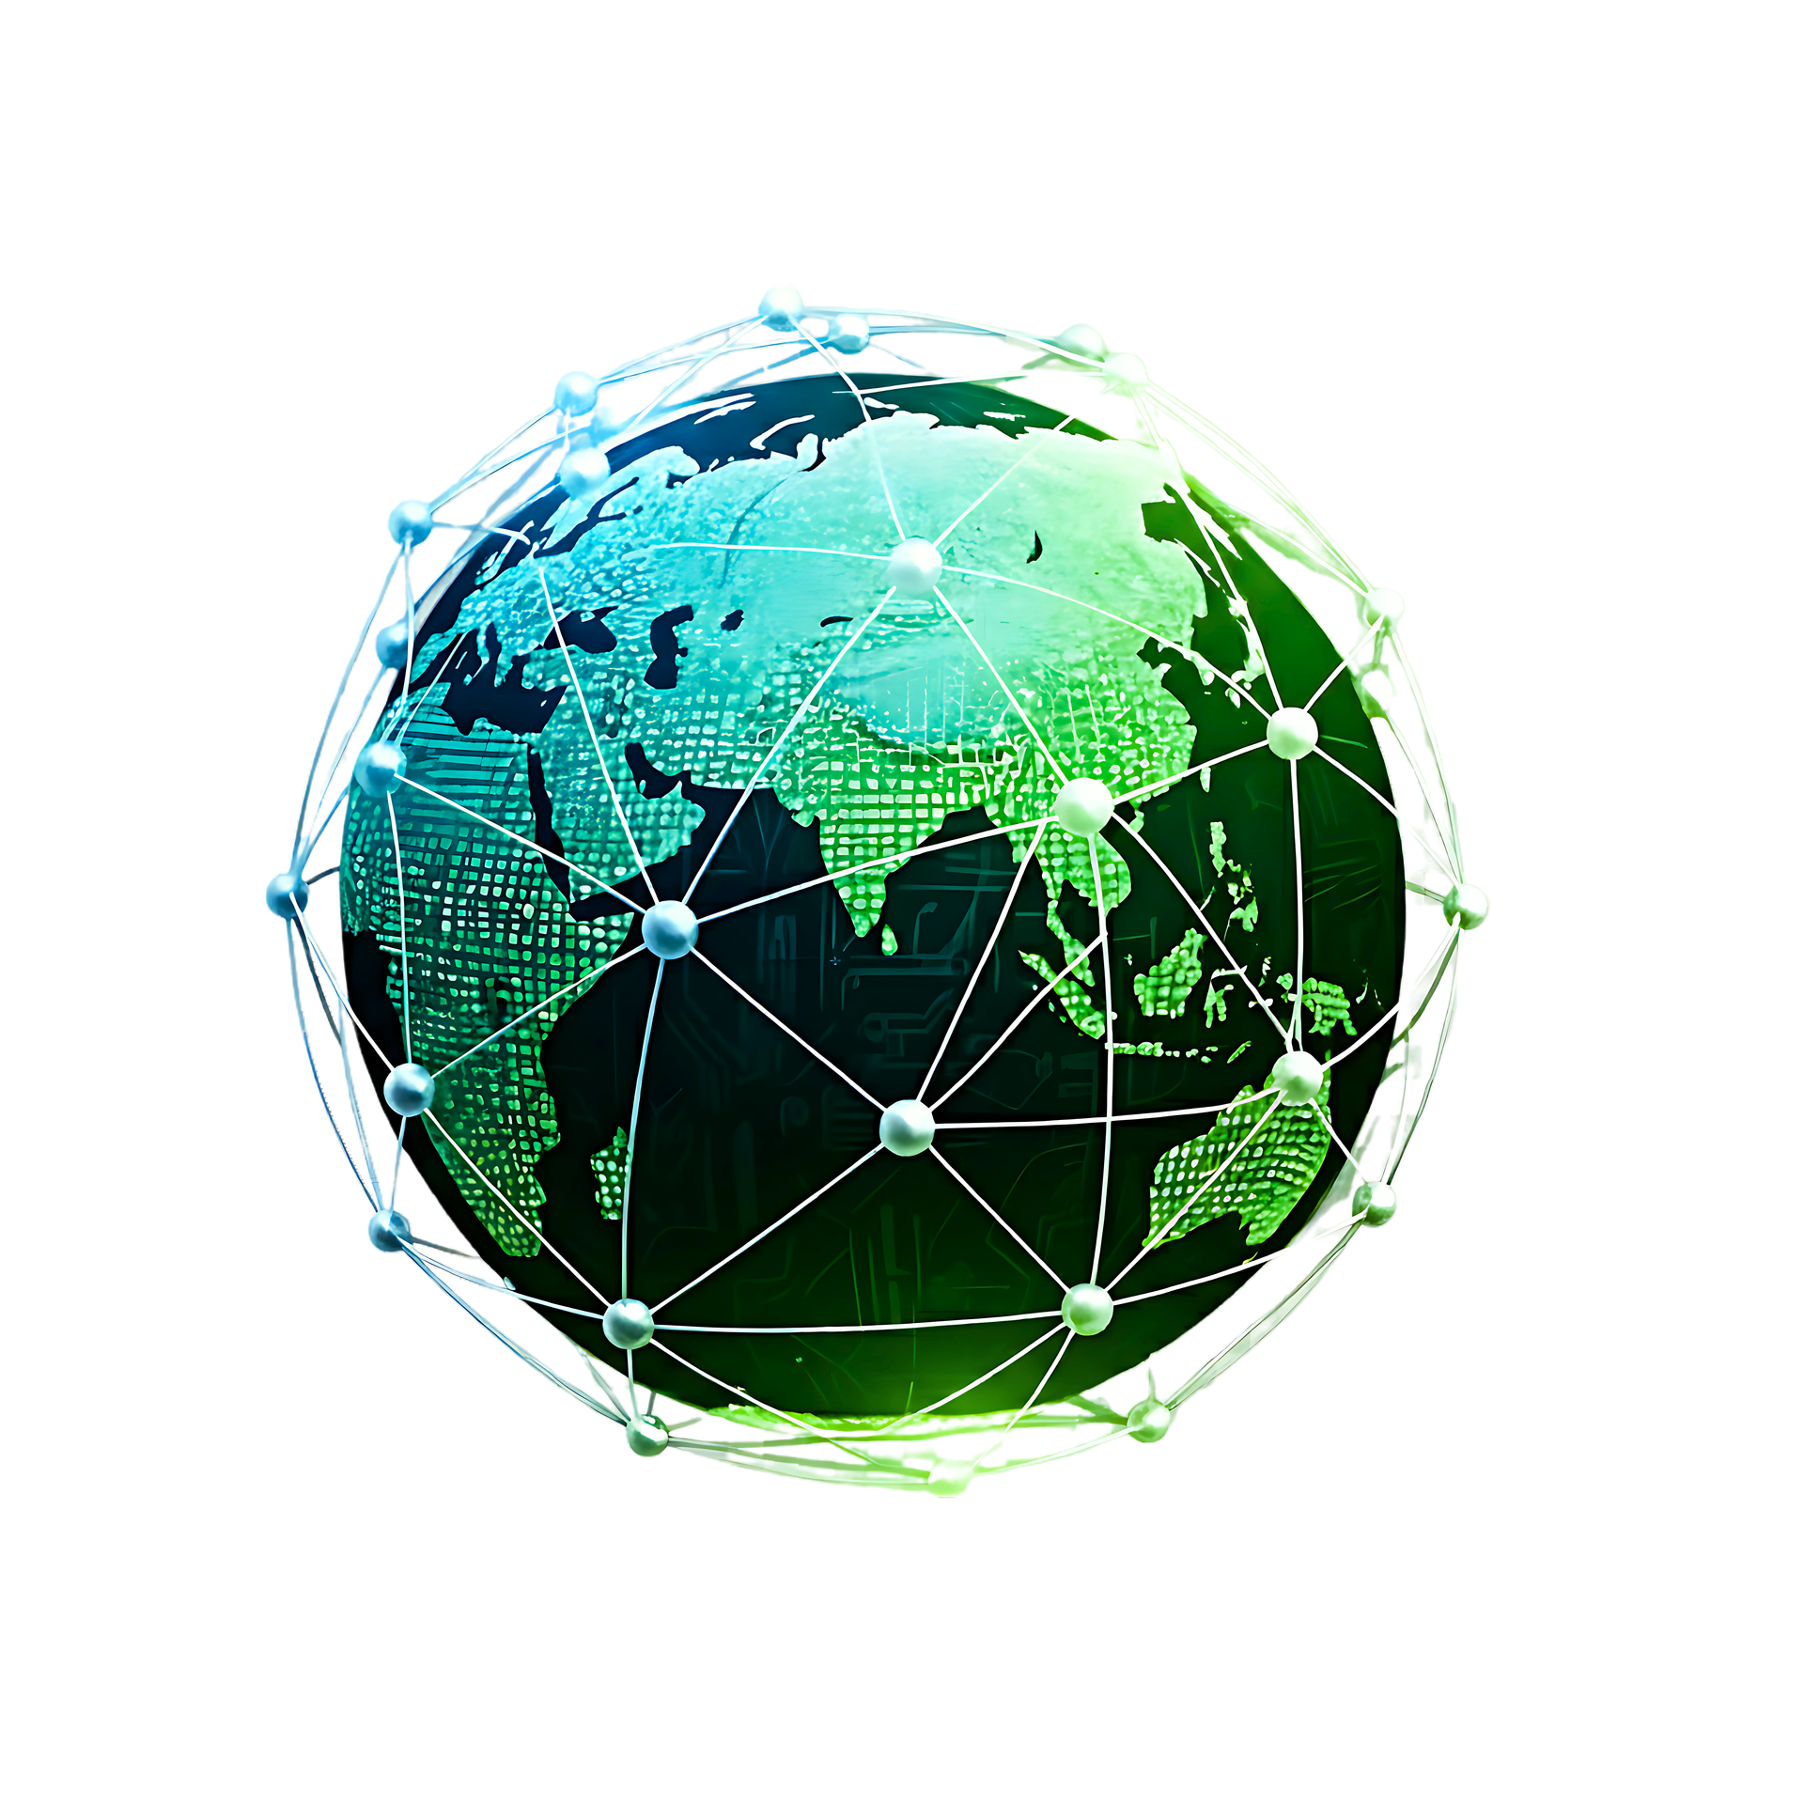

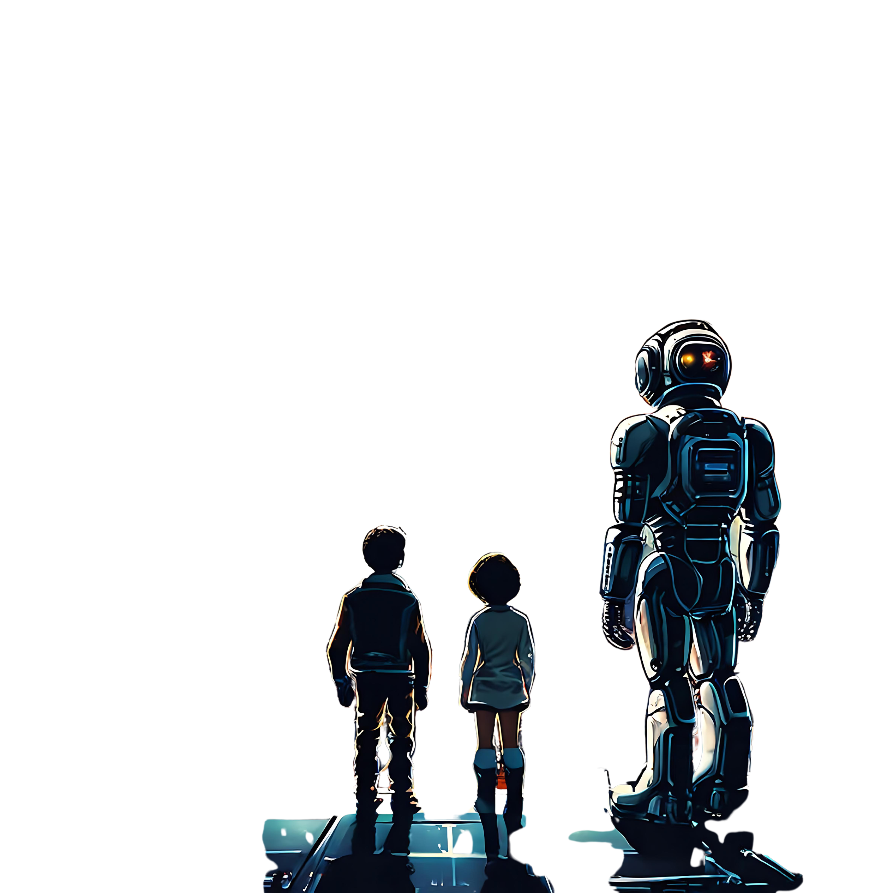
Team Name: KRIDIKSHIT
Members Name and Affiliation:
Krishnav Talukdar (AKTU)
Karan Negi (AKTU)
Vishal Singh (AKTU)
Vansh Tyagi (AKTU)
Sonali Kumari (AKTU)
Priya Singh (AKTU)

Slide 2


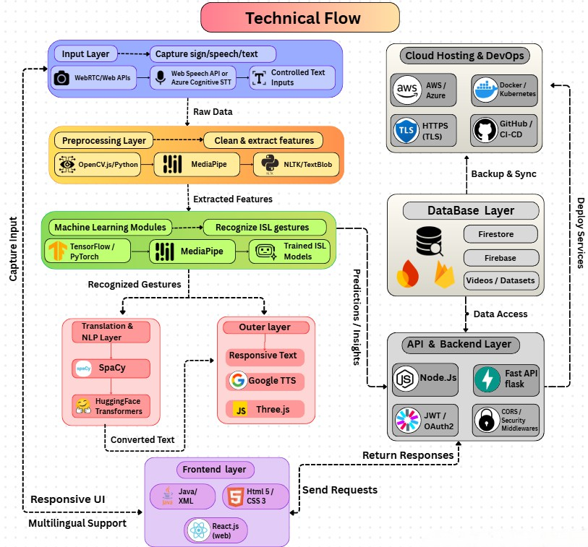
PROBLEM STATEMENT
India’s Silent Communication Crisis
India has one of the largest deaf populations globally, yet communication infrastructure for Indian Sign Language (ISL) is critically underdeveloped.
SCALE OF THE CHALLENGE
India's 63 million mute and 5 million deaf individuals face critical communication barriers due to the acute lack of accessible Indian Sign Language (ISL) services. (WHO, 2023).
ISL was officially recognized only in 2020, limiting prior technological development (Govt. of India, MINISTRY OF SOCIAL JUSTICE, 2020).
Only ~5% of hearing-impaired children in India receive basic schooling, and only ~1% have access to quality education. (Hindustan Times, 2019)
SYSTEMIC GAPS
Most AI sign-language tools prioritize American Sign Language (ASL) and not India Sign Language.
Shortage of sign language interpreters & India have 300 Certified Interpreter.
Most existing solutions offer static ISL dictionaries, not real-time conversational translation.

Slide 3
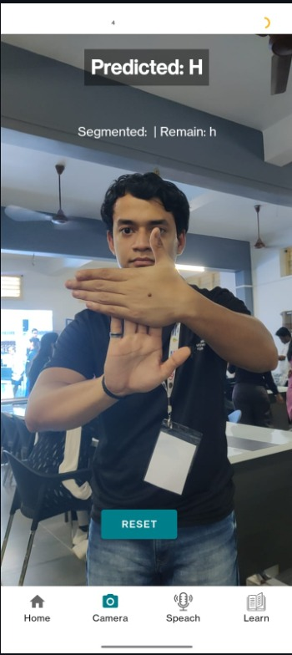
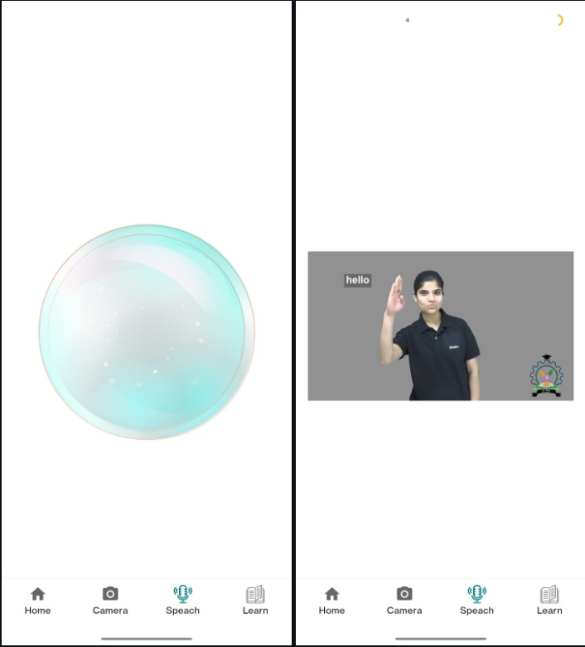
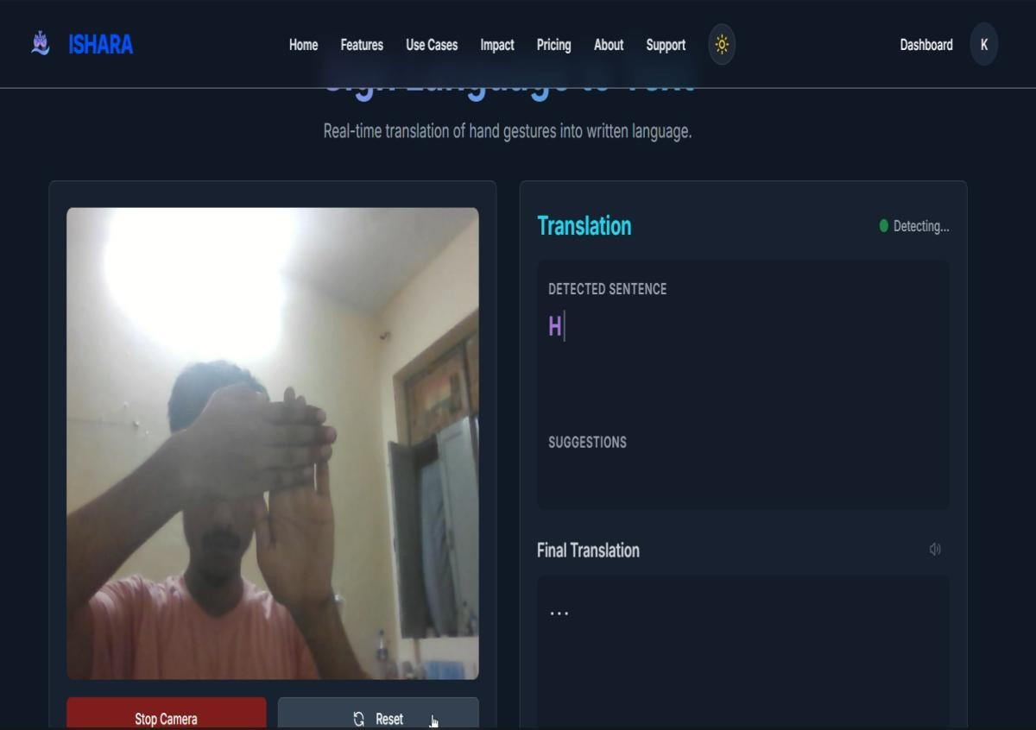
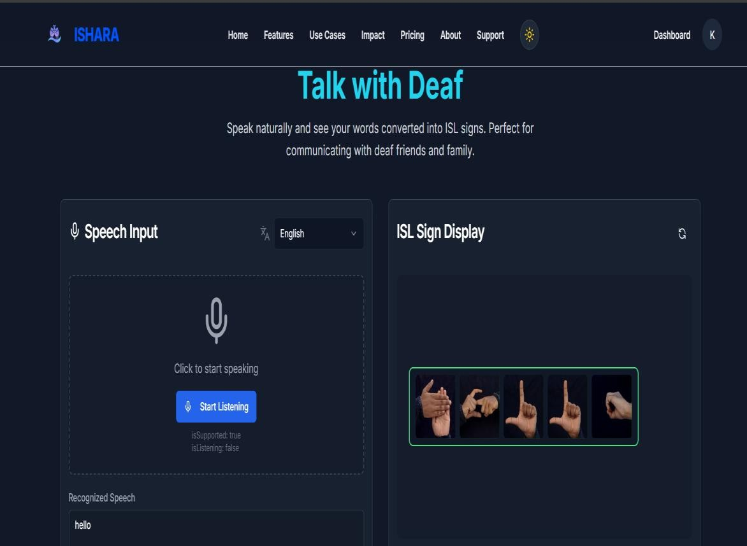
SOLUTION
Automated Real-Time Translation:-The app/web platform enables instantaneous conversion between Indian Sign Language gestures and spoken/written language, facilitating seamless conversations without human interpreters.
Advanced AI-Powered Gesture Recognition:- Utilizes cutting-edge computer vision (CNN, Media Pipe) and deep learning (LSTM, Transformers) to accurately detect and interpret both static and dynamic ISL gestures.
Bidirectional Communication :- Supports two-way translation enabling ISL users to communicate with non-signers through text, speech, or animated avatars, fostering inclusivity in education, workplaces, and public services.
User-Centric Design & Accessibility :- Offers intuitive interfaces on mobile and web, designed for ease of use by both the deaf community and wider population, with features like offline support and customizable settings.
Multilingual Translation Capability :- Integrates support for multiple spoken languages such as English, Hindi, and regional Indian languages to cater to India's diverse linguistic population, ensuring wider accessibility and usability.

Slide 4
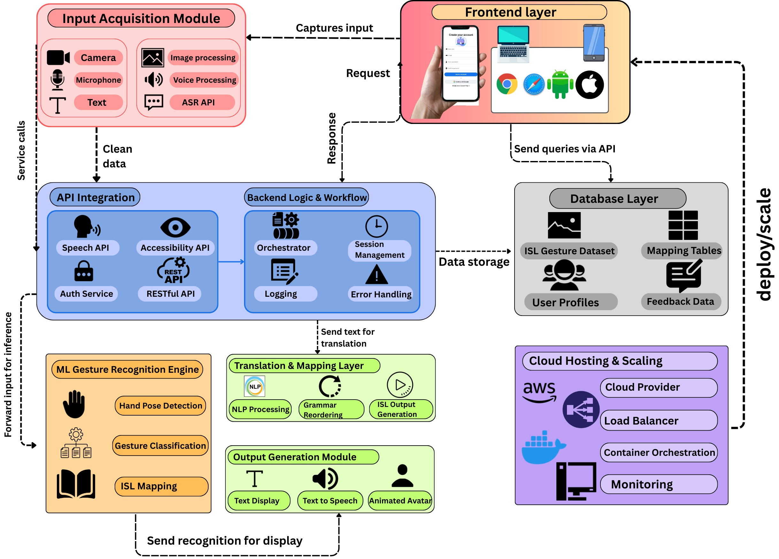

architecture

Slide 5


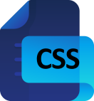










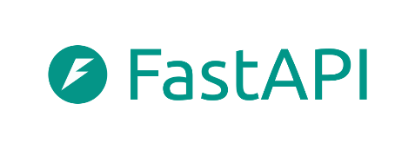

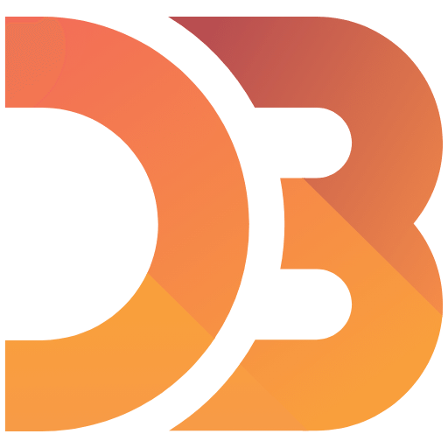

TECHNOLOGY USED
Frontend: React.Js , Android SDK (XML layouts + Java)
Backend: Python (FastAPI/Flask) , Node.js (Express)
AI / Machine Learning Layer : TensorFlow , PyTorch (CNN, LSTM, Transformers), MediaPipe for hand/keypoint tracking and gesture recognition , NLP (BERT) .
API services :- RESTful APIs, Integrations with Speech-to-Text (Google Cloud Speech), Text-to-Speech (Google Cloud TTS)
Database: Firebase Firestore , Cloud Storage
Deployment : Docker,, Vercel / Netlify , AWS , Docker , Github (CI/CD pipelines)

Slide 6
FEATURE / USP
AI-Powered Real-Time ISL Translation :- Ishara is an AI-powered real-time Indian Sign Language (ISL) translator designed specifically for Indian users.
Computer Vision & Deep Learning :-Uses advanced computer vision and deep learning models to accurately recognize hand gestures and ISL signs.
Instant Sign to Text & Speech Conversion :- Transforms sign language into readable text and natural speech instantly, enabling smooth communication.
Cross-Platform Accessibility :- Works seamlessly across mobile apps, web platforms, and smart devices, making it accessible anytime, anywhere.
Inclusive Communication Bridge :- Helps bridge the communication gap between deaf and hearing communities in education, workplaces, and daily life.

Slide 7
References / links
ExistingPlatforms
SignAble : https://signable.live
DEF-ISL App : https://def.org.in/def-isl-app/
Sanket : https://github.com/Mishra-Shreya/Sanket
ISLI Project, IIIT Bangalore : https://cognitive.iiitb.ac.in/isli/
Research & Best Practices :
https://www.ijraset.com/research-paper/advances-in-indian
-https://cognitive.iiitb.ac.in/isli/
Case Studies :
https://islrtc.nic.in/
https://signable.live/
https://def.org.in/def-isl-app/
Feature | ISHARA (OurPlatform) | SignAble | DEF-ISL App | Sanket | ISLRTC Platform
Real-time Translation
AI/ML Gesture Recognition
Multilingual Support
Bidirectional Communication
Platforms | Web, Mobile | Mobile | Android | Web, Mobile | Web, Mobile
✔
✘
✘
✘
✘
✔
✘
✔
✘
✘
✔
✘
✘
✘
✘
✔
✘
✘
✘
✘
Demo Video Link : https://youtu.be/SrEAjmk_OdE
MVP Link : kridikshit.onrender.com
Android Application link (APK) : https://www.upload-apk.com/en/kfzyzHCzTVVOK3i

Slide 8
THANK YOU

