Slide 1
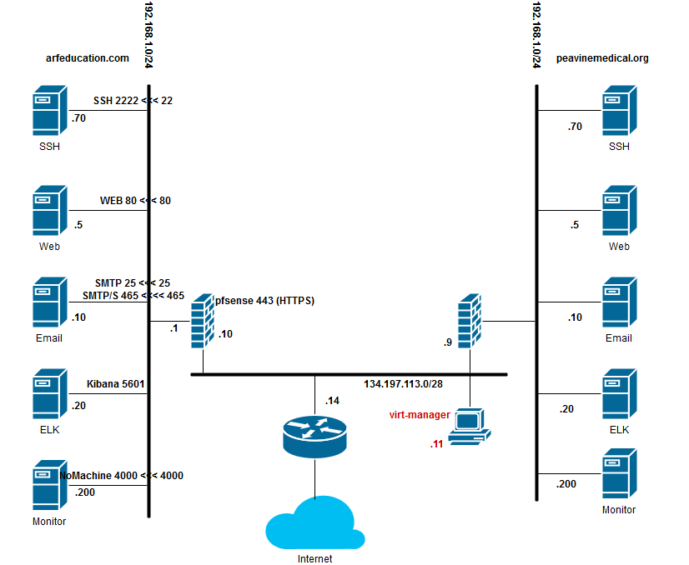
arfeducation.org
peavinemedical.com
2222 << 22, 2222
2223 << 23, 2222
22222 << 22222

Slide 2
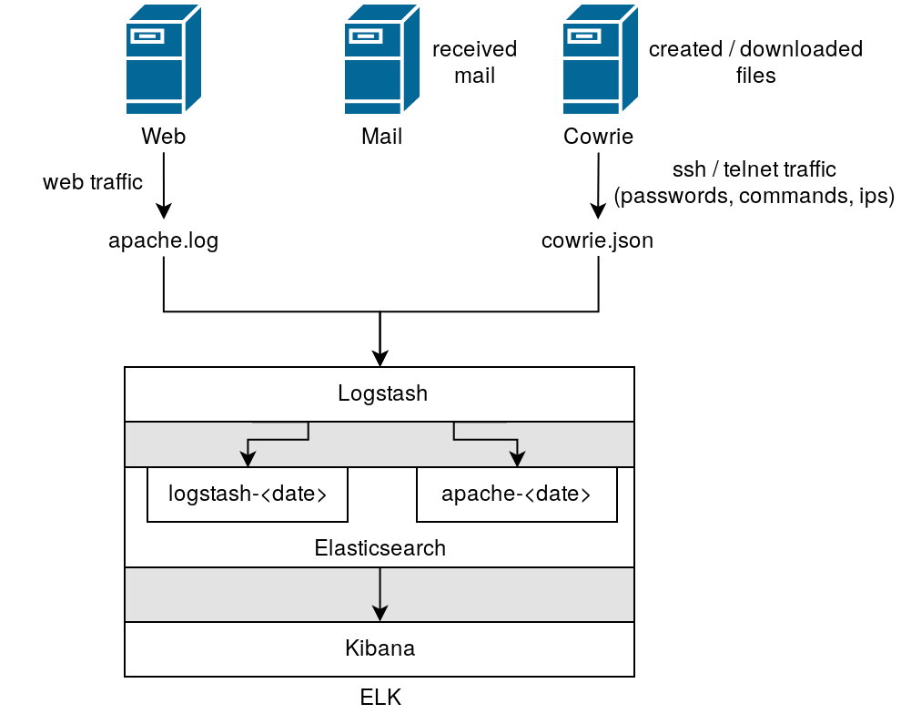

Slide 3
Information (Cowrie logs)
IPs
GeoIP information
Session ID
Port (Information only seen for a new connection)
Commands entered
Files downloaded and where they were downloaded from
Direct-tcp connection requests

Slide 4
Information (Apache logs)
Web pages accessed
User agent
Request method

Slide 5
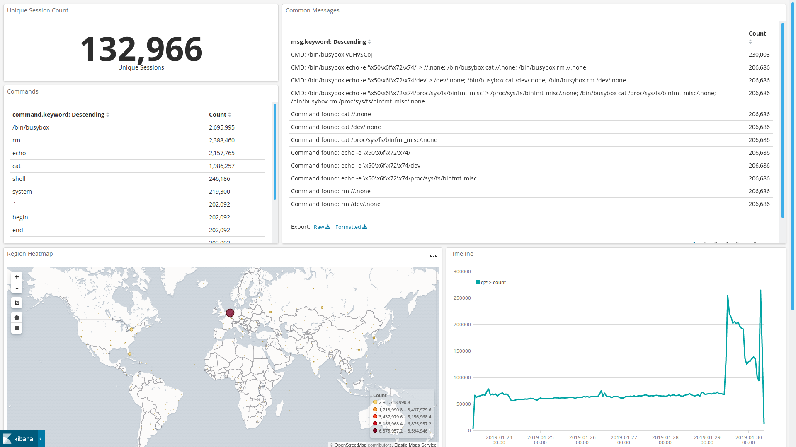

Slide 6
