Slide 1


Learning From Data
Lecture 4: Backpropagation and Neural Networks
Yang Li
Slides by Lichen Wang
11/03/2017

Slide 2

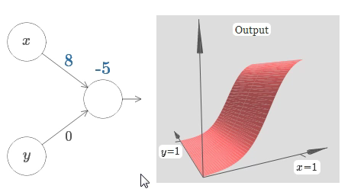
Learning From Data
Power of single neural

Slide 3
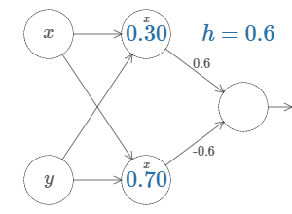
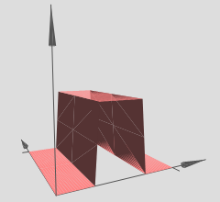
Learning From Data
Power of single neural
Two hidden units

Slide 4
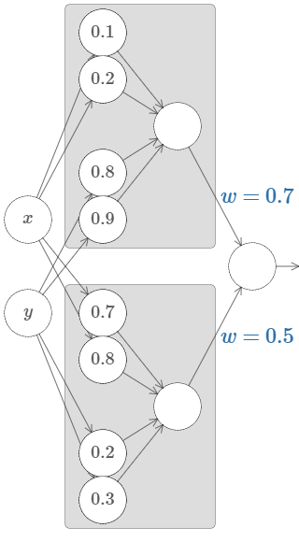
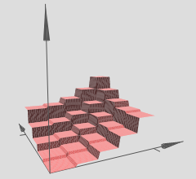
Learning From Data
Power of single neural
Many hidden units
Two hidden units

Slide 5
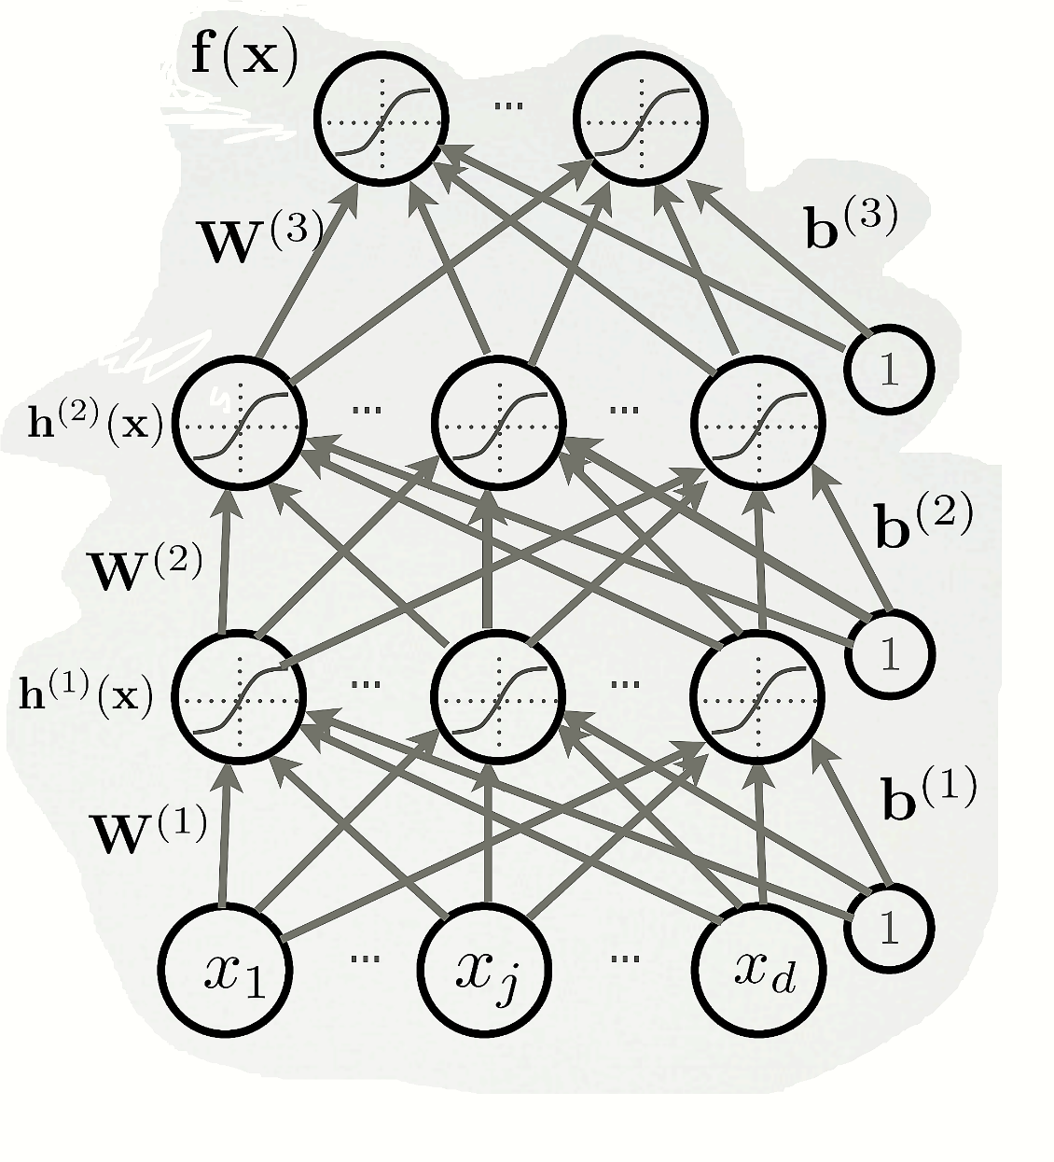
Multilayer Neural Network
Could have L hidden layers

Slide 6
Multilayer Neural Network
Could have L hidden layers
layer input activation for ,

Slide 7
Multilayer Neural Network
Could have L hidden layers
layer input activation for ,
hidden layer activation for

Slide 8
Multilayer Neural Network
Could have L hidden layers
layer input activation for ,
hidden layer activation for
output layer activation for

Slide 9
Empirical risk minimization
Empirical risk
is the loss function
is the regularizer

Slide 10
Empirical risk minimization
Empirical risk
is the loss function
is the regularizer
SVM loss
otherwise
Softmax loss

Slide 11




Empirical risk minimization
Empirical risk
is the loss function
is the regularizer
Beckham
4.9
-2.6
0.2
Yanzu
1.1
1.7
2.2
SVM loss
otherwise
Lichen
-0.9
1.2
1.2
SVM loss
Softmax loss

Slide 12
Empirical risk minimization
Empirical risk
is the loss function
is the regularizer
Beckham
4.9
-2.6
0.2
Yanzu
1.1
1.7
2.2
SVM loss
otherwise
Lichen
-0.9
1.2
1.2
SVM loss
Softmax loss
0

Slide 13
Empirical risk minimization
Empirical risk
is the loss function
is the regularizer
Beckham
4.9
-2.6
0.2
Yanzu
1.1
1.7
2.2
SVM loss
otherwise
Lichen
-0.9
1.2
1.2
SVM loss
Softmax loss
0
0.5

Slide 14
Empirical risk minimization
Empirical risk
is the loss function
is the regularizer
Beckham
4.9
-2.6
0.2
Yanzu
1.1
1.7
2.2
SVM loss
otherwise
Lichen
-0.9
1.2
1.2
SVM loss
Softmax loss
0
0.5
2

Slide 15

Optimization
To apply this algorithm, we need:
A procedure to compute the parameter gradient
The regularizer (and its gradient)
Updating rule
Initialization method

Slide 16
Optimization
Find the optimal parameter
To apply this algorithm, we need:
A procedure to compute the parameter gradient
The regularizer (and its gradient)
Updating rule
Initialization method

Slide 17
Optimization
Find the optimal parameter
To apply this algorithm, we need:
A procedure to compute the parameter gradient
The regularizer (and its gradient)
Updating rule
Initialization method
Stochastic Gradient Descent (SGD)
Algorithm
Initialize W
repeat: for each training example (x^{(t)}, y^{(t)})
2a.
2b.
Training epoch
=
Iterating over all examples

Slide 18
Optimization
Find the optimal parameter
To apply this algorithm, we need:
A procedure to compute the parameter gradient
The regularizer (and its gradient)
Updating rule
Initialization method
Stochastic Gradient Descent (SGD)
Algorithm
Initialize W
repeat: for each training example (x^{(t)}, y^{(t)})
2a.
2b.
Animation:
Training epoch
=
Iterating over all examples
http://vision.stanford.edu/teaching/cs231n-demos/linear-classify/

Slide 19
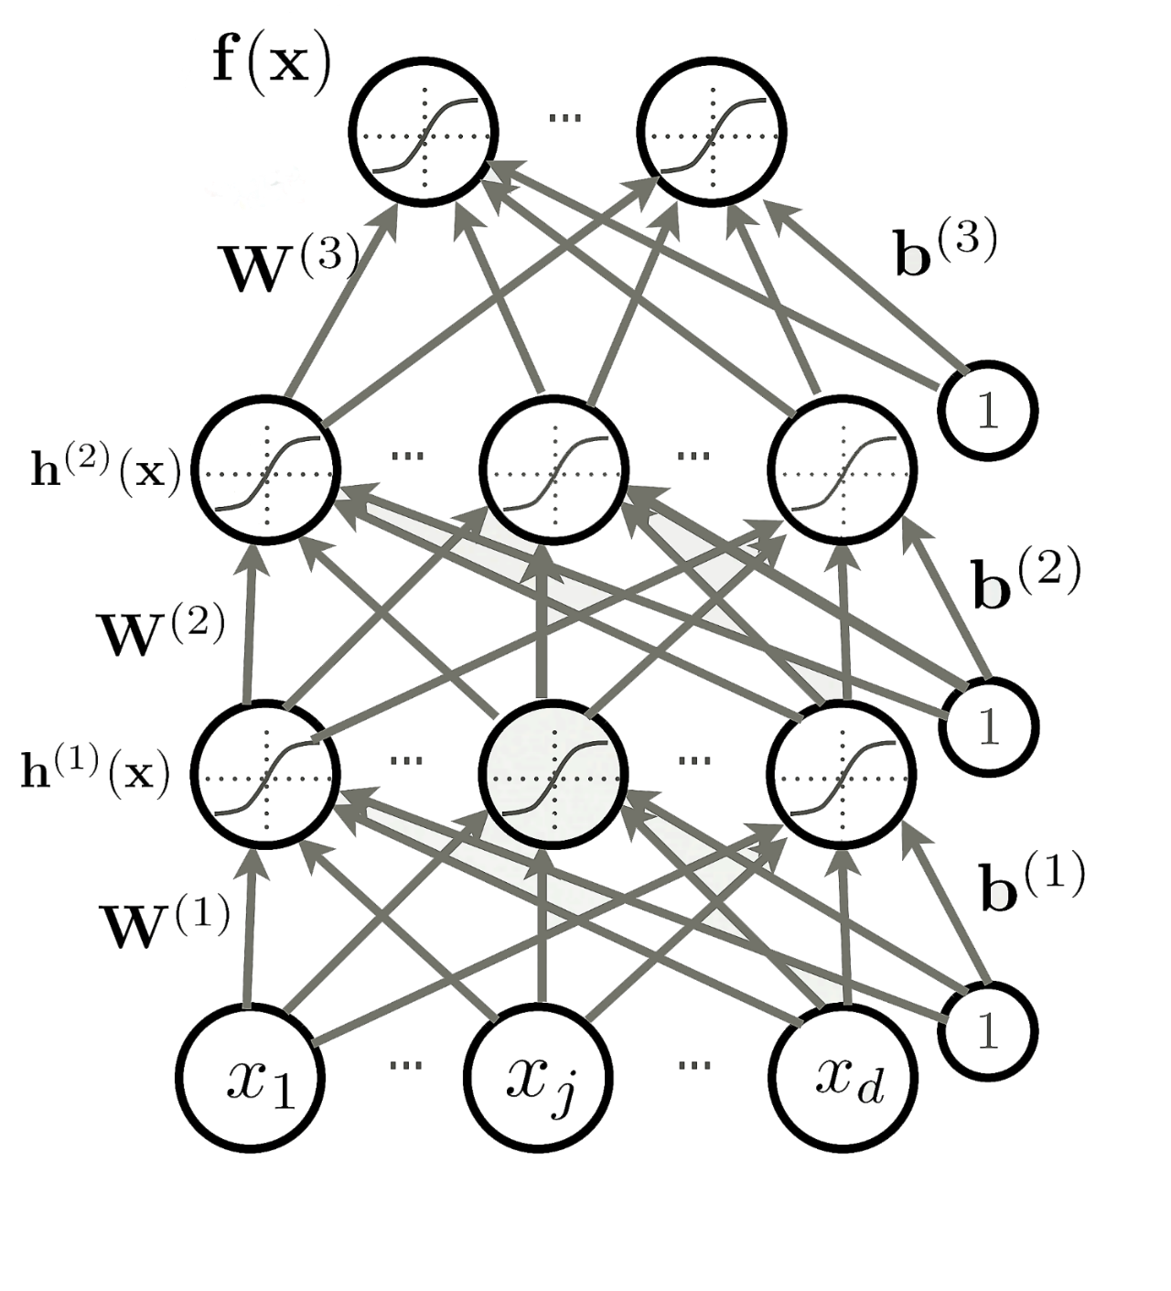
Follow the slope
How many parameter do we have?

Slide 20
Follow the slope
How many parameter do we have?
VGGNet [Simonyan and Zisserman, 2014] used 138M parameters

Slide 21
Follow the slope
How many parameter do we have?
VGGNet [Simonyan and Zisserman, 2014] used 138M parameters
In 1-dimension, the derivative of a function:

Slide 22
Follow the slope
How many parameter do we have?
VGGNet [Simonyan and Zisserman, 2014] used 138M parameters
In 1-dimension, the derivative of a function:

Slide 23
Numerical Gradient
Current W:
Gradient dW:

Slide 24
Numerical Gradient
Current W:
Gradient dW:
[0.25,
-1.56,
0.55,
3.8,
0.98,
0.77,
-0.11,
-2.9,…]
[2.1,
?,
?,
?,
?,
?,
?,
?,…]
?
Loss 1.25742

Slide 25
Numerical Gradient
Current W:
W + h (third dim):
Gradient dW:
[0.25,
-1.56,
0.55,
3.8,
0.98,
0.77,
-0.11,
-2.9,…]
[0.25 + 0.0001,
-1.56,
0.55,
3.8,
0.98,
0.77,
-0.11,
-2.9,…]
[2.1,
?,
?,
?,
?,
?,
?,
?,…]
?
Loss 1.25742
Loss 1.25763

Slide 26

Numerical Gradient
Current W:
W + h (third dim):
Gradient dW:
[0.25,
-1.56,
0.55,
3.8,
0.98,
0.77,
-0.11,
-2.9,…]
[0.25 + 0.0001,
-1.56,
0.55,
3.8,
0.98,
0.77,
-0.11,
-2.9,…]
[2.1,
?,
?,
?,
?,
?,
?,
?,…]
$$=\frac{(1.25763−1.25742) }{0.0001}$$
Loss 1.25742
Loss 1.25763

Slide 27
Follow the slope
How many parameter do we have?
VGGNet [Simonyan and Zisserman, 2014] used 138M parameters
In 1-dimension, the derivative of a function:

Slide 28
Follow the slope
How many parameter do we have?
VGGNet [Simonyan and Zisserman, 2014] used 138M parameters
In 1-dimension, the derivative of a function:
Numerical gradient: approximate, slow, easy to write

Slide 29
Follow the slope
How many parameter do we have?
VGGNet [Simonyan and Zisserman, 2014] used 138M parameters
In 1-dimension, the derivative of a function:
Numerical gradient: approximate, slow, easy to write
Calculus!
Analytic gradient: exact, fast, error-prone

Slide 30











Backpropagation
$$x$$
We want
$$z$$
$$f$$
$$x$$
$$q$$
$$+$$
$$y$$
$$f$$
$$y$$
$$×$$
$$z$$

Slide 31
Backpropagation
$$x$$
We want
$$z$$
$$f$$
$$x$$
-2
$$q$$
$$+$$
$$y$$
5
$$f$$
$$y$$
$$×$$
$$z$$
-4

Slide 32
Backpropagation
$$x$$
We want
$$z$$
$$f$$
$$x$$
-2
$$q$$
$$+$$
3
$$y$$
5
$$f$$
$$y$$
$$×$$
$$z$$
-4

Slide 33
Backpropagation
$$x$$
We want
$$z$$
$$f$$
$$x$$
-2
$$q$$
$$+$$
3
$$y$$
5
$$f$$
-12
$$y$$
$$×$$
$$z$$
-4

Slide 34
Backpropagation
$$x$$
We want
$$z$$
$$f$$
$$x$$
-2
$$q$$
$$+$$
3
$$y$$
5
$$f$$
-12
$$y$$
$$×$$
1
$$z$$
-4

Slide 35
Backpropagation
$$x$$
We want
$$z$$
$$f$$
$$x$$
-2
$$q$$
$$+$$
3
-4
$$y$$
5
$$f$$
-12
$$y$$
$$×$$
1
$$z$$
-4
3

Slide 36
Backpropagation
$$x$$
We want
$$z$$
$$f$$
$$x$$
-2
-4
$$q$$
$$+$$
3
-4
$$y$$
5
$$f$$
-12
$$y$$
-4
$$×$$
1
$$z$$
-4
3

Slide 37

Backpropagation
$$x$$
We want
$$z$$
$$f$$
$$x$$
-2
-4
$$q$$
3
gradient
$$+$$
-4
$$\frac{dL}{dz}$$
$$y$$
5
$$f$$
-12
$$y$$
-4
$$×$$
1
$$z$$
-4
3

Slide 38


Backpropagation
$$x$$
We want
$$\frac{dz}{dy}$$
$$z$$
$$f$$
$$x$$
-2
-4
$$q$$
3
gradient
$$+$$
$$\frac{dz}{dy}$$
-4
$$\frac{dL}{dz}$$
$$y$$
5
$$f$$
-12
$$y$$
-4
$$×$$
1
$$z$$
-4
3

Slide 39
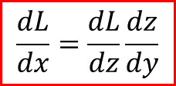

Backpropagation
$$x$$
$$\frac{dL}{dx}=\frac{dL}{dz}\frac{dz}{dx}$$
We want
$$\frac{dz}{dy}$$
$$z$$
$$f$$
$$x$$
-2
-4
$$q$$
3
gradient
$$+$$
$$\frac{dz}{dy}$$
-4
$$\frac{dL}{dz}$$
$$y$$
5
$$f$$
-12
$$y$$
-4
$$×$$
1
$$\frac{dL}{dx}=\frac{dL}{dz}\frac{dz}{dy}$$
$$z$$
-4
3

Slide 40












Backpropagation
$$w_{0}$$
$$×$$
$$x_{0}$$
$$+$$
$$w_{1}$$
$$×$$
$$+$$
$$×−1$$
$$exp$$
$$+1$$
$$1/x$$
$$x_{1}$$
$$w_{2}$$

Slide 41


Backpropagation
$$w_{0}$$
2.0
$$f\left(x\right)=ax$$
$$×$$
$$x_{0}$$
-1.0
$$+$$
$$w_{1}$$
-3.0
$$f\left(x\right)=ax$$
$$×$$
$$+$$
$$×−1$$
$$exp$$
$$+1$$
$$1/x$$
$$x_{1}$$
-2.0
$$w_{2}$$
-3.0

Slide 42

Backpropagation
$$w_{0}$$
2.0
$$×$$
-2.0
$$x_{0}$$
-1.0
$$f_{c}\left(x\right)=c+x$$
$$+$$
$$w_{1}$$
-3.0
$$×$$
6.0
$$+$$
$$×−1$$
$$exp$$
$$+1$$
$$1/x$$
$$x_{1}$$
-2.0
$$w_{2}$$
-3.0

Slide 43

Backpropagation
$$w_{0}$$
2.0
$$×$$
-2.0
$$x_{0}$$
-1.0
4.0
$$+$$
$$w_{1}$$
-3.0
$$f_{c}\left(x\right)=c+x$$
$$×$$
6.0
$$+$$
$$×−1$$
$$exp$$
$$+1$$
$$1/x$$
$$x_{1}$$
-2.0
$$w_{2}$$
-3.0

Slide 44
Backpropagation
$$w_{0}$$
2.0
$$×$$
-2.0
$$x_{0}$$
-1.0
4.0
$$+$$
$$w_{1}$$
-3.0
$$×$$
6.0
1.0
$$+$$
$$×−1$$
$$exp$$
$$+1$$
$$1/x$$
$$x_{1}$$
-2.0
$$w_{2}$$
-3.0

Slide 45


Backpropagation
$$w_{0}$$
2.0
$$×$$
-2.0
$$x_{0}$$
-1.0
4.0
$$+$$
$$w_{1}$$
-3.0
$$f\left(x\right)=ax$$
$$×$$
6.0
1.0
-1.0
$$+$$
$$×−1$$
$$exp$$
$$+1$$
$$1/x$$
$$x_{1}$$
-2.0
$$w_{2}$$
-3.0
${\left({w0 \atop \begin{aligned}w1 \\ w2\end{aligned}}\right)}^{T}\left({x0 \atop \begin{aligned}x1 \\ x2\end{aligned}}\right)$=

Slide 46

Backpropagation
$$w_{0}$$
2.0
$$×$$
-2.0
$$x_{0}$$
-1.0
4.0
$$+$$
$$w_{1}$$
-3.0
$$×$$
6.0
1.0
-1.0
0.37
$$+$$
$$×−1$$
$$exp$$
$$+1$$
$$1/x$$
$$x_{1}$$
-2.0
$$f\left(x\right)=e^{x}$$
$$w_{2}$$
-3.0

Slide 47

Backpropagation
$$w_{0}$$
2.0
$$×$$
-2.0
$$x_{0}$$
-1.0
4.0
$$+$$
$$w_{1}$$
-3.0
$$f_{c}\left(x\right)=c+x$$
$$×$$
6.0
1.0
-1.0
0.37
1.37
$$+$$
$$×−1$$
$$exp$$
$$+1$$
$$1/x$$
$$x_{1}$$
-2.0
$$w_{2}$$
-3.0

Slide 48

Backpropagation
$$w_{0}$$
2.0
$$×$$
-2.0
$$x_{0}$$
-1.0
4.0
$$+$$
$$w_{1}$$
-3.0
$$×$$
6.0
1.0
-1.0
0.37
1.37
0.729
$$+$$
$$×−1$$
$$exp$$
$$+1$$
$$1/x$$
$$x_{1}$$
-2.0
$$f\left(x\right)=\frac{1}{x}$$
$$w_{2}$$
-3.0

Slide 49
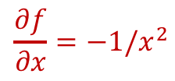

Backpropagation
$$w_{0}$$
2.0
$$×$$
-2.0
$$x_{0}$$
-1.0
4.0
$$+$$
$$w_{1}$$
-3.0
$$f\left(x\right)=\frac{1}{x}$$
$$×$$
6.0
1.0
-1.0
0.37
1.37
0.729
$$+$$
$$×−1$$
$$exp$$
$$+1$$
$$1/x$$
1.0
$$x_{1}$$
-2.0
$$\frac{∂f}{∂x}=−1/x^{2}$$
$$w_{2}$$
-3.0

Slide 50

Backpropagation
$$w_{0}$$
2.0
$$×$$
-2.0
$$x_{0}$$
-1.0
4.0
$$+$$
$$w_{1}$$
-3.0
$$f_{c}\left(x\right)=c+x$$
$$×$$
6.0
1.0
-1.0
0.37
1.37
0.729
$$+$$
$$×−1$$
$$exp$$
$$+1$$
$$1/x$$
-0.53
1.0
$$x_{1}$$
-2.0
$$\frac{∂fc}{∂x}=1$$
$$w_{2}$$
-3.0

Slide 51
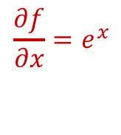

Backpropagation
$$w_{0}$$
2.0
$$×$$
-2.0
$$x_{0}$$
-1.0
4.0
$$+$$
$$w_{1}$$
-3.0
$$f\left(x\right)=e^{x}$$
$$×$$
6.0
1.0
-1.0
0.37
1.37
0.729
$$+$$
$$×−1$$
$$exp$$
-0.53
$$+1$$
$$1/x$$
-0.53
1.0
$$x_{1}$$
-2.0
$$\frac{∂f}{∂x}=e^{x}$$
$$w_{2}$$
-3.0

Slide 52
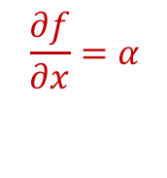
Backpropagation
$$w_{0}$$
2.0
$$×$$
-2.0
$$x_{0}$$
-1.0
4.0
$$+$$
$$w_{1}$$
-3.0
$$f\left(x\right)=ax$$
$$×$$
6.0
1.0
-1.0
0.37
1.37
0.729
$$+$$
$$×−1$$
-0.2
$$exp$$
-0.53
$$+1$$
$$1/x$$
-0.53
1.0
$$x_{1}$$
-2.0
$$\frac{∂f}{∂x}=α$$
$$w_{2}$$
-3.0

Slide 53
Backpropagation
$$w_{0}$$
2.0
$$×$$
-2.0
$$x_{0}$$
-1.0
4.0
$$+$$
$$w_{1}$$
-3.0
$$×$$
6.0
1.0
-1.0
0.37
1.37
0.729
$$+$$
$$×−1$$
-0.2
$$exp$$
-0.53
$$+1$$
$$1/x$$
0.2
-0.53
1.0
$$x_{1}$$
-2.0
$$w_{2}$$
-3.0

Slide 54
Backpropagation
$$w_{0}$$
2.0
$$×$$
-2.0
$$x_{0}$$
-1.0
4.0
$$+$$
0.2
$$w_{1}$$
-3.0
$$×$$
6.0
1.0
-1.0
0.37
1.37
0.729
$$+$$
$$×−1$$
-0.2
$$exp$$
-0.53
$$+1$$
$$1/x$$
0.2
-0.53
1.0
$$x_{1}$$
-2.0
$$w_{2}$$
-3.0

Slide 55
Backpropagation
$$w_{0}$$
2.0
$$×$$
-2.0
$$x_{0}$$
-1.0
4.0
$$+$$
0.2
$$w_{1}$$
-3.0
$$×$$
6.0
1.0
-1.0
0.37
1.37
0.729
$$+$$
$$×−1$$
-0.2
$$exp$$
-0.53
$$+1$$
$$1/x$$
0.2
-0.53
1.0
$$x_{1}$$
-2.0
$$w_{2}$$
-3.0
0.2

Slide 56
Backpropagation
$$w_{0}$$
2.0
$$×$$
-2.0
0.2
$$x_{0}$$
-1.0
4.0
$$+$$
0.2
$$w_{1}$$
-3.0
$$×$$
6.0
1.0
-1.0
0.37
1.37
0.729
-0.2
$$+$$
$$×−1$$
-0.2
$$exp$$
-0.53
$$+1$$
$$1/x$$
0.2
-0.53
1.0
$$x_{1}$$
-2.0
$$w_{2}$$
-3.0
0.2

Slide 57
Backpropagation
$$w_{0}$$
2.0
-0.2
$$×$$
-2.0
0.2
$$x_{0}$$
-1.0
0.4
4.0
$$+$$
0.2
$$w_{1}$$
-3.0
-0.4
$$×$$
6.0
1.0
-1.0
0.37
1.37
0.729
-0.2
$$+$$
$$×−1$$
-0.2
$$exp$$
-0.53
$$+1$$
$$1/x$$
0.2
-0.53
1.0
$$x_{1}$$
-2.0
-0.6
$$w_{2}$$
-3.0
0.2

Slide 58

Backpropagation
$$w_{0}$$
2.0
-0.2
$$×$$
-2.0
0.2
$$x_{0}$$
-1.0
0.4
4.0
$$+$$
0.2
$$w_{1}$$
-3.0
-0.4
$$×$$
6.0
1.0
-1.0
0.37
1.37
0.729
-0.2
$$+$$
$$×−1$$
-0.2
$$exp$$
-0.53
$$+1$$
$$1/x$$
0.2
-0.53
1.0
$$x_{1}$$
-2.0
-0.6
-1.0
$$max$$
-3.0
$$w_{2}$$
-3.0
max gate
0.2

Slide 59
Backpropagation
$$w_{0}$$
2.0
-0.2
$$×$$
-2.0
0.2
$$x_{0}$$
-1.0
0.4
4.0
$$+$$
0.2
$$w_{1}$$
-3.0
-0.4
$$×$$
6.0
1.0
-1.0
0.37
1.37
0.729
-0.2
$$+$$
$$×−1$$
-0.2
$$exp$$
-0.53
$$+1$$
$$1/x$$
0.2
-0.53
1.0
$$x_{1}$$
-2.0
-0.6
-1.0
-1.0
$$max$$
-3.0
$$w_{2}$$
-3.0
max gate
0.2

Slide 60
Backpropagation
$$w_{0}$$
2.0
$$×$$
-2.0
$$x_{0}$$
-1.0
4.0
$$+$$
$$w_{1}$$
-3.0
$$×$$
6.0
1.0
-1.0
0.37
1.37
0.729
$$+$$
$$×−1$$
-0.2
$$exp$$
-0.53
$$+1$$
$$1/x$$
-0.53
1.0
$$x_{1}$$
-2.0
-1.0
-1.0
$$max$$
-3.0
$$w_{2}$$
-3.0
max gate

Slide 61
Backpropagation
$$w_{0}$$
2.0
$$×$$
-2.0
$$x_{0}$$
-1.0
4.0
$$+$$
$$w_{1}$$
-3.0
$$×$$
6.0
1.0
-1.0
0.37
1.37
0.729
$$+$$
$$×−1$$
-0.2
$$exp$$
-0.53
$$+1$$
$$1/x$$
-0.53
1.0
$$x_{1}$$
-2.0
-1.0
-1.0
$$max$$
1.0
-3.0
$$w_{2}$$
-3.0
max gate

Slide 62
Backpropagation
$$w_{0}$$
2.0
$$×$$
-2.0
$$x_{0}$$
-1.0
4.0
$$+$$
$$w_{1}$$
-3.0
$$×$$
6.0
1.0
-1.0
0.37
1.37
0.729
$$+$$
$$×−1$$
-0.2
$$exp$$
-0.53
$$+1$$
$$1/x$$
-0.53
1.0
$$x_{1}$$
-2.0
1.0
-1.0
-1.0
$$max$$
1.0
-3.0
$$w_{2}$$
-3.0
0
max gate

Slide 63
Backpropagation
$$w_{0}$$
2.0
$$×$$
-2.0
$$x_{0}$$
-1.0
4.0
$$+$$
$$w_{1}$$
-3.0
branches
$$×$$
6.0
1.0
-1.0
0.37
1.37
0.729
$$+$$
$$×−1$$
-0.2
$$exp$$
-0.53
$$+1$$
$$1/x$$
-0.53
1.0
$$x_{1}$$
-2.0
1.0
-1.0
-1.0
$$max$$
1.0
-3.0
$$w_{2}$$
-3.0
0
max gate

Slide 64
Backpropagation
$$w_{0}$$
2.0
$$×$$
-2.0
$$x_{0}$$
-1.0
4.0
$$+$$
$$w_{1}$$
-3.0
branches
$$×$$
6.0
1.0
-1.0
0.37
1.37
0.729
$$+$$
$$×−1$$
-0.2
$$exp$$
-0.53
$$+1$$
$$1/x$$
-0.8
-0.53
1.0
$$x_{1}$$
-2.0
1.0
-1.0
-1.0
$$max$$
1.0
-3.0
$$w_{2}$$
-3.0
0
max gate

Slide 65




Backpropagation
Vectorized example
d
m
$$W$$
m
$$×$$
$L$2
d
$$x$$

Slide 66
Backpropagation
Vectorized example
d
m
$$W$$
m
$$×$$
$L$2
d
$$x$$

Slide 67
Backpropagation
Vectorized example
d
m
$$W$$
m
$$×$$
$L$2
d
$$x$$

Slide 68
Backpropagation
Vectorized example
d
m
$$W$$
m
$$×$$
$L$2
d
$$x$$

Slide 69
Backpropagation
Vectorized example
d
m
$$W$$
m
$$×$$
$L$2
d
$$x$$

Slide 70
Backpropagation
Vectorized example
d
m
$$W$$
m
$$×$$
$L$2
d
$$x$$

