Slide 1


Questionnaire Data Collection
Question Structure Recovery and Sample Collection
IARC Rating Questionnaire

Slide 2
Part 1: Recovering the Questionnaire Graph with DFS
Core idea
Root Question
• Start traversal from multiple root questions
• Click each option and record newly revealed child questions
• Apply the same recursive process to each child question
• Backtrack after each branch and continue exploring other options
• Recover a question-option-child graph instead of a flat question list
Option: Yes
Option: No
Child Question
Terminate
DFS + Backtracking

Slide 3
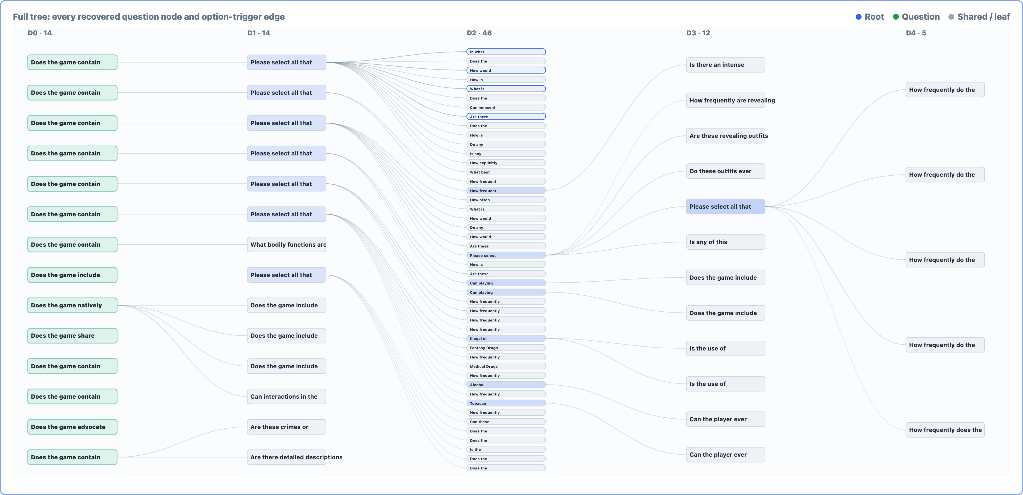
Recovered Structure: Complete Game Tree
The full tree shows every recovered question node and option-triggered edge; node labels are shortened to fit one slide.

Slide 4
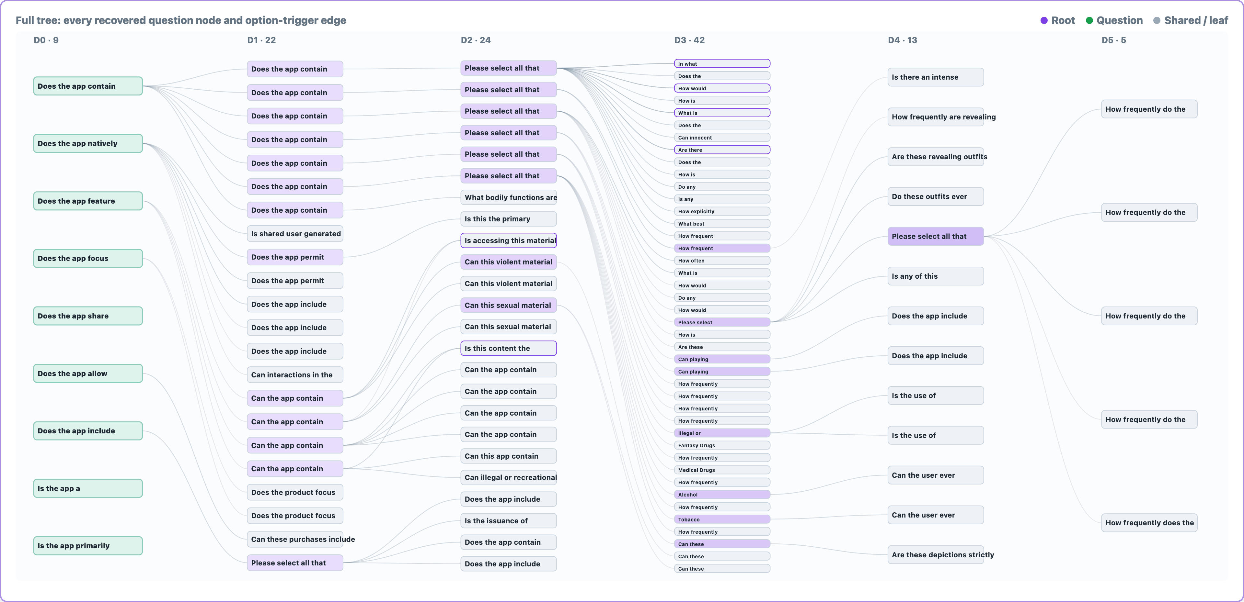
Recovered Structure: Complete All Other Tree
The full tree shows every recovered question node and option-triggered edge; node labels are shortened to fit one slide.

Slide 5
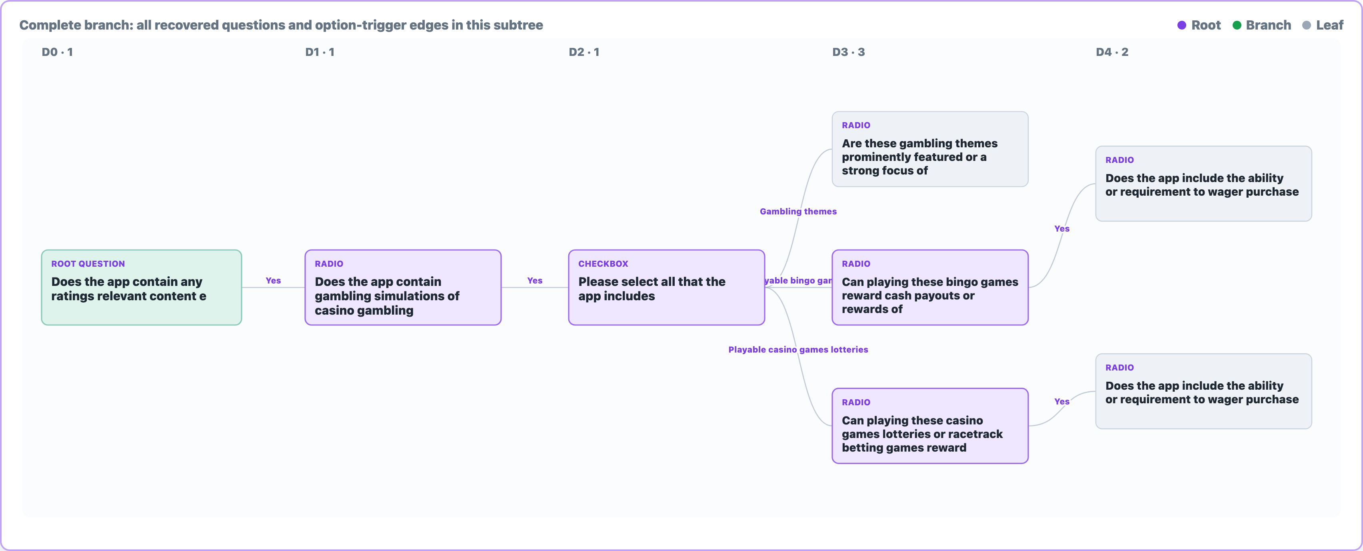
Expansion Example: Depth-4 Question and Children
A complete All Other gambling subtree: all recovered option-triggered questions are shown through depth 4.
The screenshot is generated from HTML and follows the same compact tree style as the full-structure slides.

Slide 6
Part 2: Questionnaire Sample Collection Strategy
The Social tree has only 12 questions and 24 options, with limited rating signal, so it is excluded from the main sampling target.
1
2
3
4
Baseline
Structural coverage
Risk paths
Gap filling
Choose the lowest-risk answers to establish the minimum-rating path
Prioritize options that reveal child questions and increase coverage
Combine risk type and severity choices to cover different rating outcomes
Identify low-frequency options and add targeted supplemental samples
Goal: build a coverage-oriented dataset for learning rating logic, rather than simulating a natural answer distribution.

Slide 7
Part 3: Final Data Distribution
ESRB Label Distribution
Main dataset
Mature 17+
365
Game + All Other Types
Teen
339
Adults only 18+
241
Everyone
182
Takeaway
Everyone 10+
138
The samples cover the major rating labels from Everyone to Adults Only 18+, supporting downstream multi-class modeling.
The Social tree has limited signal and is excluded from the main model training set.

