Slide 1


Chapter 3:
Feature Engineering and Model Input Preparation
Presenter:Bofan Chen
Chapter 4:
Machine Learning Model Training & Evaluation
Algorithm Benchmarking:
From High-Dimensional Sparse Features to Age Rating Prediction
Notes:
This part is about Task 4, feature engineering and model input preparation.

Slide 2
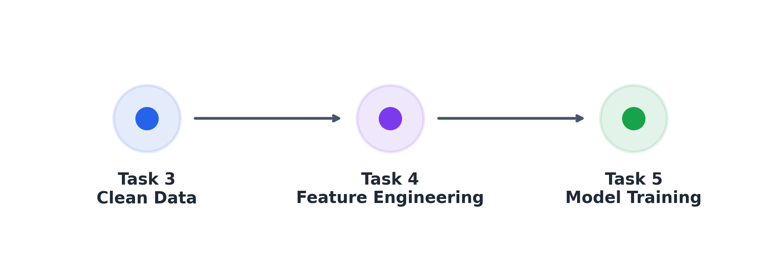
Goal: Convert cleaned questionnaire data into model-ready inputs.
✅ Main responsibilities:
• Convert raw answers into numerical features
Connects the cleaned dataset with training
• Prepare train / validation / test datasets
• Encode North America age rating labels
• Prevent target leakage from rating outputs
• Generate reusable metadata for model training
Notes:
In the whole project pipeline, our work is between data cleaning and model training. Task 3 provides a clean dataset, but the data is still in a raw questionnaire format. Machine learning models cannot directly use these text answers.
So our goal is to convert the cleaned questionnaire answers into numerical model inputs. Specifically, we encode different types of questions, prepare train, validation, and test datasets, encode the North America rating labels, and generate reusable metadata for the modeling stage.
A very important requirement in this step is to avoid target leakage, because the dataset contains multiple regional rating outputs.

Slide 3
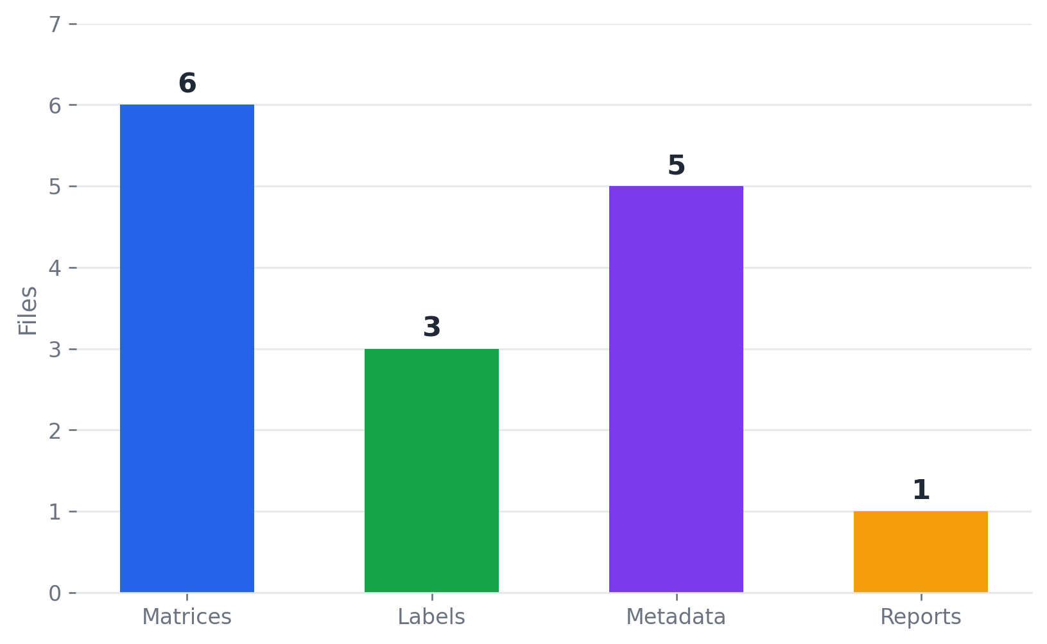
Input and Output
✅ Input from Task 3:
• train.csv
• test.csv
• column_groups.json
• data_dictionary.csv
✅ Output for Task 5:
• CSV feature matrices
• Sparse NPZ matrices
• Encoded labels
• Feature dictionary
• Label mapping
• Class weights
• Engineering report
Notes:
For the input, we mainly use four files from Task 3.
The first two are train.csv and test.csv, which contain the cleaned questionnaire samples. The other two are column_groups.json and data_dictionary.csv. These metadata files tell us which columns are features, which columns are target labels, and what type each question is.
After feature engineering, we generate several outputs for Task 5. The most important ones are X_train, X_val, and X_test, which are the encoded feature matrices. We also generate y_train, y_val, and y_test as encoded labels.
Besides that, we provide a feature dictionary, label mapping, class weights, sparse matrix files, and an engineering report. These files make the next modeling step easier and more reproducible.

Slide 4

Target and Leakage Control
rating__north_america
Prediction
target
Allowed model inputs
• category
• answer__*
questionnaire fields
• All regional rating fields are outputs of the same questionnaire.
• Using them as input features would leak the answer into the model.
• sample_id
• split
• all rating__* columns
Excluded columns
Reason
Notes:
In this task, we choose rating__north_america as the prediction target. This corresponds to the ESRB-style age rating in North America.
For model inputs, we only allow the questionnaire category and the answer columns. These columns start with answer double underscore.
We explicitly exclude sample_id, split, and all rating columns. This is important because all regional rating fields are outputs of the same questionnaire. If we use one regional rating to predict another regional rating, the model would indirectly see the answer.
So this leakage guard makes sure that the model learns from questionnaire answers, not from other rating results.

Slide 5

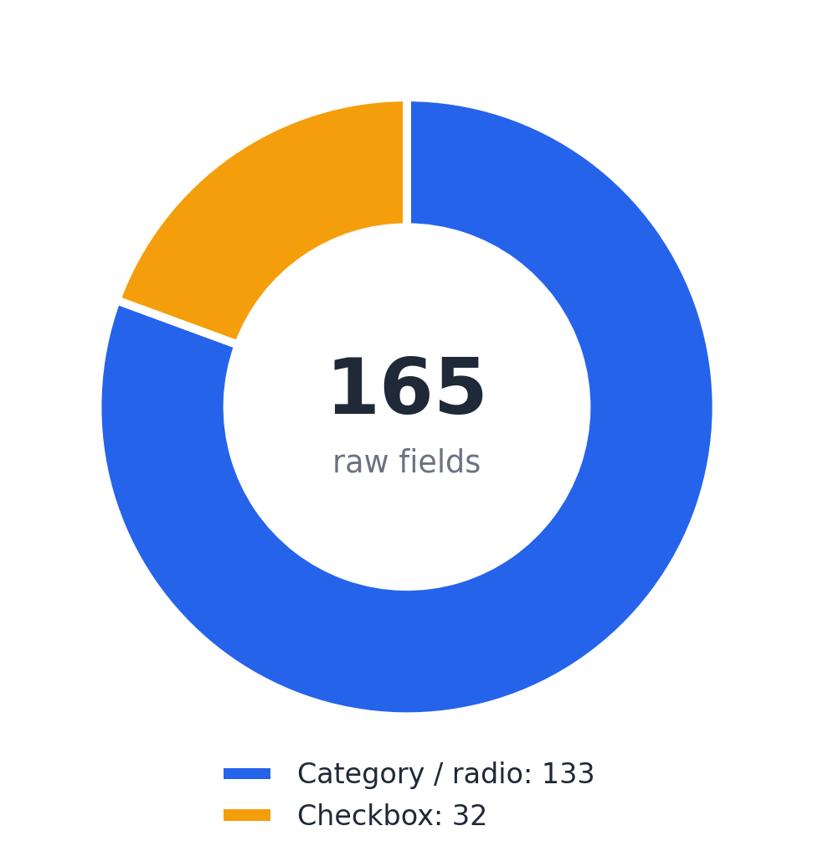
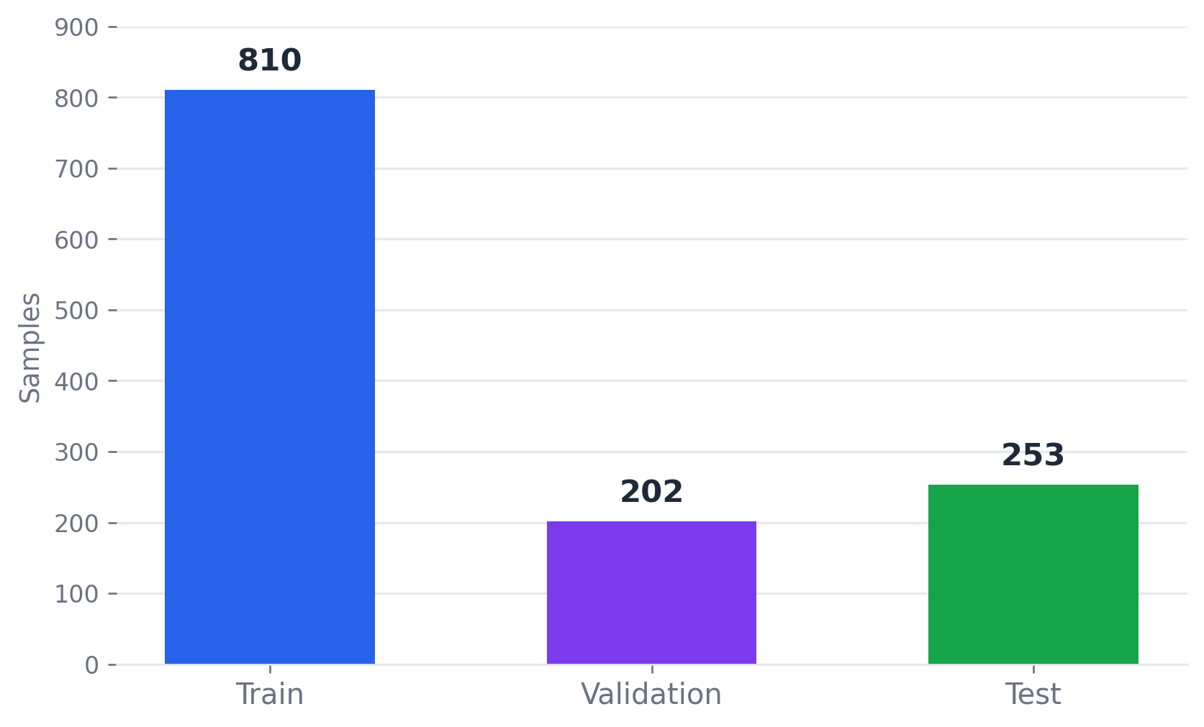
Encoding Strategy & Dataset Split
Raw feature types
The original Task 3 test set is kept unchanged.
Task 4 split:
• Train: 810 samples
• Validation: 202 samples
• Test: 253 samples
The validation set is split from Task 3 train.csv using a fixed seed.
The split is stratified by category and North America rating.
单击此处添加图表标题
Encoding rules:
• Category fields are one-hot encoded
• Radio questions are one-hot encoded
• Checkbox questions are expanded into multi-hot features
• Structural missing markers are preserved as explicit values
Notes:
The cleaned dataset still contains categorical text values, so we need to encode them into numerical features.
For the category field and radio questions, we use one-hot encoding. Each possible answer becomes a binary feature.
For checkbox questions, one sample may select multiple options. Therefore, we split the combined answer string and convert it into multi-hot features.
We also preserve structural missing values, such as inactive questions and not applicable questions. These values are meaningful because the questionnaire has a tree-like structure. If a question is inactive, that itself tells us something about the previous answers.
/////
Task 3 already provides a train and test split, and we keep the original test set unchanged.
From the Task 3 training set, we further split out a validation set. Finally, we have 810 training samples, 202 validation samples, and 253 test samples.
The validation split uses a fixed seed, so the result is reproducible. It is also stratified by questionnaire category and North America rating, so the label distribution is kept as stable as possible across different splits.
This gives Task 5 a clean setup for model training, model selection, and final testing.

Slide 6
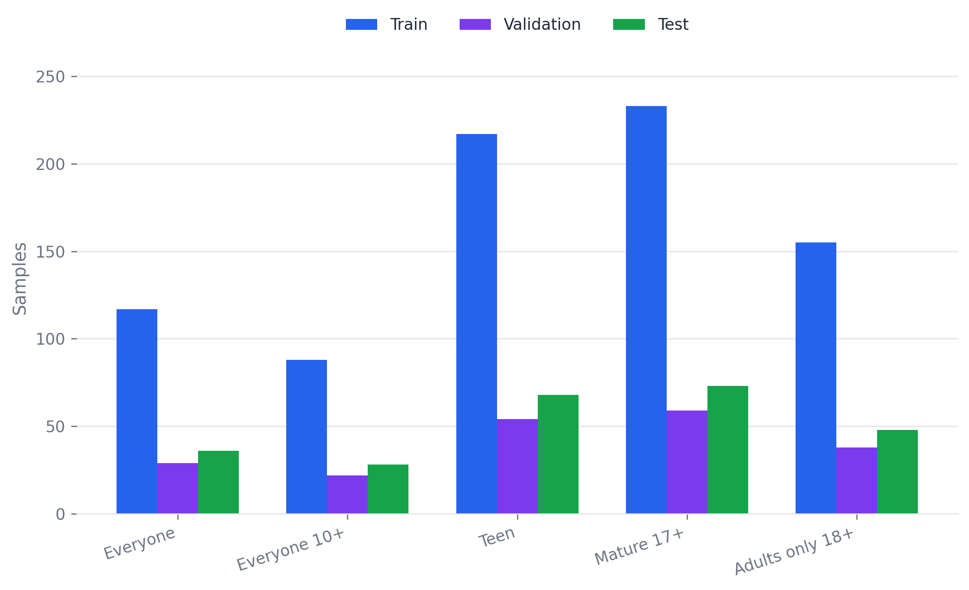
Target Label Distribution
🔄 Classes:
• Everyone • Teen • Everyone 10+ • Mature 17+ • Adults only 18+
⚙ The distribution is moderately imbalanced, so class weights are also generated for downstream models.
The target is a five-class ESRB-style classification problem.
Notes:
Here we show the distribution of the North America rating labels.
The task is a five-class classification problem. The five classes are Everyone, Everyone 10+, Teen, Mature 17+, and Adults only 18+.
The distribution is not perfectly balanced. Mature 17+ and Teen have more samples, while Everyone 10+ has fewer samples. This imbalance may affect model training, especially for minority classes.
Because of this, we also generate class weights, so downstream models can reduce bias toward majority classes.

Slide 7
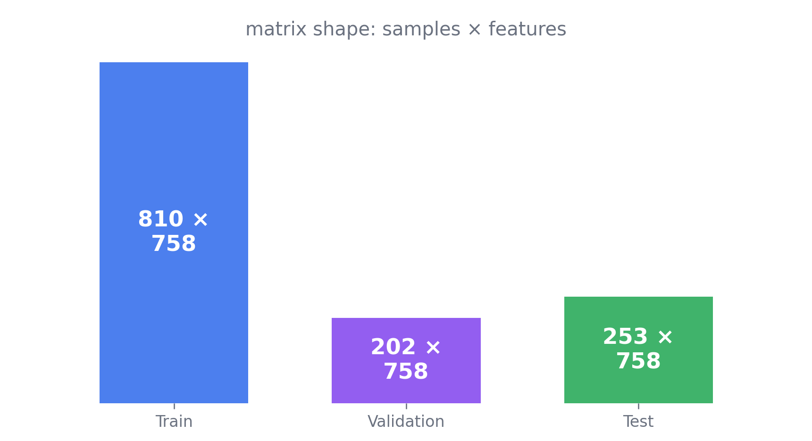
Feature Space
🔄 Raw feature columns: 165
⚙ Encoded feature columns: 758
📊 The feature space expands because:
• Radio answers become one-hot indicators
• Checkbox answers become multiple binary indicators
• Missing-state markers are also encoded
Matrix Shapes
Notes:
After encoding, the feature space becomes much larger.
Originally, we have 165 raw feature columns. After one-hot and multi-hot encoding, we get 758 encoded feature columns.
This expansion is expected. Radio questions produce one binary feature for each possible answer, and checkbox questions can produce multiple binary indicators for different selected options.
The final output is a binary feature matrix, which can be directly used by common machine learning models such as logistic regression, random forest, support vector machines, or gradient boosting models.

Slide 8
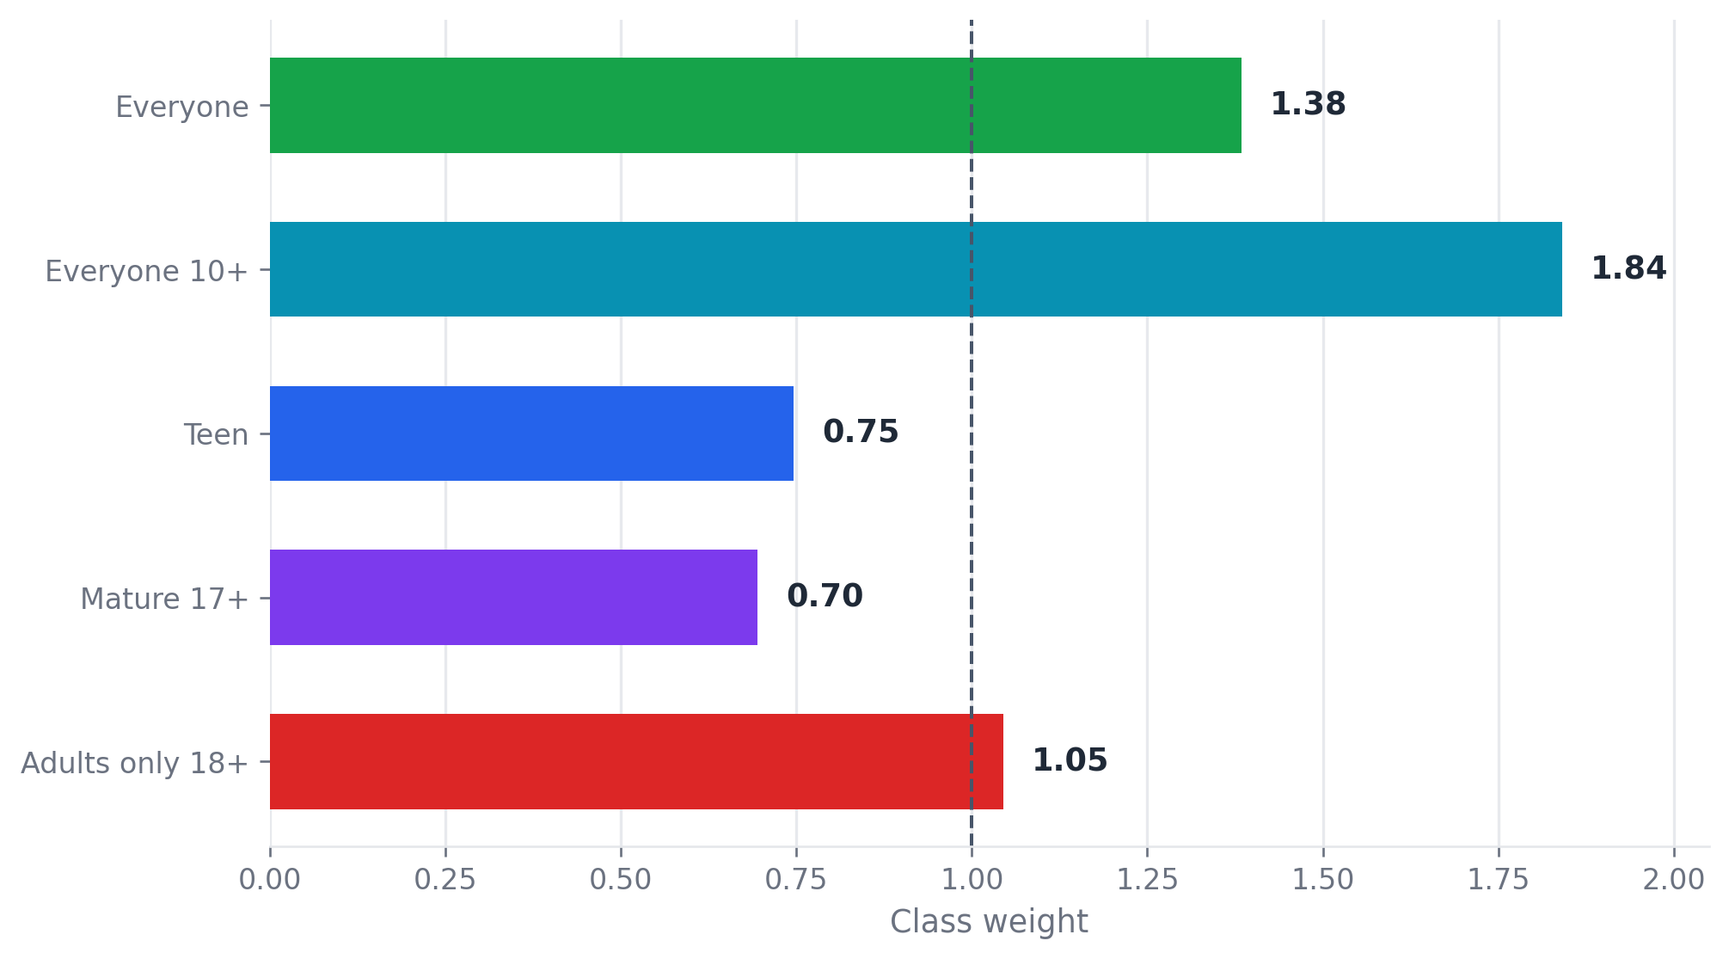
Class Imbalance and Final Checks
🔄 Purpose:
• Reduce bias toward majority classes
• Improve learning for smaller classes
• Support models using class_weight="balanced"
⚙ Final validation checks:
• Same feature columns across train, validation, and test
• No missing values in encoded matrices
• No rating leakage
• Reproducible split and metadata
🛡 Class weights are generated for Task 5 model training
Notes:
Finally, we generate balanced class weights for the model training stage.
The purpose is to reduce the model's bias toward majority classes and give more importance to smaller classes. For example, Everyone 10+ receives a higher weight because it has fewer training samples.
Before delivering the outputs, we also run several validation checks. We make sure that train, validation, and test have exactly the same feature columns. We check that there are no missing values in the encoded matrices. We also verify that no rating columns are included as model inputs.
Overall, Task 4 produces a clean, reproducible, and leakage-free feature engineering pipeline for Task 5 model training.

