Slide 1
Preprocessor

Slide 2
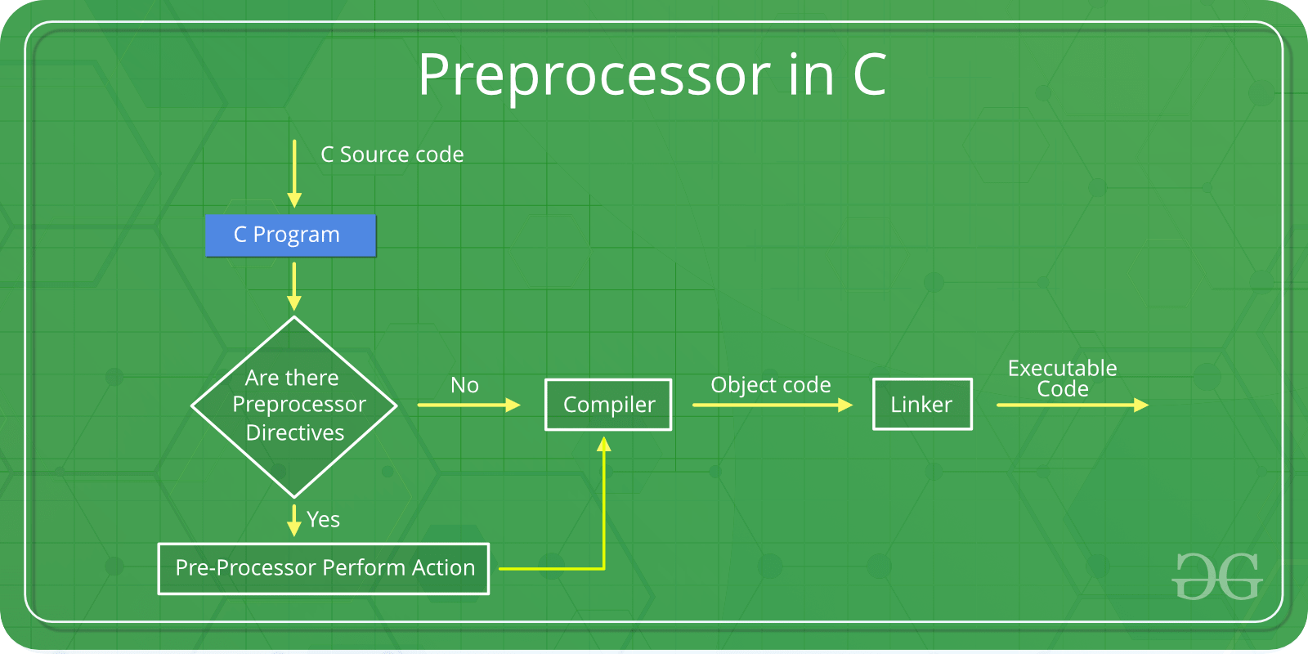

Slide 3
Macros
File Inclusion
Conditional Compilation
Other directives

Slide 4
#pragma directive
Issues special commands to the compiler, using a standardized method
This directive is a special purpose directive and is used to turn on or off some features. This type of directives are compiler-specific, i.e., they vary from compiler to compiler. Some of the #pragma directives are discussed below:
#pragma startup and #pragma exit: These directives help us to specify the functions that are needed to run before program startup (before the control passes to main()) and just before program exit (just before the control returns from main()).

Slide 5
#pragma warn Directive: This directive is used to hide the warning message which is displayed during compilation. We can hide the warnings as shown below:
#pragma warn -rvl: This directive hides those warnings which are raised when a function that is supposed to return a value does not return a value.
#pragma warn -par: This directive hides those warnings which are raised when a function does not use the parameters passed to it.
#pragma warn -rch: This directive hides those warnings which are raised when a code is unreachable. For example, any code written after the return statement in a function is unreachable.

