Slide 1

Music Score Page Turner
CityU-EE Gifted Education Fund Programme: AIoT Coding, Engineering and Entrepreneurial Skills Education for Gifted Students
Scan and perform!
Team Members (Project ID: 4)
06 Chan Yat Long Ariel | 08 Edward Cheung

Slide 2
Introduction
An automatic music score page turner for musicians. Uses Optical Music Recognition (OMR) and Dynamic Time Warping (DTW)
Demo Video: https://www.youtube.com/watch?v=qrnlEPvXHVU

Slide 3
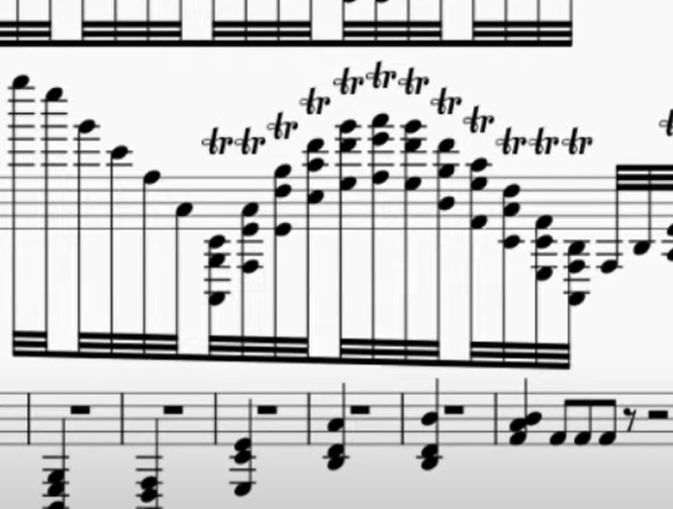
Background & Motivation
As music enthusiasts, we like to find sheet music from the internet to learn and play.
However, it is annoying to manually turn a page of the score as it greatly interrupts the flow of our hands
This problem is amplified by scores with poor typesetting. Imagine this is the end of page in a violin score

Slide 4
What is the target market?
Any casual musicians who plays an instrument
Plans to expand the target market to professional ensembles/ orchestras as well as new learners

Slide 5

Existing solution 1 — Enote3
Enote3: A software that targets professional musicians
Great features for professional musicians
Automated page turning (Coming soon)
Can’t import scores
Expensive subscription fees

Slide 6
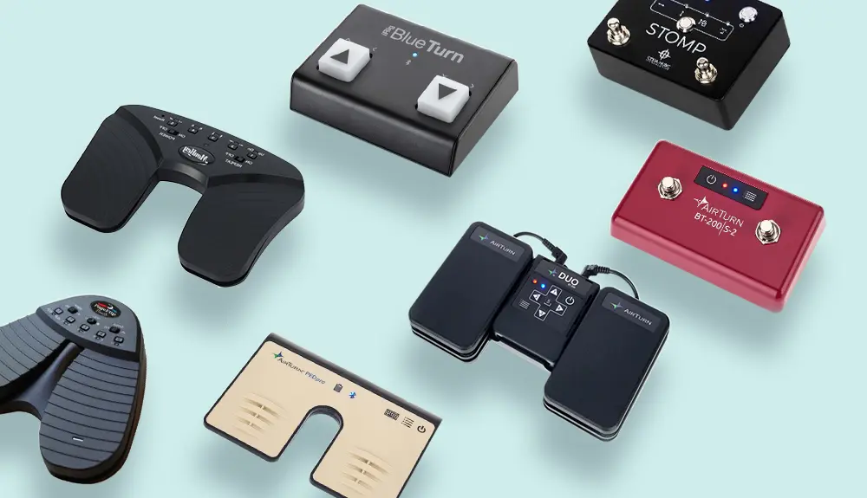
Existing solution 2 — Page turner pedals
Active user input
Not suitable for instruments that already has need of using legs e.g. piano, organ
Expensive (At least 44.99 Euros for a pedal with reasonable quality) Best Page Turners for Sheet Music in 2022: the complete review

Slide 7


Existing solution 3 — OMR Apps
Good examples: PlayScore 2, Sheet Music Scanner
Both doesn’t include realtime page turning functionality
PlayScore 2:
Subscription needed (USD4.99 per month) for scanning whole pages of sheet music
Sheet Music Scanner:
Less expensive (USD4.99, one time purchase), but the set of recognisable music characters is incomplete

Slide 8
Existing solution 4a — Realtime Audio-to-Audio (A2A) Alignment Systems
Github open source repositories e.g. https://github.com/Sma1033/Realtime-audio2audio-alignment
Hard to setup for non-programmers
Requires reference audio which might not exist for every single music scores
Additional programming is needed for page turning functionality

Slide 9
Existing solution 4b — Music Score to Audio + Realtime Audio-to-Audio (A2A) Alignment
File formats for music scores include MusicXML, mscx, mscz … → Troublesome conversion and audio synthesis as specific software are needed
Can’t directly synthesize audio from images of music score/ inaccurate conversion (e.g. scan-score)
⇒ Unreliable/ extremely inconvenient for musicians, and they would still face countless headaches in the A2A alignment part

Slide 10
Existing solution 5 — Page turning using eye-tracking technology
Millie’s Library and other e-book applications uses eye-tracking for page turning
When the user glances at a certain part of the screen, the application turns a page
⇒ Troublesome for musicians who likes to look around during their performance, which is common for professional musicians

Slide 11
Problems to address
There is no easily available software that conveniently and automatically turns a page of any given music score
Impromptu improvisations (e.g. transposition of melody) or unintentional mistakes by musicians during the performance may affect the accuracy of the audio alignment systems

Slide 12
Our solution – Part I (OMR)
Using Optical Music Recognition (OMR) to extract music information from images of music scores
Uses GitHub - cal-pratt/SheetVision: Read sheet music and convert to midi, a GitHub Repository that runs a template matching algorithm using the OpenCV Library, generates a .mid file
The user can use other software to edit the generated .mid file to correct any mistakes from the OMR output
The .mid files are converted to a .wav files, which are used as a ‘reference audio’

Slide 13
Our solution – Part II (Real time page turning)
3. Real-time score following:
The chroma features of the ‘reference audio’ and real-time microphone input are extracted
Use the Dynamic Time Warping (DTW) algorithm, to compare sliding windows of the extracted chroma features, hence ‘tracking’ which part of the score is the musician at
When the DTW algorithm reaches the end of the reference audio of the page, the software turns a page

Slide 14
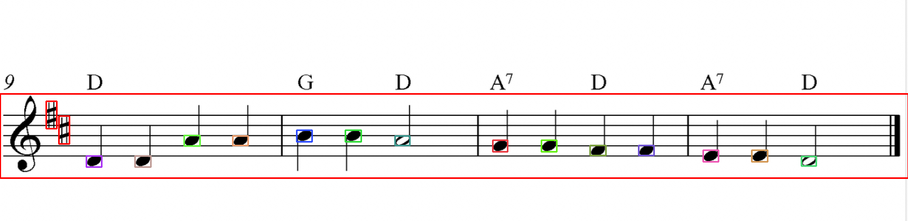
Technical details to our solution — OMR
Optical Music Recognition (OMR) is a superset of Optical Character Music Recognition (OCR). The goal of OMR is to teach the computer to read and interpret music scores — Wikipedia
https://github.com/cal-pratt/SheetVision uses a template matching algorithm to locate musical symbols on the music score
Other feasible methods include using a neural network (*More in related publications – OMR)

Slide 15
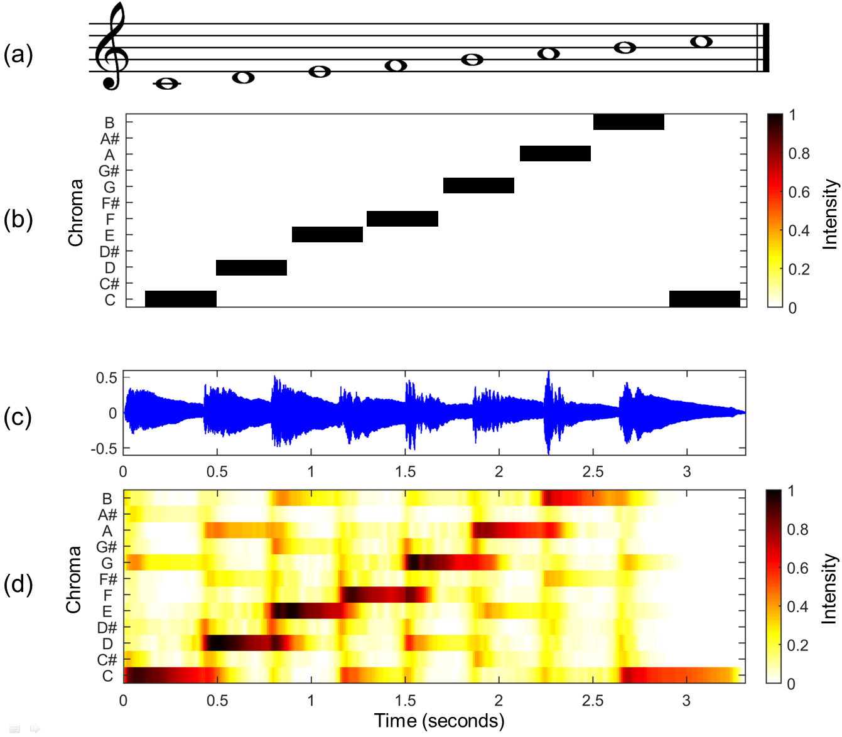
Technical details to our solution — Audio Feature Extraction
Chroma-based features are pitch-based audio features
In this software, 12 Chroma classes are extracted, representing 12 pitch classes in most modern western musical instruments (C, C#, D, …)
Chroma features captures the harmonic and melodic characteristics of music while being robust to changes on tone quality. Therefore theoretically this software works for multiple types of instruments

Slide 16
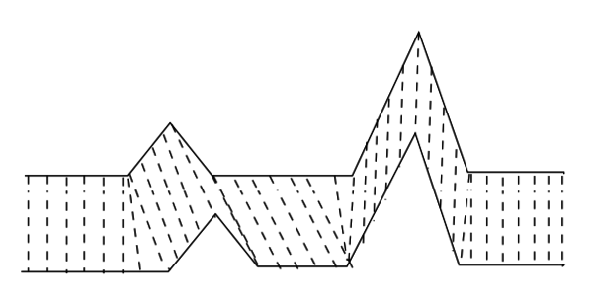
Technical details to our solution — DTW
Dynamic time warping (DTW) is an algorithm that measures the similarity between 2 temporal sequences, which may vary in speed — Wikipedia
DTW is an efficient algorithm, hence suitable for real-time applications
Parts of code in this software originates from https://www.audiolabs-erlangen.de/resources/MIR/FMP/C3/C3_MusicSynchronization.html

Slide 17
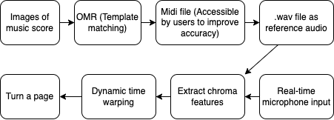
Complete pipeline of our solution

Slide 18
Timeline
Christmas Holiday
Early Jan
Mid Jan
Late Jan
Fininalising technical plans
Completion of individual sections
Start assembling and testing
Deciding on whether need to change to other plans
Final calibration
Filiming + editing for demo video
Completion of Pitching Deck Final Version

Slide 19
Current limitations
The SheetVision repository only recognizes a handful of musical symbols classes and is quite slow
Noisy images of music score as well as loud background noises in real-time microphone input leads to low accuracy in page turning
Right now the software can only turn 1 page, i.e. only 2-page music sheets can be fed into the software

Slide 20
Future work/ directions
Research on methods to increase the variety of recognisable musical symbol with improved accuracy and speed
Research on improving the accuracy of DTW score following
Preprocessing of real-time audio input e.g. noise reduction
iOS/ Android app, with
Score annotation functionality,
In-app audio recording and playback functions, and
Marking and listing out mistakes during practice/ performance
In-sync multi-device page turning for ensembles/ orchestras

Slide 21
Thanks!
Any questions?
Contact details:
Email: cyla.hk@gmail.com
GitHub: https://github.com/CYL-Ariel

