Slide 1



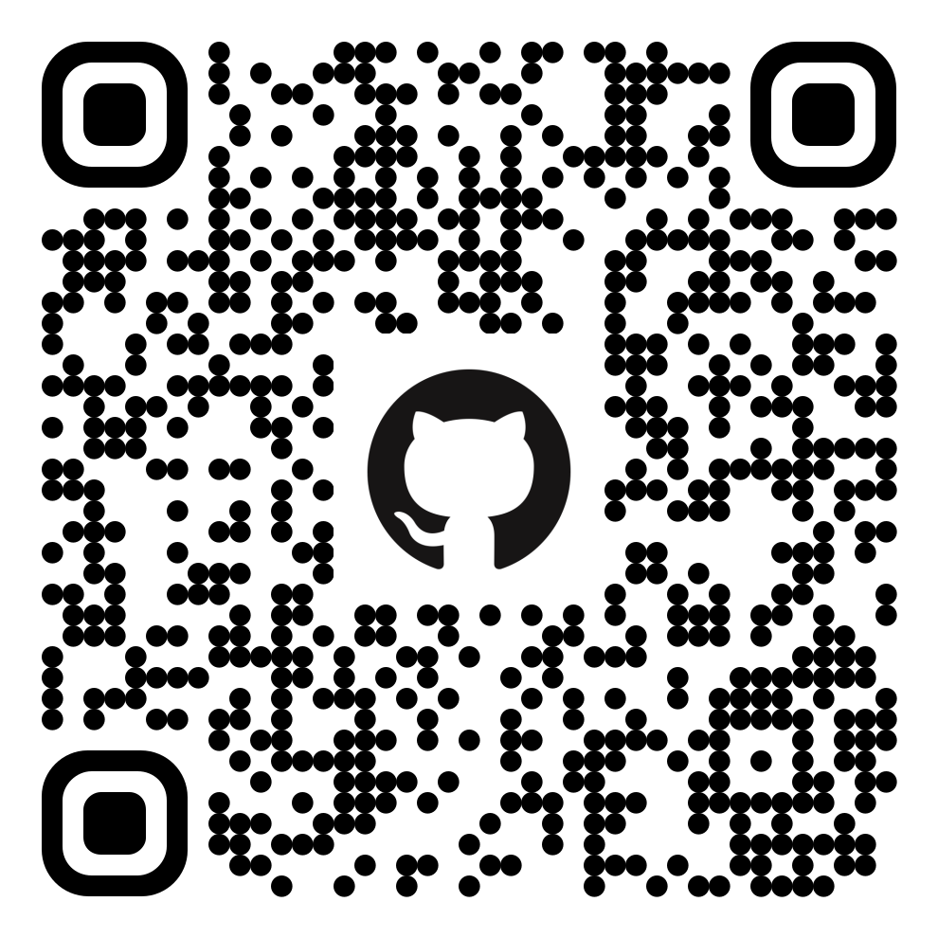
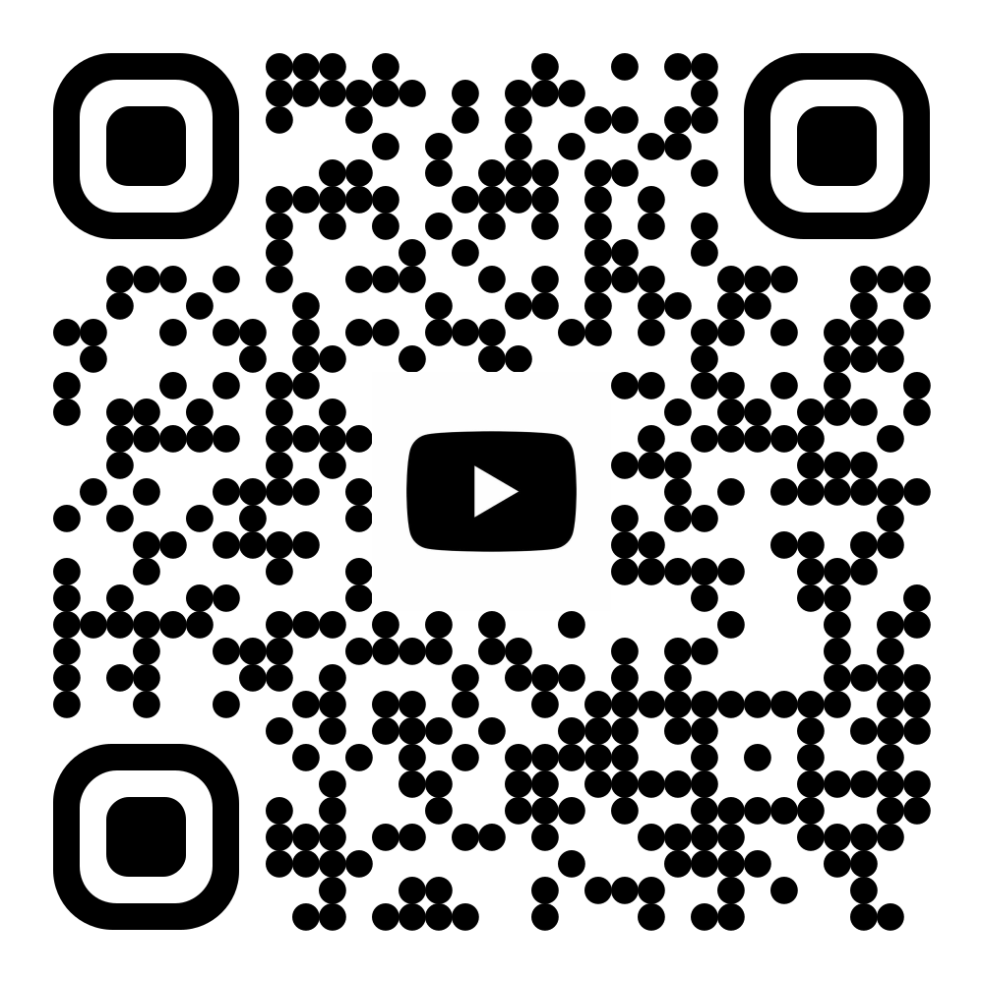

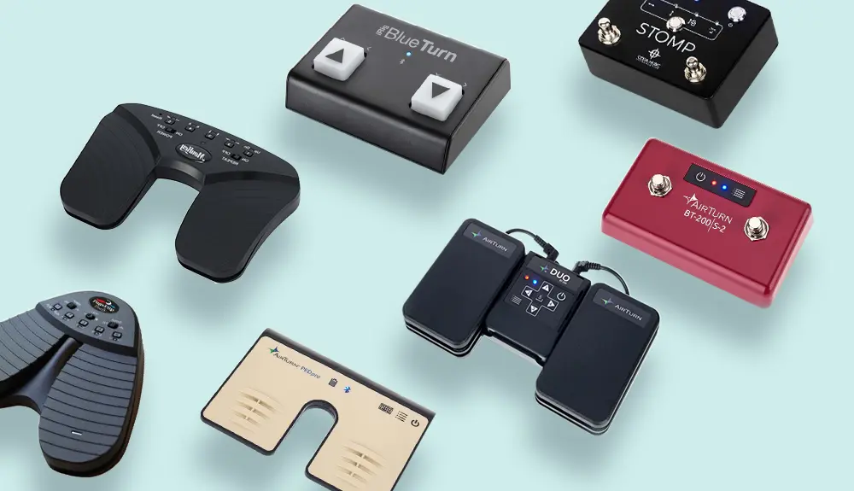
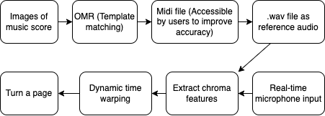
AIoT Coding, Engineering and Entrepreneurial Skills Education for Gifted Students
Music Score Page Turner
Students: 06 Chan Yat Long Ariel | 08 Cheung Tsz Hong Edward
Project ID: P4
Abstract
Results / Application
To allow for continuous reading of a music score during play, an automatic music score page turner is created for musicians using Optical Music Recognition (OMR) and Dynamic Time Warping (DTW) technology.
A computer application that includes both OMR and page turning functionality is created
The OMR part recognises simple music scores fairly accurately
The page turner can turn 1 page in a 2-page music score
Musicians can play pieces and not worry about their page not flipping
Objective / Background / Motivation
Ariel is a piano player
Lots of sheet music from the internet
Troublesome to manually turn a page
Disrupts the flow of play
Existing good solutions cost HKD300
QR Code for GitHub Page
QR Code for Video Demo
GitHub Link
YouTube Link
Digital software (Enote3): Cannot import pdf digital scores
Mechanical page turning pedals: Incompatible with some pianos
Methodology
Discussion / Conclusion
OMR (Template matching) to recognise handcrafted features (notes) from images of a musical score, then generating a reference audio
Chroma features of the 2 audio streams are extracted, and compared using Dynamic Time Warping
Used Tkinter (A python library) for GUI
The project combined a few existing libraries of handcrafted acoustic features to creatively construct a solution to make the page turning process more convenient and automatic.
Through this project, creative, innovative problem-solving skills, technical knowledge and resilient attitudes were developed.
In the future, an app can be developed to include a more appealing GUI, models of improved accuracy and allow for better portability and personalisation.

