Slide 1

Music Score Page Turner
CityU-EE Gifted Education Fund Programme: AIoT Coding, Engineering and Entrepreneurial Skills Education for Gifted Students
Scan and perform!
Team Members (Project ID)
06 Chan Yat Long Ariel | 08 Edward Cheung

Slide 2
Introduction
An automatic music score page turner for musicians using Optical Music Recognition (OMR) and Dynamic Time Wrapping (DTW)

Slide 3
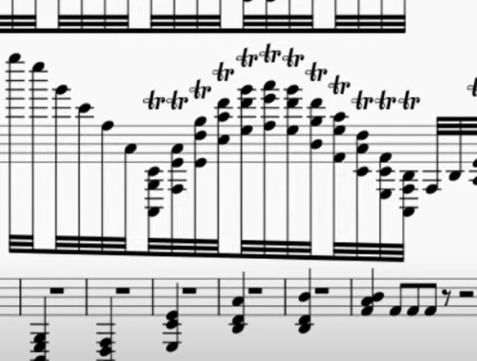
Background & Motivation
As casual pianists, we like to find sheet music from the internet to play.
However, it is annoying to manually turn a page of the score as it greatly interrupts the flow of our hands
This problem is amplified by scores with poor typesetting e.g. Imagine this is the end of page in a violin score (This isn’t the worst we’ve seen)

Slide 4
What is the target market?
Any casual musicians who plays an instrument

Slide 5

Existing solution 1 — Enote3
Enote3: A software that targets professional musicians
Great features for professional musicians
Automated page turning (Coming soon)
Can’t import scores
Expensive subscription fees

Slide 6
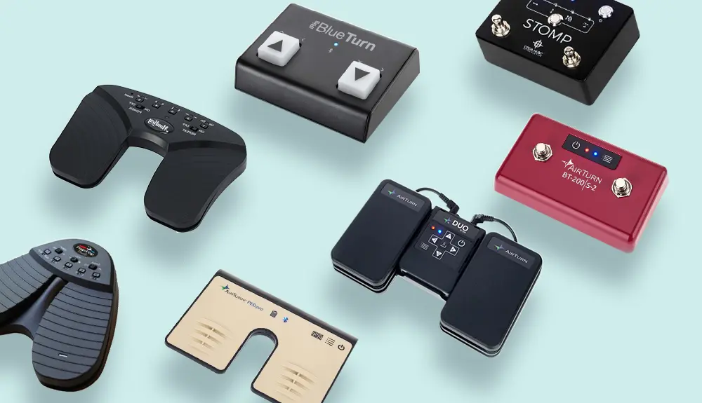
Existing solution 2 — Page turner pedals
Active user input
Not suitable for instruments that already has need of using legs e.g. piano, organ
Expensive (At least 44.99 Euros for a pedal with reasonable quality) Best Page Turners for Sheet Music in 2022: the complete review

Slide 7


Existing solution 3 — OMR Apps
Good examples: PlayScore 2, Sheet Music Scanner
Both doesn’t include realtime page turning functionality
PlayScore 2:
Subscription needed (USD4.99 per month) for scanning whole pages of sheet music
Sheet Music Scanner:
Less expensive (USD4.99, one time purchase), but the set of recognisable music characters is incomplete

Slide 8
Existing solution 4a — Realtime Audio-to-Audio (A2A) Alignment Systems
Github open source repositories e.g. https://github.com/Sma1033/Realtime-audio2audio-alignment
Hard to setup for non-programmers
Requires reference audio which might not exist for every single music scores
Additional programming is needed for page turning functionality

Slide 9
Existing solution 4b — Music Score to Audio + Realtime Audio-to-Audio (A2A) Alignment
File formats for music scores include MusicXML, mscx, mscz … → Troublesome conversion and audio synthesis as specific software are needed
Can’t directly synthesize audio from images of music score/ inaccurate conversion (e.g. scan-score)
⇒ Unreliable/ extremely inconvenient for musicians, and they would still face countless headaches in the A2A alignment part

Slide 10
Problems to address
There is no easily available software that conveniently and automatically turns a page of any given music score
Impromptu improvisations (e.g. transposition of melody) or unintentional mistakes by musicians during the performance may affect the accuracy of the audio alignment systems

Slide 11
Our solution
Using an Optical Music Recognition (OMR) ML model to extract musical information from images of music scores
Synthesize a reference audio using the extracted info + mark the timings (Reference audio) for page turning
(TBC) Extract audio features of both the reference audio and realtime microphone input e.g. MFCCs
Perform Dynamic Time Wrapping (DTW) for realtime A2A Alignment/ Tracking

Slide 12
Technical details to our solution — OMR
Dataset: Deepscores Dataset – Lukas Tuggener
ML Model structure: TBC
Related publications:

Slide 13
Technical details to our solution — DTW
Related publications:

Slide 14
Technical details to our solution — Audio Feature Extraction
Includes Mel-frequency cepstral coefficients (MFCCs), Skewness, Kurtosis, etc
Used in Plan B/C in case Plan A didn’t perform well
Related publications:

Slide 15
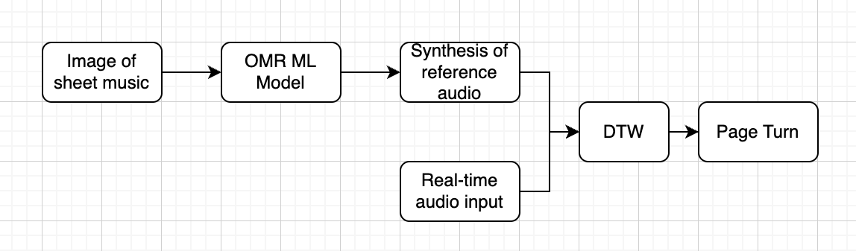
Complete pipeline of our solution (Plan A)

Slide 16
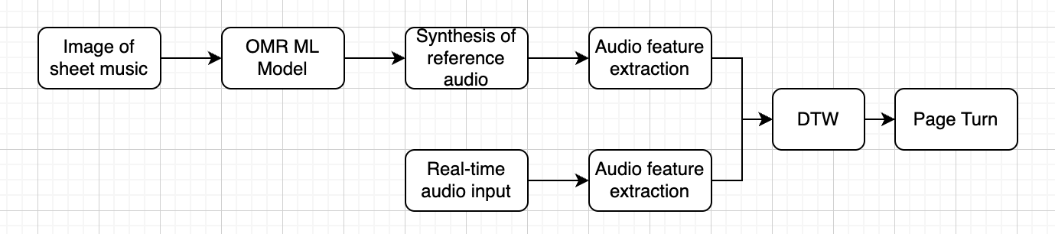
Complete pipeline of our solution (Plan B)

Slide 17
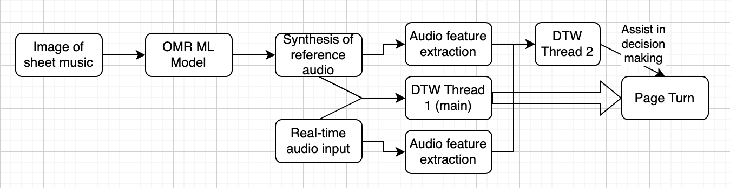
Complete pipeline of our solution (Plan C)

Slide 18
Comparing plans A, B and C
Plans | A | B | C
Theoretical Speed | Faster | Slower | Slower
Audio Feature Extraction | None | Directly used in DTW | Used to assist main DTW thread

Slide 19
Timeline
Christmas Holiday
Early Jan
Mid Jan
Late Jan
Fininalising technical plans
Completion of individual sections
Start assembling and testing
Deciding on whether need to change to other plans
Final calibration
Filiming + editing for demo video
Completion of Pitching Deck Final Version

Slide 20
Future work
Preprocessing of realtime audio input e.g. noise reduction, human voice removal
Score annotation
Marking and listing out mistakes on scores
Instrument recognition for individual musicians in an ensemble
iOS/ Android app
In-app audio recording and playback functions

Slide 21
Thanks!
Any questions?
Contact details:
Email
Website, if any

