Slide 1

Data Science Part Time 07 Phase Three final project submission
Focus: Classification Analysis
Submitted by: Cynthiah Sheilah Atieno
Instructor name: Samuel Karu

Slide 2
Overview
Business problem
Aim: Syria Telco aims to enhance its customer retention efforts by understanding and predicting customer churn.
Goal: To create a machine learning model that predicts the likelihood of a customer discontinuing their services in the near future.
By identifying high-risk customers early, Syria Telco can tailor personalized retention offers, improve customer satisfaction, and reduce revenue loss associated with churn.
This model will help the company proactively implement targeted retention strategies, thereby minimizing revenue loss and improving customer retention.

Slide 3
Business understanding: Approach
Based on the business problem at hand, the steps below were used for data analysis and model creation:
Use of Exploratory Data Analysis (EDA) in Python
Split the Data into Training and Test Sets
Choosing and Training a Model
Classification metrics
Model Tuning
Cross Validation
Hyper parameter Optimization

Slide 4

Data understanding
Sets of data:
Syria Telco data set was provided.
The primary dataset used for this Analysis is the; 'bigml_59c28831336c6604c800002a.csv' file

Slide 5

Data analysis

Slide 6
Data cleaning and preparation
Importing relevant libraries
Loading and previewing the data
Handling Missing Values
Checking Number of labels: cardinality
Encoding Categorical Variables
Finding the correlation between variables. I used Correlation Heatmap

Slide 7
Step 0: Imports and reading data
Imported the relevant files to be used in data analysis:
import numpy as np
import pandas as pd
import matplotlib.pyplot as plt
import seaborn as sns
from sklearn.preprocessing import StandardScaler
%matplotlib inline
from sklearn.model_selection import train_test_split
from sklearn.metrics import classification_report, accuracy_score, confusion_matrix
from sklearn.linear_model import LogisticRegression
from sklearn.metrics import roc_auc_score
from sklearn.model_selection import cross_val_score, KFold
from sklearn.tree import DecisionTreeClassifier
from sklearn.model_selection import StratifiedKFold
from sklearn.model_selection import GridSearchCV

Slide 8
Step 1: Data understanding
Viewed different types of rows and columns in the data
Viewed first five columns in the data frame
state | account length | area code | phone number | international plan | voice mail plan | number vmail messages | total day minutes | total day calls | total day charge | ... | total eve calls | total eve charge | total night minutes | total night calls | total night charge | total intl minutes | total intl calls | total intl charge | customer service calls | churn
0 | KS | 128 | 415 | 382-4657 | no | yes | 25 | 265.1 | 110 | 45.07 | ... | 99 | 16.78 | 244.7 | 91 | 11.01 | 10.0 | 3 | 2.70 | 1 | False
1 | OH | 107 | 415 | 371-7191 | no | yes | 26 | 161.6 | 123 | 27.47 | ... | 103 | 16.62 | 254.4 | 103 | 11.45 | 13.7 | 3 | 3.70 | 1 | False
2 | NJ | 137 | 415 | 358-1921 | no | no | 0 | 243.4 | 114 | 41.38 | ... | 110 | 10.30 | 162.6 | 104 | 7.32 | 12.2 | 5 | 3.29 | 0 | False
3 | OH | 84 | 408 | 375-9999 | yes | no | 0 | 299.4 | 71 | 50.90 | ... | 88 | 5.26 | 196.9 | 89 | 8.86 | 6.6 | 7 | 1.78 | 2 | False
4 | OK | 75 | 415 | 330-6626 | yes | no | 0 | 166.7 | 113 | 28.34 | ... | 122 | 12.61 | 186.9 | 121 | 8.41 | 10.1 | 3 | 2.73 | 3 | False

Slide 9
Step 1: Data understanding
Described the data frame
account length | area code | number vmail messages | total day minutes | total day calls | total day charge | total eve minutes | total eve calls | total eve charge | total night minutes | total night calls | total night charge | total intl minutes | total intl calls | total intl charge | customer service calls
count | 3333.000000 | 3333.000000 | 3333.000000 | 3333.000000 | 3333.000000 | 3333.000000 | 3333.000000 | 3333.000000 | 3333.000000 | 3333.000000 | 3333.000000 | 3333.000000 | 3333.000000 | 3333.000000 | 3333.000000 | 3333.000000
mean | 101.064806 | 437.182418 | 8.099010 | 179.775098 | 100.435644 | 30.562307 | 200.980348 | 100.114311 | 17.083540 | 200.872037 | 100.107711 | 9.039325 | 10.237294 | 4.479448 | 2.764581 | 1.562856
std | 39.822106 | 42.371290 | 13.688365 | 54.467389 | 20.069084 | 9.259435 | 50.713844 | 19.922625 | 4.310668 | 50.573847 | 19.568609 | 2.275873 | 2.791840 | 2.461214 | 0.753773 | 1.315491
min | 1.000000 | 408.000000 | 0.000000 | 0.000000 | 0.000000 | 0.000000 | 0.000000 | 0.000000 | 0.000000 | 23.200000 | 33.000000 | 1.040000 | 0.000000 | 0.000000 | 0.000000 | 0.000000
25% | 74.000000 | 408.000000 | 0.000000 | 143.700000 | 87.000000 | 24.430000 | 166.600000 | 87.000000 | 14.160000 | 167.000000 | 87.000000 | 7.520000 | 8.500000 | 3.000000 | 2.300000 | 1.000000
50% | 101.000000 | 415.000000 | 0.000000 | 179.400000 | 101.000000 | 30.500000 | 201.400000 | 100.000000 | 17.120000 | 201.200000 | 100.000000 | 9.050000 | 10.300000 | 4.000000 | 2.780000 | 1.000000
75% | 127.000000 | 510.000000 | 20.000000 | 216.400000 | 114.000000 | 36.790000 | 235.300000 | 114.000000 | 20.000000 | 235.300000 | 113.000000 | 10.590000 | 12.100000 | 6.000000 | 3.270000 | 2.000000
max | 243.000000 | 510.000000 | 51.000000 | 350.800000 | 165.000000 | 59.640000 | 363.700000 | 170.000000 | 30.910000 | 395.000000 | 175.000000 | 17.770000 | 20.000000 | 20.000000 | 5.400000 | 9.000000

Slide 10
Step 2: Data preparation
Key steps followed:
Finding missing values
Encoding Categorical Variables
Feature creation
Summary of categorical variables
There are 4 categorical variables. These are given by state, international plan, voice mail plan and phone number.
There are two binary categorical variables - international plan and voice mail plan.
churn is the target variable.
There were no missing values in categorical variable.

Slide 11
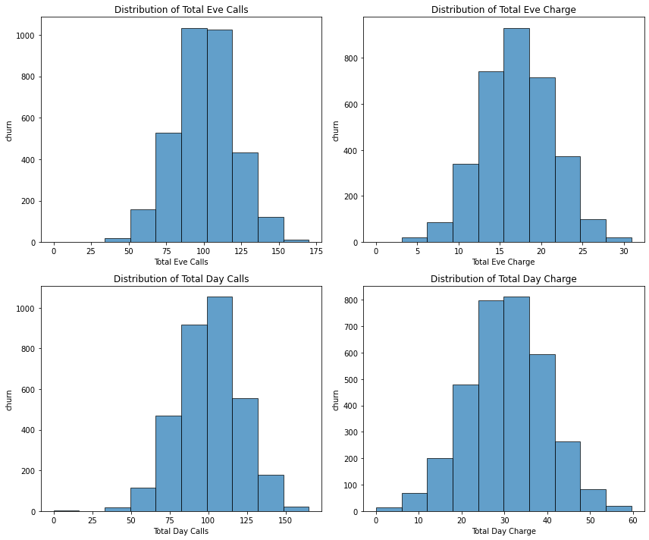
Step 3: Feature understanding
Key steps followed:
Plotting feature distribution
Histogram

Slide 12
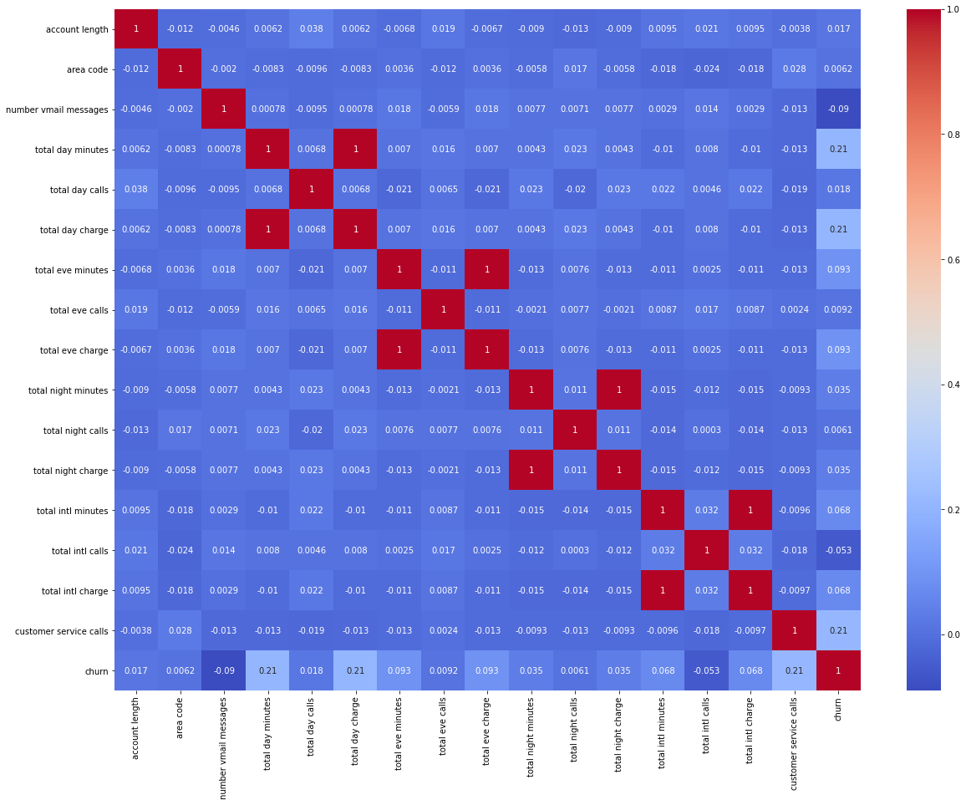
Step 4: Feature relationships
Heatmap correlation

Slide 13
Step 5: Exploratory Data Analysis
Defining features and target variable
X = df_encoded.drop(columns=['churn'])
y = df_encoded['churn']
2. Split data into training and test sets
X_train, X_test, y_train, y_test = train_test_split(X, y, test_size=0.2, random_state=42)
3. Choose and Train a Model
X_train, X_test, y_train, y_test = train_test_split(X, y, test_size=0.2, random_state=42)
model = LogisticRegression()
model.fit(X_train, y_train)
y_pred = model.predict(X_test)
print(len(y_test))

Slide 14
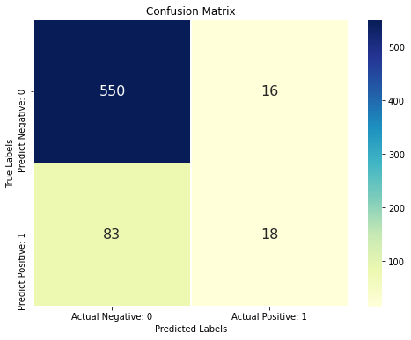
Step 5: Exploratory Data Analysis
4. fit the model
model.fit(X_train, y_train)
# Predict on test data
y_pred = model.predict(X_test)
5. (a) Compute confusion matrix
cm = confusion_matrix(y_test, y_pred)
5. (b) Plot the confusion matrix
plt.figure(figsize=(8, 6))
sns.heatmap(cm_matrix, annot=True, fmt='d', cmap='YlGnBu',
cbar=True, annot_kws={"size": 16}, linewidths=.5)
plt.title('Confusion Matrix')
plt.xlabel('Predicted Labels')
plt.ylabel('True Labels')
plt.show()

Slide 15
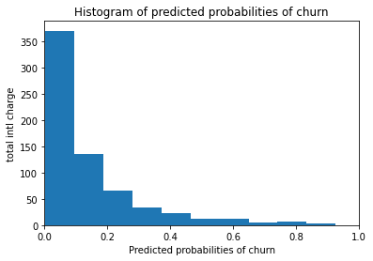
Observation
Plot histogram of predicted probabilities
There are small number of observations with probability > 0.5.
So, these small number of observations predict that customers will churn.
Majority of observations predict that customers will not churn.

Slide 16
Model tuning
I experimented with ROC AUC curve and cross validate with decision tree to find out if they provide a better performance for the True class.
In this technique, I measured the area under the curve (AUC). A perfect classifier will have a ROC AUC equal to 1, whereas a purely random classifier will have a ROC AUC equal to 0.5.
So, ROC AUC is the percentage of the ROC plot that is underneath the curve.
Compute ROC AUC
ROC_AUC = roc_auc_score(y_test, y_pred1) print('ROC AUC : {:.4f}'.format(ROC_AUC))
ROC AUC of our model approaches towards 1. So, we can conclude that our classifier does a good job in predicting whether customer will churn or not.

Slide 17
Cross validation
I used decision tree for cross validation
Initialized the Decision Tree classifier
dt_classifier = DecisionTreeClassifier()
Define Cross-Validation Strategy
I used StratifiedKFold as it ensures each fold has the same proportion of class labels, which is especially useful for classification problems.
Define cross-validation strategy
cv = StratifiedKFold(n_splits=5, shuffle=True, random_state=42)
Apply cross-validation
scores = cross_val_score(dt_classifier, X, y, cv=cv, scoring='accuracy')
Print results
print(f"Accuracy scores for each fold: {scores}")
print(f"Mean accuracy: {scores.mean():.2f}")
print(f"Standard deviation of accuracy: {scores.std():.2f}")

Slide 18
Cross validation: Findings
Our, original model score is found to be 0.852. The average cross-validation score is 0.91.
The mean accuracy of 0.91 indicates that, on average, the decision tree model correctly classifies 91% of the samples across all folds. This is a high accuracy, suggesting that the model performs well on the dataset.
Standard deviation: 0.02
The standard deviation of 0.02 indicates that the accuracy scores vary slightly across the folds. This low standard deviation suggests that the model's performance is consistent and stable across different subsets of the data

Slide 19
Hyperparameter Optimization using GridSearch CV
Define parameter grid
param_grid = {
'criterion': ['gini', 'entropy'],
'max_depth': [None, 10, 20, 30],
'min_samples_split': [2, 5, 10],
'min_samples_leaf': [1, 2, 4]
}
Initialize GridSearchCV
grid_search = GridSearchCV(
estimator=dt_classifier,
param_grid=param_grid,
cv=5, # Number of cross-validation folds
scoring='accuracy', # Metric to evaluate performance
n_jobs=-1, # Number of parallel jobs to run (-1 means using all processors)
verbose=1 # Verbosity level

Slide 20
Hyperparameter Optimization using GridSearch CV
Fit the model with GridSearchCV
grid_search.fit(X_train, y_train)
Get the best parameters and best score
print(f"Best parameters: {grid_search.best_params_}")
print(f"Best score: {grid_search.best_score_:.2f}")
Get the best estimator
best_model = grid_search.best_estimator_
Predict using the best model
y_pred = best_model.predict(X_test)
Evaluate the model
print(f"Test accuracy: {accuracy_score(y_test, y_pred):.2f}")
Findings:
Our original model test accuracy is 0.852 while GridSearch CV accuracy is 0.94.
We can see that GridSearch CV improve the performance for this particular model.

Slide 21
Overall Findings
From the analysis of the Syria Telco data sets, below are the findings:
The logistic regression model accuracy score is 0.852. So, the model does a very good job in predicting whether or not the customer will churn.
Small number of observations predict that customer will churn. Majority of observations predict that customer will not churn.
Our original model test accuracy is 0.852 while GridSearch CV accuracy is 0.94. We can see that GridSearch CV improve the performance for this particular model.

Slide 22
Recommendations
Leverage the Best-Performing Model
Adopt the Decision Tree model for primary churn predictions due to its higher accuracy and consistency.
Address Class Imbalance: There is a small number of observations predicting churn, indicating class imbalance. I would recommend the use of resampling techniques or class weight adjustments
Validate Model Performance
Monitor and validate models regularly to ensure continued performance and adaptation.
Leverage GridSearch CV to optimize both models and refine feature selection.
Business Implications and Actions Implement actionable strategies based on model predictions to reduce churn effectively. Churn Prediction Utilization: Use the high-performing models to proactively address customer churn. Implement strategies such as targeted retention campaigns, personalized offers, or enhanced customer service for those predicted to churn.
Resource Allocation: Allocate resources effectively based on model predictions to maximize the impact on customer retention.

Slide 23

Any questions?

Slide 24


Thank you so much
Cynthiah Atieno
+254 700 065572
cynthia.atieno@student.moringaschool.com

