Slide 1
Chapter 11 查询处理和查询优化

Slide 2
Chapter 11: Query Processing
概述 Overview
查询代价的度量
关系代数运算的执行
选择
连接
表达式计算
查询优化

Slide 3
11.1 Basic Steps in Query Processing
1. Parsing and translation语法分析与翻译
2. Optimization 优化
3. Evaluation 执行

Slide 4
Basic Steps in Query Processing (Cont.)
语法分析与翻译 Parsing and translation
将查询语句翻译成内部的表达形式， 基于关系代数的形式。
语法分析器检查语法，验证查询中出现的关系。
执行 Evaluation
查询执行引擎接受一个查询执行计划（ query-evaluation plan ）, 执行该计划,并把结果返回给查询。

Slide 5
Basic Steps in Query Processing : 优化(Optimization)
一个关系代数表达式relational algebra expression 可以有多种等价的表达
例, σ_{salary<75000}(∏_{salary}(instructor)) is equivalent to ∏_{salary}(σ_{salary<75000}(instructor))
Each relational algebra operation can be evaluated using one of several different algorithms
相应的, 一个关系集合表达式可以用多种形式执行。
注解了具体执行细节的执行策略称作evaluation-plan执行计划.
例, 可以使用一个 index on salary 来找到 salary < 75000的教工
或可以执行complete relation scan , 丢弃掉 salary ≥ 75000的教工

Slide 6
Figure 12.02

Slide 7
Basic Steps: Optimization (Cont.)
Query Optimization: 在所有等价的执行计划中选择执行代价最小的choose the one with lowest cost.
Cost is estimated using statistical information from the database catalog
e.g. number of tuples in each relation, size of tuples, etc.
In this chapter we study
How to measure query costs
Algorithms for evaluating relational algebra operations
How to combine algorithms for individual operations in order to evaluate a complete expression
how to optimize queries, that is, how to find an evaluation plan with lowest estimated cost

Slide 8
11.2 Measures of Query Cost查询代价度量
Cost is generally measured as total elapsed time for answering query
Many factors contribute to time cost
disk accesses, CPU, or even network communication
Typically disk access is the 最主要的 cost, and is also relatively easy to estimate. Measured by taking into account
Number of seeks * average-seek-cost
Number of blocks read * average-block-read-cost
Number of blocks written * average-block-write-cost
Cost to write a block is greater than cost to read a block
data is read back after being written to ensure that the write was successful

Slide 9
Measures of Query Cost (Cont.)
For simplicity we just use the number of block transfers from disk and the number of seeks as the cost measures
t_{T} – time to transfer one block
t_{S} – time for one seek
Cost for b block transfers plus S seeks b * t_{T} + S * t_{S}
We ignore CPU costs for simplicity
Real systems do take CPU cost into account
We do not include cost to writing output to disk in our cost formulae

Slide 10
Measures of Query Cost (Cont.)
Several algorithms can reduce disk IO by using extra buffer space
Amount of real memory available to buffer depends on other concurrent queries and OS processes, known only during execution
We often use worst case estimates, assuming only the minimum amount of memory needed for the operation is available
Required data may be buffer resident already, avoiding disk I/O
But hard to take into account for cost estimation
Notes:
10

Slide 11
11.3 Selection Operation选择运算
File scan
Algorithm A1 (linear search). Scan each file block and test all records to see whether they satisfy the selection condition.
Cost estimate = b_{r} block transfers + 1 seek
b_{r} 代表 number of blocks containing records from relation r
If selection is on a key attribute, can stop on finding record
cost = (b_{r} /2) block transfers + 1 seek
Linear search can be applied regardless of
selection condition or
ordering of records in the file, or
availability of indices
Note: binary search generally does not make sense since data is not stored consecutively
except when there is an index available,
and binary search requires more seeks than index search

Slide 12
使用索引的选择 Selections Using Indices
索引扫描 Index scan – 使用索引的搜索算法
selection condition must be on search-key of index.
A2 (主索引, 码属性等值比较equality on key). 检索到满足响应等值条件的唯一一条记录
Cost = (h_{i} + 1) * (t_{T} + t_{S})
A3 (主索引, , 非码属性等值比较) 检索到多条记录。
这些记录是在连续的存储块上
设 b = number of blocks containing matching records
Cost = h_{i} * (t_{T} + t_{S}) + t_{S} + t_{T} * b

Slide 13
Selections Using Indices
A4 (secondary index, equality on nonkey).
Retrieve a single record if the search-key is a candidate key
Cost = (h_{i} + 1) * (t_{T} + t_{S})
Retrieve multiple records if search-key is not a candidate key
each of n matching records may be on a different block
Cost = (h_{i} + n) * (t_{T} + t_{S})
Can be very expensive!
Notes:
13

Slide 14
涉及比较的选择 Selections Involving Comparisons
形如 σ_{A≤V} (r) or σ_{A ≥ V}(r) 的选择，可以使用
文件线性搜索
或 按以下方法之一使用索引来实现选择运算:
A5 (primary index, comparison). (Relation is sorted on A)
For σ_{A ≥ V}(r) use index to find first tuple ≥ v and scan relation sequentially from there
For σ_{A≤V} (r) just scan relation sequentially till first tuple > v; do not use index
A6 (secondary index, comparison).
For σ_{A ≥ V}(r) use index to find first index entry ≥ v and scan index sequentially from there, to find pointers to records.
For σ_{A≤V} (r) just scan leaf pages of index finding pointers to records, till first entry > v
In either case, retrieve records that are pointed to
requires an I/O for each record
Linear file scan may be cheaper

Slide 15
Implementation of Complex Selections
Conjunction: σ_{θ1}∧ _{θ2}∧. . . _{θn}(r)
A7 (conjunctive selection using one index).
Select a combination of θ_{i} and algorithms A1 through A7 that results in the least cost for σ_{θi} (r).
Test other conditions on tuple after fetching it into memory buffer.
A8 (conjunctive selection using composite index).
Use appropriate composite (multiple-key) index if available.
A9 (conjunctive selection by intersection of identifiers).
Requires indices with record pointers.
Use corresponding index for each condition, and take intersection of all the obtained sets of record pointers.
Then fetch records from file
If some conditions do not have appropriate indices, apply test in memory.

Slide 16
Algorithms for Complex Selections
Disjunction:σ_{θ1}∨ _{θ2} ∨. . . _{θn} (r).
A10 (disjunctive selection by union of identifiers).
Applicable if all conditions have available indices.
Otherwise use linear scan.
Use corresponding index for each condition, and take union of all the obtained sets of record pointers.
Then fetch records from file
Negation: σ_{¬θ}(r)
Use linear scan on file
If very few records satisfy ¬θ, and an index is applicable to θ
Find satisfying records using index and fetch from file

Slide 17
11.3.2 连接运算 Join Operation
实施连接运算的几种不同算法
嵌套循环连接 Nested-loop join
块嵌套循环连接 Block nested-loop join
索引嵌套循环连接 Indexed nested-loop join
归并连接 Merge-join
散列连接 Hash-join
Choice based on cost estimate
例子使用如下信息
关系中的记录数，student: 5,000 takes: 10,000
关系所占磁盘块数， student: 100 takes: 400

Slide 18
嵌套循环连接 Nested-Loop Join
To compute the theta join r _{θ} s for each tuple t_{r} in r do begin for each tuple t_{s} in s do begin test pair (t_{r},t_{s}) to see if they satisfy the join condition θ if they do, add t_{r} • t_{s} to the result. end end
r is called the outer relation and s the inner relation of the join.
Requires no indices and can be used with any kind of join condition.
Expensive since it examines every pair of tuples in the two relations.

Slide 19
Nested-Loop Join (Cont.)
In the worst case, if there is enough memory only to hold one block of each relation, the estimated cost is n_{r} ∗ b_{s} + b_{r} block transfers, plus n_{r} + b_{r} seeks
If the smaller relation fits entirely in memory, use that as the inner relation.
Reduces cost to b_{r} + b_{s} block transfers and 2 seeks
Assuming worst case memory availability cost estimate is
with student as outer relation:
5000 ∗ 400 + 100 = 2,000,100 block transfers,
5000 + 100 = 5100 seeks
with takes as the outer relation
10000 ∗ 100 + 400 = 1,000,400 block transfers and 10,400 seeks
If smaller relation (student) fits entirely in memory, the cost estimate will be 500 block transfers.
Block nested-loops algorithm (next slide) is preferable更可取.

Slide 20
块嵌套循环连接 Block Nested-Loop Join
它是嵌套循环链接的一个变种，内层关系的每一块与外层关系每一块形成一对.
for each block B_{r} of r do begin for each block B_{s} of s do begin for each tuple t_{r} in B_{r} do begin for each tuple t_{s} in B_{s} do begin Check if (t_{r},t_{s}) satisfy the join condition if they do, add t_{r} • t_{s} to the result. end end end end

Slide 21
Block Nested-Loop Join (Cont.)
Worst case estimate: b_{r} ∗ b_{s} + b_{r} block transfers + 2 * b_{r} seeks
Each block in the inner relation s is read once for each block in the outer relation
with student as outer relation:
100 ∗ 400 + 100 = 40,100 block transfers,
2 * 100 = 200 seeks
Best case: b_{r} + b_{s} block transfers + 2 seeks.

Slide 22
嵌套循环与块嵌套循环的改进
嵌套循环与块嵌套循环的改进:
在块嵌套循环中, 用 M - 2 磁盘blocks 作为外层关系的存取单位, M = 可用内存的blocks大小; 使用剩余的两块来缓存内层关系和输出
Cost = ⎡b_{r} / (M-2)⎤ ∗ b_{s} + b_{r} block transfers + 2 ⎡b_{r} / (M-2)⎤ seeks
如果等值连接属性是内层关系的码，则对每个外层关系元组，内层循环一旦找到了首条匹配的元组就可以中止。
对内层循环轮流做向前、向后的扫描，该方法对磁盘读写请求排序，使得上次扫描时留在缓冲区中的数据可以重用，减少磁盘存取次数。 (with LRU replacement)
如果内层循环的连接属性上有索引，可以用更有效的索引查找法替代文件扫描法。 (next slide)

Slide 23
索引嵌套循环连接 Indexed Nested-Loop Join
索引查找可以替换文件扫描，如果：
连接是等值连接或自然连接，且
在内层关系的连接属性上有索引
可以为计算连接而建立一个临时索引
For each tuple t_{r} in the outer relation r, use the index to look up tuples in s that satisfy the join condition with tuple t_{r}.
Worst case: buffer has space for only one page of r, and, for each tuple in r, we perform an index lookup on s.
Cost of the join: b_{r} (t_{T} + t_{S}) + n_{r} ∗ c
c 是通过索引获取s中所有满足匹配条件元组的代价。
c 可以估算为在s上使用连接条件进行单次选择运算的代价。
If indices are available on join attributes of both r and s, use the relation with fewer tuples as the outer relation.

Slide 24
Example of Costs
Compute student takes, with student as the outer relation.
Let takes have a primary B⁺-tree index on the attribute ID, which contains 20 entries in each index node.
Since takes has 10,000 tuples, the height of the tree is 4, and one more access is needed to find the actual data
student has 5000 tuples
Cost of block nested loops join
400*100 + 100 = 40,100 block transfers + 2 * 100 = 200 seeks
assuming worst case memory
may be significantly less with more memory
Cost of indexed nested loops join
100 + 5000 * 5 = 25,100 block transfers and seeks.
CPU cost likely to be less than that for block nested loops join

Slide 25
归并连接 Merge-Join
Sort both relations on their join attribute
Merge the sorted relations to join them
Join step is similar to the merge stage of the sort-merge algorithm.
Main difference is handling of duplicate values in join attribute — every pair with same value on join attribute must be matched
Detailed algorithm in book

Slide 26
Merge-Join (Cont.)
Can be used only for equi-joins and natural joins
Each block needs to be read only once (assuming all tuples for any given value of the join attributes fit in memory）
Thus the cost of merge join is: b_{r} + b_{s} block transfers + ⎡b_{r} / b_{b}⎤ + ⎡b_{s} / b_{b}⎤ seeks
+ the cost of sorting if relations are unsorted.
混合hybrid merge-join: If one relation is sorted, and the other has a secondary B⁺-tree index on the join attribute
Merge the sorted relation with the leaf entries of the B⁺-tree .
Sort the result on the addresses of the unsorted relation’s tuples
Scan the unsorted relation in physical address order and merge with previous result, to replace addresses by the actual tuples
Sequential scan more efficient than random lookup

Slide 27
散列连接 Hash-Join
Applicable for equi-joins and natural joins.
A hash function h is used to partition tuples of both relations
h maps JoinAttrs values to {0, 1, ..., n}, where JoinAttrs 表示 the common attributes of r and s used in the natural join.
r₀, r₁, . . ., r_{n} 表示 partitions of r tuples
Each tuple t_{r} ∈ r is put in partition r_{i} where i = h(t_{r} [JoinAttrs]).
s₀, s₁. . ., s_{n} 表示 partitions of s tuples
Each tuple t_{s} ∈s is put in partition s_{i}, where i = h(t_{s} [JoinAttrs]).
Note: In book, r_{i} is 表示为 H_{ri,} s_{i} is 表示为H_{si} and n is 表示为 n_{h.}

Slide 28
Hash-Join (Cont.)

Slide 29
Hash-Join (Cont.)
r tuples in r_{i} need only to be compared with s tuples in s_{i} Need not be compared with s tuples in any other partition, since:
an r tuple and an s tuple that satisfy the join condition will have the same value for the join attributes.
If that value is hashed to some value i, the r tuple has to be in r_{i} and the s tuple in s_{i}.

Slide 30
散列连接算法 Hash-Join Algorithm
The hash-join of r and s is computed as follows.
1. Partition the relation s using hashing function h. When partitioning a relation, one block of memory is reserved as the output buffer for each partition.
2. Partition r similarly.
3. For each i:
(a) Load s_{i} into memory and build an in-memory hash index on it using the join attribute. This hash index uses a different hash function than the earlier one h.
(b) Read the tuples in r_{i} from the disk one by one. For each tuple t_{r} locate each matching tuple t_{s} in s_{i} using the in-memory hash index. Output the concatenation of their attributes.
关系 s 被称为 构造用输入build input ，关系 r被称为 探查用输入 probe input.

Slide 31
Hash-Join algorithm (Cont.)
The value n and the hash function h is chosen such that each s_{i} should fit in memory.
Typically n is chosen as ⎡b_{s}/M⎤ * f where f is a “经验系数”, typically around 1.2
The probe relation partitions s_{i} need not fit in memory
递归划分Recursive partitioning required if number of partitions n is greater than number of pages M of memory.
instead of partitioning n ways, use M – 1 partitions for s
Further partition the M – 1 partitions using a different hash function
Use same partitioning method on r
Rarely required: e.g., with block size of 4 KB, recursive partitioning not needed for relations of < 1GB with memory size of 2MB, or relations of < 36 GB with memory of 12 MB

Slide 32
Handling of Overflows
Partitioning is said to be 偏skewed if some partitions have significantly more tuples than some others
Hash-table overflow occurs in partition s_{i} if s_{i} does not fit in memory. Reasons could be
Many tuples in s with same value for join attributes
Bad hash function
Overflow resolution can be done in build phase
Partition s_{i} is further partitioned using different hash function.
Partition r_{i} must be similarly partitioned.
Overflow avoidance performs partitioning carefully to avoid overflows during build phase
E.g. partition build relation into many partitions, then combine them
Both approaches fail with large numbers of duplicates
Fallback option: use block nested loops join on overflowed partitions

Slide 33
Cost of Hash-Join
If recursive partitioning is not required: cost of hash join is 3(b_{r} + b_{s}) +4 ∗ n_{h} block transfers + 2( ⎡b_{r} / b_{b}⎤ + ⎡b_{s} / b_{b}⎤) seeks
If recursive partitioning required:
number of passes required for partitioning build relation s to less than M blocks per partition is ⎡log_{⎣M/bb⎦–1}(b_{s}/M)⎤
best to choose the smaller relation as the build relation.
Total cost estimate is: 2(b_{r} + b_{s}) ⎡log_{⎣M/bb⎦–1}(b_{s}/M)⎤ + b_{r} + b_{s} block transfers + 2(⎡b_{r} / b_{b}⎤ + ⎡b_{s} / b_{b}⎤) ⎡log_{⎣M/bb⎦–1}(b_{s}/M) ⎤ seeks
If the entire build input can be kept in main memory no partitioning is required
Cost estimate goes down to b_{r} + b_{s}.

Slide 34
Example of Cost of Hash-Join
instructor teaches
Assume that memory size is 20 blocks
b_{instructor}= 100 and b_{teaches} = 400.
instructor is to be used as build input. Partition it into five partitions, each of size 20 blocks. This partitioning can be done in one pass.
Similarly, partition teaches into five partitions,each of size 80. This is also done in one pass.
Therefore total cost, ignoring cost of writing partially filled blocks:
3(100 + 400) = 1500 block transfers + 2( ⎡100/3⎤ + ⎡400/3⎤) = 336 seeks

Slide 35
混合散列连接 Hybrid Hash–Join
Useful when memory sized are relatively large, and the build input is bigger than memory.
Main feature of hybrid hash join:
Keep the first partition of the build relation in memory.
E.g. With memory size of 25 blocks, instructor can be partitioned into five partitions, each of size 20 blocks.
Division of memory:
The first partition occupies 20 blocks of memory
1 block is used for input, and 1 block each for buffering the other 4 partitions.
teaches is similarly partitioned into five partitions each of size 80
the first is used right away for probing, instead of being written out
Cost of 3(80 + 320) + 20 +80 = 1300 block transfers for hybrid hash join, instead of 1500 with plain hash-join.
Hybrid hash-join most useful if M >>

Slide 36
Complex Joins
Join with a conjunctive condition:
r _{θ1∧ θ 2∧... ∧ θ n} s
Either use nested loops/block nested loops, or
Compute the result of one of the simpler joins r _{θi} s
final result comprises those tuples in the intermediate result that satisfy the remaining conditions
θ₁ ∧ . . . ∧ θ_{i –1} ∧ θ_{i +1} ∧ . . . ∧ θ_{n}
Join with a disjunctive condition
r _{θ1 ∨ θ2 ∨... ∨ θn} s
Either use nested loops/block nested loops, or
Compute as the union of the records in individual joins r _{θ i} s:
(r _{θ1} s) ∪ (r _{θ2} s) ∪ . . . ∪ (r _{θn} s)

Slide 37
Other Operations
Duplicate elimination can be implemented via hashing or sorting.
On sorting duplicates will come adjacent to each other, and all but one set of duplicates can be deleted.
Optimization: duplicates can be deleted during run generation as well as at intermediate merge steps in external sort-merge.
Hashing is similar – duplicates will come into the same bucket.
Projection:
perform projection on each tuple
followed by duplicate elimination.

Slide 38
Other Operations : Aggregation
Aggregation can be implemented in a manner similar to duplicate elimination.
Sorting or hashing can be used to bring tuples in the same group together, and then the aggregate functions can be applied on each group.
Optimization: combine tuples in the same group during run generation and intermediate merges, by computing partial aggregate values
For count, min, max, sum: keep aggregate values on tuples found so far in the group.
When combining partial aggregate for count, add up the aggregates
For avg, keep sum and count, and divide sum by count at the end

Slide 39
Other Operations : Set Operations
Set operations (∪, ∩ and ⎯): can either use variant of merge-join after sorting, or variant of hash-join.
E.g., Set operations using hashing:
Partition both relations using the same hash function
Process each partition i as follows.
Using a different hashing function, build an in-memory hash index on r_{i}.
Process s_{i} as follows
r ∪ s:
Add tuples in s_{i} to the hash index if they are not already in it.
At end of s_{i} add the tuples in the hash index to the result.

Slide 40
Other Operations : Set Operations
E.g., Set operations using hashing:
as before partition r and s,
as before, process each partition i as follows
build a hash index on r_{i}
Process s_{i} as follows
r ∩ s:
output tuples in s_{i} to the result if they are already there in the hash index
r – s:
for each tuple in s_{i}, if it is there in the hash index, delete it from the index.
At end of s_{i} add remaining tuples in the hash index to the result.
Notes:
40

Slide 41
Other Operations : Outer Join
Outer join can be computed either as
A join followed by addition of null-padded non-participating tuples.
by modifying the join algorithms.
Modifying merge join to compute r s
In r s, non participating tuples are those in r – Π_{R}(r s)
Modify merge-join to compute r s:
During merging, for every tuple t_{r} from r that do not match any tuple in s, output t_{r} padded with nulls.
Right outer-join and full outer-join can be computed similarly.

Slide 42
Other Operations : Outer Join
Modifying hash join to compute r s
If r is probe relation, output non-matching r tuples padded with nulls
If r is build relation, when probing keep track of which r tuples matched s tuples. At end of s_{i} output non-matched r tuples padded with nulls
Notes:
42

Slide 43
1.4 表达式计算 Evaluation of Expressions
至今，我们已经研究了单个运算如何执行
执行包含多个运算的整个表达式树的可选方案
物化 Materialization: 将每次计算的结果物化materialize (存储)到磁盘上的一个临时关系， 重复.
流水线Pipelining: 一个运算的结果传递给下一个，而不必保存临时关系。

Slide 44
11.4.1 物化 Materialization
物化执行 Materialized evaluation:从最底层（树的底部）开始,一次执行一个操作。 将中间结果物化到一个临时关系，用来执行下一层操作。
例如, 对下图的表达式树，先计算并存储 然后再将存储的临时关系与instructor进行连接运算, 最后计算在 name属性上的投影。

Slide 45
Materialization (Cont.)
物化执行总是可以应用的。
写中间结果到磁盘和读回它们的代价可能是非常高的。
之前的操作成本公式忽略了写中间结果到磁盘, 所以
Overall cost = Sum of costs of individual operations + cost of writing intermediate results to disk
双缓冲 Double buffering: use two output buffers for each operation, when one is full write it to disk while the other is getting filled
Allows overlap of disk writes with computation and reduces execution time

Slide 46
11.4.2 流水线 Pipelining
流水线计算 Pipelined evaluation : 为减少临时文件，将多个关系操作组合成一个操作的流水线来实现，将一个操作的结果传递给下一个操作。
例如, 在前一个表达式树中, 存储以下操作的结果
而是将元组直接转递给join..连接运算； 不存储连接运算的结果, 直接将元组传递给投影运算。
Much cheaper than materialization: no need to store a temporary relation to disk.
流水线可能不总是可用的 – 例如，排序, 散列连接hash-join.
For pipelining to be effective, use evaluation algorithms that generate output tuples even as tuples are received for inputs to the operation.
Pipelines can be executed in two ways: demand driven and producer driven

Slide 47
Pipelining (Cont.)
流水线可按以下两种方式之一来执行：
需求驱动demand driven or lazy 执行
system repeatedly requests next tuple from top level operation
Each operation requests next tuple from children operations as required, in order to output its next tuple
In between calls, operation has to maintain “state” so it knows what to return next
生产者驱动 producer-driven or eager 流水线
Operators produce tuples eagerly and pass them up to their parents
Buffer maintained between operators, child puts tuples in buffer, parent removes tuples from buffer
if buffer is full, child waits till there is space in the buffer, and then generates more tuples
System schedules operations that have space in output buffer and can process more input tuples
可替代的名称:流水线的 拉pull 和 推push 模式

Slide 48
Pipelining (Cont.)
Implementation of demand-driven pipelining
Each operation is implemented as an iterator implementing the following operations
open()
E.g. file scan: initialize file scan
state: pointer to beginning of file
E.g.merge join: sort relations;
state: pointers to beginning of sorted relations
next()
E.g. for file scan: Output next tuple, and advance and store file pointer
E.g. for merge join: continue with merge from earlier state till next output tuple is found. Save pointers as iterator state.
close()

Slide 49
Evaluation Algorithms for Pipelining
Some algorithms are not able to output results even as they get input tuples
E.g. merge join, or hash join
intermediate results written to disk and then read back
Algorithm variants to generate (at least some) results on the fly, as input tuples are read in
E.g. hybrid hash join generates output tuples even as probe relation tuples in the in-memory partition (partition 0) are read in
Double-pipelined join technique: Hybrid hash join, modified to buffer partition 0 tuples of both relations in-memory, reading them as they become available, and output results of any matches between partition 0 tuples
When a new r₀ tuple is found, match it with existing s₀ tuples, output matches, and save it in r₀
Symmetrically for s₀ tuples

Slide 50
11.5 查询优化 Query Optimization
查询优化概述
关系表达式转换
表达式结果集统计大小的估计
执行计划选择

Slide 51
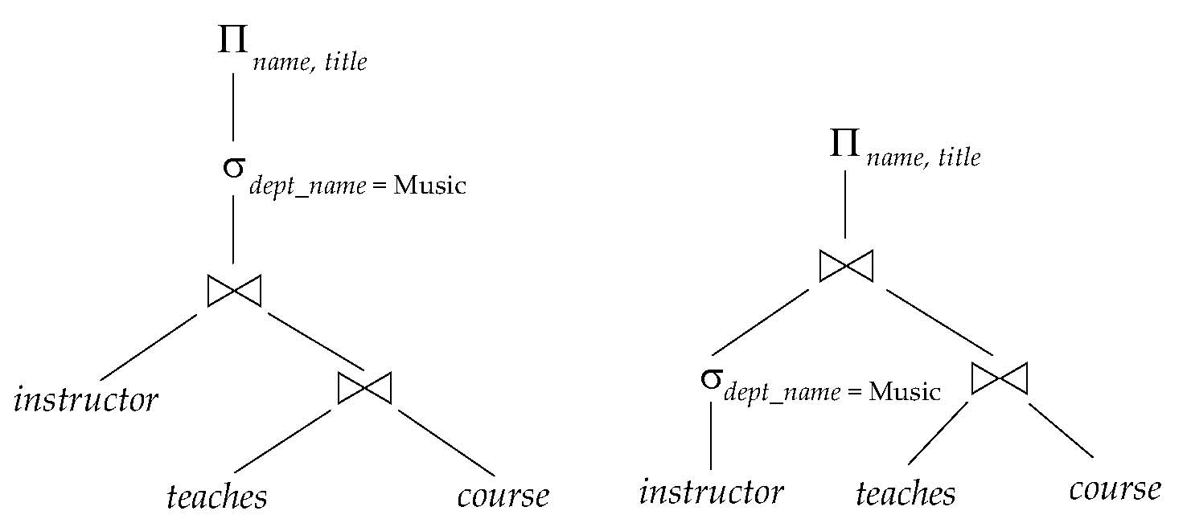
Introduction
Alternative ways of evaluating a given query
Equivalent expressions
Different algorithms for each operation

Slide 52
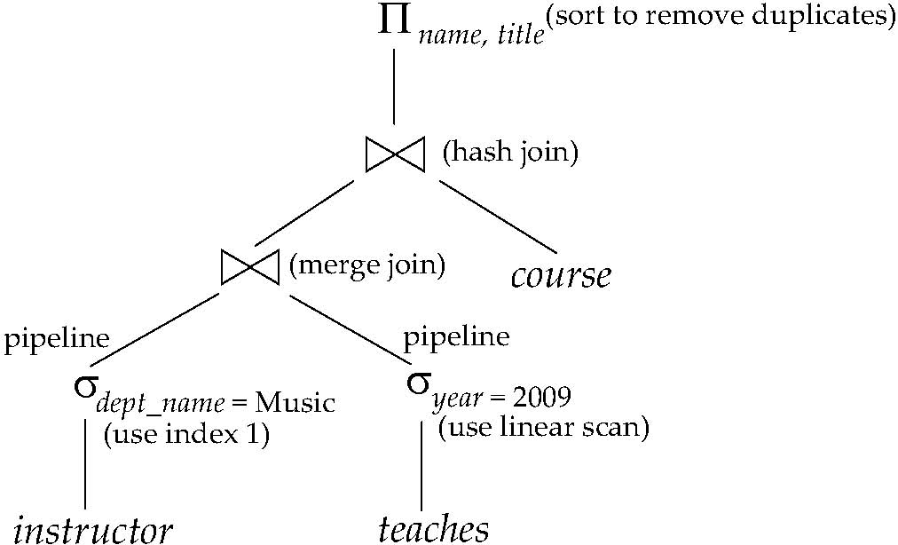
Introduction (Cont.)
一个执行计划evaluation plan定义了每个运算使用的算法，以及运算之间的执行应该如何协调。

Slide 53
Introduction (Cont.)
Cost difference between evaluation plans for a query can be enormous
E.g. seconds vs. days in some cases
Steps in cost-based query optimization
Generate logically equivalent expressions using equivalence rules
Annotate resultant expressions to get alternative query plans
Choose the cheapest plan based on estimated cost
Estimation of plan cost based on:
Statistical information about relations. Examples:
number of tuples, number of distinct values for an attribute
Statistics estimation for intermediate results
to compute cost of complex expressions
Cost formulae for algorithms, computed using statistics

Slide 54
关系表达式转换
Two relational algebra expressions are said to be equivalent if the two expressions generate the same set of tuples on every legal database instance
Note: order of tuples is irrelevant
we don’t care if they generate different results on databases that violate integrity constraints
In SQL, inputs and outputs are multisets of tuples
Two expressions in the multiset version of the relational algebra are said to be equivalent if the two expressions generate the same multiset of tuples on every legal database instance.
An equivalence rule says that expressions of two forms are equivalent
Can replace expression of first form by second, or vice versa

Slide 55
等价规则 Equivalence Rules
1. 合取选择运算可分解为单个选择运算的序列
2. 选择运算满足交换律.
3. 一系列投影运算中只有最后一个运算是必需的，其余的可省略.
选择运算可与笛卡尔积以及θ 连接相结合.
σ_{θ}(E₁ X E₂) = E₁ _{θ} E₂
σ_{θ1}(E₁ _{θ2} E₂) = E₁ _{θ1∧ θ2} E₂

Slide 56
Equivalence Rules (Cont.)
5. θ 连接运算满足(and natural joins) 满足交换律. E_{1 θ} E₂ = E₂ _{θ} E₁
6. (a) 自然连接Natural join满足结合律:
(E₁ E₂) E₃ = E₁ (E₂ E₃) (b) θ 连接具有以下方式的结合律: (E_{1 θ1} E₂) _{θ2∧ θ3} E₃ = E_{1 θ1∧ θ3} (E₂ _{θ2} E₃) θ₂ 只涉及 E₂ 和 E₃中的属性

Slide 57
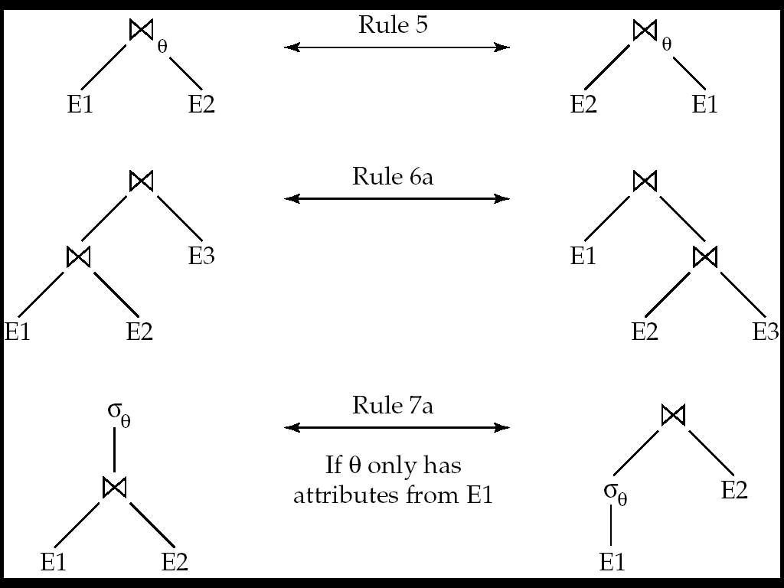
Pictorial Depiction of Equivalence Rules

Slide 58
Equivalence Rules (Cont.)
7. 选择运算在下面两个条件下对 θ 连接运算具有分配律:
(a) When all the attributes in θ₀ involve only the attributes of one of the expressions (E₁) being joined. σ_{θ0}(E₁ _{θ} E₂) = (σ_{θ0}(E₁)) _{θ} E₂
(b) When θ ₁ involves only the attributes of E₁ and θ₂ involves only the attributes of E₂.
σ_{θ1}∧_{θ2} (E₁ _{θ} E₂) = (σ_{θ1}(E₁)) _{θ} (σ_{θ2} (E₂))

Slide 59
Equivalence Rules (Cont.)
8. 投影运算在下面条件下对θ 运算具有分配律:
(a) if θ involves only attributes from L₁ ∪ L₂:
(b) Consider a join E_{1 θ} E₂.
Let L₁ and L₂ be sets of attributes from E₁ and E₂, respectively.
Let L₃ be attributes of E₁ that are involved in join condition θ, but are not in L₁ ∪ L₂, and
let L₄ be attributes of E₂ that are involved in join condition θ, but are not in L₁ ∪ L₂.
∏
(
E
E
)
=
(
∏
(
E
))
(
∏
(
E
))
L
1
∪
L
2
1
θ
2
L
1
1
θ
L
2
2
∏
(
E
E
)
=
∏
((
∏
(
E
))
(
∏
(
E
)))
L
1
∪
L
2
1
θ
2
L
1
∪
L
2
L
1
∪
L
3
1
θ
L
2
∪
L
4
2

Slide 60
Equivalence Rules (Cont.)
集合的并与交满足交换律 E₁ ∪ E₂ = E₂ ∪ E₁ E₁ ∩ E₂ = E₂ ∩ E₁
(set difference is not commutative).
集合的并与交满足结合律.
(E₁ ∪ E₂) ∪ E₃ = E₁ ∪ (E₂ ∪ E₃) (E₁ ∩ E₂) ∩ E₃ = E₁ ∩ (E₂ ∩ E₃)
选择运算对 ∪, ∩ and –具有分配律 σ_{θ} (E₁ – E₂) = σ_{θ} (E₁) – σ_{θ}(E₂) and similarly for ∪ and ∩ in place of – Also: σ_{θ} (E₁ – E₂) = σ_{θ}(E₁) – E₂ and similarly for ∩ in place of –, but not for ∪
12. 投影运算对并运算具有分配律
Π_{L}(E₁ ∪ E₂) = (Π_{L}(E₁)) ∪ (Π_{L}(E₂))

Slide 61
Exercise
Create equivalence rules involving
The group by/aggregation operation
Left outer join operation

Slide 62
Transformation Example: Pushing Selections
Query: Find the names of all instructors in the Music department, along with the titles of the courses that they teach
Π_{name, title}(σ_{dept_name= “Music”} (instructor (teaches Π_{course_id, title} (course))))
Transformation using rule 7a.
Π_{name, title}((σ_{dept_name= “Music”}(instructor)) (teaches Π_{course_id, title} (course)))
Performing the selection as early as possible reduces the size of the relation to be joined.

Slide 63
Example with Multiple Transformations
Query: Find the names of all instructors in the Music department who have taught a course in 2009, along with the titles of the courses that they taught
Π_{name, title}(σ_{dept_name= “Music”∧year = 2009} (instructor (teaches Π_{course_id, title} (course))))
Transformation using join associatively (Rule 6a):
Π_{name, title}(σ_{dept_name= “Music”∧gear = 2009} ((instructor teaches) Π_{course_id, title} (course)))
Second form provides an opportunity to apply the “perform selections early” rule, resulting in the subexpression
σ_{dept_name = “Music”} (instructor) σ _{year = 2009} (teaches)

Slide 64
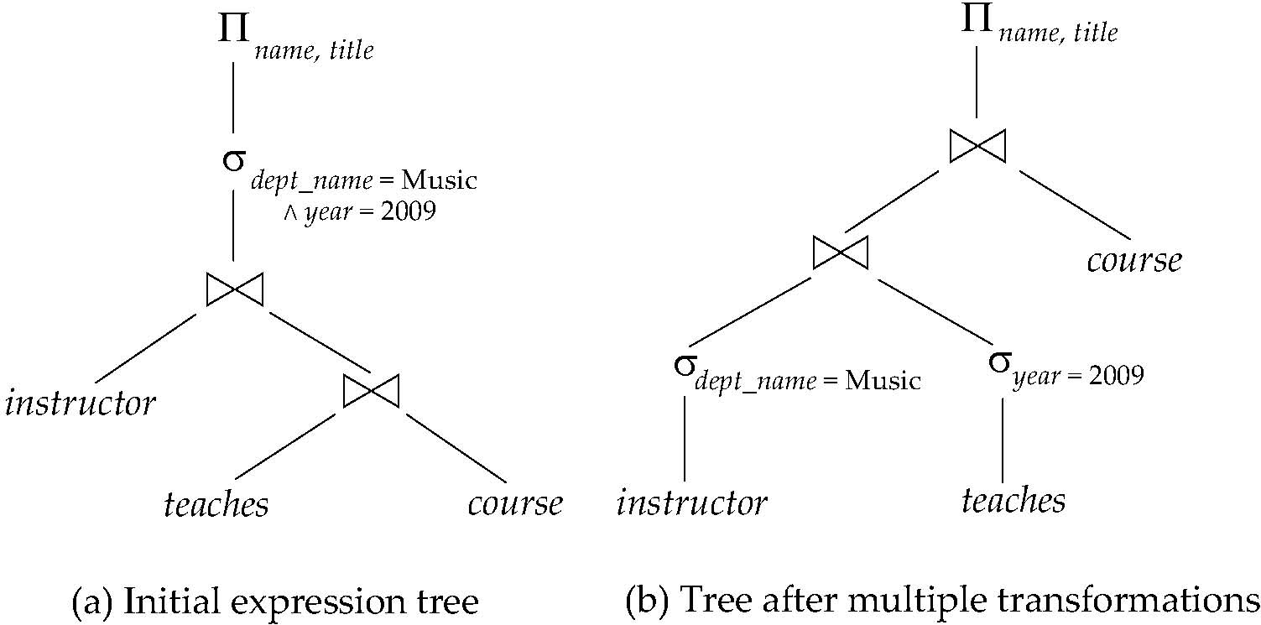
Multiple Transformations (Cont.)

Slide 65
Transformation Example: Pushing Projections
Consider: Π_{name, title}(σ_{dept_name= “Music”} (instructor) teaches) Π_{course_id, title} (course))))
When we compute
(σ_{dept_name = “Music”} (instructor teaches)
we obtain a relation whose schema is: (ID, name, dept_name, salary, course_id, sec_id, semester, year)
Push projections using equivalence rules 8a and 8b; eliminate unneeded attributes from intermediate results to get: Π_{name, title}(Π_{name, course_id} ( σ_{dept_name= “Music”} (instructor) teaches)) Π_{course_id, title} (course))))
Performing the projection as early as possible reduces the size of the relation to be joined.

Slide 66
Join Ordering Example
For all relations r_{1,} r_{2,} and r₃,
(r₁ r₂) r₃ = r₁ (r₂ r₃ )
(Join Associativity)
If r₂ r₃ is quite large and r₁ r₂ is small, we choose
(r₁ r₂) r₃
so that we compute and store a smaller temporary relation.

Slide 67
Join Ordering Example (Cont.)
Consider the expression
Π_{name, title}(σ_{dept_name= “Music”} (instructor) teaches) Π_{course_id, title} (course))))
Could compute teaches Π_{course_id, title} (course) first, and join result with σ_{dept_name= “Music”} (instructor) but the result of the first join is likely to be a large relation.
Only a small fraction of the university’s instructors are likely to be from the Music department
it is better to compute
σ_{dept_name= “Music”} (instructor) teaches
first.

Slide 68
Enumeration of Equivalent Expressions
Query optimizers use equivalence rules to systematically generate expressions equivalent to the given expression
Can generate all equivalent expressions as follows:
Repeat
apply all applicable equivalence rules on every subexpression of every equivalent expression found so far
add newly generated expressions to the set of equivalent expressions
Until no new equivalent expressions are generated above
The above approach is very expensive in space and time
Two approaches
Optimized plan generation based on transformation rules
Special case approach for queries with only selections, projections and joins

Slide 69
Implementing Transformation Based Optimization
Space requirements reduced by sharing common sub-expressions:
when E1 is generated from E2 by an equivalence rule, usually only the top level of the two are different, subtrees below are the same and can be shared using pointers
E.g. when applying join commutativity
Same sub-expression may get generated multiple times
Detect duplicate sub-expressions and share one copy
Time requirements are reduced by not generating all expressions
Dynamic programming
We will study only the special case of dynamic programming for join order optimization
E1
E2

Slide 70
代价估算 Cost Estimation
Cost of each operator computed as described in Chapter 12
Need statistics of input relations
E.g. number of tuples, sizes of tuples
Inputs can be results of sub-expressions
Need to estimate statistics of expression results
To do so, we require additional statistics
E.g. number of distinct values for an attribute
More on cost estimation later

Slide 71
11.5.4 执行计划的选择 Choice of Evaluation Plans
Must consider the interaction of evaluation techniques when choosing evaluation plans
choosing the cheapest algorithm for each operation independently may not yield best overall algorithm. E.g.
merge-join may be costlier than hash-join, but may provide a sorted output which reduces the cost for an outer level aggregation.
nested-loop join may provide opportunity for pipelining
Practical query optimizers incorporate elements of the following two broad approaches:
1. Search all the plans and choose the best plan in a cost-based fashion.
2. Uses heuristics to choose a plan.

Slide 72
基于代价的优化 Cost-Based Optimization
Consider finding the best join-order for r₁ r₂ . . . r_{n}.
There are (2(n – 1))!/(n – 1)! different join orders for above expression. With n = 7, the number is 665280, with n = 10, the number is greater than 176 billion!
No need to generate all the join orders. Using dynamic programming, the least-cost join order for any subset of {r₁, r₂, . . . r_{n}} is computed only once and stored for future use.

Slide 73
Dynamic Programming in Optimization
To find best join tree for a set of n relations:
To find best plan for a set S of n relations, consider all possible plans of the form: S₁ (S – S₁) where S₁ is any non-empty subset of S.
Recursively compute costs for joining subsets of S to find the cost of each plan. Choose the cheapest of the 2^{n} – 2 alternatives.
Base case for recursion: single relation access plan
Apply all selections on R_{i} using best choice of indices on R_{i}
When plan for any subset is computed, store it and reuse it when it is required again, instead of recomputing it
Dynamic programming

Slide 74
Join Order Optimization Algorithm
procedure findbestplan(S) if (bestplan[S].cost ≠ ∞) return bestplan[S] // else bestplan[S] has not been computed earlier, compute it now if (S contains only 1 relation) set bestplan[S].plan and bestplan[S].cost based on the best way of accessing S /* Using selections on S and indices on S */
else for each non-empty subset S1 of S such that S1 ≠ S P1= findbestplan(S1) P2= findbestplan(S - S1) A = best algorithm for joining results of P1 and P2 cost = P1.cost + P2.cost + cost of A if cost < bestplan[S].cost bestplan[S].cost = cost bestplan[S].plan = “execute P1.plan; execute P2.plan; join results of P1 and P2 using A” return bestplan[S]
* Some modifications to allow indexed nested loops joins on relations that have selections (see book)

Slide 75
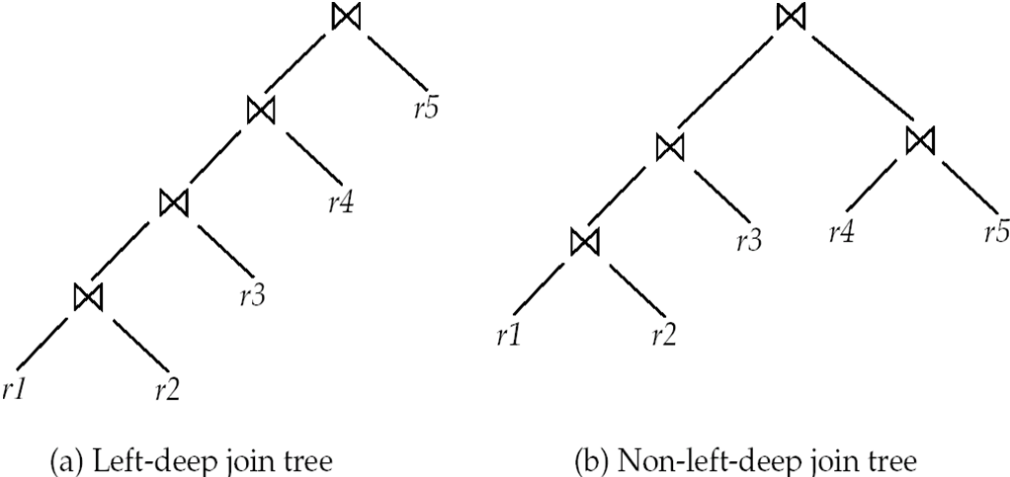
Left Deep Join Trees
In left-deep join trees, the right-hand-side input for each join is a relation, not the result of an intermediate join.

Slide 76
Cost of Optimization
With dynamic programming time complexity of optimization with bushy trees is O(3^{n}).
With n = 10, this number is 59000 instead of 176 billion!
Space complexity is O(2^{n})
To find best left-deep join tree for a set of n relations:
Consider n alternatives with one relation as right-hand side input and the other relations as left-hand side input.
Modify optimization algorithm:
Replace “for each non-empty subset S1 of S such that S1 ≠ S”
By: for each relation r in S let S1 = S – r .
If only left-deep trees are considered, time complexity of finding best join order is O(n 2^{n})
Space complexity remains at O(2^{n})
Cost-based optimization is expensive, but worthwhile for queries on large datasets (typical queries have small n, generally < 10)

Slide 77
Interesting Sort Orders
Consider the expression (r₁ r₂) r₃ (with A as common attribute)
An interesting sort order is a particular sort order of tuples that could be useful for a later operation
Using merge-join to compute r₁ r₂ may be costlier than hash join but generates result sorted on A
Which in turn may make merge-join with r₃ cheaper, which may reduce cost of join with r₃ and minimizing overall cost
Sort order may also be useful for order by and for grouping
Not sufficient to find the best join order for each subset of the set of n given relations
must find the best join order for each subset, for each interesting sort order
Simple extension of earlier dynamic programming algorithms
Usually, number of interesting orders is quite small and doesn’t affect time/space complexity significantly

Slide 78
Cost Based Optimization with Equivalence Rules
Physical equivalence rules allow logical query plan to be converted to physical query plan specifying what algorithms are used for each operation.
Efficient optimizer based on equivalent rules depends on
A space efficient representation of expressions which avoids making multiple copies of subexpressions
Efficient techniques for detecting duplicate derivations of expressions
A form of dynamic programming based on memoization, which stores the best plan for a subexpression the first time it is optimized, and reuses in on repeated optimization calls on same subexpression
Cost-based pruning techniques that avoid generating all plans
Pioneered by the Volcano project and implemented in the SQL Server optimizer

Slide 79
启发式优化 Heuristic Optimization
Cost-based optimization is expensive, even with dynamic programming.
Systems may use heuristics to reduce the number of choices that must be made in a cost-based fashion.
Heuristic optimization transforms the query-tree by using a set of rules that typically (but not in all cases) improve execution performance:
Perform selection early (reduces the number of tuples)
Perform projection early (reduces the number of attributes)
Perform most restrictive selection and join operations (i.e. with smallest result size) before other similar operations.
Some systems use only heuristics, others combine heuristics with partial cost-based optimization.

Slide 80
Structure of Query Optimizers
Many optimizers considers only left-deep join orders.
Plus heuristics to push selections and projections down the query tree
Reduces optimization complexity and generates plans amenable to pipelined evaluation.
Heuristic optimization used in some versions of Oracle:
Repeatedly pick “best” relation to join next
Starting from each of n starting points. Pick best among these
Intricacies of SQL complicate query optimization
E.g. nested subqueries

Slide 81
Structure of Query Optimizers (Cont.)
Some query optimizers integrate heuristic selection and the generation of alternative access plans.
Frequently used approach
heuristic rewriting of nested block structure and aggregation
followed by cost-based join-order optimization for each block
Some optimizers (e.g. SQL Server) apply transformations to entire query and do not depend on block structure
Optimization cost budget to stop optimization early (if cost of plan is less than cost of optimization)
Plan caching to reuse previously computed plan if query is resubmitted
Even with different constants in query
Even with the use of heuristics, cost-based query optimization imposes a substantial overhead.
But is worth it for expensive queries
Optimizers often use simple heuristics for very cheap queries, and perform exhaustive enumeration for more expensive queries

Slide 82
代价估计的统计 Statistics for Cost Estimation

Slide 83
代价估计的统计性信息 Statistical Information for Cost Estimation
n_{r}: number of tuples in a relation r.
b_{r}: number of blocks containing tuples of r.
l_{r}: size of a tuple of r.
f_{r}: blocking factor of r — i.e., the number of tuples of r that fit into one block.
V(A, r): number of distinct values that appear in r for attribute A; same as the size of ∏_{A}(r).
If tuples of r are stored together physically in a file, then:

Slide 84
直方图 Histograms
Histogram on attribute age of relation person
Equi-width histograms
Equi-depth histograms

Slide 85
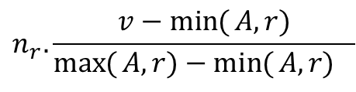
选择大小的估计 Selection Size Estimation
σ_{A=v}(r)
n_{r} / V(A,r) : number of records that will satisfy the selection
Equality condition on a key attribute: size estimate = 1
σ_{A≤V}(r) (case of σ_{A ≥ V}(r) is symmetric)
Let c denote the estimated number of tuples satisfying the condition.
If min(A,r) and max(A,r) are available in catalog
c = 0 if v < min(A,r)
c =
If histograms available, can refine above estimate
In absence of statistical information c is assumed to be n_{r} / 2.
$$n_{r}.\frac{v−\min{(}A,r)}{\max{(}A,r)−\min{(}A,r)_{}}$$

Slide 86
Size Estimation of Complex Selections
The selectivity of a condition θ_{i} is the probability that a tuple in the relation r satisfies θ_{i} .
If s_{i} is the number of satisfying tuples in r, the selectivity of θ_{i} is given by s_{i} /n_{r}.
Conjunction: σ_{θ1∧ θ2∧. . . ∧ θn} (r). Assuming indepdence, estimate of tuples in the result is:
Disjunction:σ_{θ1∨} _{θ2 ∨. . . ∨} _{θn} (r). Estimated number of tuples:
Negation: σ_{¬θ}(r). Estimated number of tuples: n_{r} – size(σ_{θ}(r))

Slide 87
连接运算: 执行例子
Running example: student takes
Catalog information for join examples:
n_{student} = 5,000.
f_{student} = 50, which implies that b_{student} =5000/50 = 100.
n_{takes} = 10000.
f_{takes} = 25, which implies that b_{takes} = 10000/25 = 400.
V(ID, takes) = 2500, which implies that on average, each student who has taken a course has taken 4 courses.
Attribute ID in takes is a foreign key referencing student.
V(ID, student) = 5000 (primary key!)

Slide 88
估计连接运算中大小 Estimation of the Size of Joins
The Cartesian product r x s contains n_{r} .n_{s} tuples; each tuple occupies s_{r} + s_{s} bytes.
If R ∩ S = ∅, then r s is the same as r x s.
If R ∩ S is a key for R, then a tuple of s will join with at most one tuple from r
therefore, the number of tuples in r s is no greater than the number of tuples in s.
If R ∩ S in S is a foreign key in S referencing R, then the number of tuples in r s is exactly the same as the number of tuples in s.
The case for R ∩ S being a foreign key referencing S is symmetric.
In the example query student takes, ID in takes is a foreign key referencing student
hence, the result has exactly n_{takes} tuples, which is 10000

Slide 89
Estimation of the Size of Joins (Cont.)
If R ∩ S = {A} is not a key for R or S. If we assume that every tuple t in R produces tuples in R S, the number of tuples in R S is estimated to be: If the reverse is true, the estimate obtained will be: The lower of these two estimates is probably the more accurate one.
Can improve on above if histograms are available
Use formula similar to above, for each cell of histograms on the two relations

Slide 90
Estimation of the Size of Joins (Cont.)
Compute the size estimates for depositor customer without using information about foreign keys:
V(ID, takes) = 2500, and V(ID, student) = 5000
The two estimates are 5000 * 10000/2500 = 20,000 and 5000 * 10000/5000 = 10000
We choose the lower estimate, which in this case, is the same as our earlier computation using foreign keys.

Slide 91
Size Estimation for Other Operations
Projection: estimated size of ∏_{A}(r) = V(A,r)
Aggregation : estimated size of _{A}g_{F}(r) = V(A,r)
Set operations
For unions/intersections of selections on the same relation: rewrite and use size estimate for selections
E.g. σ_{θ1} (r) ∪ σ_{θ2} (r) can be rewritten as σ_{θ1 ˅ θ2} (r)
For operations on different relations:
estimated size of r ∪ s = size of r + size of s.
estimated size of r ∩ s = minimum size of r and size of s.
estimated size of r – s = r.
All the three estimates may be quite inaccurate, but provide upper bounds on the sizes.

Slide 92
Size Estimation (Cont.)
Outer join:
Estimated size of r s = size of r s + size of r
Case of right outer join is symmetric
Estimated size of r s = size of r s + size of r + size of s

Slide 93
Estimation of Number of Distinct Values
Selections: σ_{θ} (r)
If θ forces A to take a specified value: V(A,σ_{θ} (r)) = 1.
e.g., A = 3
If θ forces A to take on one of a specified set of values: V(A,σ_{θ} (r)) = number of specified values.
(e.g., (A = 1 V A = 3 V A = 4 )),
If the selection condition θ is of the form A op r estimated V(A,σ_{θ} (r)) = V(A.r) * s
where s is the selectivity of the selection.
In all the other cases: use approximate estimate of min(V(A,r), n_{σθ (r)} )
More accurate estimate can be got using probability theory, but this one works fine generally

Slide 94
Estimation of Distinct Values (Cont.)
Joins: r s
If all attributes in A are from r estimated V(A, r s) = min (V(A,r), n _{r s})
If A contains attributes A1 from r and A2 from s, then estimated V(A,r s) =
min(V(A1,r)*V(A2 – A1,s), V(A1 – A2,r)*V(A2,s), n_{r s})
More accurate estimate can be got using probability theory, but this one works fine generally

Slide 95
Estimation of Distinct Values (Cont.)
Estimation of distinct values are straightforward for projections.
They are the same in ∏_{A (r)} as in r.
The same holds for grouping attributes of aggregation.
For aggregated values
For min(A) and max(A), the number of distinct values can be estimated as min(V(A,r), V(G,r)) where G denotes grouping attributes
For other aggregates, assume all values are distinct, and use V(G,r)

Slide 96
Additional Optimization Techniques
Nested Subqueries
Materialized Views

Slide 97
Optimizing Nested Subqueries**
Nested query example: select name from instructor where exists (select * from teaches where instructor.ID = teaches.ID and teaches.year = 2007)
SQL conceptually treats nested subqueries in the where clause as functions that take parameters and return a single value or set of values
Parameters are variables from outer level query that are used in the nested subquery; such variables are called correlation variables
Conceptually, nested subquery is executed once for each tuple in the cross-product generated by the outer level from clause
Such evaluation is called correlated evaluation
Note: other conditions in where clause may be used to compute a join (instead of a cross-product) before executing the nested subquery

Slide 98
Optimizing Nested Subqueries (Cont.)
Correlated evaluation may be quite inefficient since
a large number of calls may be made to the nested query
there may be unnecessary random I/O as a result
SQL optimizers attempt to transform nested subqueries to joins where possible, enabling use of efficient join techniques
E.g.: earlier nested query can be rewritten as select name from instructor, teaches where instructor.ID = teaches.ID and teaches.year = 2007
Note: the two queries generate different numbers of duplicates (why?)
teaches can have duplicate IDs
Can be modified to handle duplicates correctly as we will see
In general, it is not possible/straightforward to move the entire nested subquery from clause into the outer level query from clause
A temporary relation is created instead, and used in body of outer level query

Slide 99
Optimizing Nested Subqueries (Cont.)
In general, SQL queries of the form below can be rewritten as shown
Rewrite: select … from L₁ where P₁ and exists (select * from L₂ where P₂)
To: create table t₁ as select distinct V from L₂ where P₂¹ select … from L₁, t₁ where P₁ and P₂²
P₂¹ contains predicates in P₂ that do not involve any correlation variables
P₂² reintroduces predicates involving correlation variables, with relations renamed appropriately
V contains all attributes used in predicates with correlation variables

Slide 100
Optimizing Nested Subqueries (Cont.)
In our example, the original nested query would be transformed to create table t₁ as select distinct ID from teaches where year = 2007 select name from instructor, t₁ where t₁.ID = instructor.ID
The process of replacing a nested query by a query with a join (possibly with a temporary relation) is called decorrelation.
Decorrelation is more complicated when
the nested subquery uses aggregation, or
when the result of the nested subquery is used to test for equality, or
when the condition linking the nested subquery to the other query is not exists,
and so on.

Slide 101
Materialized Views**
A materialized view is a view whose contents are computed and stored.
Consider the view create view department_total_salary(dept_name, total_salary) as select dept_name, sum(salary) from instructor group by dept_name
Materializing the above view would be very useful if the total salary by department is required frequently
Saves the effort of finding multiple tuples and adding up their amounts

Slide 102
Materialized View Maintenance
The task of keeping a materialized view up-to-date with the underlying data is known as materialized view maintenance
Materialized views can be maintained by recomputation on every update
A better option is to use incremental view maintenance
Changes to database relations are used to compute changes to the materialized view, which is then updated
View maintenance can be done by
Manually defining triggers on insert, delete, and update of each relation in the view definition
Manually written code to update the view whenever database relations are updated
Periodic recomputation (e.g. nightly)
Above methods are directly supported by many database systems
Avoids manual effort/correctness issues

Slide 103
Incremental View Maintenance
The changes (inserts and deletes) to a relation or expressions are referred to as its differential
Set of tuples inserted to and deleted from r are denoted i_{r} and d_{r}
To simplify our description, we only consider inserts and deletes
We replace updates to a tuple by deletion of the tuple followed by insertion of the update tuple
We describe how to compute the change to the result of each relational operation, given changes to its inputs
We then outline how to handle relational algebra expressions

Slide 104
Join Operation
Consider the materialized view v = r s and an update to r
Let r^{old} and r^{new} denote the old and new states of relation r
Consider the case of an insert to r:
We can write r^{new} s as (r^{old} ∪ i_{r}) s
And rewrite the above to (r^{old} s) ∪ (i_{r} s)
But (r^{old} s) is simply the old value of the materialized view, so the incremental change to the view is just i_{r} s
Thus, for inserts v^{new} = v^{old} ∪(i_{r} s)
Similarly for deletes v^{new} = v^{old} – (d_{r} s)
A, 1
B, 2
1, p
2, r
2, s
A, 1, p
B, 2, r
B, 2, s
C,2
C, 2, r
C, 2, s

Slide 105
Selection and Projection Operations
Selection: Consider a view v = σ_{θ}(r).
v^{new} = v^{old} ∪σ_{θ}(i_{r})
v^{new} = v^{old} - σ_{θ}(d_{r})
Projection is a more difficult operation
R = (A,B), and r(R) = { (a,2), (a,3)}
∏_{A}(r) has a single tuple (a).
If we delete the tuple (a,2) from r, we should not delete the tuple (a) from ∏_{A}(r), but if we then delete (a,3) as well, we should delete the tuple
For each tuple in a projection ∏_{A}(r) , we will keep a count of how many times it was derived
On insert of a tuple to r, if the resultant tuple is already in ∏_{A}(r) we increment its count, else we add a new tuple with count = 1
On delete of a tuple from r, we decrement the count of the corresponding tuple in ∏_{A}(r)
if the count becomes 0, we delete the tuple from ∏_{A}(r)

Slide 106
Aggregation Operations
count : v = _{A}g_{count(B)}^{(r)}.
When a set of tuples i_{r} is inserted
For each tuple r in i_{r}, if the corresponding group is already present in v, we increment its count, else we add a new tuple with count = 1
When a set of tuples d_{r} is deleted
for each tuple t in i_{r.}we look for the group t.A in v, and subtract 1 from the count for the group.
If the count becomes 0, we delete from v the tuple for the group t.A
sum: v = _{A}g_{sum (B)}^{(r)}
We maintain the sum in a manner similar to count, except we add/subtract the B value instead of adding/subtracting 1 for the count
Additionally we maintain the count in order to detect groups with no tuples. Such groups are deleted from v
Cannot simply test for sum = 0 (why?)
To handle the case of avg, we maintain the sum and count aggregate values separately, and divide at the end

Slide 107
Aggregate Operations (Cont.)
min, max: v = _{A}g_{min (B)} (r).
Handling insertions on r is straightforward.
Maintaining the aggregate values min and max on deletions may be more expensive. We have to look at the other tuples of r that are in the same group to find the new minimum

Slide 108
Other Operations
Set intersection: v = r ∩ s
when a tuple is inserted in r we check if it is present in s, and if so we add it to v.
If the tuple is deleted from r, we delete it from the intersection if it is present.
Updates to s are symmetric
The other set operations, union and set difference are handled in a similar fashion.
Outer joins are handled in much the same way as joins but with some extra work
we leave details to you.

Slide 109
Handling Expressions
To handle an entire expression, we derive expressions for computing the incremental change to the result of each sub-expressions, starting from the smallest sub-expressions.
E.g. consider E₁ E₂ where each of E₁ and E₂ may be a complex expression
Suppose the set of tuples to be inserted into E₁ is given by D₁
Computed earlier, since smaller sub-expressions are handled first
Then the set of tuples to be inserted into E₁ E₂ is given by D₁ E₂
This is just the usual way of maintaining joins

Slide 110
Query Optimization and Materialized Views
Rewriting queries to use materialized views:
A materialized view v = r s is available
A user submits a query r s t
We can rewrite the query as v t
Whether to do so depends on cost estimates for the two alternative
Replacing a use of a materialized view by the view definition:
A materialized view v = r s is available, but without any index on it
User submits a query σ_{A=10}(v).
Suppose also that s has an index on the common attribute B, and r has an index on attribute A.
The best plan for this query may be to replace v by r s, which can lead to the query plan σ_{A=10}(r) s
Query optimizer should be extended to consider all above alternatives and choose the best overall plan

Slide 111
Materialized View Selection
Materialized view selection: “What is the best set of views to materialize?”.
Index selection: “what is the best set of indices to create”
closely related, to materialized view selection
but simpler
Materialized view selection and index selection based on typical system workload (queries and updates)
Typical goal: minimize time to execute workload , subject to constraints on space and time taken for some critical queries/updates
One of the steps in database tuning
more on tuning in later chapters
Commercial database systems provide tools (called “tuning assistants” or “wizards”) to help the database administrator choose what indices and materialized views to create

Slide 112
Additional Optimization Techniques

Slide 113
Top-K Queries
Top-K queries
select * from r, s where r.B = s.B order by r.A ascending limit 10
Alternative 1: Indexed nested loops join with r as outer
Alternative 2: estimate highest r.A value in result and add selection (and r.A <= H) to where clause
If < 10 results, retry with larger H

Slide 114
Optimization of Updates
Halloween problem
update R set A = 5 * A where A > 10
If index on A is used to find tuples satisfying A > 10, and tuples updated immediately, same tuple may be found (and updated) multiple times
Solution 1: Always defer updates
collect the updates (old and new values of tuples) and update relation and indices in second pass
Drawback: extra overhead even if e.g. update is only on R.B, not on attributes in selection condition
Solution 2: Defer only if required
Perform immediate update if update does not affect attributes in where clause, and deferred updates otherwise.

Slide 115
Join Minimization
Join minimization
select r.A, r.B from r, s where r.B = s.B
Check if join with s is redundant, drop it
E.g. join condition is on foreign key from r to s, r.B is declared as not null, and no selection on s
Other sufficient conditions possible select r.A, s2.B from r, s as s1, s as s2 where r.B=s1.B and r.B = s2.B and s1.A < 20 and s2.A < 10
join with s1 is redundant and can be dropped (along with selection on s1)
Lots of research in this area since 70s/80s!

Slide 116
Multiquery Optimization
Example
Q1: select * from (r natural join t) natural join s
Q2: select * from (r natural join u) natural join s
Both queries share common subexpression (r natural join s)
May be useful to compute (r natural join s) once and use it in both queries
But this may be more expensive in some situations
e.g. (r natural join s) may be expensive, plans as shown in queries may be cheaper
Multiquery optimization: find best overall plan for a set of queries, expoiting sharing of common subexpressions between queries where it is useful

Slide 117
Multiquery Optimization (Cont.)
Simple heuristic used in some database systems:
optimize each query separately
detect and exploiting common subexpressions in the individual optimal query plans
May not always give best plan, but is cheap to implement
Shared scans: widely used special case of multiquery optimization
Set of materialized views may share common subexpressions
As a result, view maintenance plans may share subexpressions
Multiquery optimization can be useful in such situations
Notes:
117

Slide 118
Parametric Query Optimization
Example select * from r natural join s where r.a < $1
value of parameter $1 not known at compile time
known only at run time
different plans may be optimal for different values of $1
Solution 1: optimize at run time, each time query is submitted
can be expensive
Solution 2: Parametric Query Optimization:
optimizer generates a set of plans, optimal for different values of $1
Set of optimal plans usually small for 1 to 3 parameters
Key issue: how to do find set of optimal plans efficiently
best one from this set is chosen at run time when $1 is known
Solution 3: Query Plan Caching
If optimizer decides that same plan is likely to be optimal for all parameter values, it caches plan and reuses it, else reoptimize each time
Implemented in many database systems

Slide 119
Exercises
Practice Exercises:
11.1 11.2 11.3 11.4 11.6 11.7
Exercises:
11.8
Notes:
119

Slide 120
End of Chapter

