Slide 1
05/22 Meeting

Slide 2
Contents
Progress Update:
Manually labeled comments(for training model)
Comment Funnel Function Model
This week’s task:
Input Filtering System
Regex on front-end for simple filtering
Input filtering model for complex filtering tasks

Slide 3
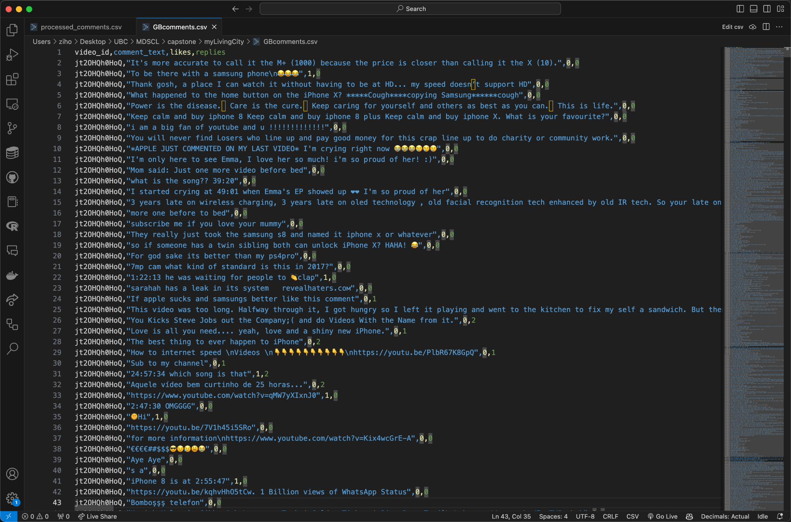
Youtube comments
Different lengths
Not plain text, emoji exists
Comments that make no sense
Bad language
Network language
……

Slide 4
Sentiment and keyword tagging
I'm only here to see Emma, I love her so much! i'm so proud of her! :) | ['0. Positive | 1. exclaim | 2. love | 3. Emma | 4. proud | 5. much | 6. her | 7. :)']
The best thing to ever happen to iPhone | ['0. Positive | 1. Praise | 2. Best | 3. Thing | 4. Happen | 5. iPhone | 6. Ever | 7. To']
Yes now I can afford iphone 6 | ['0. Positive | 1. Rejoice | 2. iPhone | 3. Afford | 4. Now | 5. Can | 6. Six']
Apple is terrible and they only care about the money | ['0. Negative | 1. Slam | 2. Terrible | 3. Money | 4. Care | 5. Apple']
Does anyone have $1000 | ['0. Neutral | 1. Ask | 2. Anyone | 3. Have | 4. Money | 5. Amount | 6. Dollar | 7. Cash']

Slide 5
Model …
Consider reducing the amount of calculation
Limitation of the Back-end server
Improving response speed

Slide 6
Model …
*New Comment
*Comment Tags
"I was definitely interested in it before I see the price. So EXPENSIVE!"
['Negative', 'Exclaimed', 'Expensive', 'Interested', 'Price', 'See', 'Definitely', 'So']

Slide 7
Model …
sentence
word
*New Comment
*Comment Tags
Existing Comment
Existing Tags
Existing Comment
Existing Tags
Existing Comment
Existing Tags
……
……
Existing Comment
Existing Tags
Existing Comment
Existing Tags

Slide 8
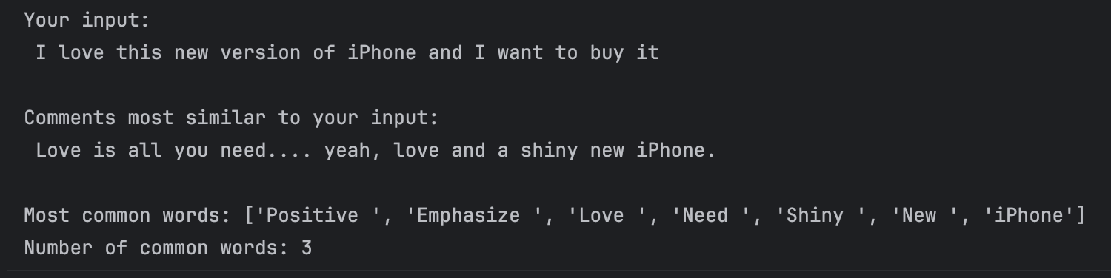
Examples
Currently only trained and checked 500 sentences (with more than 700,000 in dataset)

Slide 9
Discussion
Q & A

