Slide 1
05/28 Meeting

Slide 2
Contents
Progress Update:
Comment Funnel Function Fine Tuned
Comment Filtering Function Created
This week’s task:
Improve the two functions
Create Gauge Statistics and Display Dashboard

Slide 3
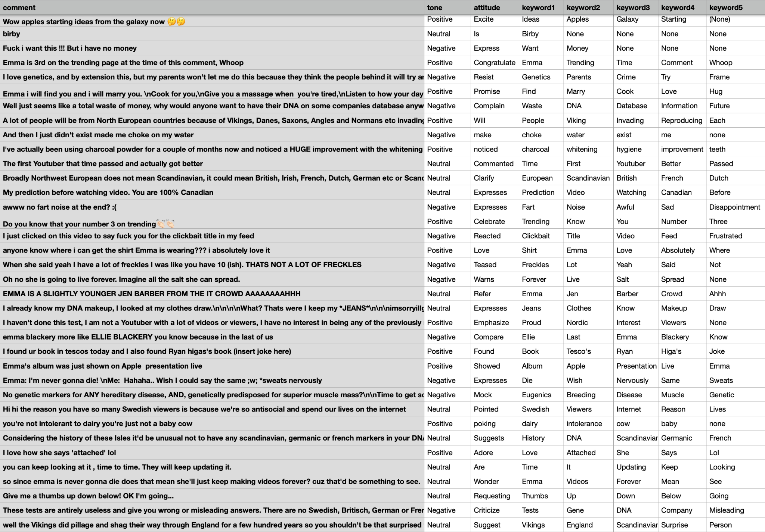
Comment
Funnel Function
Improved the model’s capability of understanding and extracting important tags
Takes 0.3-0.5 second to process one comment.

Slide 4
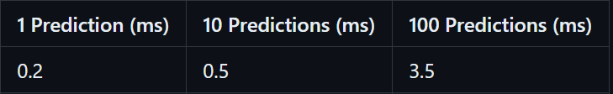
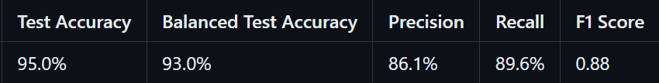
Comment Filtering Function
A fast and robust function
* Test data is from a kaggle challenge dataset

Slide 5
Model Structure
Vectorization: Bag of Words(turns any text string into a vector by counting how many times each given word appears)
Example: “I am swimming, I am happy.”
I | am | swimming | happy
2 | 2 | 1 | 1

Slide 6
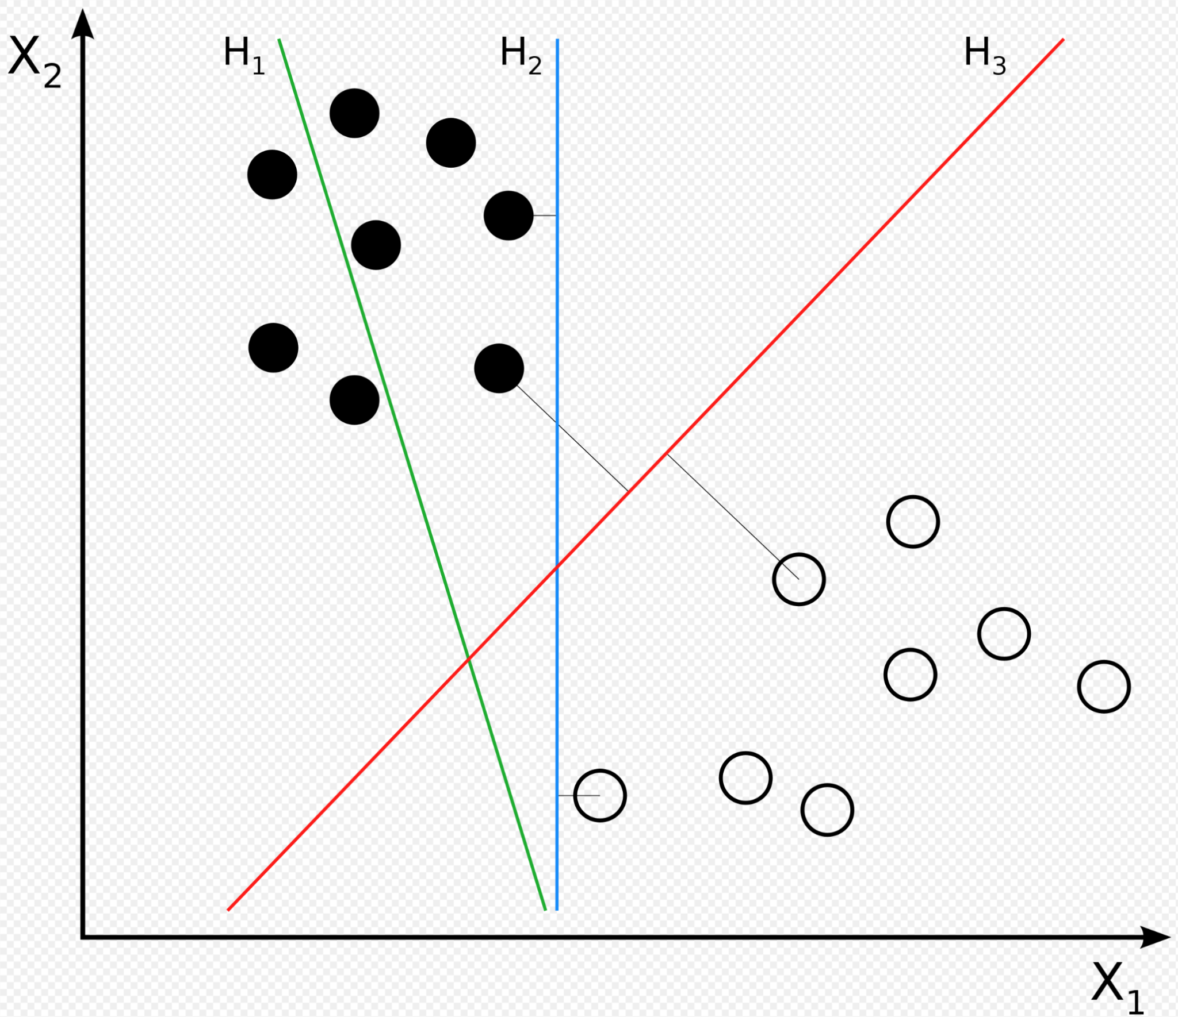
Model Structure
Linear Support vector machine(SVM)
The model learns which words are “bad” and how “bad” they are because those words appear more often in offensive texts. It’s as if the training process is picking out the “bad” words itself, which is much better than using a fixed wordlist.
Source: Wikipedia(Svm separating hyperplanes)

Slide 7
Highlights
Fast and robust
Simple structure, easy to setup or modify according to future demand
No bad word list required, learns by itself
Smarter and more flexible than Regular Expression

Slide 8
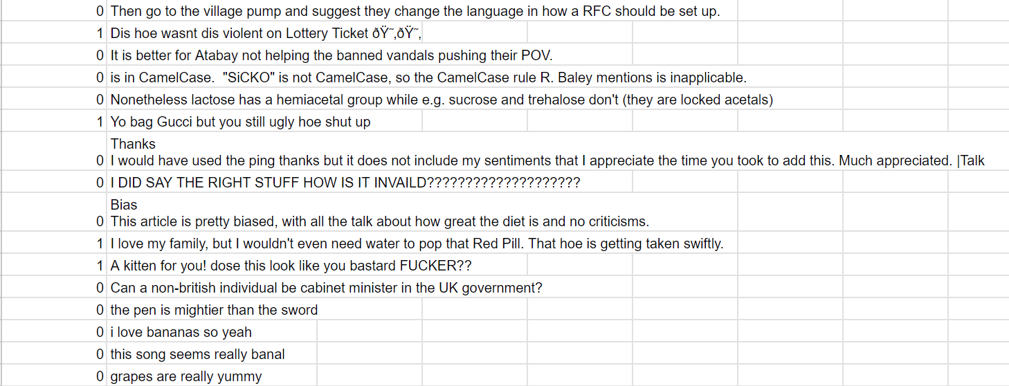
Demo

Slide 9
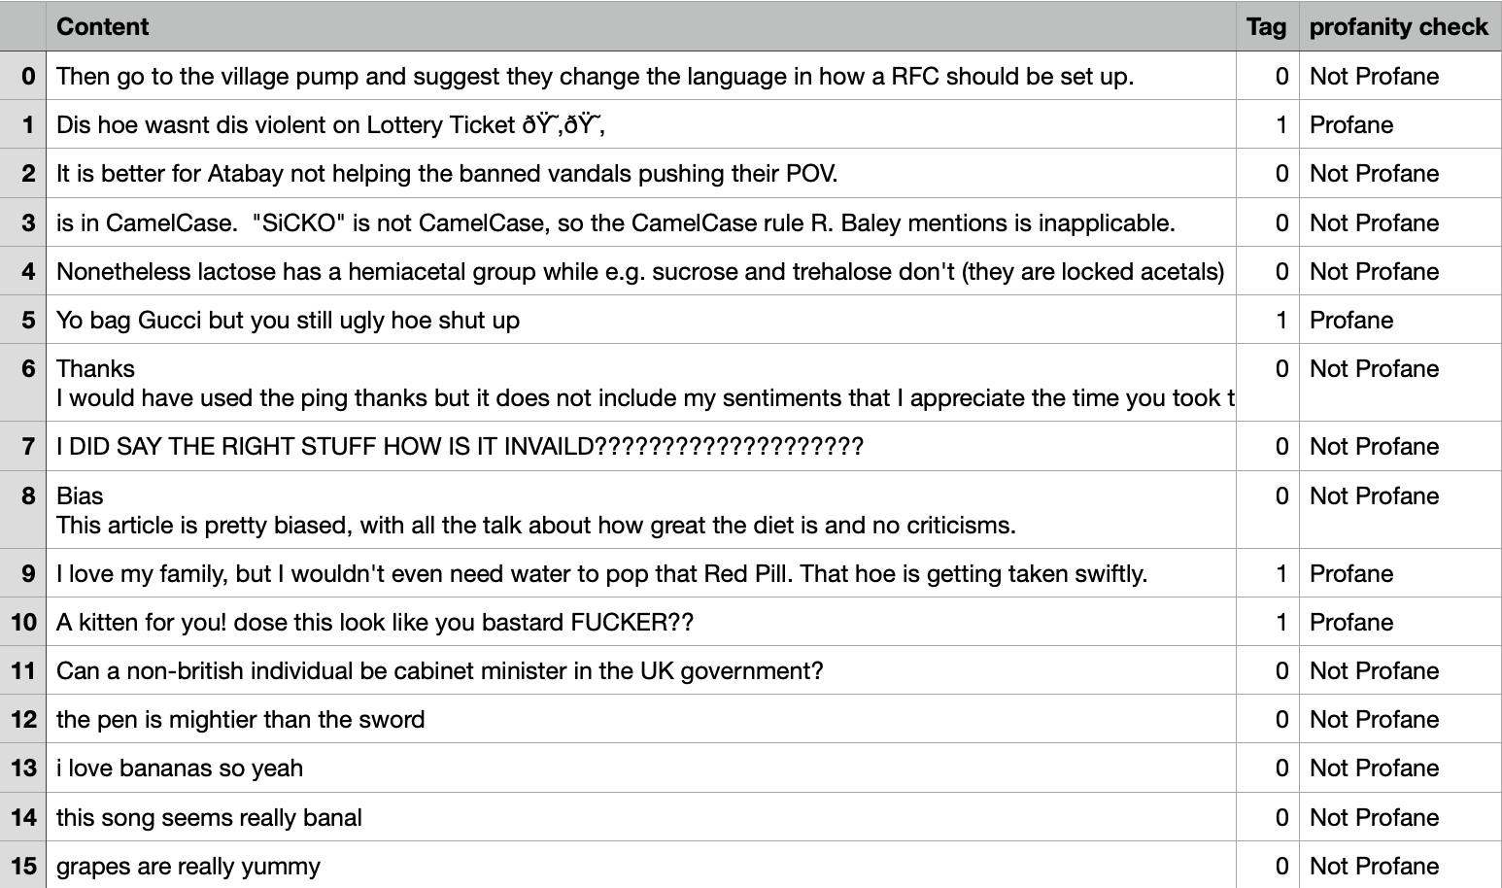
Demo

Slide 10
Discussion
Q & A

