Slide 1
06/05 Meeting

Slide 2
Contents
Progress Update:
API Setup
Statistical Data Dashboard Created
This week’s task:
Provide API setup support
Modify data dashboard according to demand
Develop Summation Comment Display

Slide 3
API Setup Progress
API Setup Note Available on Google Drive
Background
Function Description
API Requirement
Meeting with Camosun:
Docker set up
Database Connection on PostgreSQL

Slide 4
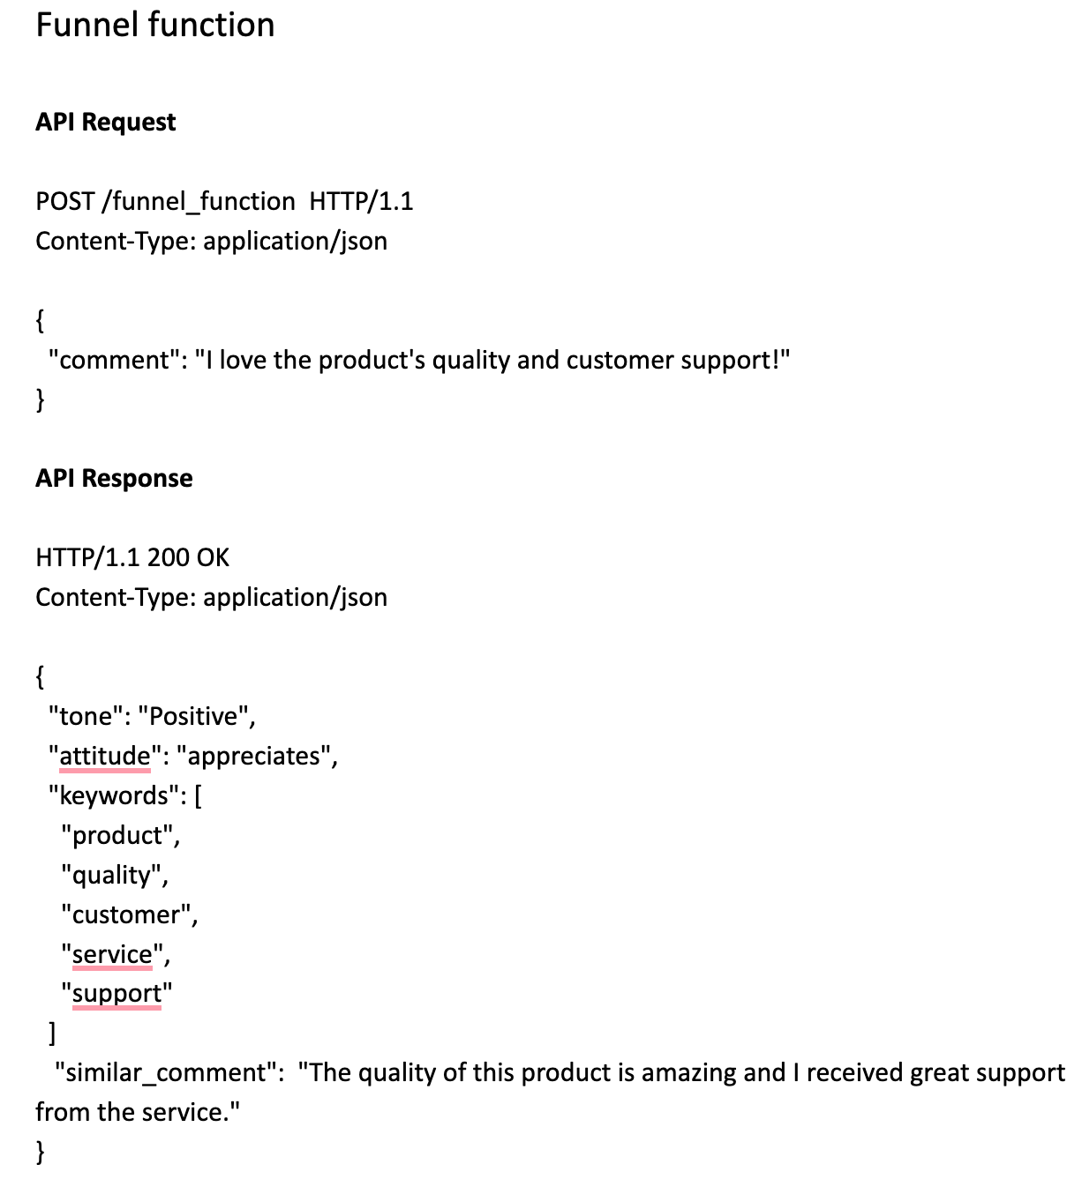
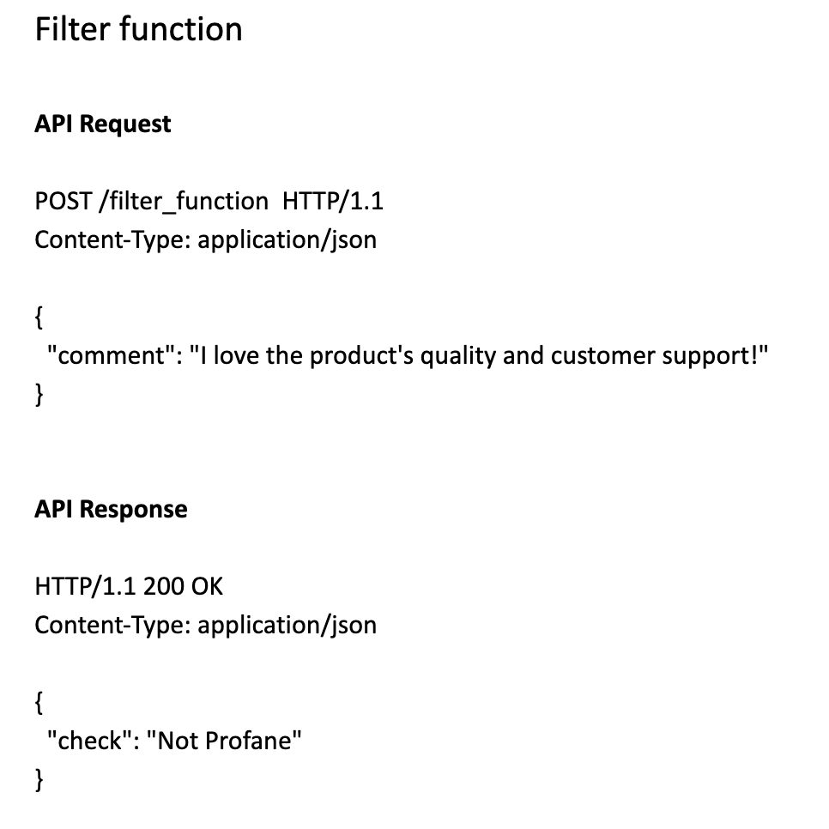
API Setup Document

Slide 5
API Setup Discussion
API setup goal
Rapid deployment
Independent modules (Not affect the original code development)
Easy to call the function

Slide 6
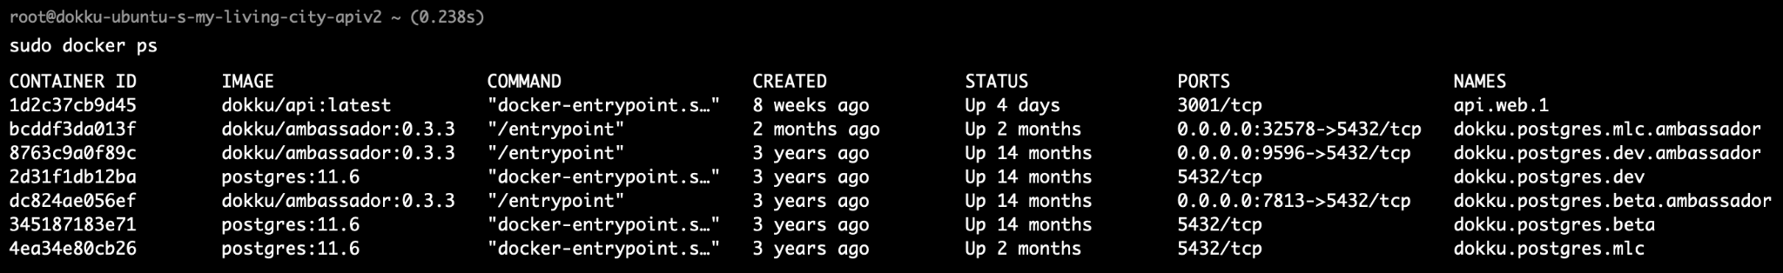
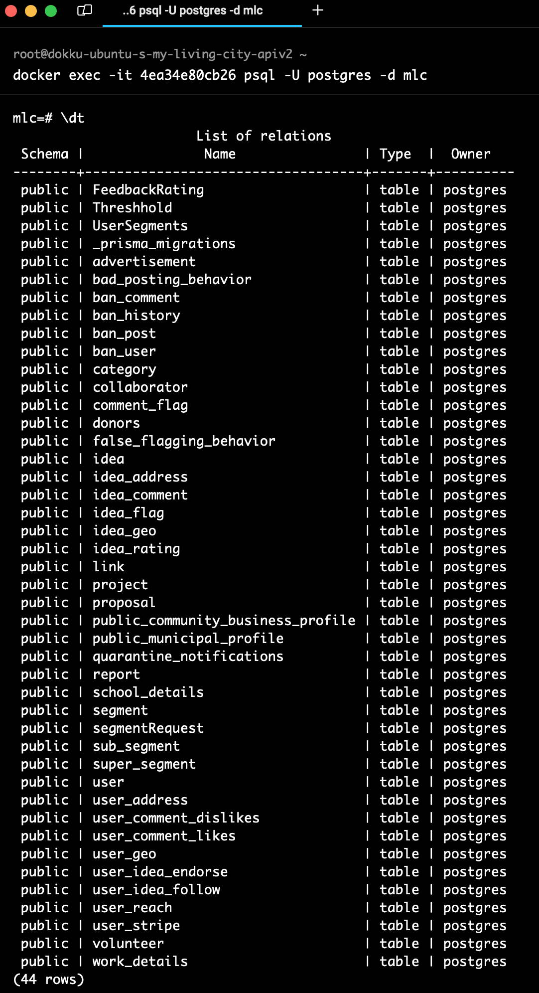
API Set up
Access to docker
Define a new schema to store the comments for processing

Slide 7
API Setup Goal
Camosun can easily call the function by API
Funnel function & Filter function
We can access to the database and process the new comment
Interacting with the database

Slide 8
Gauge Statistics and Display Dashboard
Semantic analysis chart
Attitude chart
Keyword chart
User-type chart
Gender chart
Income-level chart
Age-group chart
Racial-cultural-affiliation chart
写一下为什么做这些图，有什么意义，能为用户提供什么样的帮助
然后投屏展示一下这些图
别用gpt3.5 (好的哥)

Slide 9
Discussion
Q & A

