Slide 1
Ghost
Narrative Puzzle Game for Chatbot/NLP Learning
Course concept Intent, entity, dialog, confidence, fallback
4th Group Meeting · MSc Advanced Computing · King's College London
Chao-Yang Tang

Slide 2
4TH GROUP MEETING
Project Goal and Flow
Main question
How can selected IBM SkillsBuild chatbot and NLP concepts be turned into playable puzzle levels in Ghost?
Game-based learning
Narrative & agents
LLM support boundary
Actions should directly teach content: the player learns the concept by doing the concept.
Ghost and Lily turn abstract NLP topics into a motivated repair task with social scaffolding.
Future LLM use is for hints, explanations, and response variation
scoring remains deterministic.
1
Communication problem
2
Puzzle action
3
Deterministic check
4
Visible response
→
→
→
Ghost misunderstands or replies out of order.
Player classifies, tags, or connects.
Validators decide correctness, not an LLM.
Ghost’s reaction changes based on the result.

Slide 3
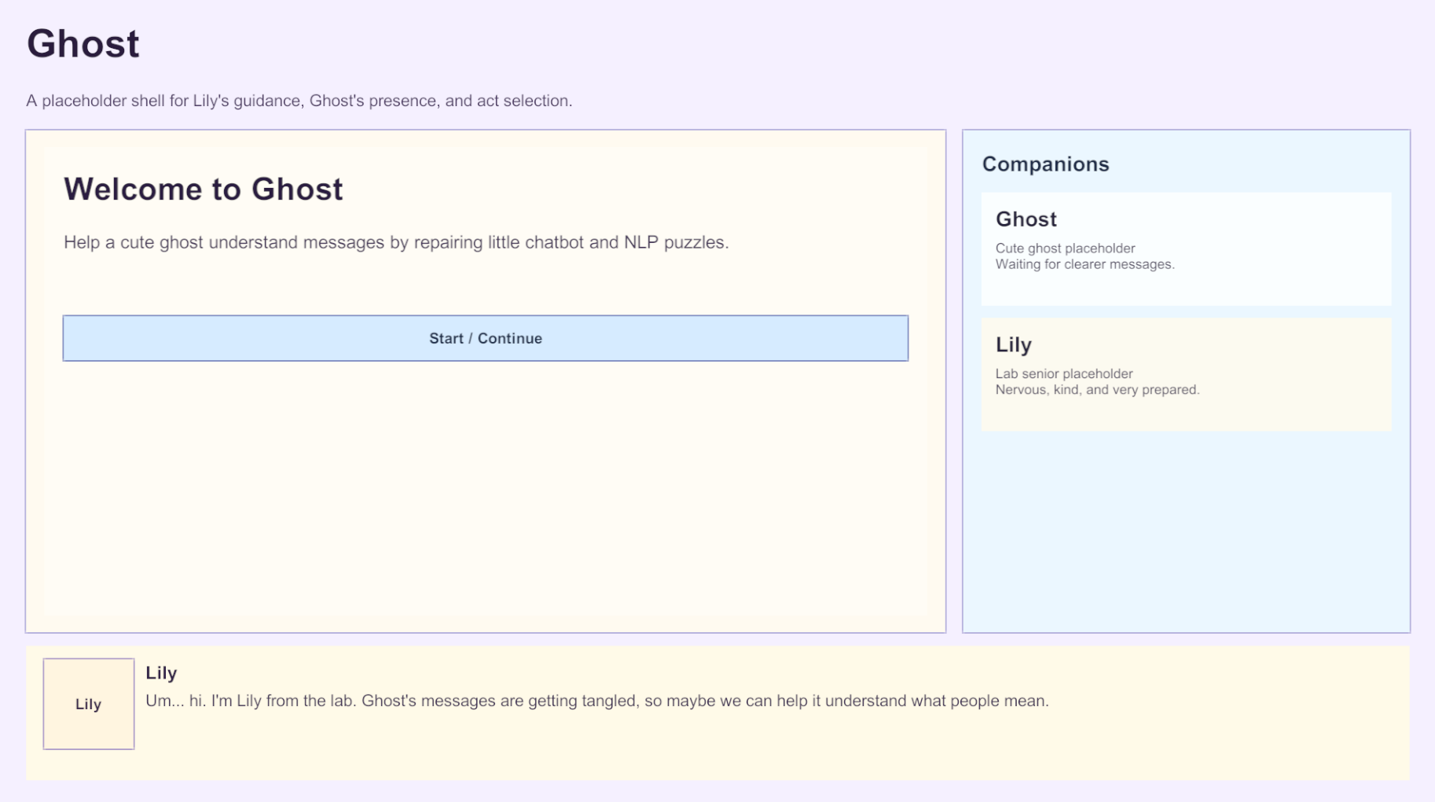
4TH GROUP MEETING
DEMO — Game Shell + Narrative
What this demonstrates
• Player name entry feeds narrative state.
• Lily dialogue frame introduces each Act.
• Return-to-hub overlay keeps acts connected.

Slide 4
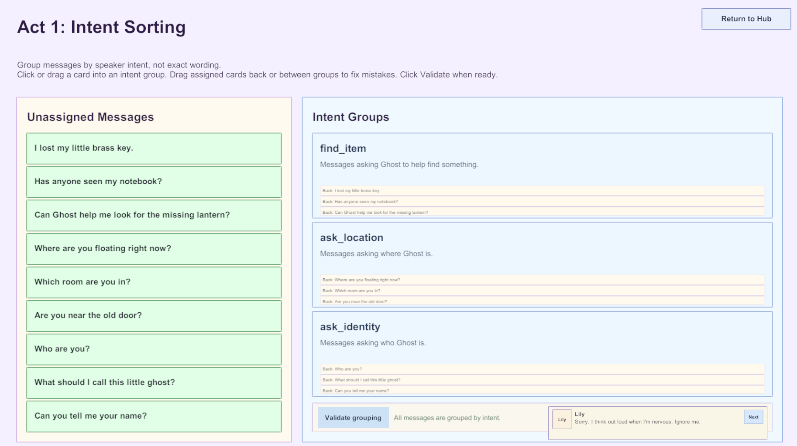
4TH GROUP MEETING
DEMO — Acts 1
Act 1: Intent classification
Players group messages by purpose, then receive deterministic feedback from the validator.

Slide 5
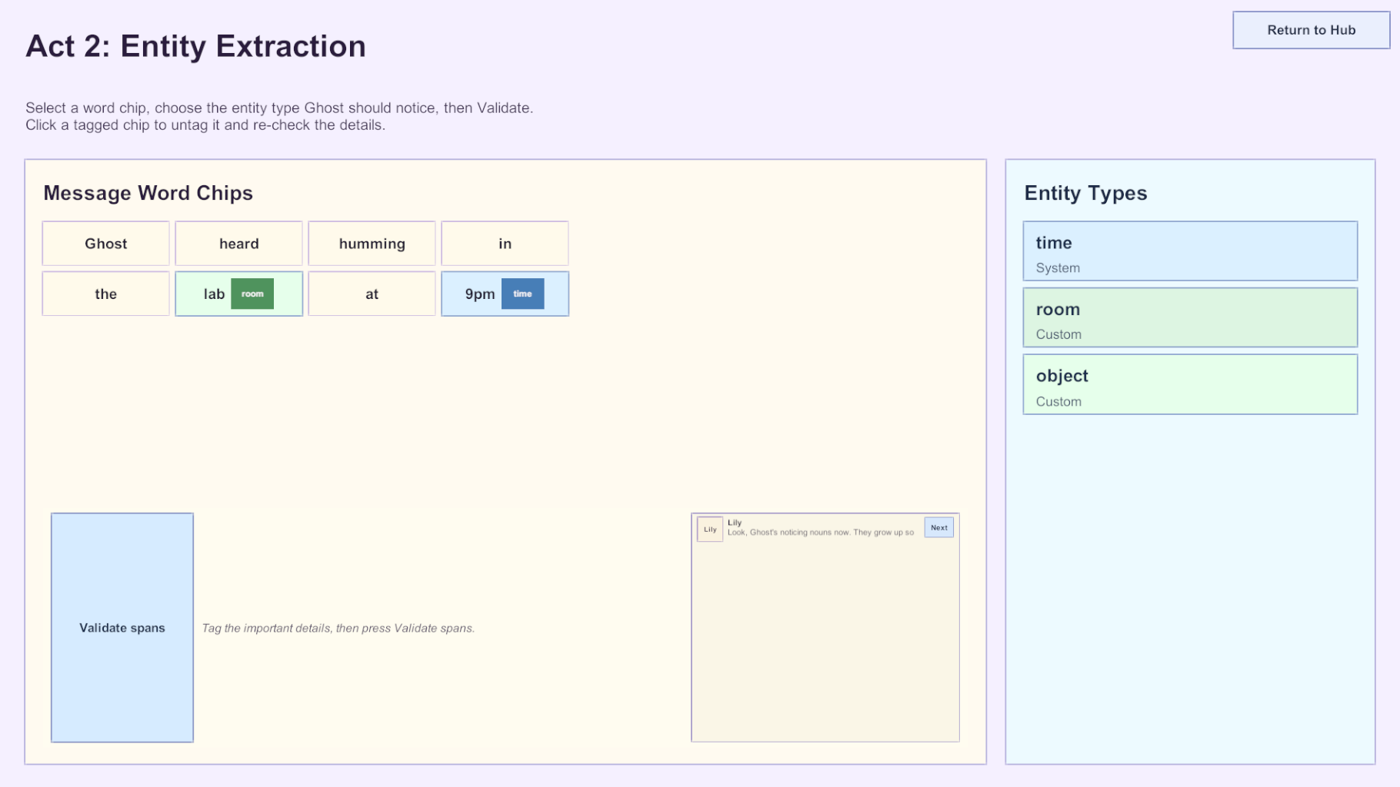
4TH GROUP MEETING
DEMO — Acts 2
Act 2: Entity extraction
Players tag spans and entity types, including system/custom distinction and synonym cases.

Slide 6
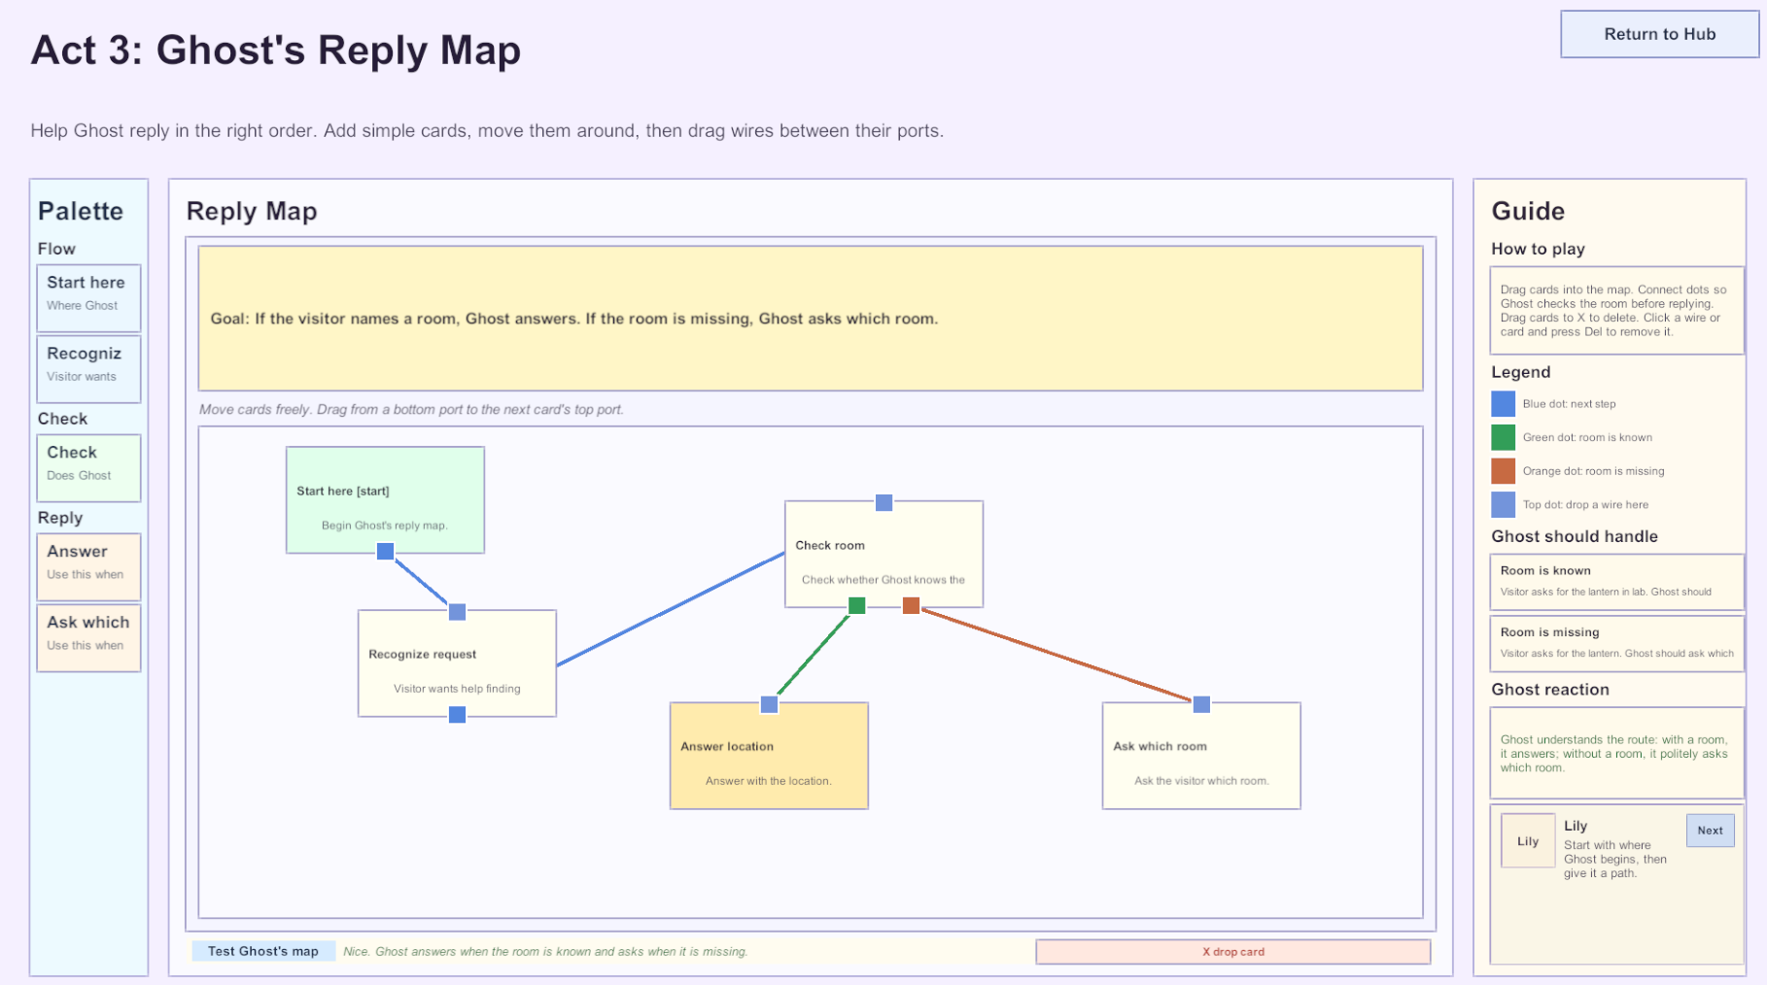
4TH GROUP MEETING
DEMO 3 — Act 3 Node Graph
Reply-map gameplay
• Drag cards from palette to canvas.
• Connect ports with straight wires.
• Test Ghost’s map with target cases.
• Success/failure changes Ghost’s reaction.
• Trash / Delete removes nodes or wires.

Slide 7
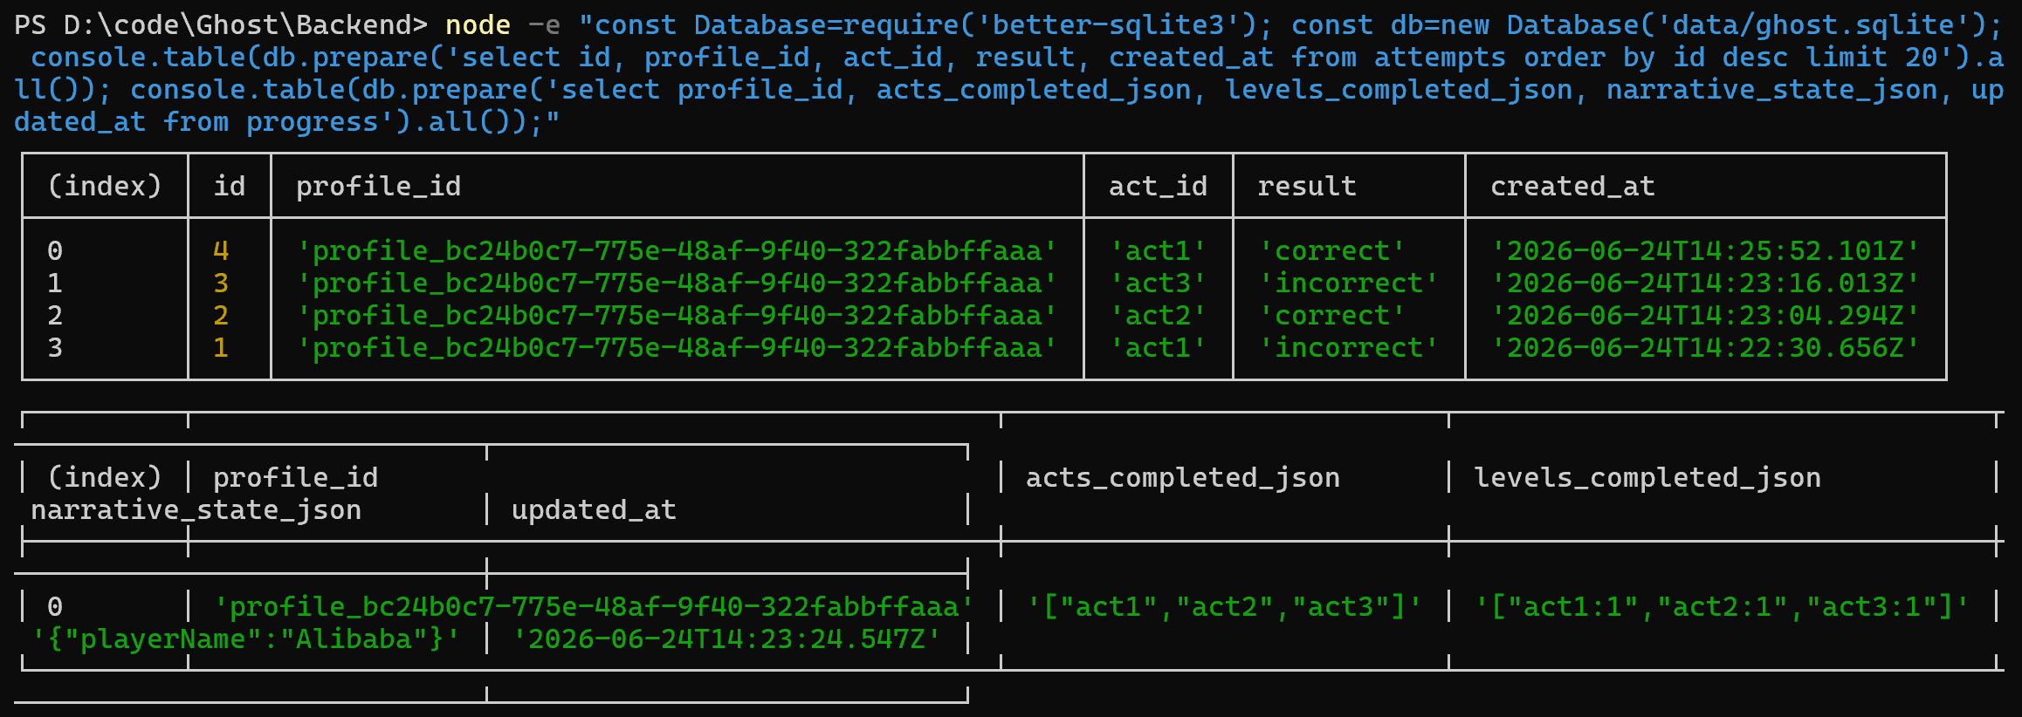
4TH GROUP MEETING
Current Prototype Status
Backend log proof: attempts and progress saved in SQLite
Area
Results
Playable content
Game shell and Acts 1–3 screens are implemented
Puzzle checking
Rule-based validators are implemented
Story data
Act intro and in-act dialogue data are connected
Backend
Content, profile, progress, and attempt logging APIs are working

Slide 8
4TH GROUP MEETING
System Architecture: Planned vs Implemented
Unity WebGL Client
Deterministic Logic
Node.js / TS REST
SQLite Database
→
→
→
Shell + Acts 1–3
validators + graph simulator
content, progress, attempts
local prototype store
↑
Future LLM layer
hints, explanations, response variation
Implemented
Acts 1–3 · Game Shell/narrative · backend REST service · SQLite schema · client sync
Future
LLM hints/Ghost responses · Acts 4–8 graph extensions and capstone
How much LLM integration is necessary for final assessment?

