Slide 1
OH

Slide 2
Problem and Motivation
THREE PROBLEMS
THIS PROJECT AIMS TO
1
Current course is passive
Make learning active
Video, text, multiple choice only
Player makes design decisions with real consequences
2
No game for chatbot design
Gap in game-based learning research
Make design thinking visible
3
Ghost's language shows what the player has learned
Characters not used for learning
Agents are decoration, not mechanism

Slide 3
Theoretical Framework
Three mechanisms. Each provides something the others cannot.
Game-Based
Learning
Narrative
Learning
Pedagogical
Agents
COGNITIVE ENGAGEMENT
AFFECTIVE ENGAGEMENT
SCAFFOLDING
Player applies each chatbot concept to solve a puzzle.
Solving = understanding.
No decorative game layer.
Story gives meaning to puzzles.
Ghost's growth gives emotional stakes.
Players stay motivated through 8 to 24 levels.
Lily gives hints as player makes errors.
Ghost shows learning progress visibly.
Errors become learning steps.
Drives: active learning
Drives: sustained motivation
Drives: error recovery
Key idea: all three must work together. Removing any one reduces the others.

Slide 4
Issues from Last Meeting
AREA
ISSUE
RQ design
RQ still depended on a user experiment
Literature
No recent LLM papers after 2022
Design scope
Too many levels and too many puzzle types
Evaluation
Same as RQ design issue
System
No fallback if LLM fails

Slide 5
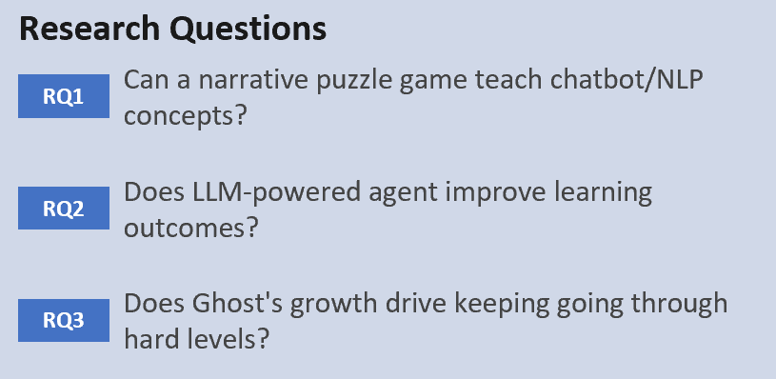
Research Design
RQ1
Does each puzzle correctly teach the chatbot concept for its Act?
Curriculum mapping table. Puzzle must REQUIRE the player to apply the concept.
The puzzle is valid only if it cannot be solved without using the concept
RQ2
Does Agent stay on topic for that Act and level?
Mean score per Act..
Test prompts (1 per Act x 3 hint tiers). Each reply scored: correct topic? correct hint level? no factual errors? Run 3 times each.

Slide 6
Key Literature
RECENT WORK (2024 to 2025)
Huber et al. (2024)
Game structure reduces LLM over-reliance.
Control how students use LLM.
Limit: Perspective piece, not an experiment.
Goslen et al. (2025)
LLM generates adaptive plans inside Crystal Island game. Plans matched student behavior in 144 students.
Limit: Plan generation only, not hint delivery.
Gong et al. (2025)
LLM scaffolding in a game improved learning and reduced cognitive load. Higher-load students asked LLM more.
Limit: Elementary students, not graduate level.

Slide 7
Design Decisions
Level scope
01
Puzzle types
02
LLM fallback
03
Minimum 1 level per Act (8 total)
Target 2 per Act (16)
Stretch 3 per Act (24)
Fewer types 8 -> 3 ~ 4
If Ollama fails: Lily shows multiple choice hint
Player picks one then can still discuss freely
Player chat freedom
04
Save progress
05
Player can talk to Lily at any time
In waiting and loading screens too
In the course, Lily stays on topic for that Act only
SHA-256 hash of username and password
Server stores hash only, never the original
Player re-enters same input from any device

Slide 8
Questions for Supervisor
Three RQs with no user study. Design analysis and system test only. Is this enough for MSc level?
Is the RQ design OK?
Q2
Q3
Full design is 24 levels. Minimum build is 8 levels (1 per Act). Is that the right way to frame scope?
Level count framing
Q5

