Slide 1
應用深度學習辨識視網膜病變
王麒凱
施宇修

Slide 2
學習目標
認識到視網膜病變作為公共衛生問題的重要性
討論視網膜病變是發達國家失明的主要原因
確定視網膜病變的危險因素
描述和區分視網膜病變的階段
了解風險因素和年度擴張眼科檢查在預防視力喪失中的作用

Slide 3
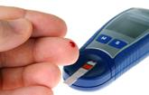
DIABETES MELLITUS
Diabetes Mellitus is a group of diseases characterized by high blood glucose levels. Diabetes results from defects in the body's ability to produce and/or use insulin.
Type 1 diabetes is usually diagnosed in children and young adults, and was previously known as juvenile diabetes. In type 1 diabetes, the body does not produce insulin. 5% of people with diabetes have this form of the disease.
In Type 2 diabetes, either the body does not produce enough insulin or the cells ignore the insulin. This is the most common form of diabetes.
http://www.diabetes.org/diabetes-basics/?loc=GlobalNavDB

Slide 4
DIABETIC RETINOPATHY (DR) DEFINITION
Progressive dysfunction of the retinal blood vessels caused by chronic hyperglycemia.
DR can be a complication of diabetes type 1 or diabetes type 2.
Initially, DR is asymptomatic, if not treated though it can cause low vision and blindness.
http://www.mdconsult.com/das/book/pdf/282715756-3/978-0-323-04332-8/4-u1.0-B978-0-323-04332-8..00092-5..DOCPDF.pdf?isbn=978-0-323-04332-8&eid=4-u1.0-B978-0-323-04332-8..00092-5..DOCPDF

Slide 5
什麼是視網膜
視網膜是內層眼球內襯的多層光敏神經組織。光聚焦在視網膜上，然後通過視神經傳遞到大腦。
黃斑是視網膜中心的高度敏感區域，負責中央視力。閱讀，識別面部和執行需要精細，清晰視覺的其他活動需要黃斑。

Slide 6
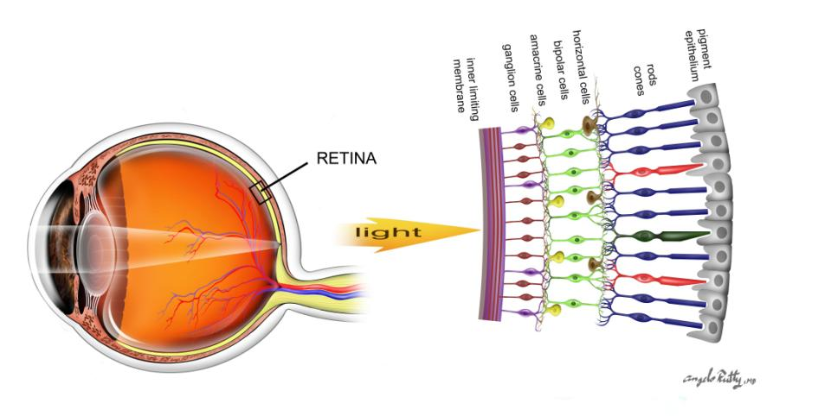
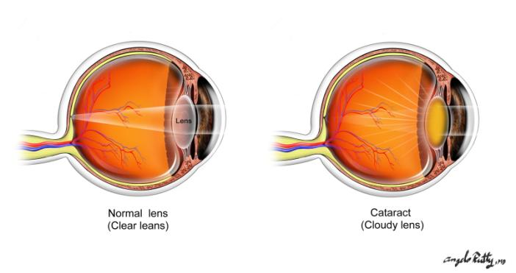
RETINA

Slide 7
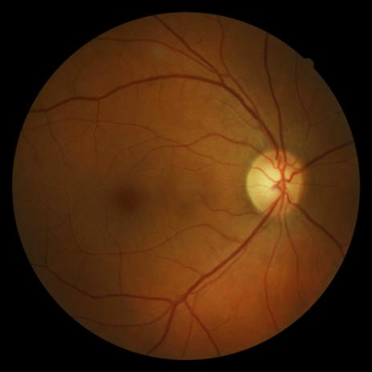
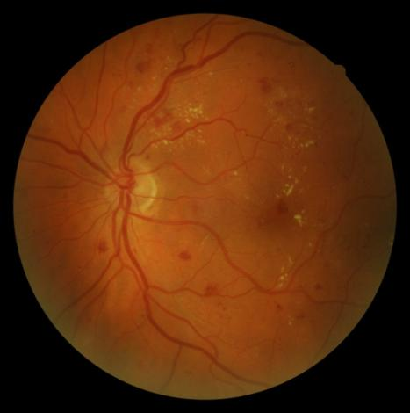
Healthy Retina
Diabetic Retinopathy

Slide 8
DIABETIC RETINOPATHY EPIDEMIOLOGY
The total number of people with diabetes is projected to rise from 285 million in 2010 to 439 million in 2030.
Diabetic retinopathy is responsible for 1.8 million of the 37 million cases of blindness throughout the world .
Diabetic retinopathy (DR) is the leading cause of blindness in people of working age in industrialized countries.
http://www.who.int/bulletin/volumes/82/11/en/844.pdf
http://www.ncbi.nlm.nih.gov/pubmed/19896746
Notes:
http://jama.ama-assn.org/content/304/6/649.short?rss=1
‹#›

Slide 9
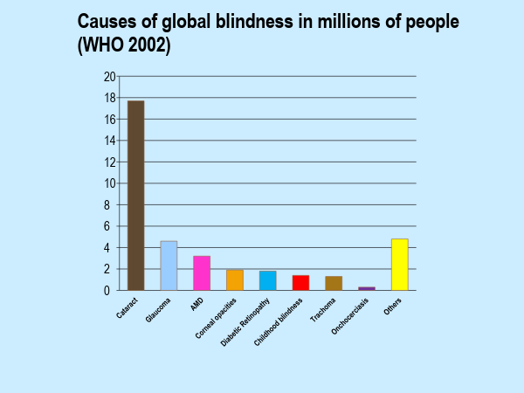
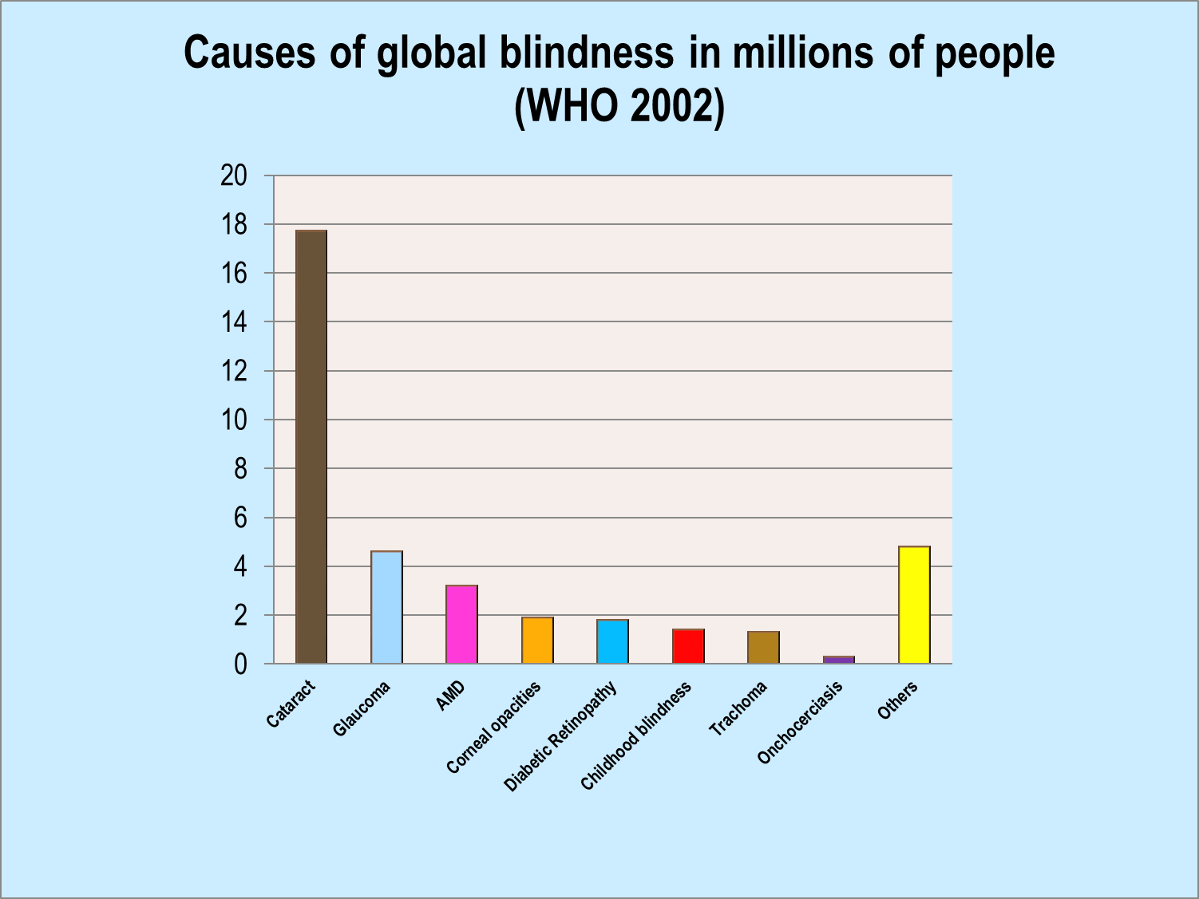
A. Foster S.Resnikoff. The impact of vision 2020 on global blindness. Eye 2005; 19:1133-1135

Slide 10
DIABETIC RETINOPATHY EPIDEMIOLOGY
The best predictor of diabetic retinopathy is the duration of the disease
After 20 years of diabetes, nearly 99% of patients with type 1 diabetes and 60% with type 2 have some degree on diabetic retinopathy
33% of patients with diabetes have signs of diabetic retinopathy
People with diabetes are 25 times more likely to become blind than the general population.
Ophthalmology Myron Yanoff MD and Jay S. Duker
Basic and Clinical Science Course, Section 12: Retina and Vitreous AAO
http://www.aao.org/eyecare/news/upload/Eye-Health-Fact-Sheet.pdf -
Notes:
http://one.aao.org/CE/PracticeGuidelines/PPP_Content.aspx?cid=d0c853d3-219f-487b-a524-326ab3cecd9a

Slide 11
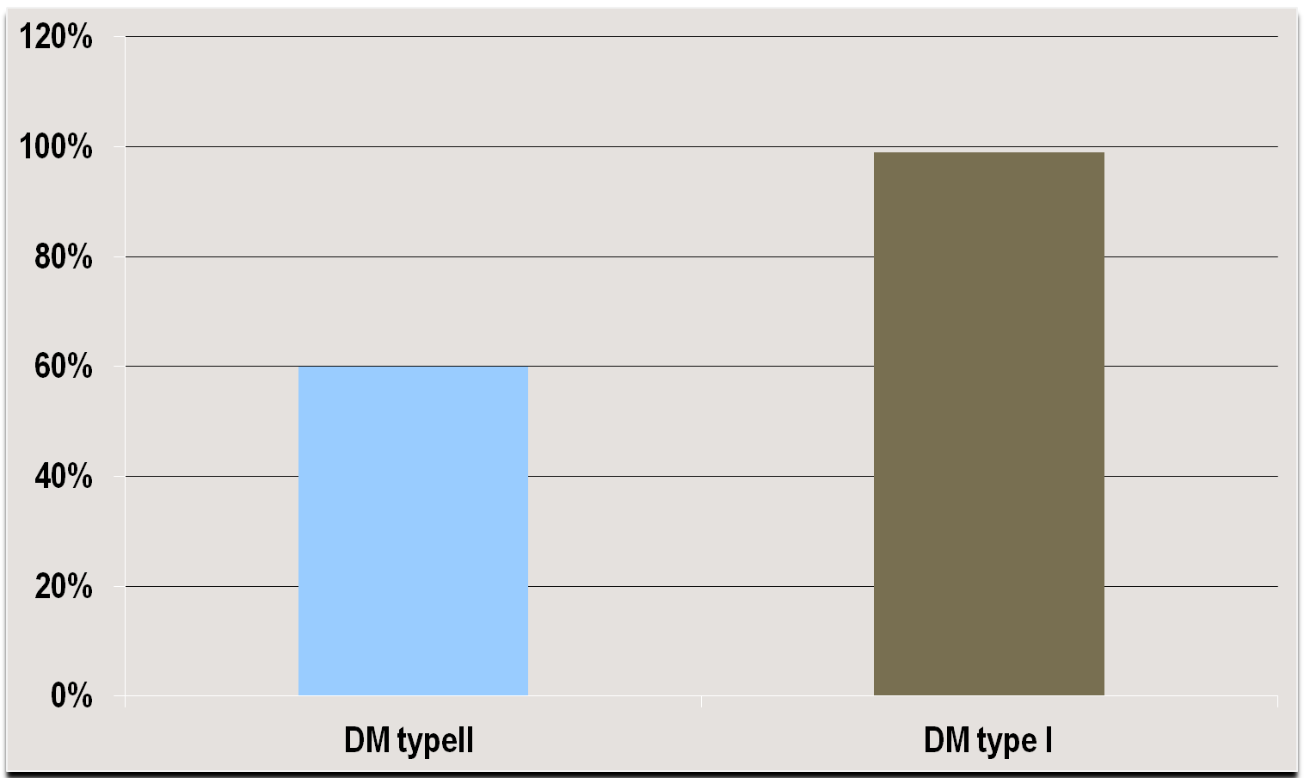

PREVALENCE OF DIABETIC RETINOPATHY AFTER 20 YEARS OF DIAGNOSIS

Slide 12
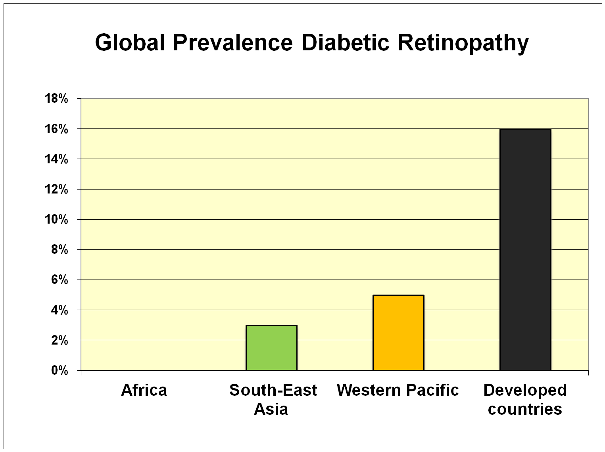
http://www.who.int/bulletin/volumes/82/11/en/844.pdf

Slide 13
DIABETIC RETINOPATHY SYMPTOMS
Diabetic retinopathy is asymptomatic in early stages of the disease
As the disease progresses symptoms may include
Blurred vision
Floaters
Fluctuating vision
Distorted vision
Dark areas in the vision
Poor night vision
Impaired color vision
Partial or total loss of vision

Slide 14
Risk factors
Duration of diabetes
Poor Blood Sugar control
HTN
Hyperlipidemia
Barriers to care
http://jama.ama-assn.org/content/304/6/649.short?rss=1

Slide 15
The Effect of Intensive Diabetes Treatment
On the Progression of Diabetic Retinopathy
In Insulin-Dependent Diabetes Mellitus
The Diabetes Control and Complications Trial
The Diabetes Control and Complications Trial Research Group
Intensive control reduced the risk of developing retinopathy by 76% and slowed progression of retinopathy by 54%; intensive control also reduced the risk of clinical neuropathy by 60% and albuminuria by 54%.
Arch Ophthalmol. 1995; 113:36-51

Slide 16
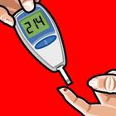
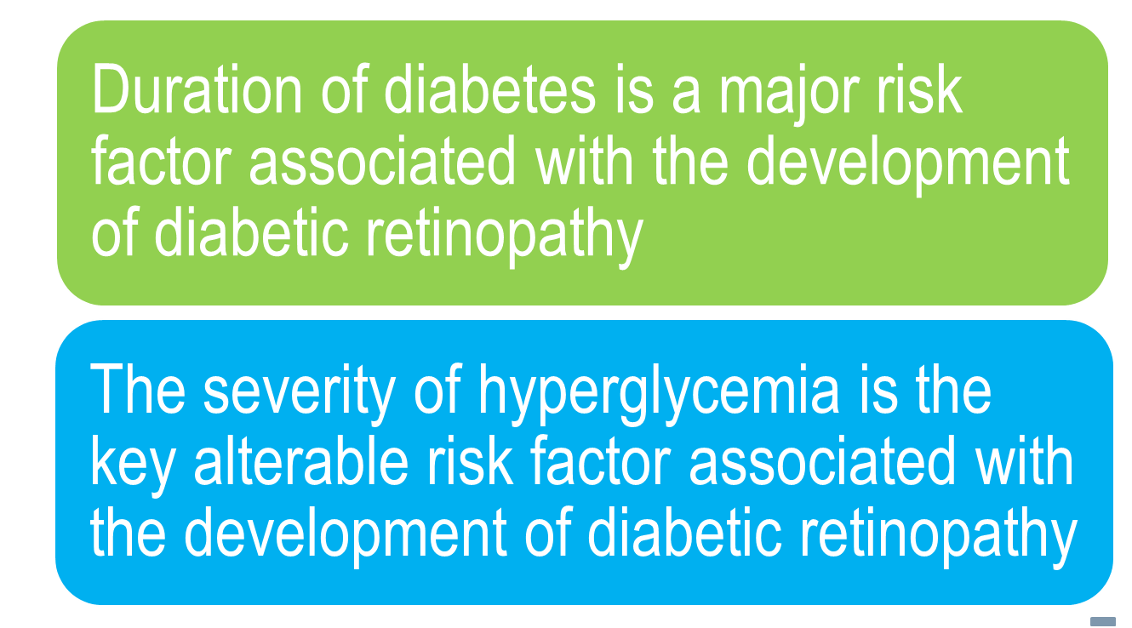
RISK FACTORS DIABETIC RETINOPATHY
http://one.aao.org/CE/PracticeGuidelines/PPP_Content.aspx?cid=d0c853d3-219f-487b-a524-326ab3cecd9a

Slide 17

How diabetes cause vision loss
HOW DIABETES CAUSES VISION LOSS
Macular edema
Clinical significant macular edema
Diabetes
Preclinical changes
Background DR
Vision loss
Preproliferative DR
Proliferative DR
Vitreous hemorrhage and/or Retinal detachment and/or neovascular glaucoma

Slide 18
PATHOPHYSIOLOGY
Diabetic Retinopathy is a microvasculopathy that causes:
Retinal capillary occlusion
Retinal capillary leakage

Slide 19
MICROVASCULAR OCCLUSION
Microvascular occlusion is caused by:
Thickening of capillary basement membranes
Abnormal proliferation of capillary endothelium
Increased platelet adhesion
Increased blood viscosity
Defective fibrinolysis
Retina in systemic disease : a color manual of ophthalmoscopy / Homayoun Tabandeh, Morton F. Goldberg 2009

Slide 20

Microvascular Occlusion
Ischemia
Infarction
Increased VEFG
Cotton – wool spot
Neovascularization
Vitreous hemorrhage
Fibrovascular bands
Neovascular glaucoma
Tractional retinal detachment
Retina in systemic disease : a color manual of ophthalmoscopy / Homayoun Tabandeh, Morton F. Goldberg 2009

Slide 21
MICROVASCULAR LEAKAGE
Microvascular leakage is caused by:
Impairment of endothelial tight junctions
Loss of pericytes
Weakening of capillary walls
Elevated levels of vascular endothelial growth factor (VEGF)
Retina in systemic disease : a color manual of ophthalmoscopy / Homayoun Tabandeh, Morton F. Goldberg 2009

Slide 22




Microvascular Leakage
Edema
Hard exudates
Retinal hemorrhage
Retina in systemic disease : a color manual of ophthalmoscopy / Homayoun Tabandeh, Morton F. Goldberg 2009.

Slide 23
Diabetic Eye Disease Key Points
RECOMMENDED EYE EXAMINATION SCHEDULE
Diabetes Type | Recommended Time of First Examination | Recommended Follow-up*
Type 1 | 3-5 years after diagnosis | Yearly
Type 2 | At time of diagnosis | Yearly
Prior to pregnancy (type 1 or type 2) | Prior to conception and early in the first trimester | No retinopathy to mild moderate NPDR every 3-12 months Severe NPDR or worse every 1-3 months.
Treatments exist but work best before vision is lost
*Abnormal findings may dictate more frequent follow-up examinations
h ttp://one.aao.org/CE/PracticeGuidelines/PPP_Content.aspx?cid=d0c853d3-219f-487b-a524-326ab3cecd9a

Slide 24
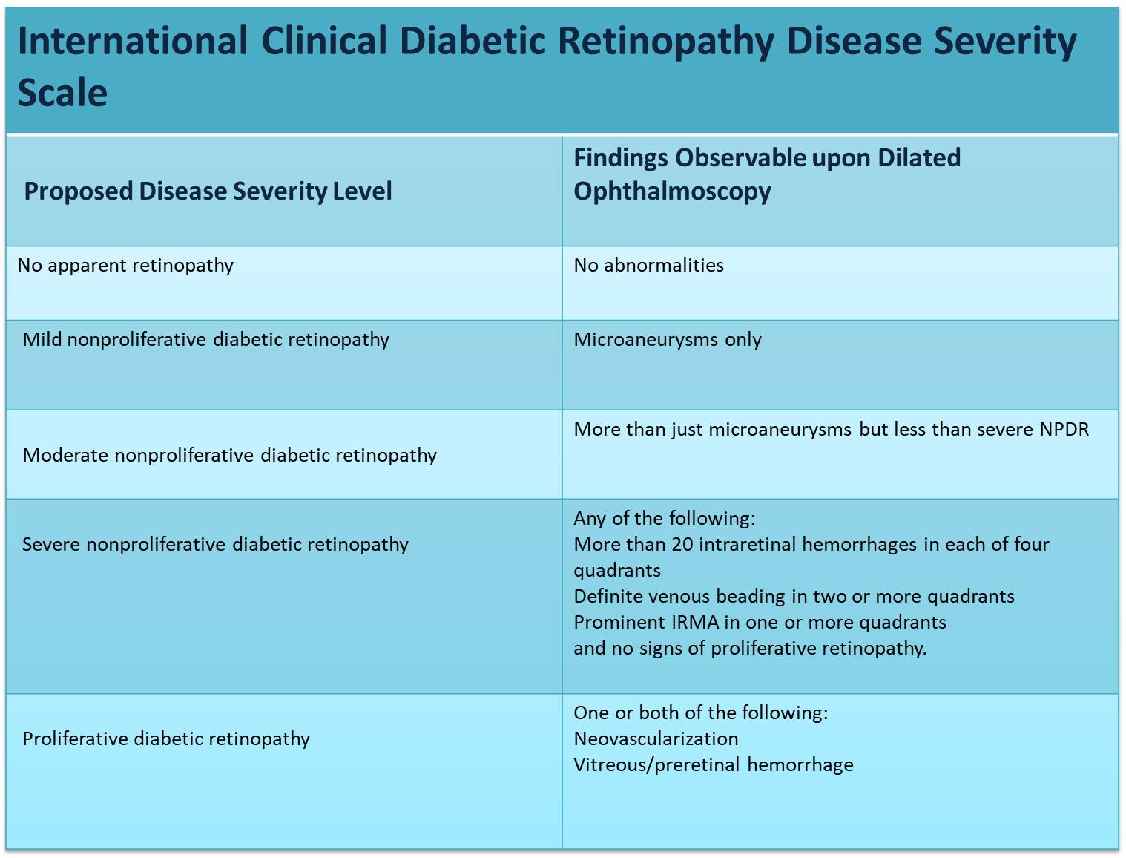
Findings Obsd
Proposed international clinical diabetic retinopathy and diabetic macular edema disease severity scales
Ophthalmology Volume 110, Number 9, September 2003
Notes:
http://www.mdconsult.com/das/book/pdf/282715756-3/978-0-323-04332-8/4-u1.0-B978-0-323-04332-8..00092-5..DOCPDF.pdf?isbn=978-0-323-04332-8&eid=4-u1.0-B978-0-323-04332-8..00092-5..DOCPDF
‹#›

Slide 25

No retinopathy

Slide 26
MILD NONPROLIFERATIVE DIABETIC RETINOPATHY
Characteristics
Microaneurysms only

Slide 27
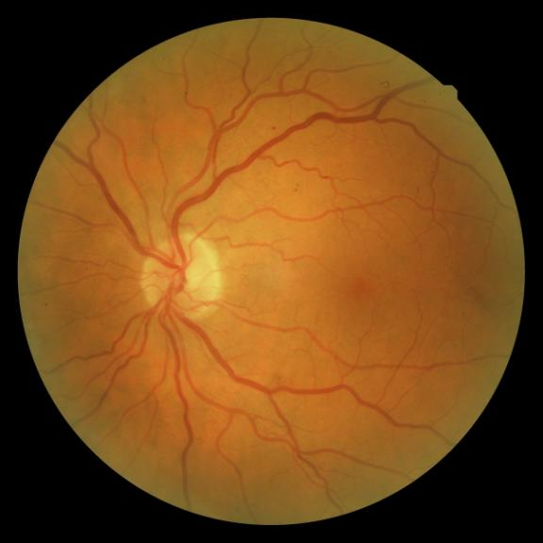
MILD NONPROLIFERATIVE DIABETIC RETINOPATHY
Microaneurysms

Slide 28
MODERATE NONPROLIFERATIVE DIABETIC RETINOPATHY (NPDR)
Characteristics
More than just microaneurysms but less than severe NPDR but less than severe NPD
Notes:
http://www.who.int/bulletin/volumes/82/11/en/844.pdf
http://www.ncbi.nlm.nih.gov/pubmed/19896746
‹#›

Slide 29
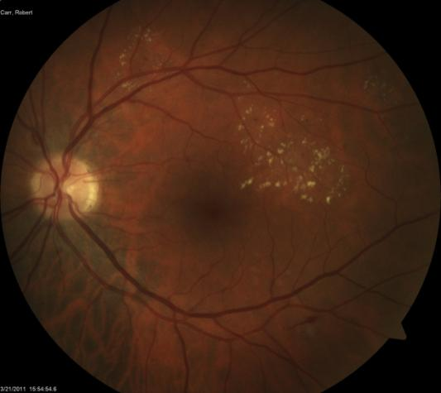
MODERATE NONPROLIFERATIVE DIABETIC RETINOPATHY (NPDR)
Microaneurysm
Hard exudates
Flamed shaped hemorrhage

Slide 30
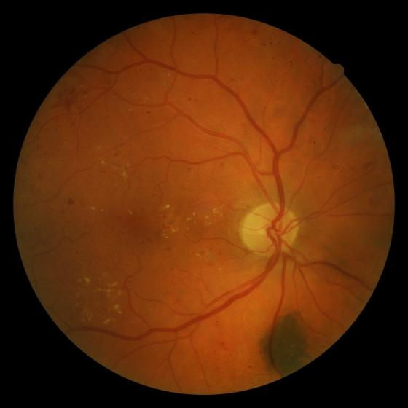
MODERATE NONPROLIFERATIVE DIABETIC RETINOPATHY (NPDR)
Hard exudates
microaneurysm

Slide 31
SEVERE NONPROLIFERATIVE DIABETIC RETINOPATHY (NPDR)
Any of the following:
More than 20 intraretinal hemorrhages in each of four quadrants
Definite venous beading in two or more quadrants
Prominent Intraretinal Microvascular Abnormalities (IRMA) in one or more quadrants
And no signs of proliferative retinopathy

Slide 32
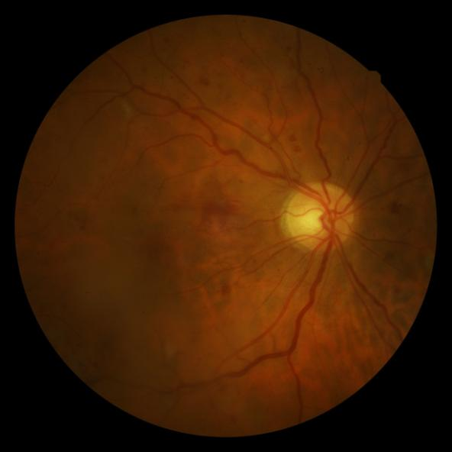
Severe Nonproliferative Diabetic Retinopathy (NPDR)
Venous beading

Slide 33
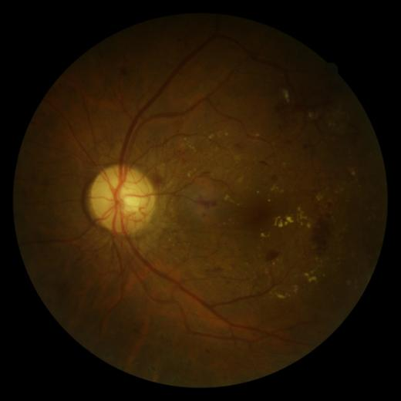
Proliferative Diabetic Retinopathy (PDR)
Characteristics
Neovascularization
Vitreous/preretinal hemorrhage

Slide 34
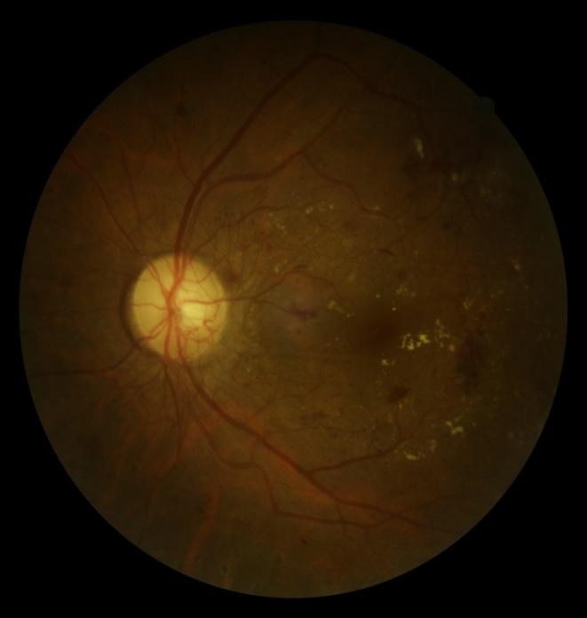
PROLIFERATIVE DIABETIC RETINOPATHY
Cotton-wool
spot
Neovascularization
Neovascularization
Hard exudate
Blot hemorrhage

Slide 35
HIGH-RISK PROLIFERATIVE DIABETIC RETINOPATHY
At risk for serious vision loss
Any combination of three of the following four findings
Presence of vitreous or preretinal hemorrhage.
Presence of new vessels (neovascularization, NV)
Location of NV on or near the optic disc.
Moderate to severe extent of new vessels.
Basic and Clinical Science Course, Section 12: Retina and Vitreous AAO

Slide 36
DIABETIC MACULAR EDEMA
Diabetic macular edema is the leading cause of legal blindness in diabetics.
Diabetic macular edema can be present at any stage of the disease, but is more common in patients with proliferative diabetic retinopathy.

Slide 37
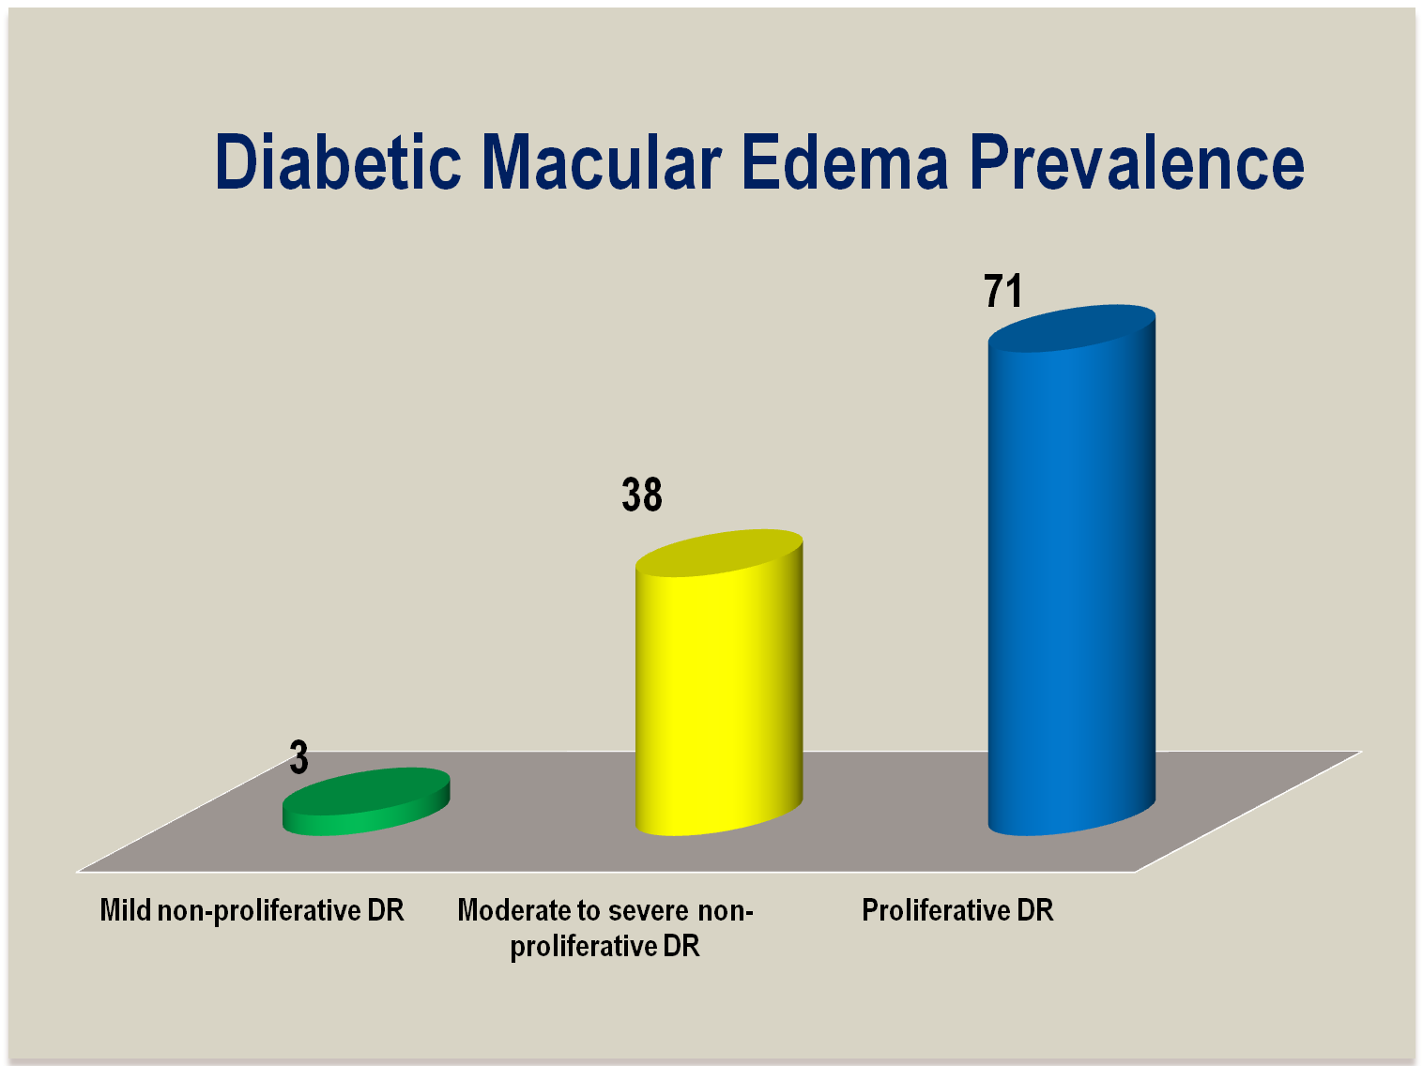
Meta analysis and review on the effect on bevacizumab id diabetic macular edema
Graefes Arch Clin Exp Ophthalmol(2011) 249:15-27

Slide 38

Why is Diabetic macular edema so important?
The macula is responsible for central vision.
Diabetic macular edema may be asymptomatic at first. As the edema moves in to the fovea (the center of the macula) the patient will notice blurry central vision. The ability to read and recognize faces will be compromised.
Macula
Fovea

Slide 39


Normal
Macular Edema

Slide 40
CLINICALLY SIGNIFICANT MACULAR EDEMA (CSME)
Thickening of the retina at or within 500 µm of the center of the macula.
Hard exudates at or within 500 µm of the center of the macula, if associated with thickening of the adjacent retina.
Area of retinal thickening 1 disc area or larger, within 1 disc diameter of the center of the macula.
ETDRS

Slide 41
INTERNATIONAL CLINICAL DIABETIC MACULAR EDEMA DISEASE SEVERITY SCALE
Proposed disease severity level | Findings observable upon dilated ophthalmoscopy
DME apparently absent DME apparently present DME present | No apparent retinal thickening or hard exudates in posterior pole Some apparent retinal thickening or hard exudates in posterior pole Mild DME (some retinal thickening or hard exudates in posterior pole but distant from the center of the macula) Moderate DME (retinal thickening or hard exudates approaching the center of the macula but not involving the center) Severe DME (retinal thickening or hard exudates involving the center of the macula)
Proposed International Clinical Diabetic
Retinopathy and Diabetic Macular Edema
Disease Severity Scales
Ophthalmology Volume 110, Number 9, September 2003

Slide 42
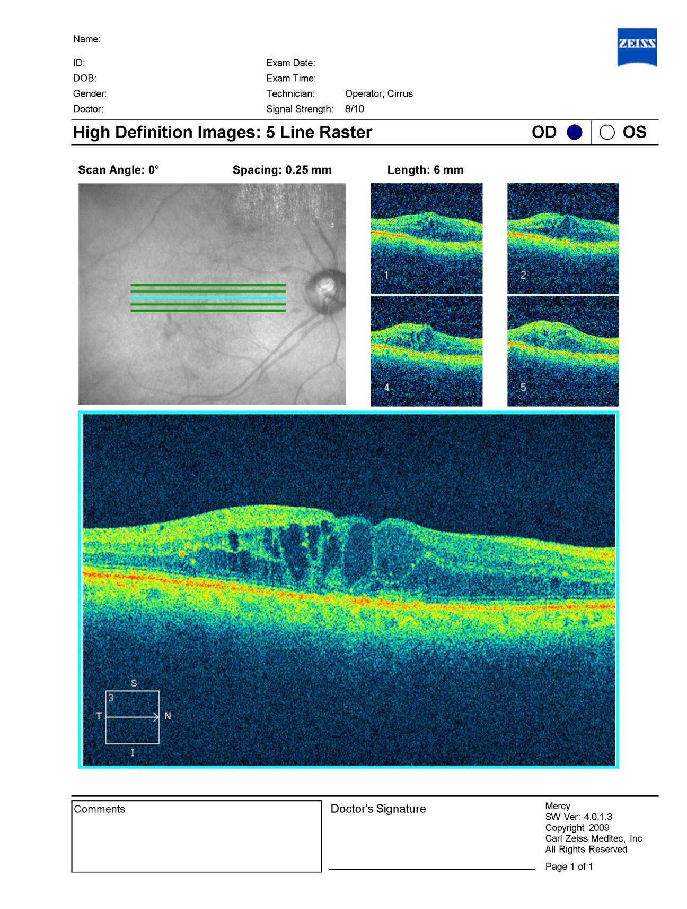
Imaging of macular edema with optical coherence tomography

Slide 43

PREVENTION
90 percent of diabetic eye disease can be prevented simply by proper regular examinations, treatment and by controlling blood sugar.
http://www.aao.org/newsroom/release/20091030.cfm
Notes:
Ophthalmology Myron Yanoff MD and Jay S. Duker
Basic and Clinical Science Course, Section 12: Retina and Vitreous AAO
http://www.aao.org/eyecare/news/upload/Eye-Health-Fact-Sheet.pdf -
‹#›

Slide 44
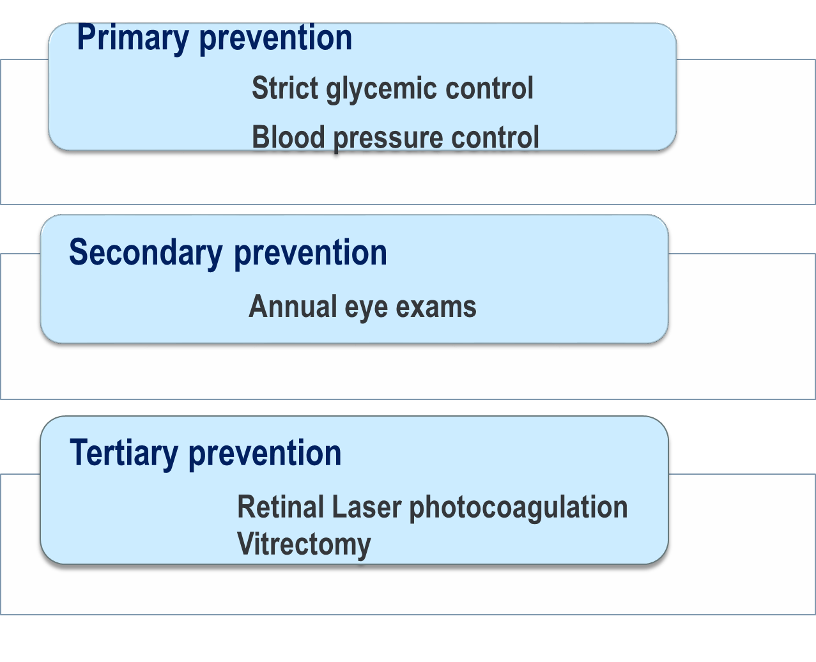

Slide 45
DIABETIC RETINOPATHY TREATMENT
The best measure for prevention of loss of vision from diabetic retinopathy is strict glycemic control

Slide 46
LASER PHOTOCOAGULATION
Laser Photocoagulation is recommended for eyes with:
Clinical significant macular edema CSME
High risk Proliferative diabetic retinopathy

Slide 47
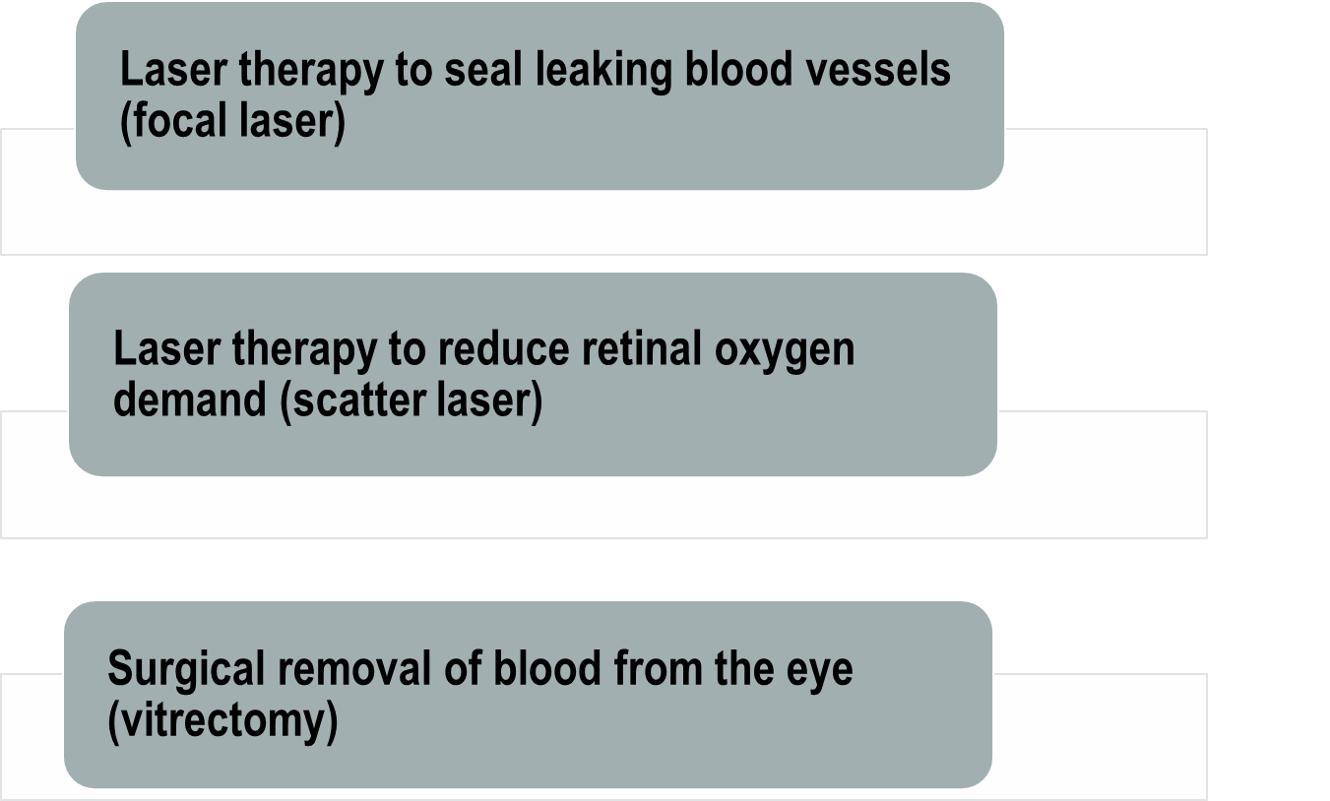
DIABETIC RETINOPATHY TREATMENT ONCE DR THREATENS VISION TREATMENTS CAN INCLUDE:

Slide 48
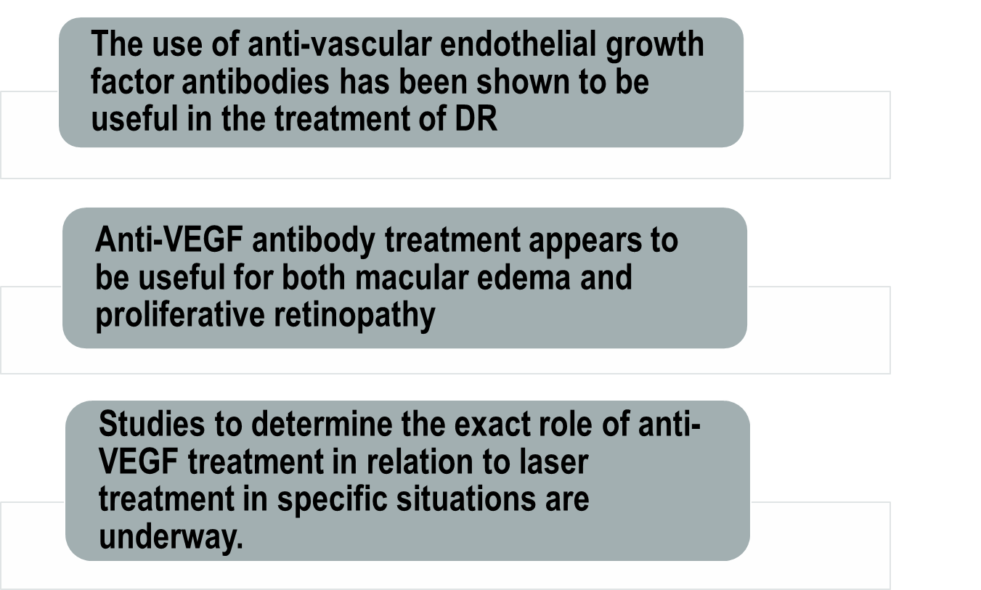
DIABETIC RETINOPATHY TREATMENT NEWER DEVELOPMENTS:
http://drcrnet.jaeb.org

Slide 49
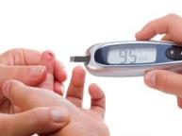


CONCLUSIONS
Diabetic Retinopathy is preventable through strict glycemic control and annual dilated eye exams by an ophthalmologist.
Notes:
‹#›

Slide 50
"Alone we can do so little, together we can do so much.”
Helen Keller

Slide 51
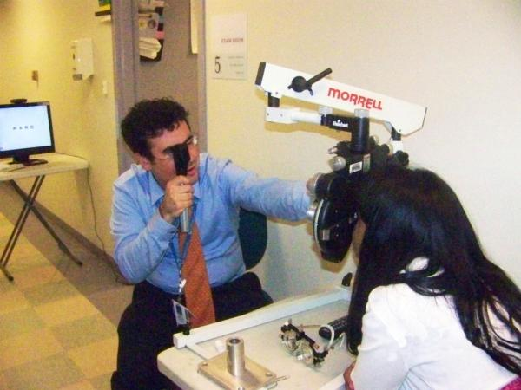


The Guerrilla Eye Service of the UPMC Eye Center is dedicated to eliminating barriers to eye care for patients in the Western Pennsylvania area.

Slide 52


Authors
Ines Serrano, is am ophthalmologist trained in Peru at the Universidad Nacional Mayor de San Marcos. She is currently pursuing her multidisciplinary Masters in Public Health at the Graduate School of Public Health at the University of Pittsburgh. She has a long standing interest in minority health and health care disparities.
Evan (Jake) Waxman, is currently Assistant Professor and vice Chair for Education at the University of Pittsburgh Department of Ophthalmology. He is the recipient of multiple medical student and resident teaching awards. His current areas of focus include the use of interactive fiction in the creation of virtual patients for training health care providers and research into delivery of eye care in underserved populations.

Slide 53
REFERENCES
Retina in systemic disease : a color manual of ophthalmoscopy / Homayoun Tabandeh, Morton F. Goldberg 2009
Goyal S, Laavalley M, Subramanian ML, Meta analysis and review on the effect on bevacizumab in diabetic macular edema, Graefes Arch Clin Exp Ophthalmol(2011) 249:15-27
C. P. Wilkinson, MD,1 Frederick L. Ferris, III, MD,2 Ronald E. Klein, MD, MPH,3 Paul P. Lee, MD, JD,4 Carl David Agardh, MD,5 Matthew Davis, MD,3 Diana Dills, MD,6 Anselm Kampik, MD,7 R. Pararajasegaram, MD,8 Juan T. Verdaguer, MD,9 representing the Global Diabetic Retinopathy Project Group, Proposed International Clinical Diabetic, Retinopathy and Diabetic Macular Edema Disease Severity Scales Ophthalmology Volume 110, Number 9, September 2003 Proposed international clinical diabetic retinopathy and diabetic macular edema disease severity scales

Slide 54
REFERENCES
Preferred Practice Patterns, Diabetic retinopathy, America Academy of Ophthalmology 2008. http://one.aao.org/CE/PracticeGuidelines/PPP_Content.aspx?cid=d0c853d3-219f-487b-a524-326ab3cecd9a
Brett J. Rosenblatt and William E. Benson Diabetic Retinopathy Yanoff & Duker: Ophthalmology, 3rd ed. http://www.mdconsult.com/das/book/pdf/282715756-3/978-0-323-04332-8/4-u1.0-B978-0-323- 04332- 8..00092-5..DOCPDF.pdf?isbn=978-0-323-04332-8&eid=4-u1.0-B978-0-323-04332-8..00092- 5..DOCPDF
Resnikoff S, Pascolini D, Etya'ale D, Kocur I, Pararajasegaram R, Pokharel GP, Mariotti SP. Global data on visual impairment in the year 2002. Bull World Health Organ. 2004 Nov;82(11):844-51. Epub 2004 Dec 14.
Basic and Clinical Science Course, Section 12: Retina and Vitreous AAO, 2011-2012.
The Effect of Intensive Diabetes Treatment On the Progression of Diabetic Retinopathy In Insulin-Dependent Diabetes Mellitus, The Diabetes Control and Complications Trial Research Group, Arch Ophthalmol. 1995; 113:36-51

Slide 55
REFERENCES
http://www.ncbi.nlm.nih.gov/pubmed/19896746
http://www.aao.org/eyecare/news/upload/Eye-Health-Fact-Sheet.pdf
http://www.who.int/bulletin/volumes/82/11/en/844.pdf
http://jama.ama-assn.org/content/304/6/649.short?rss=1
http://www.aao.org/newsroom/release/20091030.cfm
http://www.diabetes.org/diabetes-basics/?loc=GlobalNavDB
http://www.ophed.com/group/2205

