Slide 1
Automatic renal segmentation for MR urography using 3D-GrabCut and random forests

Slide 2
Abstract
Purpose:
To introduce and evaluate a fully automated renal segmentation technique for glomerular filtration rate (GFR) assessment in children.
Methods:
An image segmentation method based on iterative graph cuts (GrabCut) was modified to work on time-resolved 3D dynamic contrast-enhanced MRI data sets.
A random forest classifier was trained to further segment the renal tissue into cortex, medulla, and the collecting system. The algorithm was tested on 26 subjects and the segmentation results were compared to the manually drawn segmentation maps using the F1-score metric.
A two-compartment model was used to estimate the GFR of each subject using both automatically and manually generated segmentation maps
Results:
Segmentation maps generated automatically showed high similarity to the manually drawn maps for the whole-kidney and renal cortex

Slide 3
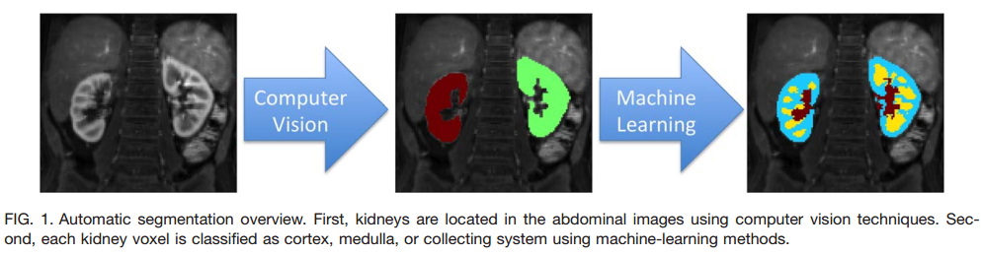
Overview of Automatic Segmentation

Slide 4
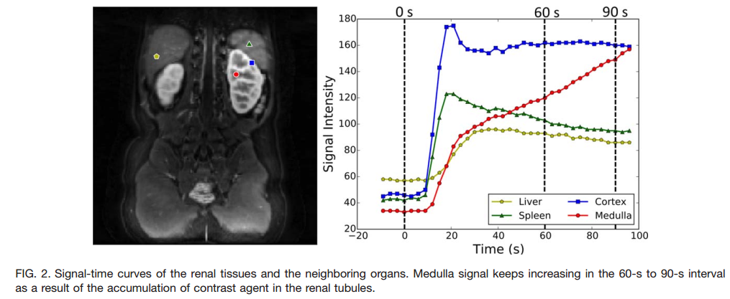
Automatic Segmentation of Renal Parenchyma

Slide 5
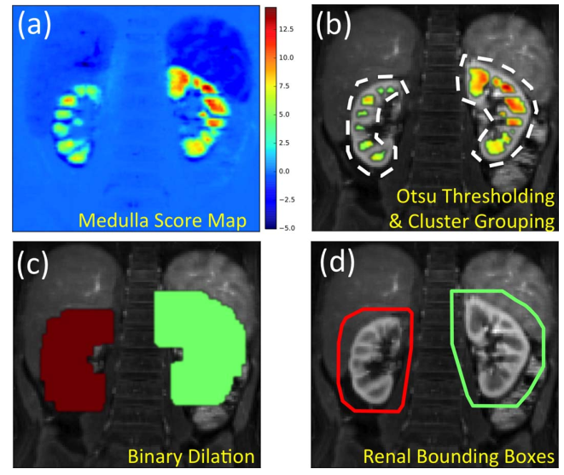
Automatic Segmentation of Renal Parenchyma
Detection of renal bounding boxes
(a) Distribution of medulla scores in the abdominal image. The scores are whitened by removing the mean and normalizing the standard deviation. The values are the number of standard deviations from the mean score.
(b)Scores above the Otsu threshold (36) overlaid on the anatomical image. Clusters within a maximum cortical thickness distance from each other grouped together under the same color.
(c) Medulla groups are dilated by the maximum cortical thickness to cover the renal parenchyma.
(d) Three-dimensional convex hulls of the dilated medulla groups are calculated to create renal bounding boxes

Slide 6
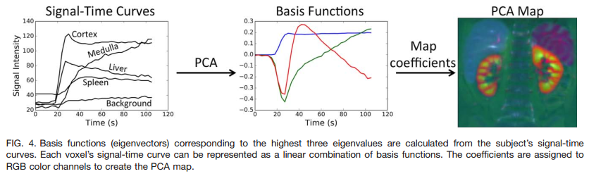
Automatic Segmentation of Renal Parenchyma

Slide 7
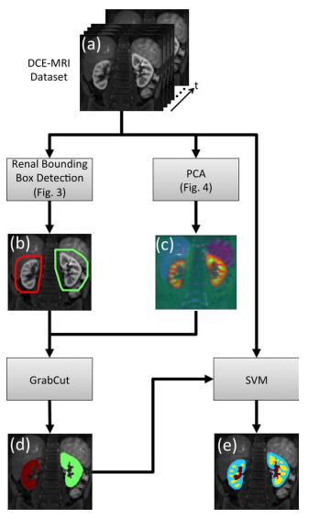
Flowchart of the automated segmentation process.
(a) Input to the algorithm is the time resolved 3D DCE-MRI data set.
(b) Renal bounding box calculated using the steps described in Figure 3.
(c) PCA is applied to the DCE-MRI data set along the time axis to reduce it to three channels represented as RGB. The resulting image has no temporal phases, however, it still has temporal information (i.e., different colors map to different signal-time curves).
(d) Output of the renal parenchyma segmentation using GrabCut.
(e) Output of the voxel level SVM classifier for segmentation of renal cortex (blue), medulla (yellow), and the collecting system (red).

Slide 8
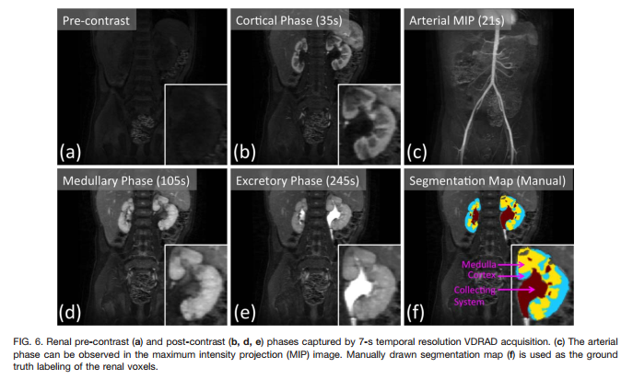
Results
retrospectively identified three different groups of data sets with different protocols that were suitable for automatic renal segmentation.

Slide 9
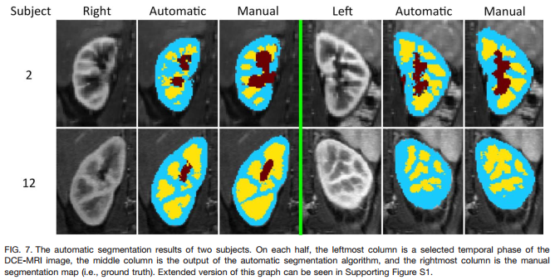
Results

Slide 10
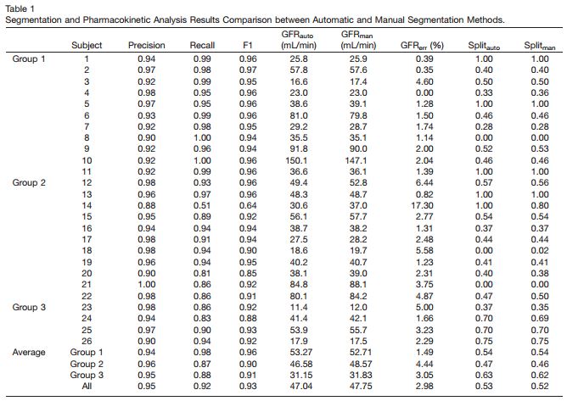
Segmentation and Pharmacokinetic Analysis Results Comparison

