Slide 1


ITE 120
PROJECT

Slide 2

CONTENT
01
OUR TEAM
02
ROLES
03
TOOLS
04
VENOM
05
DESIGN FLOW
06
ISSUES ENCOUNTERED
07
CONCLUSION

Slide 3
OUR TEAM
Phone Thit Htoo
(ID 2311070005)
Thaw Sitt Aung
(ID 2311080004)
Han Su Yin
(ID 2306090004)

Slide 4
ROLES
Phone Thit Htoo
Thaw Sitt Aung
Han Su Yin
Home Page
Tabs
Login Page
Helps with photos
and blogs
logo
Web pages
Helps with photos
and blogs

Slide 5





TOOLS
HTML
JQUERY
VS CODE
CSS

Slide 6

VENOM
"Venom" is a dynamic blog website that offers insightful articles on a wide range of topics, including technology, health, and travel lifestyles. The blog delivers the latest trends in tech innovation, practical health tips for better living, and inspiring travel guides for adventurers. With engaging content tailored to modern readers, "Venom" provides a balanced mix of information and entertainment for those looking to stay informed and inspired in their everyday lives.

Slide 7

Design
Color scheme: Black, White and Orange
Home Page
Web Page
Login Page

Slide 8
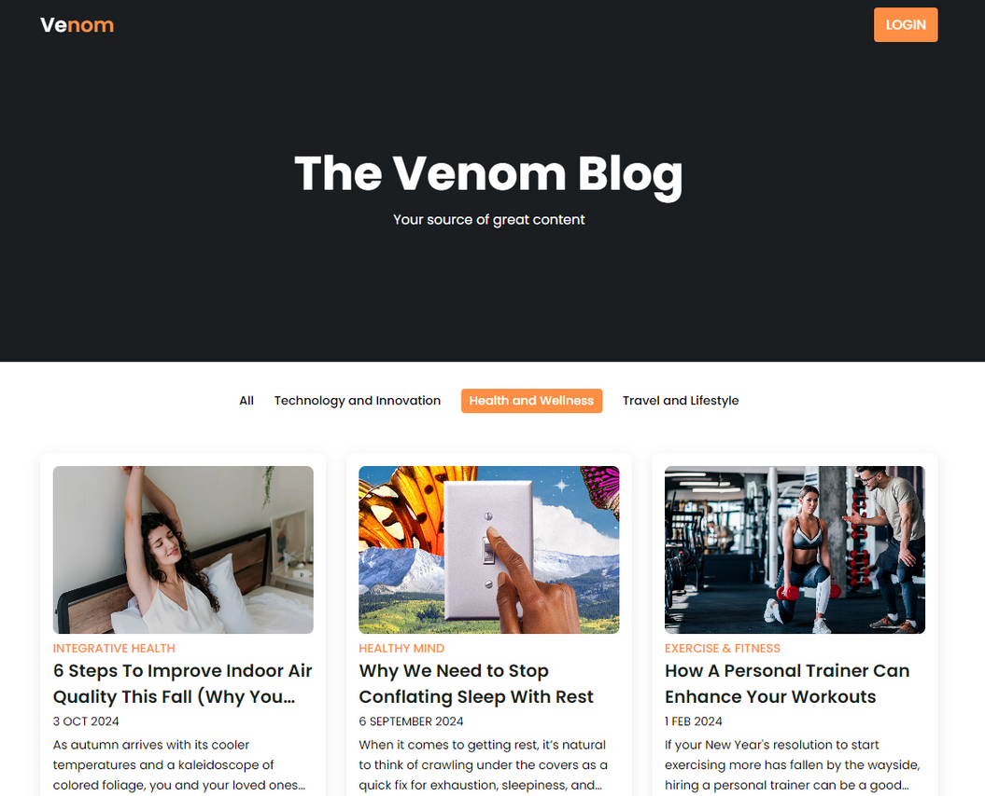
HOME PAGE
Logo
Slogan
Login button
Filter Tab bar
Web pages
Blog Discription

Slide 9

WEB PAGE
Logo
Title
Back to home button
Login Button
Picture
The blog

Slide 10
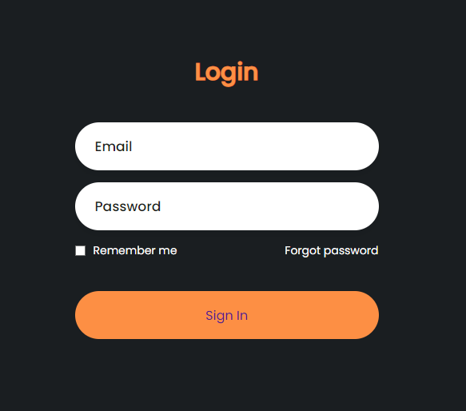
LOGIN PAGE
Username
Password
Remember me Box
Sign In Button

Slide 11

ISSUES ENCOUNTERED
Have issues redirecting to main page
Page animations
Tabs not working
Forgot how to push in git hub TwT

Slide 12

THANK YOU
Feel free to ask any questions!

