Slide 1


The QA Drive IN
Shiva King, Morgan Walsh,
Connor Young and Nilay Sanghrajka
09/09/2020

Slide 2

Introduction and Scope
Who are we?
Connor Young – Product Owner
Nilay Sanghrajka – Scrum Master
Shiva King – Developer
Morgan Walsh – Developer
What we creating
Elements altered after speaking to client

Slide 3
Technologies
MERN Stack
Unit Testing: Jest, Enzyme, Mocha Chai
Source Code Management: GitHub
Kanban Board: Jira Boards
GCP to host our API
Jenkins as the CICD

Slide 4
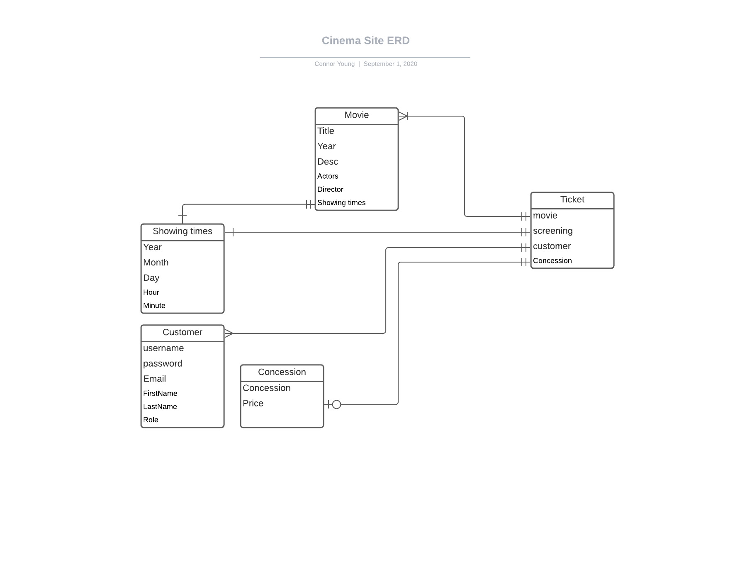
ERD Diagram

Slide 5
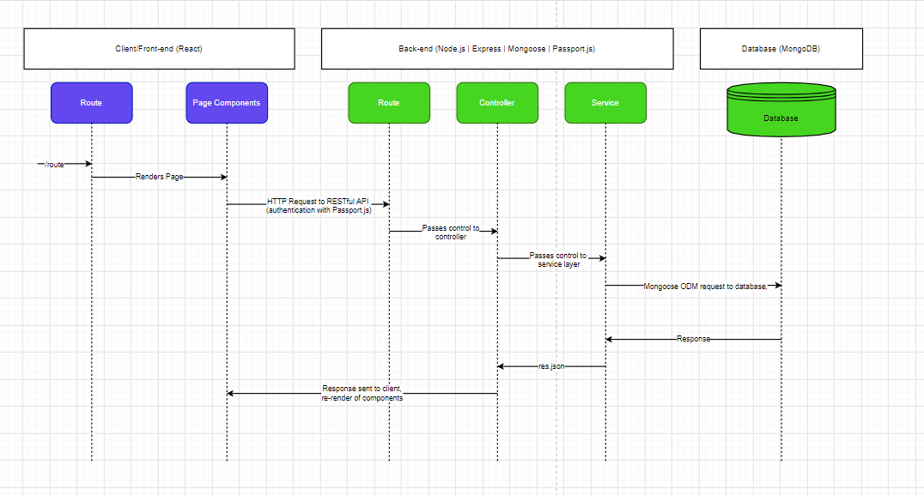
Data flow Diagram

Slide 6
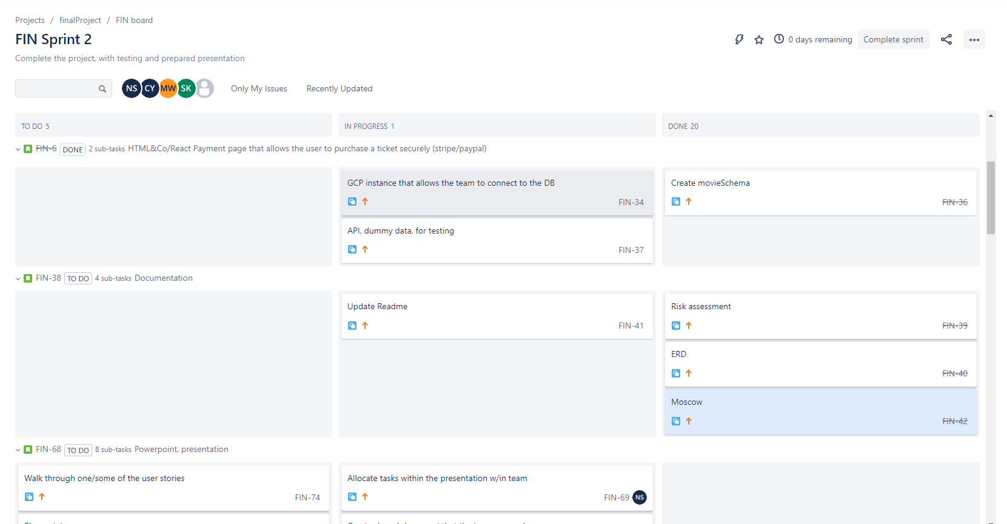
Jira Board

Slide 7
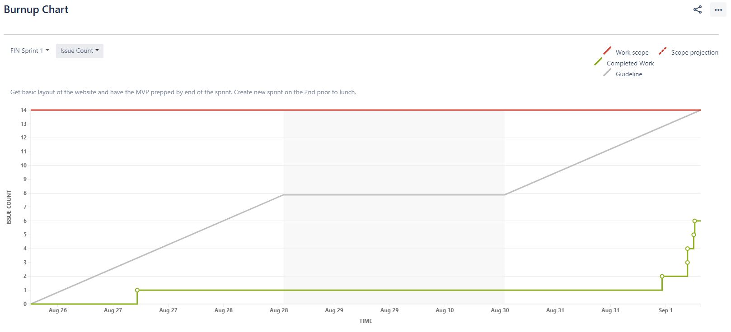
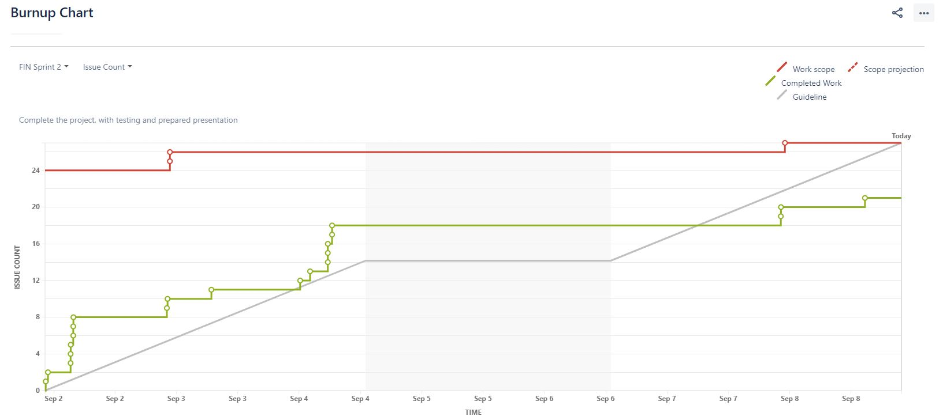
BurnUP Chart

Slide 8
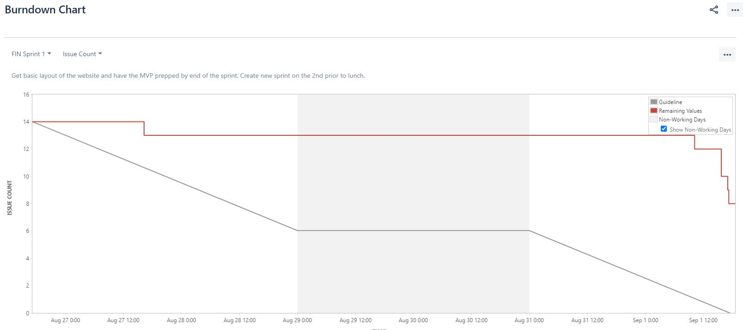
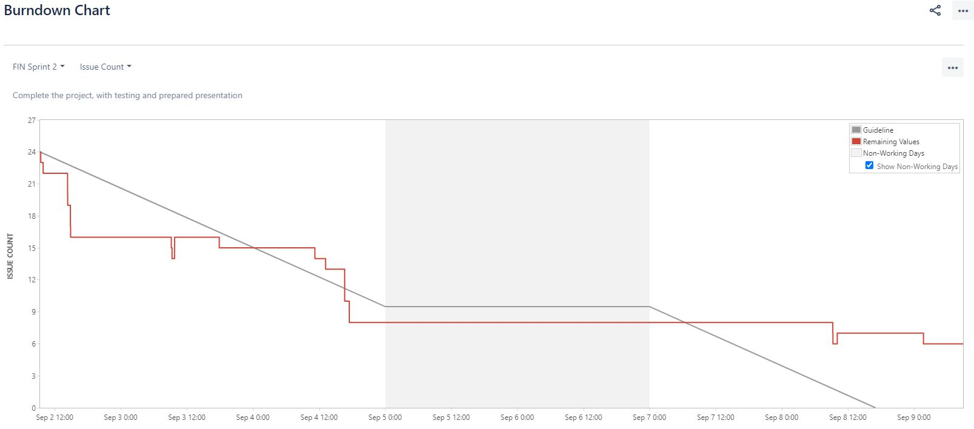
BurnDown Chart

Slide 9

demonstration

Slide 10
Project Retrospective
What went well
What we could have gone better
What we could improve

Slide 11

Conclusion

