Slide 1
Group Cinema Project
Shiva King, Morgan Walsh,
Connor Young and Nilay Sanghrajka
09/09/2020

Slide 2
Introduction and Scope
Who are we?
Connor Young – Product Owner
Nilay Sanghrajka – Scrum Master
Shiva King – Developer
Morgan Walsh – Developer
What we were

Slide 3
Technologies
MERN Stack
Back-End Programming Language:
API Development Platform:
Front-End Web Technologies:
Build Tool:
Database Management System:
Unit Testing: Jest, Mocha Chai
Source Code Management: GitHub
Kanban Board: Jira Boards

Slide 4
ERD Diagram

Slide 5
ERD Diagram

Slide 6
ERD Diagram

Slide 7
ERD Diagram

Slide 8
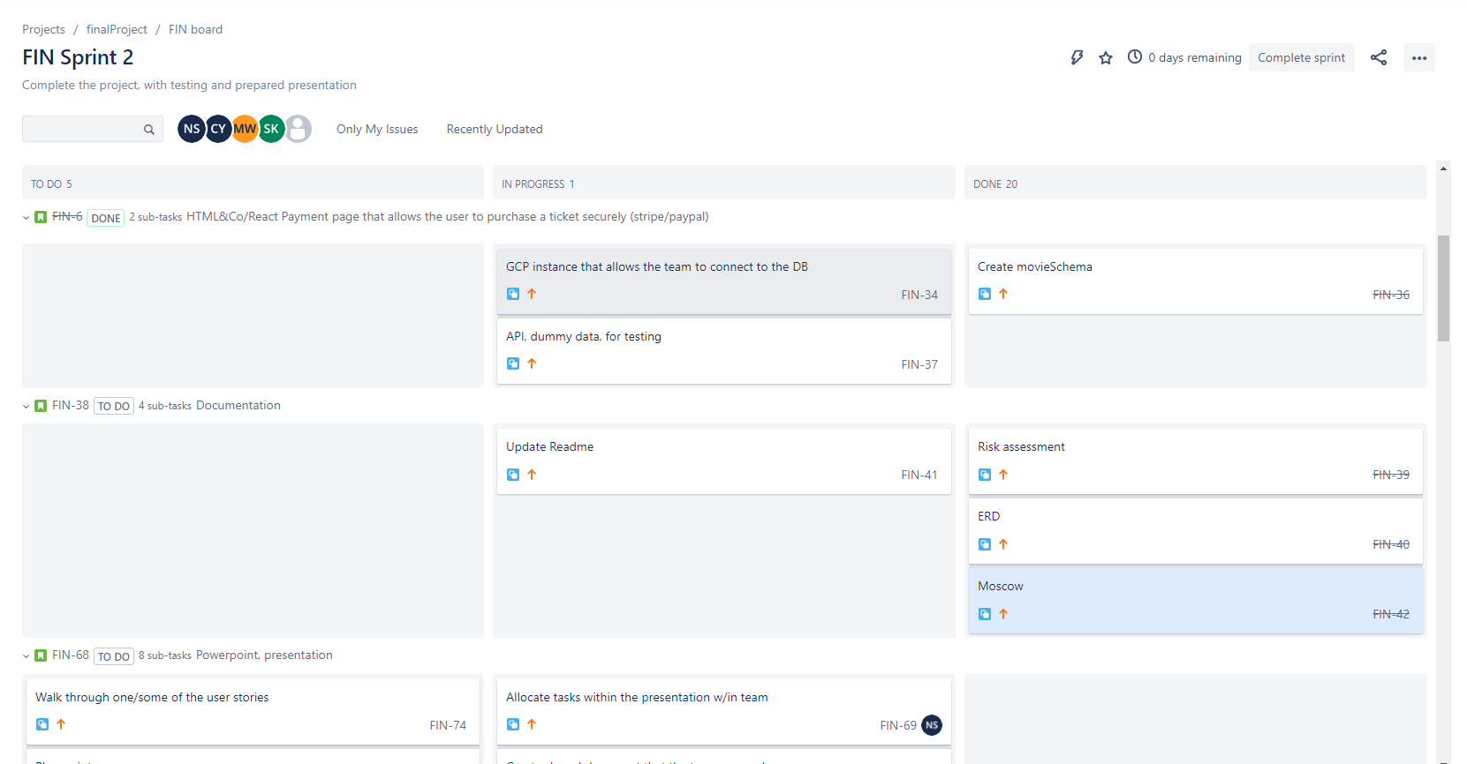
Jira Board

Slide 9
SPRINT REVIEW

Slide 10
SPRINT Retrospective

Slide 11

demonstration

Slide 12

Conculsion

