Slide 1






。
Group Members：余俊辉 陈展 李泽昊 姜润林

Slide 2
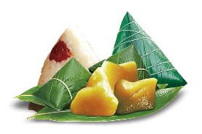


Content
1
Oringin of the Dragon Boat Festival
2
Customs of the Dragon Boat Festival
3
Tasty foods
4
Poetry

Slide 3
1
🐉 Oringin of the Dragon Boat Festival

Slide 4
🐉 Oringin of the Dragon Boat Festival
Name Origin
Fascinating origin 有趣的起源
Signifies “initial” or “beginning” 象征“初始”或“开始”
Evolved into the widely recognized name 演变为广为人知的名称
天中节
菖蒲节
粽子节
Holidays Aliases
浴兰节
双五节
解粽节

Slide 5
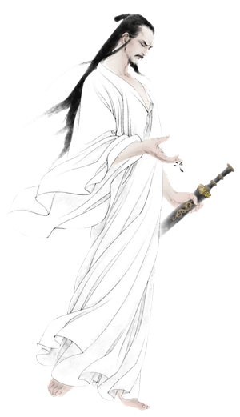
🐉 Oringin of the Dragon Boat Festival
【 屈 ·原】
In memory of Qu Yuan 纪念屈原
Qu Yuan was a patriotic poet 屈原是一个爱国诗人
drowned himself in the Miluo River 汨罗江投江自尽
Customs came into being 形成习俗

Slide 6


🐉 Oringin of the Dragon Boat Festival
In Memory of Wu Zixu
He was a loyal minister 忠诚的臣子
People commemorated him纪念他
especially popular in the Jiangsu and Zhejiang areas 在江浙一带非常流行
In Memory of Cao E
a touching story about a filial girl 关于孝女的感人故事
miraculously brought her father’s body back 奇迹般的
the great filial piety of Cao E 曹娥伟大的孝心

Slide 7
2
🐉 Customs of the Dragon Boat Festival

Slide 8
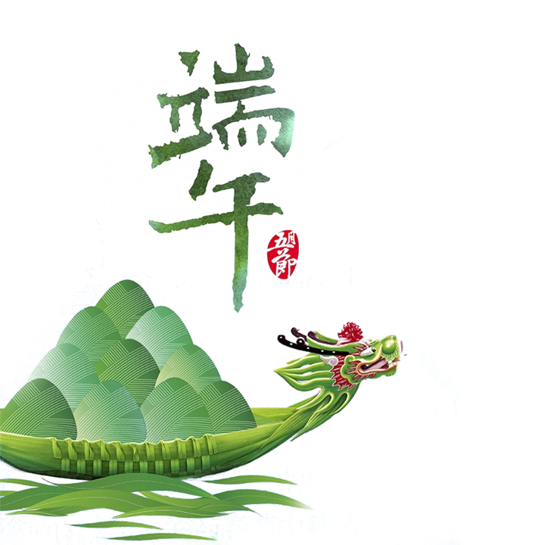
🐉 Customs of the Dragon Boat Festival
dragon boat racing
·slicing through the river 划破江面
·paddle in unison to the rhythm of the drums 随鼓点划桨
·echoing over the water 在水面上回响

Slide 9

🐉 Customs of the Dragon Boat Festival
wearing fragrant sachets
·fragrant with herbal charm 香气中蕴含草本魅力
·worn close to the heart 贴身佩戴于心口
·filled with the breath of summer herbs 充满夏日草药的气息

Slide 10
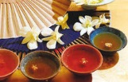
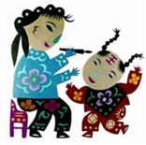
🐉 Customs of the Dragon Boat Festival
drinking medicinal wine
·steeped in ancient ritual 浸透古老仪式感
·burning warmth chasing away evil 炽热酒意驱逐邪气
·painted on brows with silent blessing 在额头描绘无声的祈愿
paint on forehead
·a single stroke to banish a hundred evils 一笔驱百邪
·a silent spell written with wine 用酒写下无声的符咒
·ritual lines tracing ancestral wisdom 仪式之线传承祖辈智慧

Slide 11
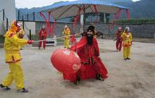
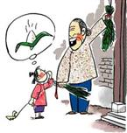
🐉 Customs of the Dragon Boat Festival
Dance of Zhong Kui
return home to avoid misfortune

Slide 12
3
🐉Tasty foods from the Dragon Boat Festival

Slide 13
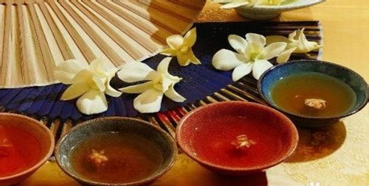
🐉Tasty foods
realgar wine
drive away bad spirits and sickness 驱走邪灵和疾病
ground a little realgar powder 磨入少量雄黄粉
hang small pouches of realgar on doors or wear bracelets
挂小袋雄黄粉或戴雄黄手环
a nod to this old custom 向这一古老习俗致敬

Slide 14
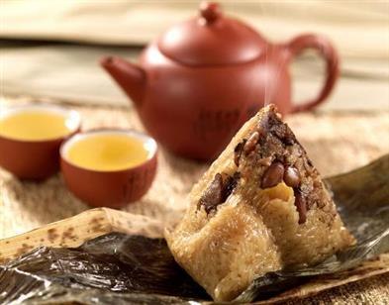
🐉Tasty foods
zongzi
zongzi are parcels of sticky rice 粽子是糯米小包裹
wrapped in bamboo or reed leaves 用竹叶或芦苇叶包裹
honor Qu Yuan 纪念屈原
unwrapping each bundle 剥开每个粽子的过程

Slide 15
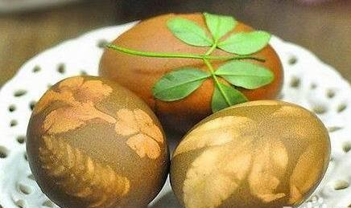
🐉Tasty foods
scallion egg
beat fresh eggs 打散新鲜鸡蛋
mix in chopped green onions 拌入切碎的葱花
soft, fluffy, and a little crunchy at the sides 松软，蓬松，边缘略脆
gentle onion flavor and smooth egg texture 清新的葱香和顺滑的蛋感

Slide 16
4
🐉poetry

Slide 17
🐉poetry
express gratitude and loyalty
表达感恩与忠诚
《端午日赐衣》(唐 杜甫)
宫衣亦有名，端午被恩荣。
细葛含风软，香罗叠雪轻。
自天题处湿，当暑著来清。
意内称长短，终身荷圣情。
reflect traditional values
反映传统价值
connect history with emotion
连接历史与情感

Slide 18
poetry
《同州端午》(唐 殷尧藩)
spend years away from home
漂泊多年
remind us of who we are and where we belong
唤醒对身份与归属的记忆
鹤发垂肩尺许长，
离家三十五端阳。
儿童见说深惊讶，
却问何方是故乡。

Slide 19
end
reflect rich emotions
bring both joy and sorrow
展现丰富的情感
带来欢乐和忧伤
connect us with history and show deep cultural values
将我们与历史联系起来，展示深厚的文化价值 making poetry an essential part of understanding Chinese tradition
使诗歌成为理解中国传统的重要组成部分

Slide 20
Thank You

