Slide 1
Getting started with C#
ICTPRG549 - Apply intermediate object-oriented language skills

Slide 2
What we’re covering
What is C#
What is an IDE (Integrated Development Environment)
Installing Visual Studio
C# Syntax & Structure
Namespaces, Classes & Statements
Main() Method
Common C# Concepts

Slide 3


What is c# (C-Sharp)
A programming language developed by Microsoft in early 2000s
Used to develop web & desktop applications, mobile apps, games and more.
A Multi Purpose Object-Oriented Programming Language

Slide 4


OBJECT-ORIENTED Languages
Allows programmers to ‘Modularise’ program into logical units of code.
Gives greater re-usability of code
Minimises need repetition within code.
Easy code maintenance and testing.
Greater Flexibility
Security & Troubleshooting
Achieved through concepts such as Inheritance, Polymorphism, Abstraction & Encapsulation.

Slide 5
What is an IDE (Integrated Development Environment)
An Integrated Development Environment is an application with tool which allows programmers to undertake all aspects of software and development from one place.
This includes:
Writing/editing source code
Debugging, profiling and testing code
Creating and deploying executable (.exe) application files

Slide 6

Ide options for c#
IDEs available for C# include:
Visual Studio
Visual Studio Code
Monodevelop
Rider
#Develop
For this class we will be using Visual Studio.

Slide 7
INSTALLING Visual studio
Go to: visualstudio.microsoft.com/downloads/ or search for Visual Studio 2019 Download in your browser.
CLICK on the FREE DOWNLOAD option under the Community Option.
RUN the Downloaded installer and follow the prompts to install.

Slide 8
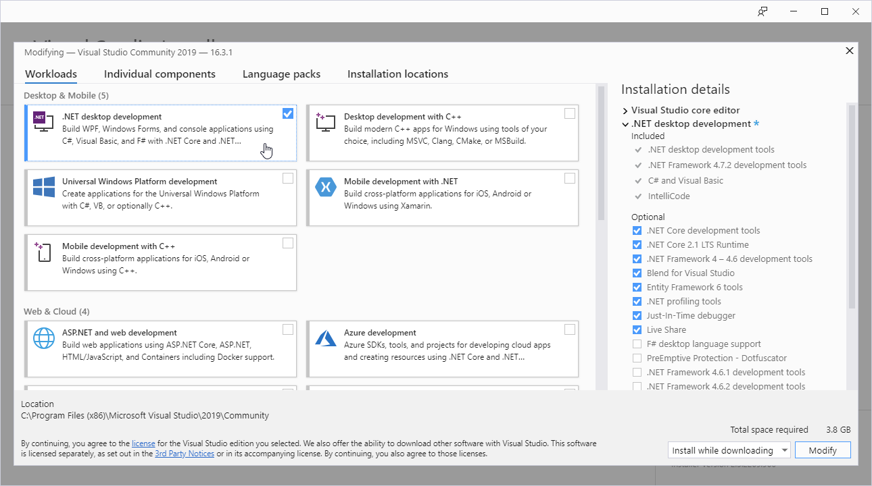
INSTALLING Visual studio (CONT)
Ensure you select the
.NET Desktop Development workload then press Install while Downloading to continue.

Slide 9

LETS WRITE OUR FIRST CLASS PROGRAM
Hello World Exercise

Slide 10
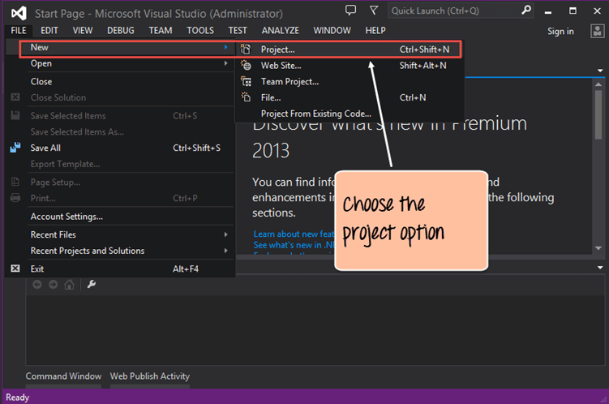
Create new project

Slide 11
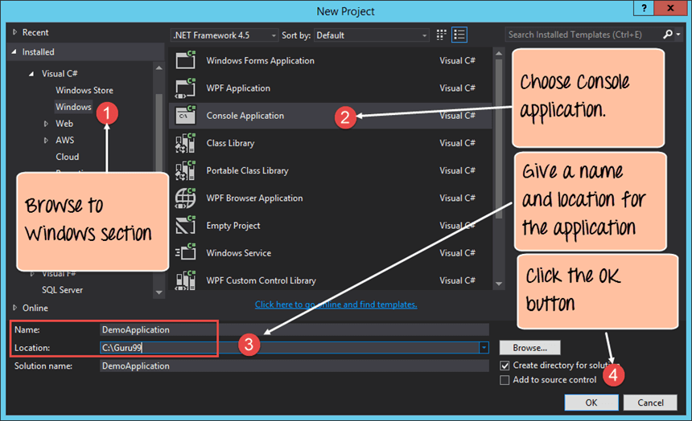
choose the project type as a Console application.

Slide 12
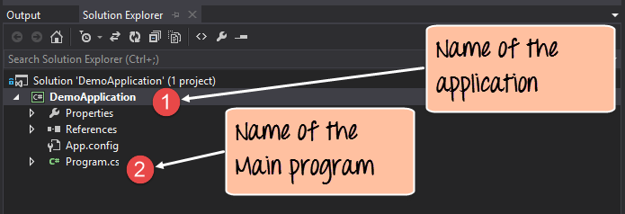

Slide 13
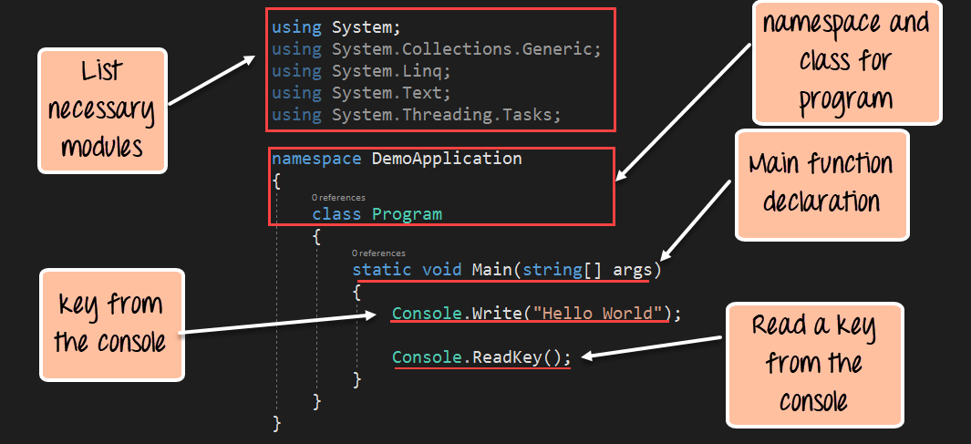

Slide 14
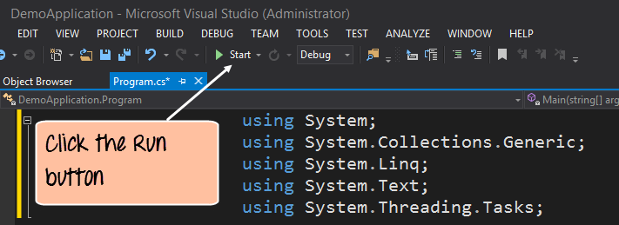
Run your .Net program.

Slide 15
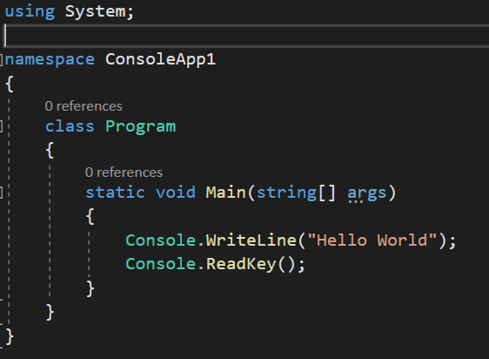
C# code example
Every piece of C# code follows a certain structure and utilizes several common components.
The example shown is a simple console application which prints the words “Hello World” in the command console.

Slide 16
namespaces
A Namespace is a way of collecting and organizing classes and program functionality together.
Every Namespace will have it’s own name and can contain a single class file, or it can contain multiple classes and libraries.
Think of it as a file draw or container that holds all your documents.

Slide 17
CLAsses
Classes act like containers that hold collections of data and logic that brings functionality to our programs.
These containers are generally a single file and are generally contained within a Namespace.
Every class has a name which follows the class declaration. Our example class is called ‘Program’

Slide 18
Using statements
Using statements allow a section of code to access another Namespace to allow it access and use the classes and functionality of the named Namespace.
By calling the System Namespace in this code example, we can then access the Console class later in our code.

Slide 19
statements
Statements are the lines of code that instruct the program to do something. They can contain various commands or instructions and are always followed by a semi-colon to indicate the end of the statement.
The example given is telling the program to write the words “Hello World” to the console before waiting for the user to press a key to continue.

Slide 20
Curly braces
Braces are used to help organize and group together sections of code within your program.
Each set of braces has an opening and closing brace to indicate the start and end of a block or sequence of code.
They help indicate what lines of your code are logically contained within a given Namespace, Class or other programming structure.

Slide 21
Main Method
This method must always appear in every program and is the starting point for every C# application.
Any code within the main method’s curly braces will be executed in sequence as your application begins.
Depending on the contained code it may create and trigger additional classes and applications as it runs but no program will start without one.

Slide 22
Other useful concepts
Commenting
Whitespace
Case-Sensitivity

Slide 23
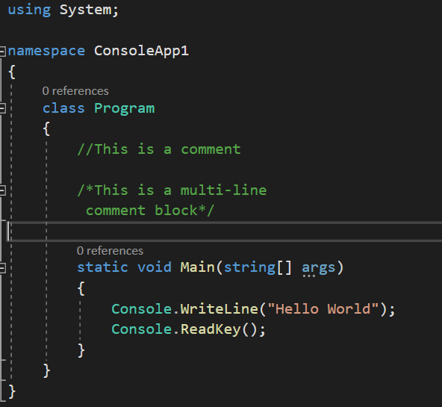
Comments
Comments can be added to your code to give additional information about your program from within your code.
The two most common ways to add comments are:
//Double forward slash for single lines
/*Forward slash followed and asterisk to start a multi-line comment block followed by the reverse to end the block*/
You program will ignore the content in the comment blocks when it runs. This is great for internal code documentation.

Slide 24
White-space
When your application is built and runs, the C# compiler ignores white-space such as empty lines and spaces before and after code blocks and statements.
This can be used to your advantage to give space between sequences of logic to make the code more readable to human eyes.
Use white-space when practical.

Slide 25
Case sensitivity
All names in C# are case sensitive.
“WriteLine” and “writeline” will not be recognized as the same thing.
Take care that when you reference something in your code that the casing matches the object you are referring to.

Slide 26
What we’ve covered so far
What is C#
What is an IDE (Integrated Development Environment)
Installing Visual Studio
C# Syntax & Structure
Namespaces, Classes & Statements
Main() Method
Common C# Concepts - Comments, White-Space & Case-Sensitivity

