Slide 1
C# Variables and data types
ICTPRG430 Apply introductory object-oriented language skills

Slide 2

More commonly used types
Data Type | Size | Description
int | 4 bytes | Stores whole numbers from -2,147,483,648 to 2,147,483,647
long | 8 bytes | Stores whole numbers from -9,223,372,036,854,775,808 to 9,223,372,036,854,775,807
float | 4 bytes | Stores fractional numbers. Sufficient for storing 6 to 7 decimal digits
double | 8 bytes | Stores fractional numbers. Sufficient for storing 15 decimal digits
bool | 1 bit | Stores true or false values
char | 2 bytes | Stores a single character/letter, surrounded by single quotes
string | 2 bytes per character | Stores a sequence of characters, surrounded by double quotes
Today we tend to only use several main data types unless working on something more specialised.

Slide 3

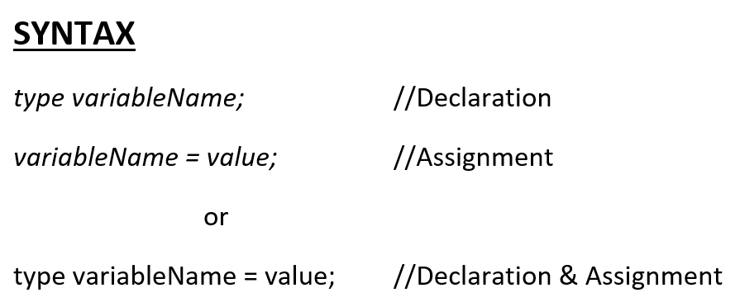
Creating a new variable
You create a variable by completing two steps:
First you declare the variable by specifying its type and giving it a name to identify it.
Then, you assign it a value appropriate for its type.
The top option is generally used when you wish to declare a variable early, then assign it a value sometime later in your code.

Slide 4
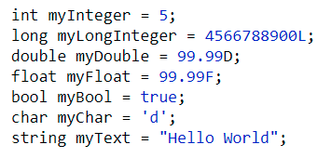
Examples
The examples shown show the syntax for each of the common data types.
Note the use of the single quote marks(‘ ’) and double quote marks (“ ”) surrounding the char and string declarations.
Also note the use of the L, D and F indicators at the end of the Long, Double and Float variables.

Slide 5
C# built-in value types:
Data Type | Size | Description
int | 4 bytes | Stores whole numbers from -2,147,483,648 to 2,147,483,647
long | 8 bytes | Stores whole numbers from -9,223,372,036,854,775,808 to 9,223,372,036,854,775,807
float | 4 bytes | Stores fractional numbers. Sufficient for storing 6 to 7 decimal digits
double | 8 bytes | Stores fractional numbers. Sufficient for storing 15 decimal digits
bool | 1 bit | Stores true or false values
char | 2 bytes | Stores a single character/letter, surrounded by single quotes
string | 2 bytes per character | Stores a sequence of characters, surrounded by double quotes

Slide 6
C# built-in reference types:
C# type keyword | .NET type
object | System.Object
string (a sequence of zero or more Unicode characters) | System.String
dynamic (Bypass compile-time type checking. Instead, these operations are resolved at run time.) | System.Object

Slide 7
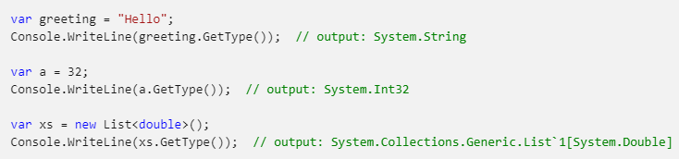
Implicitly-typed local variables

Slide 8

C# Constants
If you don't want others (or yourself) to overwrite existing values, you can add the const keyword before the variable type. This will declare the variable as "constant", which means unchangeable and read-only:

Slide 9

typecasting
Sometimes you need to convert variables from one data type to another in your code. This may be because you need to convert one numeric type to another, or you need to get user input, which is often read into the system as a string, and convert it to a number.
We do this by typecasting, and there are 2 types of ways this is done.
https://www.youtube.com/watch?v=uajWePMMs84

Slide 10
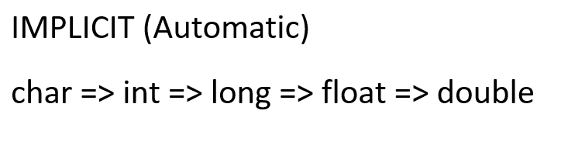
Implicit casting
When assigning a char or another numeric variable to a larger variable type, your code will do this for you automatically without any extra work.
This is possible because the larger type will always be compatible with the smaller one. This is because all the larger numeric types are simply extensions on the range of their smaller counterparts.
NOTE: char variables will convert to their numeric ASCII keycode designation.

Slide 11
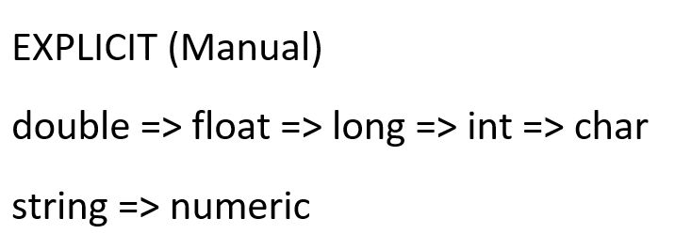
Explicit casting
Whenever converting from a larger numeric type to a smaller one or from a number to a string and vice-versa you need to attempt to perform a manual typecast.
With numeric variables this may be because a larger value may not fit inside the allowed memory of the smaller number or it may lose precision (decimal places) in doing so. Other conversions may not work due to compatibility issues such as converting a word to a number.

Slide 12
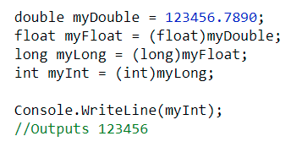
Explicit typecasting
Casting between numeric types can be done by placing the type in parentheses in front of the value being assigned to a smaller data type.
This may lead to the loss of decimal places and can still fail if the number is still too large to fit in the smaller type.

Slide 13
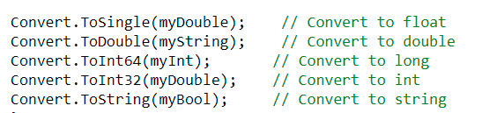
convert methods
You can change many data types from one type to another using one of the “Convert” methods. This will work for many conversions as long as the value being converted is compatible with the receiving type.
NOTE: The conversion for long is ToInt64() and for float is ToSingle() as the names long and float are actually aliases used in C#.

Slide 14
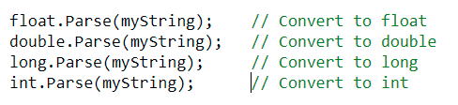
Parse methods
When converting from a string to numeric type you can also use one of the .Parse methods. This will work so long as the string being used can convert to the relevant numeric type.

Slide 15
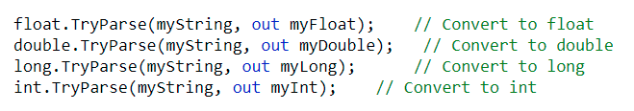
Try Parse methods
https://www.youtube.com/watch?v=u1hFV57ZIG0
A variation of the Parse is what is known as the TryParse. This first attempts to convert the value and returns a true or false value depending if it is successful. If the value can be converted the method then saves the converted value to the desired variable as indicated by the “out” parameter.
This variation is great for handling user input and preventing application crashing exceptions.
https://www.w3schools.com/cs/cs_type_casting.php

Slide 16

To String method
One final typecasting method is the .ToString() method which will convert most data types into a string format. Just add the .ToString() method call after any value or variable name to make the conversion.

Slide 17
Console. Read() vs Console.ReadLine()
https://www.youtube.com/watch?v=8dV2dNiX6DA

Slide 18
String manipulation
https://www.youtube.com/watch?v=BKYBiUAWZKM
.ToLower()
.ToUpper()
… and more https://www.completecsharptutorial.com/csharp-articles/csharp-string-function.php
… and string interpolation https://www.youtube.com/watch?v=taejaz9OwKY

Slide 19
Let’s try some
Write C# program:
ask for two numbers, swap them and print
ask for four numbers as input to calculate and print the average.
ask for the user's name and age, greet them and tell them how old they will be next year
ask for two numbers and print true if they are equivalent, otherwise print false
ask the user for the size and calculate the area and perimeter of square and circle (PI = 3.1415926535)

