Slide 1
Cyberminer – A web search engine Phase 2
Team members:
Tingwei Wu txw190006
Churong Zhang cxz173430
Feifei Guo fxg180009
Qixiang Wang qxw200000

Slide 2
Functional Requirements(1)
FR1. Case sensitive search
FR2. Hyperlink enforcement
FR3. Deletion of out-of-date URL
FR4. Multiple search engines

Slide 3
Functional Requirements(2)
FR5. Setting the number of results to show per page, and navigation between pages
FR6. Listing of the query result in ascending alphabetical order; most frequently accessed order, or per payment
FR7. Autofill, while correcting typographical errors
FR8. Specifying OR/AND/NOT Search
FR9. Filtering out symbols that are not meaningful, according to the user configuration

Slide 4
Non-Functional Requirements
NFR1. Easily understandable
NFR2. Reusable
NFR3. Good performance
NFR4. User-friendly

Slide 5
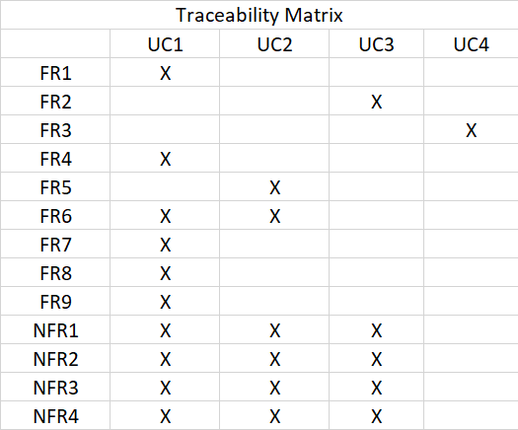

Slide 6
On Processing
Specifying NOT Search
Drawing State Transition Diagrams
Drawing Activity Diagrams

