Slide 1
Cyberminer – A web search engine Iteration 1
Team members:
Tingwei Wu txw190006
Churong Zhang cxz173430
Feifei Guo fxg180009
Qixiang Wang qxw200000

Slide 2
Functional Requirements(1)
FR1. Case sensitive search
FR2. Hyperlink enforcement
FR3. Deletion of out-of-date URL
FR4. Multiple search engines

Slide 3
Functional Requirements(2)
FR5. Setting the number of results to show per page, and navigation between pages
FR6. Listing of the query result in ascending alphabetical order; most frequently accessed order, or per payment
FR7. Autofill, while correcting typographical errors
FR8. Specifying OR/AND/NOT Search
FR9. Filtering out symbols that are not meaningful, according to the user configuration

Slide 4
Non-Functional Requirements
Easily understandable
Portable
Reusable
Good performance
User-friendly

Slide 5
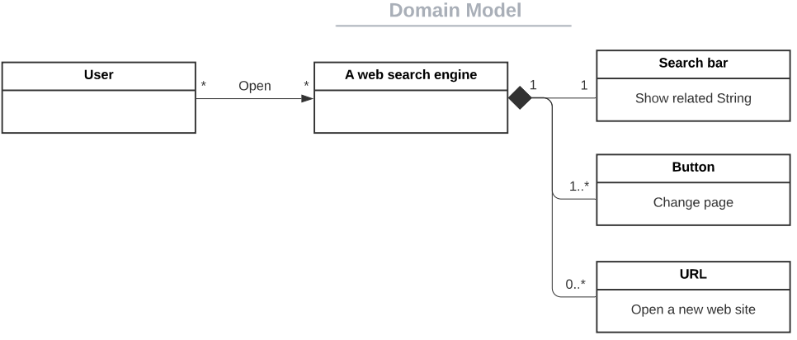
1. Domain Modeling & Requirements specification

Slide 6
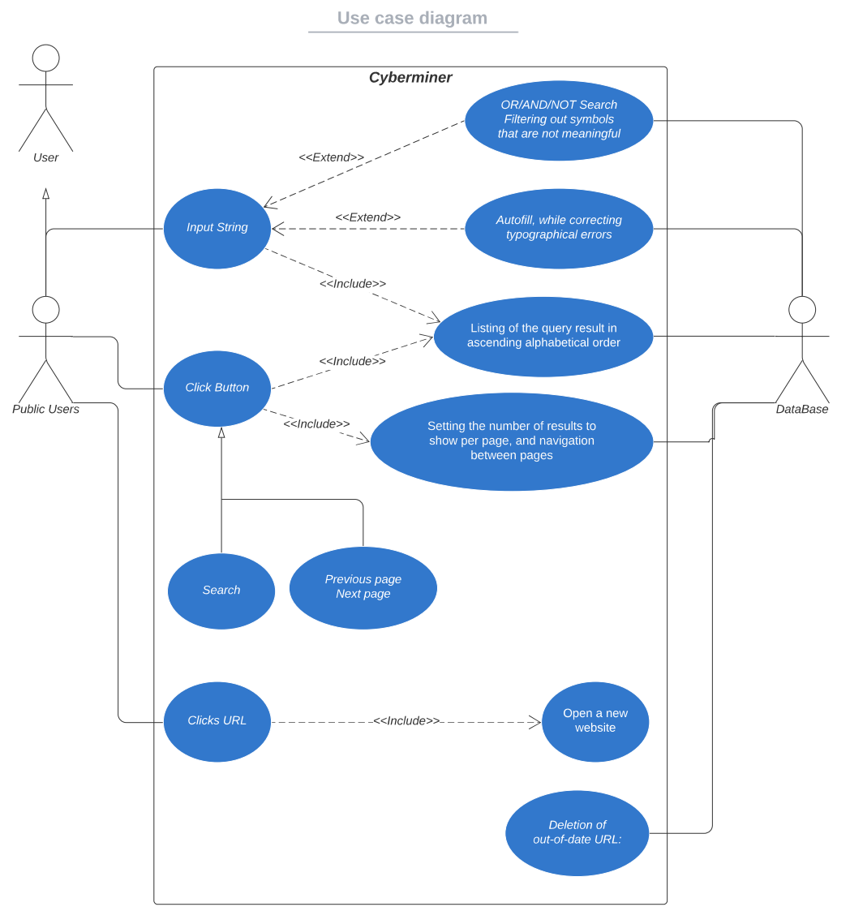
Use Case Diagram

Slide 7
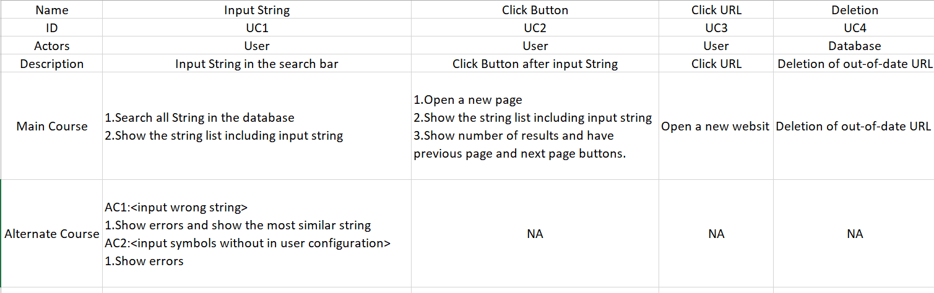
Use Case Template

Slide 8
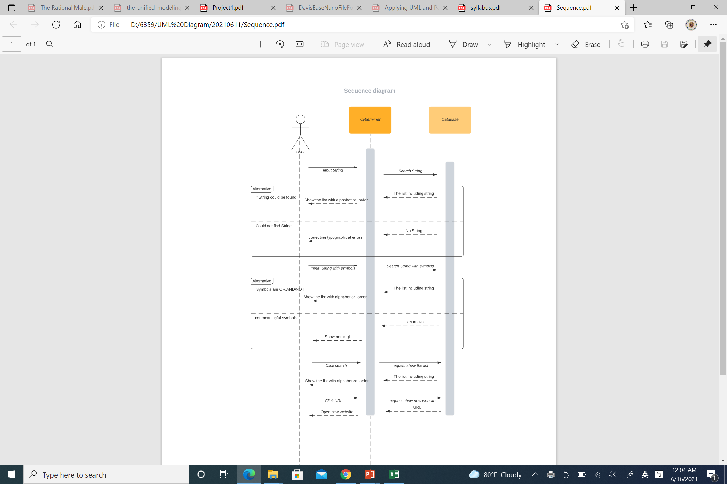
Sequence Diagram(1)
Input String

Slide 9
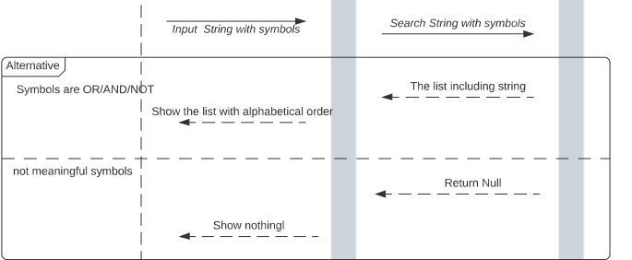
Sequence Diagram(2)
Input String with Symbol

Slide 10
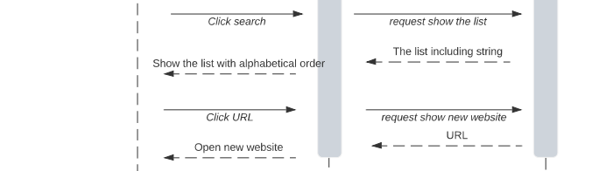
Sequence Diagram(3)
Click search and Click URL

Slide 11

Class Diagram

Slide 12
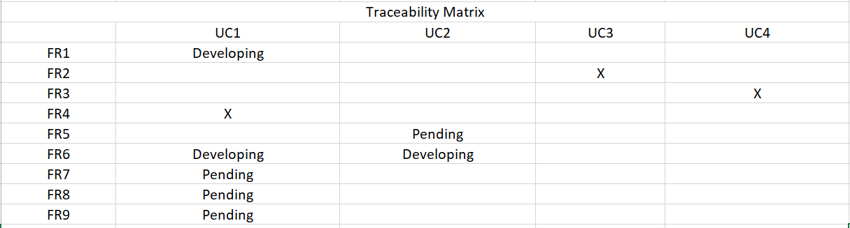
2. (Architectural) Design specification

Slide 13
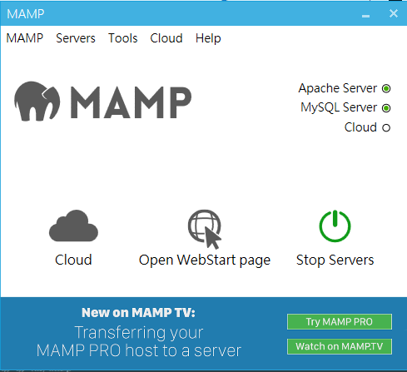
3. A Prototype implementation & User Manual
Download and Install MAMP
Activate Apache and MYSQL Server

Slide 14
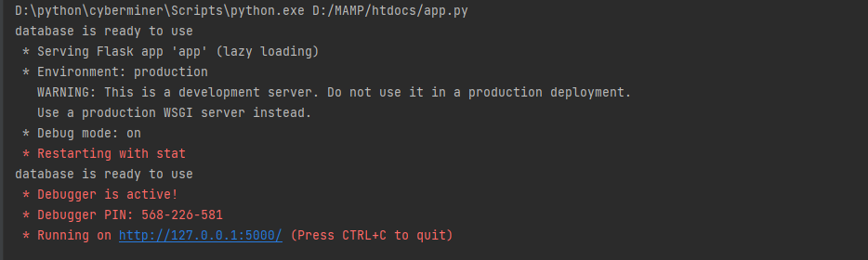
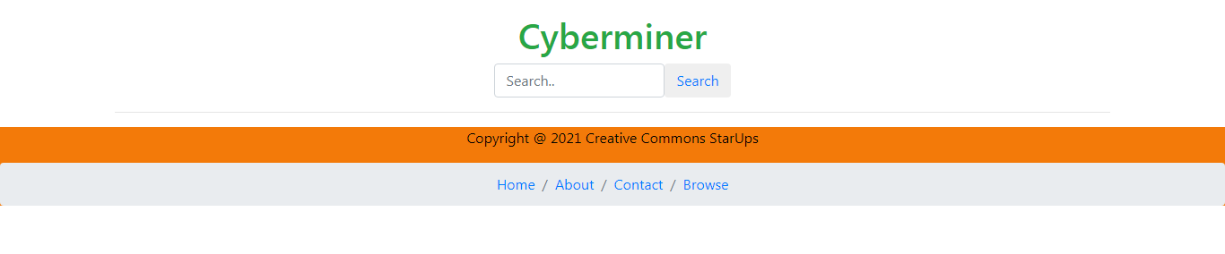
Execute app.py
Open the URL

Slide 15
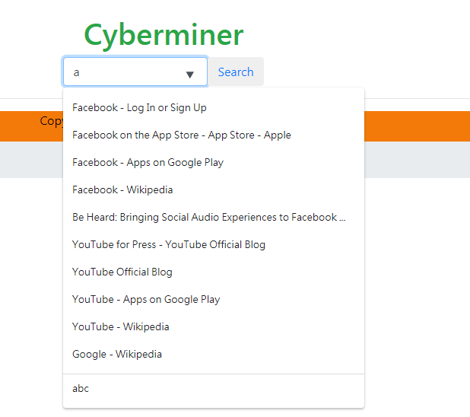
Input String and showing String in the Database

Slide 16
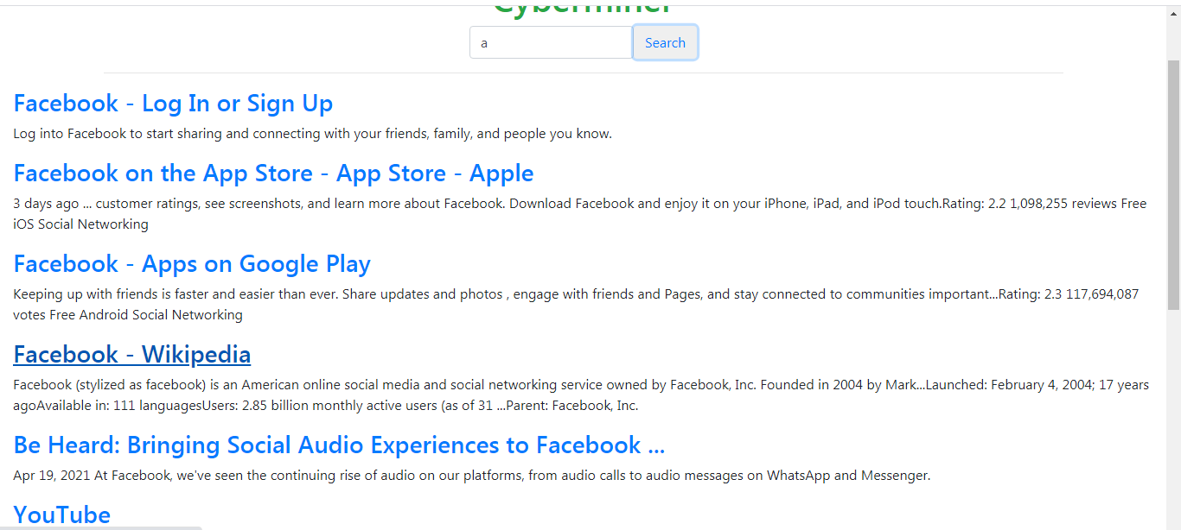
Click Search button and show the results

Slide 17
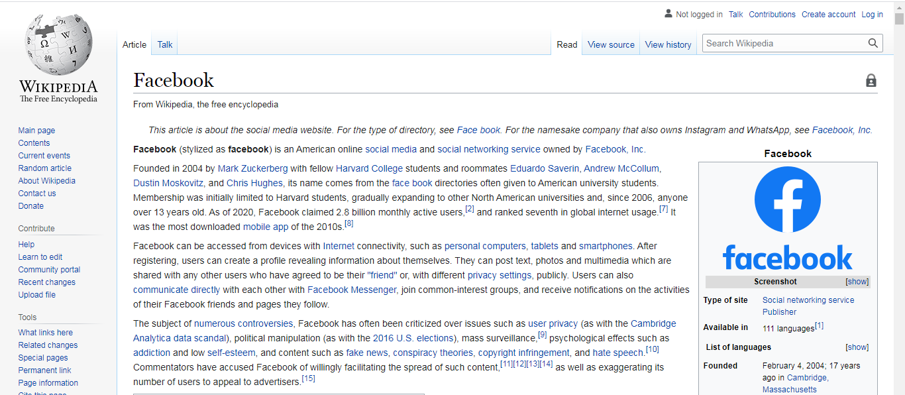
Click Facebook – Wikipedia

Slide 18
END

