Slide 1
DB-Curator
Agentic database construction for scientific evidence
From open-ended scientific questions to verified, auditable database rows
Chen Zhao, Botao Liu, Xiaoxiao Li, Tao Huan

Slide 2
Application target: build a database, not an answer
Scientific pain point
Agentic framing
What users get
Specialized databases are still built by slow expert literature curation.
Relevant evidence is scattered across papers, tables, metadata and compound mentions.
A plausible chemical name is not enough; release requires identity, scope and paper provenance.
The literature set is dynamic, not pre-curated: searches change as candidates and evidence gaps appear.
Each candidate is treated as an evidence contract with mandatory and exclusion predicates.
The loop stops only when the row is supported, rejected, or evidence-limited.
Curated compound rows with identifiers and topic labels.
Cited papers plus quote or local-context support.
Human-reviewable failure states for borderline cases.
ML takeaway: the agent is valuable because it controls retrieval, state tracking and stopping decisions, not because it writes fluent summaries.
Trusted and Efficient AI Group
2

Slide 3
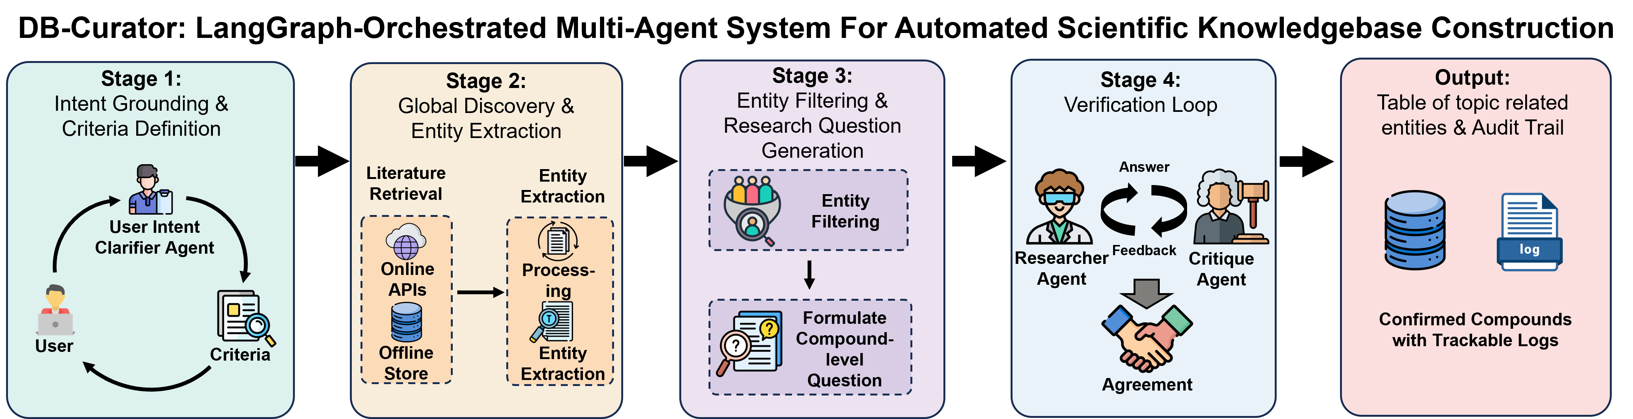
How DB-Curator turns intent into verified rows
1. Dynamic literature
Searches are seeded by the user definition, candidate identities and critique-discovered gaps.
2. Candidate grounding
Chemical mentions are normalized, filtered and converted into compound-level verification questions.
3. Predicate verification
Researcher proposes evidence; Critique audits whether each rubric predicate is actually supported.
supported
unresolved
exclusion
exhausted
Trusted and Efficient AI Group
3

Slide 4
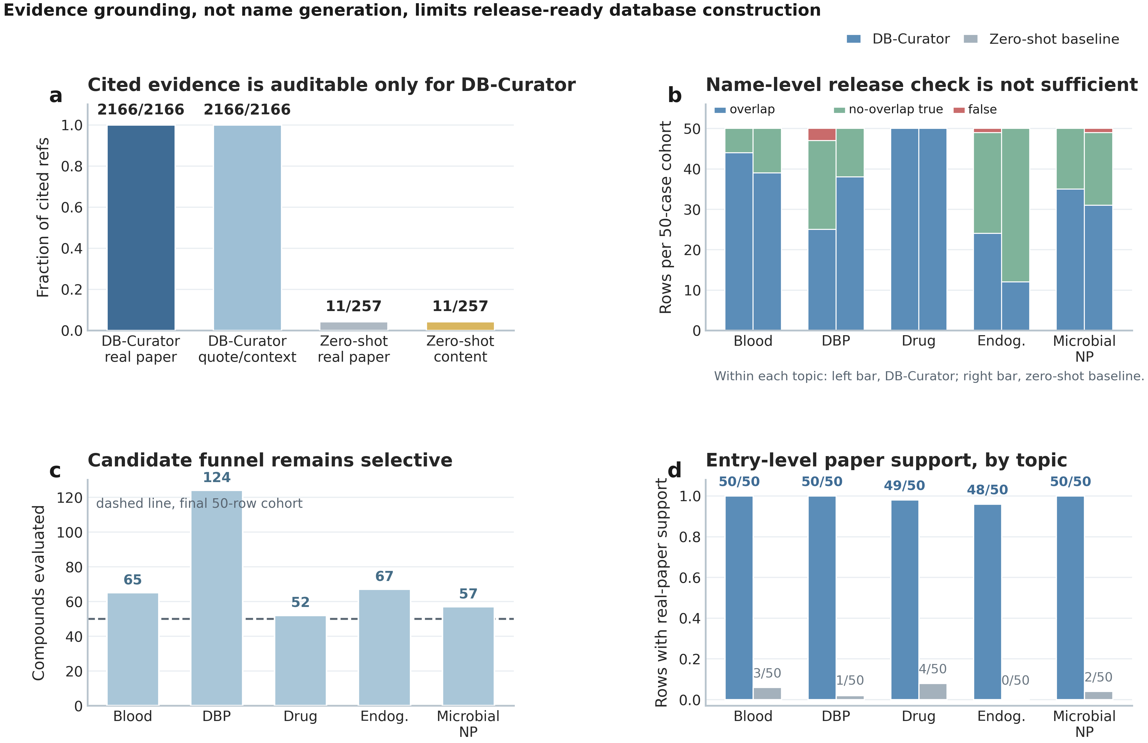
Application result: known recovery plus literature-buried additions
246/250
178
68
4
release-accepted rows
benchmark overlaps
new valid entries
errors
Fixed-cohort audit over five topics.
Known entries recovered automatically.
Absent from benchmark but accepted by human experts.
Out-of-scope or false rows.
Why this matters scientifically
Benchmarks are incomplete for open-ended curation.
A useful system should recover known compounds and surface evidence-backed additions.
DB-Curator shifts human work from full literature search to focused audit of non-overlap rows and evidence.
Trusted and Efficient AI Group
4

Slide 5
How we verify the output
Paper-level audit
Predicate-level audit
2,166/2,166
Resolve the cited item to a real primary paper using DOI, PMID, title or recovered metadata.
Search recovered paper text for the quoted span or equivalent local context.
Exclude compound-database lookup pages from primary-paper citation counts.
Required predicates must be directly supported, not only semantically nearby.
Exclusion contexts such as reagents, solvents or out-of-scope matrices block release.
Unresolved predicates trigger follow-up retrieval or remain evidence-limited.
fixed-cohort support
7,430/7,453
benchmark-scale support
11/257
zero-shot direct generation
Core contrast: baseline models can name plausible compounds, but DB-Curator produces rows whose papers and evidence spans can be audited.
Trusted and Efficient AI Group
5

Slide 6
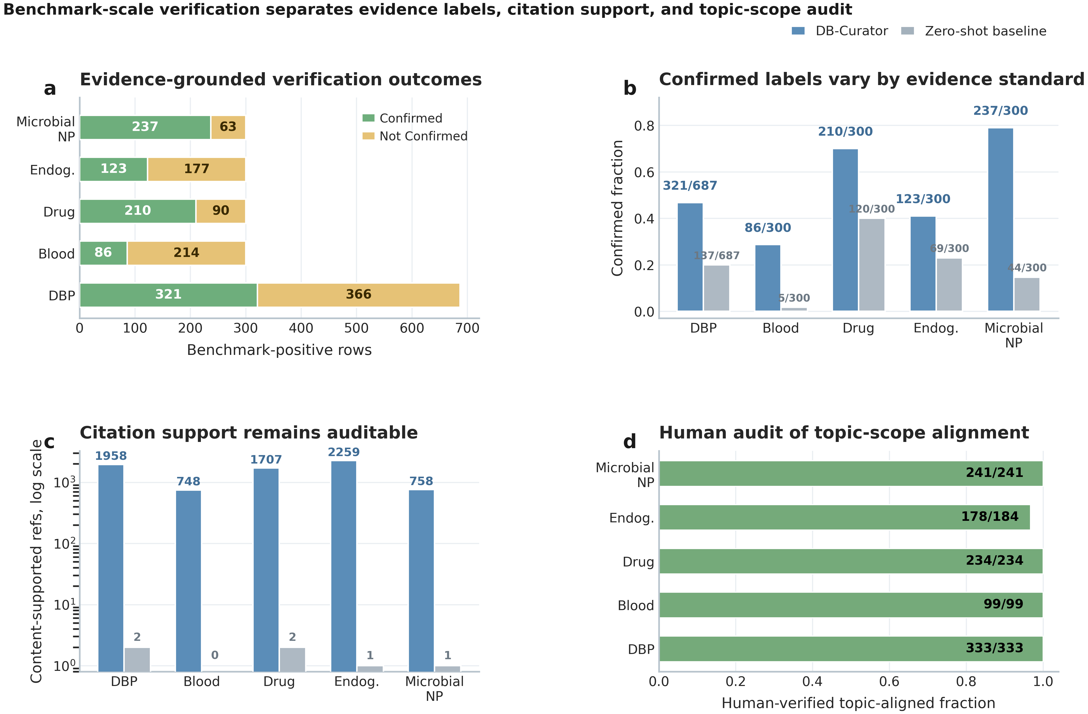
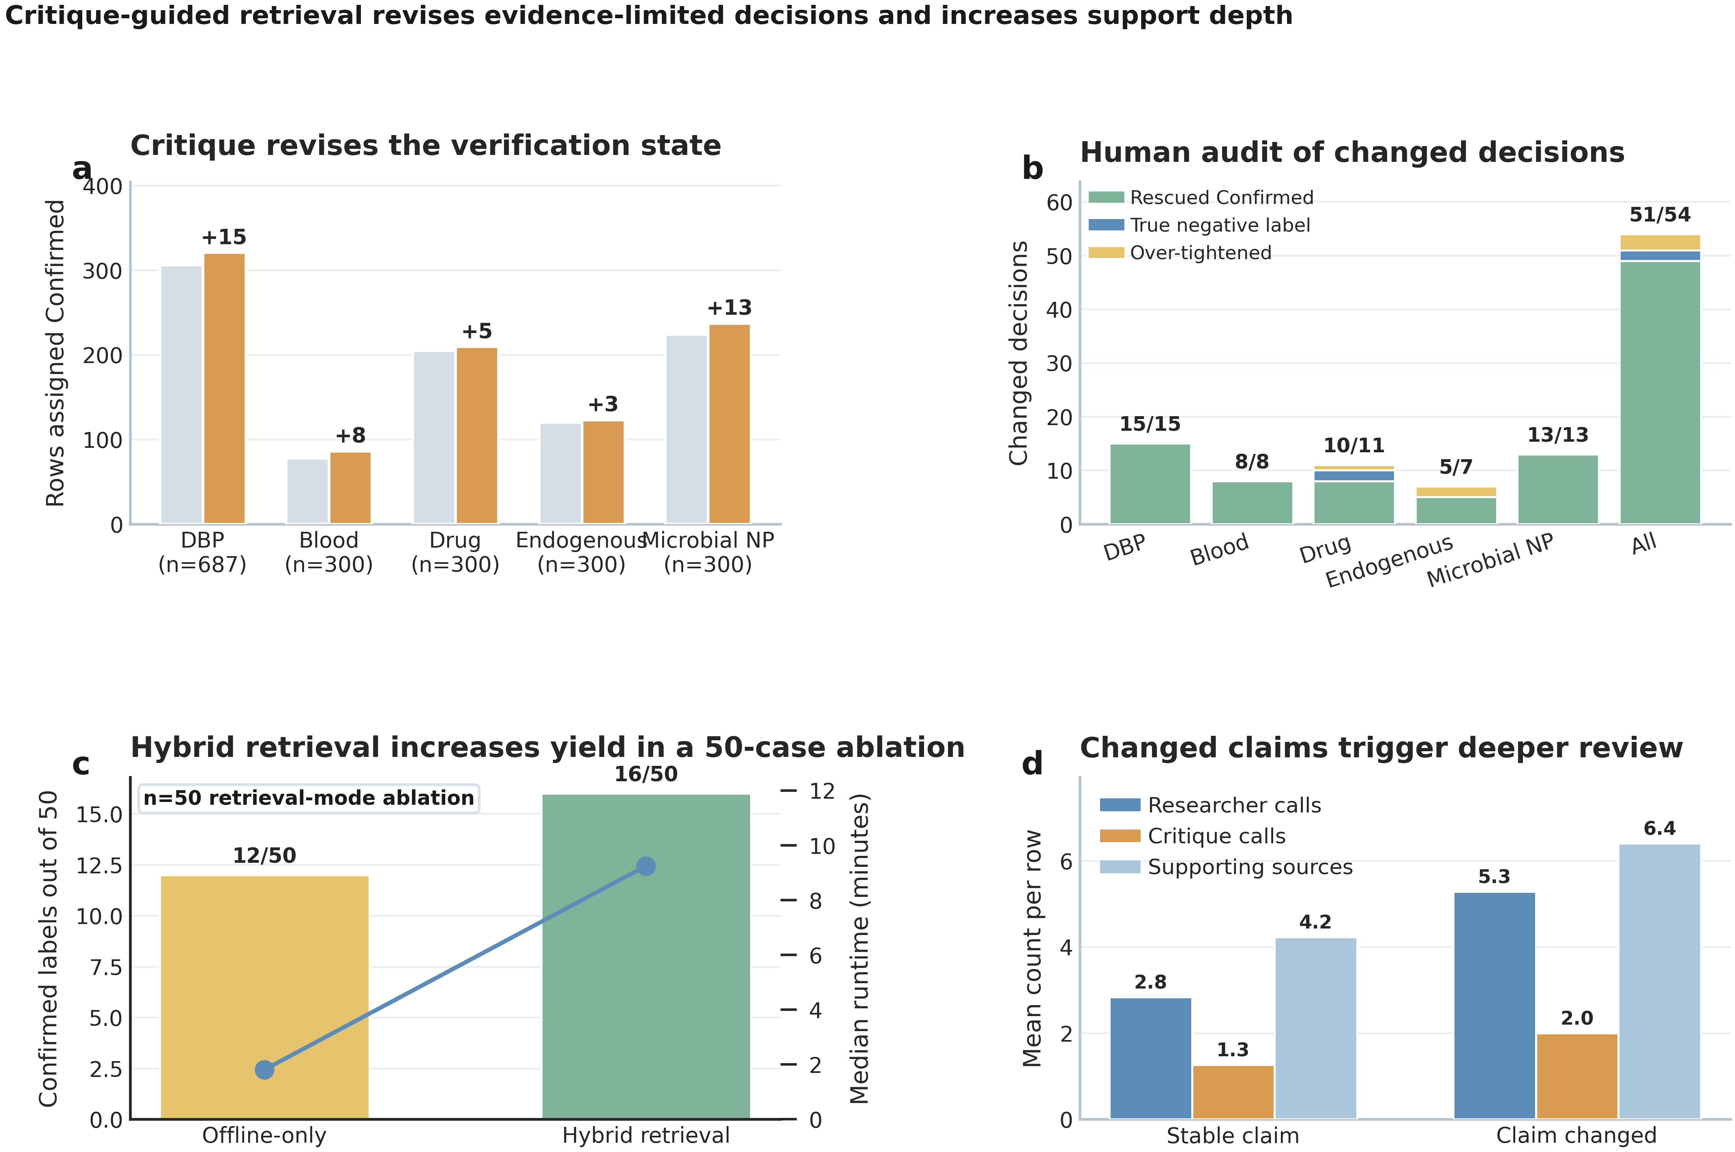
What ML experts should take away
1,887
977
49
5
candidate rows
Confirmed labels
rescued by critique
tightened
General lesson: agentic systems are most useful in science when they turn open-ended requests into inspectable states, evidence contracts and auditable artifacts.
Trusted and Efficient AI Group
6

