Slide 1
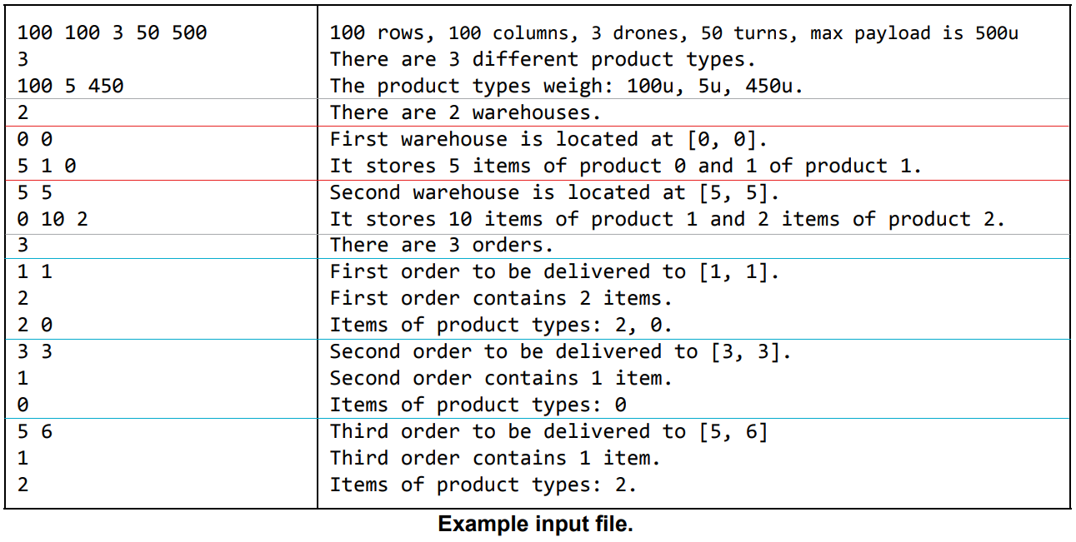
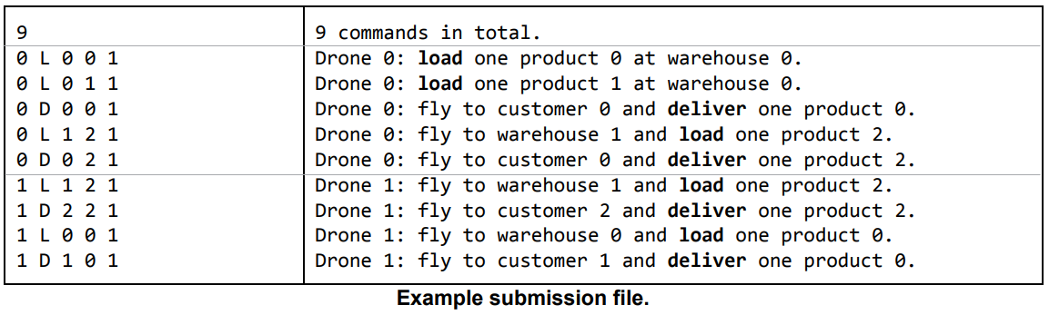
Capacitated Vehicle Routing Problem with Pickup and Delivery
Map
Products
Warehouses
Orders
Drones
Commands
Load
Deliver

Slide 2
Related Work
2020’s Kaggle approach of same problem, created by Google: https://www.kaggle.com/c/hashcode-drone-delivery
First Place solution, using Scala: https://www.kaggle.com/lyxthe/1st-place-solution | https://github.com/miraan/google-hash-code-qualification-round
Second Place Solution, using Python: https://www.kaggle.com/royceda/drone-linear-prog-and-routing-heuristic-90-done
Another Kaggle solution using Python: https://www.kaggle.com/spacelx/2020-hc-dd-2nd-place-solution-w-or-tools
Google OR-Tools for VRP e CVRP: https://developers.google.com/optimization/routing/vrp; https://developers.google.com/optimization/routing/cvrp
Google OR-Tools for CVRPPD: https://developers.google.com/optimization/routing/pickup_delivery
LocalSolver : https://www.localsolver.com/benchmarkcvrp.html | https://www.localsolver.com/docs/last/exampletour/vrp.html
CVRPPAD Hybrid Approach - https://link.springer.com/article/10.1007/s10479-017-2722-x | https://link.springer.com/content/pdf/10.1007/s10479-017-2722-x.pdf
Genetic Algorithm :
A genetic algorithm based approach to vehicle routing problem with simultaneous pick-up and deliveries (2011): https://www.sciencedirect.com/science/article/pii/S0360835211003482
A vehicle routing problem solved by using a hybrid genetic algorithm (2007): https://www.sciencedirect.com/science/article/pii/S0360835207001222
Waiting strategy for the vehicle routing problem with simultaneous pickup and delivery using genetic algorithm (2020): https://www.sciencedirect.com/science/article/pii/S0957417420307429
A hybrid genetic algorithm for the multi-depot vehicle routing problem (2005): https://www.sciencedirect.com/science/article/pii/S0952197607000887

Slide 3
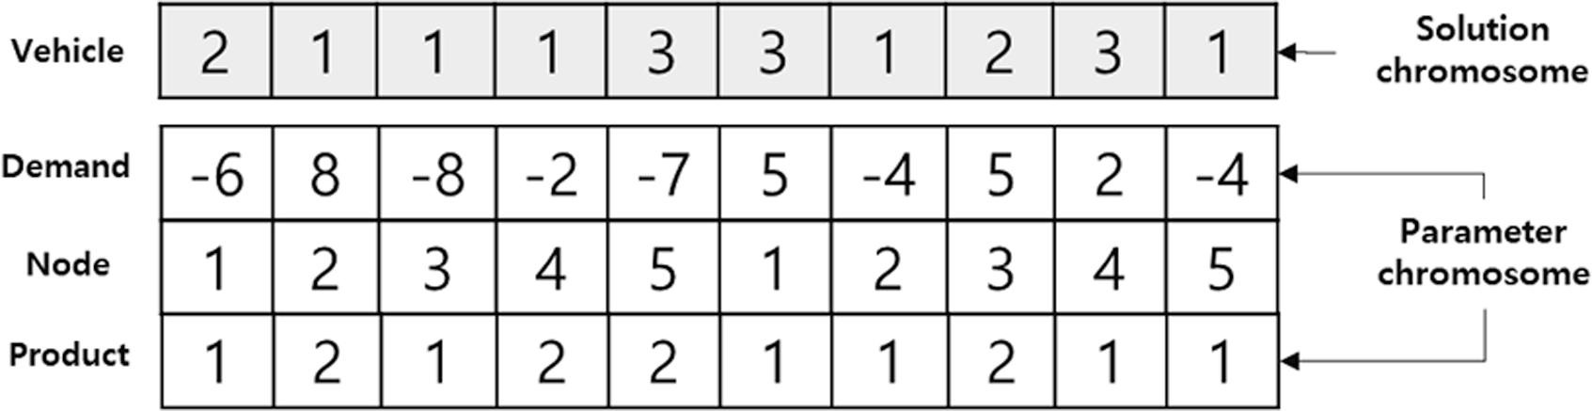
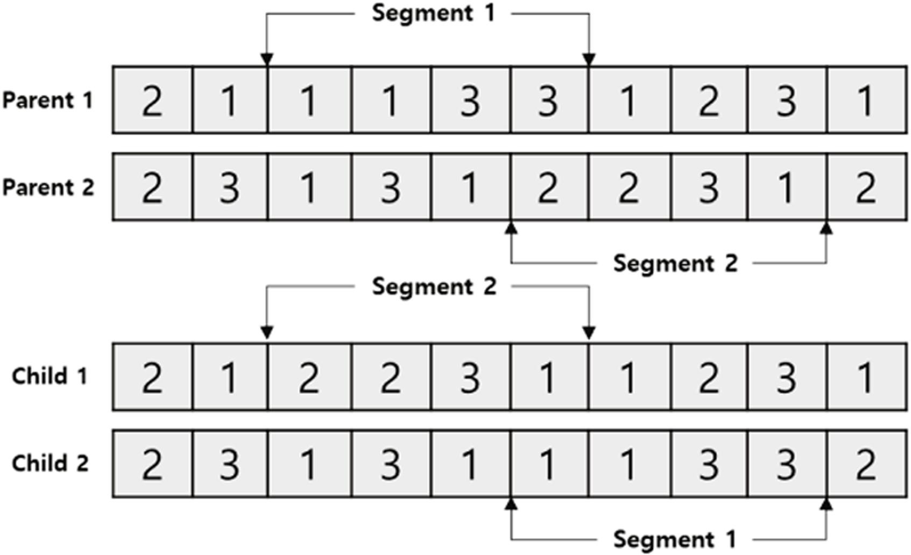
Solution Representation
Vehicle – If value is 0, no drone is assigned to that gene, but it can be used for future generations. If the value is greater than 0 and a integer, then a drone is assigned to the task represented by the gene
Demand – weight of the product to be delivered, if the value is negative, or picked up, if positive
Node – Identifier of a WH or a order. The order is identified and not the delivery point because multiple orders can have the same delivery point
Product – Identifier of the product
Crossover functions
Cause changes to the drones trajectories
A drone that pick ups product can deliver it to a different client if it is more beneficial.

Slide 4
Neighborhood/Mutation
Pq -> Product quantity
Dc -> Drone capacity
Cromossome Mutations:
Alter trajectories by switching drones of 2 genes.
Unbalance the quantities of 2 alleles of the same WH with the same item.
Add Supply genes: If there are items in WH’s that are not beeing picked up, adds a gene with a random quantity of that item, between [1, min(Pq,Dc)]
Join 2 genes: They can be of type deliver or supply, but need to have the same node. After joining, the resulting gene can stay on the position of the first gene or the second.
Gene Mutations:
Split a gene of type supplier or deliver into two genes, of either balanced or unbalanced quantities
Alter Associated Drone by replacing the current drone identifier with another or by 0

Slide 5
Implementation work carried out
Rigid Constraints
Drone Route cannot surpass the defined number of turns
Drone cannot have carry more weight than it’s capacity and cannot carry negative weight
Drone cannot take from a WH more product that available
Drone cannot pickup products from customer nodes, only from WH’s
Drone can only deliver products that he is currently carriyng
No order should receive more that than the intended products
Programming Language : Python
Development Environment : JetBrains IntelliJ
Already Implemented:
Parsing of input file
Creation of data structures to hold information

