Slide 1
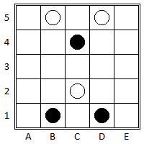
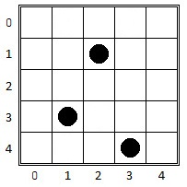
Simplified Neutreeko using Reinforced Learning
André Gomes - 201806224
Gonçalo Teixeira - 201806562
Luís Recharte - 201806743

Slide 2
Specification of Reinforced Learning Problem
Game Logic
Environment
Agents
Create Starting Condition
Possible moves
Manage player turns
Perform a move and update the board
Verify end game and tie conditions
Step – Apply the Agent action to the environment
Reset – Reset the env
Render – Print a representation of the env
Close – Finish the episode
Done – Check if episode is done
Random choice Agent
Q-learning Agent
SARSA Agent
Monte Carlo Agent (not implemented)

Slide 3
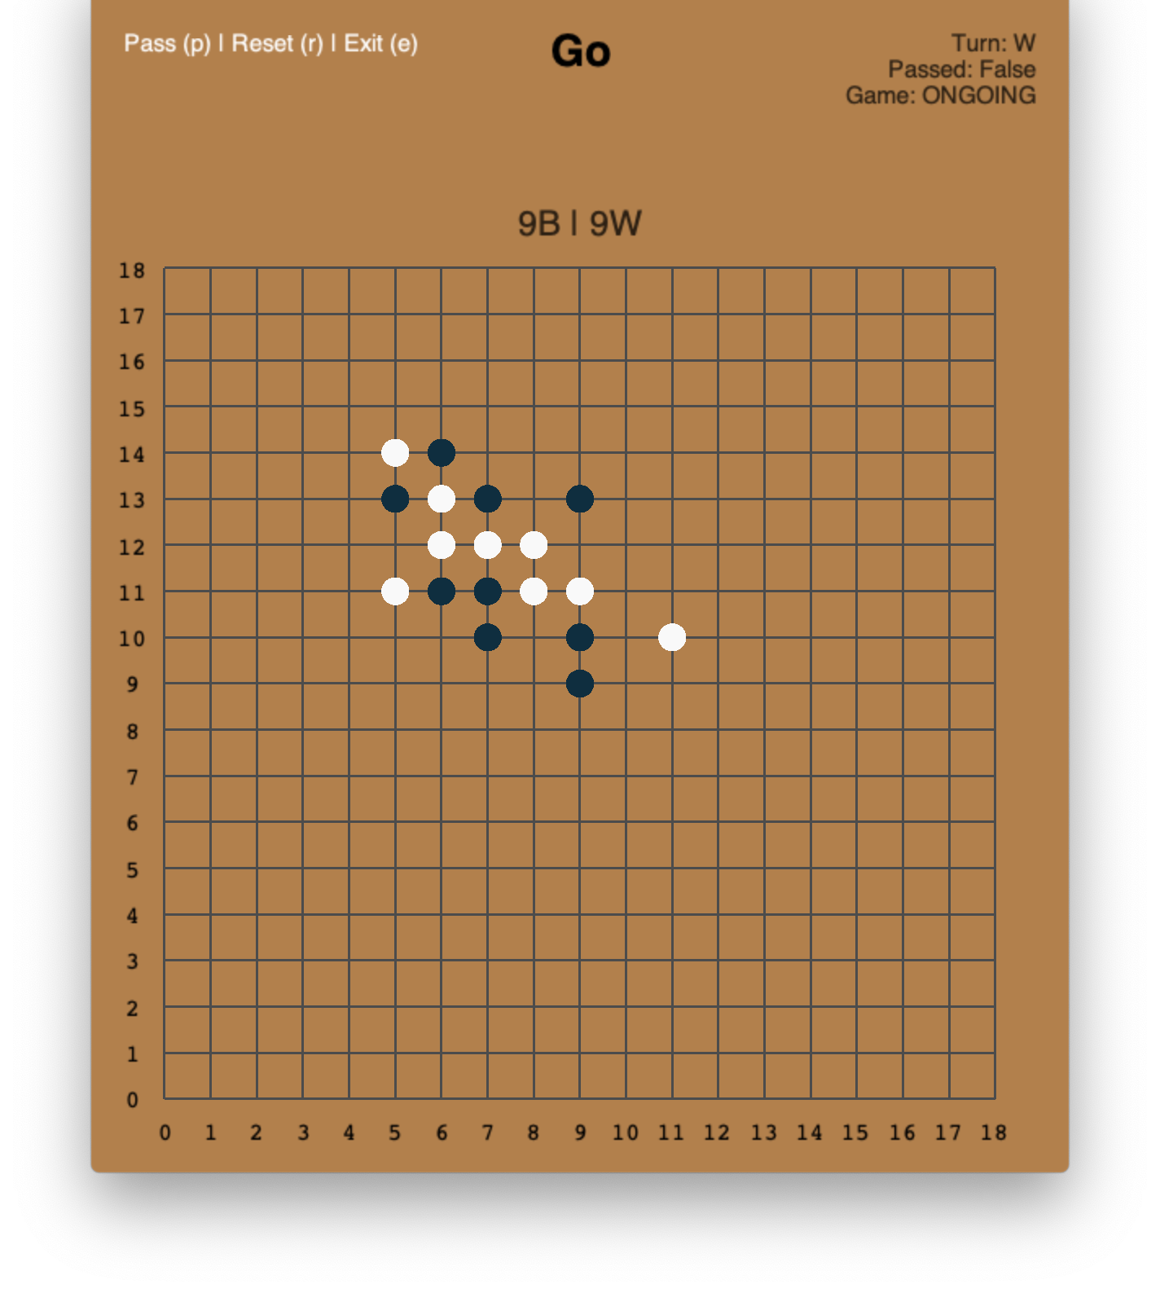
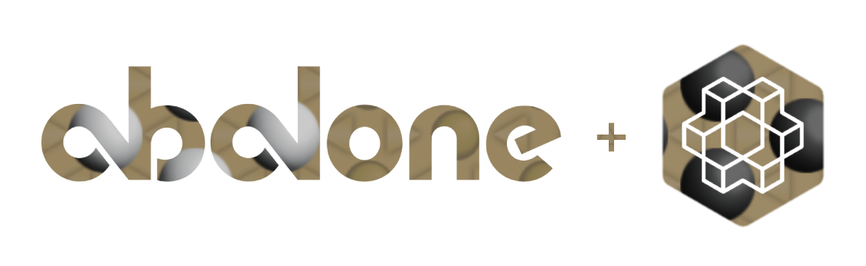
Related Work & References
Board games with OpenAI Gym:
Abalone – https://github.com/towzeur/gym-abalone
Go – https://github.com/aigagror/GymGo
Spaces’ definition – https://github.com/openai/gym/tree/master/gym/spaces
Create an environment – https://github.com/openai/gym/blob/master/docs/creating-environments.md
Table of environments – https://github.com/openai/gym/wiki/Table-of-environments
States, Observation and Action Spaces in Reinforcement Learning - https://medium.com/swlh/states-observation-and-action-spaces-in-reinforcement-learning-569a30a8d2a1
Q-Learning Agent - https://medium.com/swlh/introduction-to-q-learning-with-openai-gym-2d794da10f3d

Slide 4
Tools and Algorithms
Anaconda environment – Python 3.8
JetBrains IntelliJ
Gym, Numpy, Matplotlib
---
Q-Learning and SARSA

Slide 5
Work carried out
Started the structure of a OpenAI Gym project
1
Implemented the game logic
2
Implementation of the game loop and the environment. Random Agent to play the game
3
Define the rewards and their values. Implement the remaining agents
4
Transpose code to a Jupyter notebook
5

Slide 6
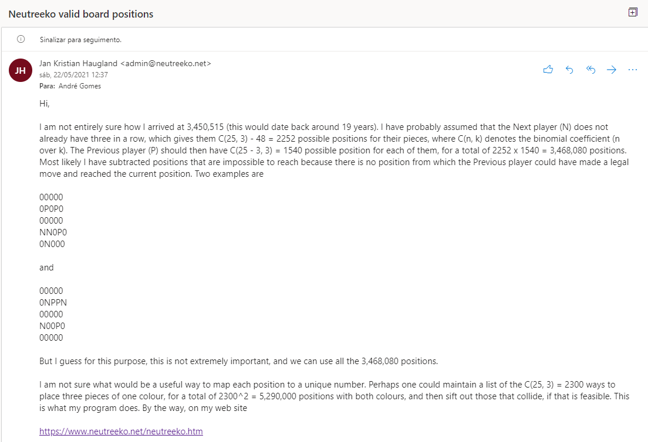

Slide 7
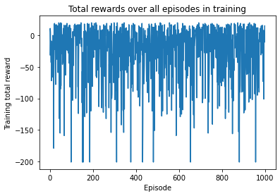
Rewards: Win: 20 Step: -1 Random Agent

Slide 8
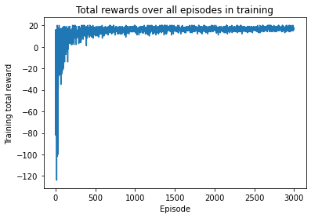
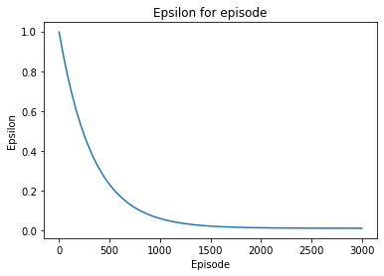
Q-Learning Agent

Slide 9
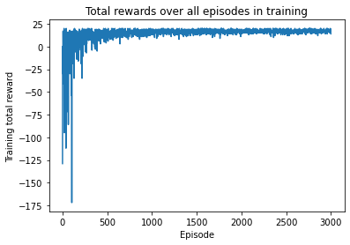
SARSA Agent

