Slide 1
Computational social science status report
Mariya Chkalova, Carina Blüm, Natalie Lang

Slide 2
Content
Research question
Data Collection
Findings
Related Work
3
4
6
July 11, 2018

Slide 3
1) Research question
How popular is female and male soccer today and what are the differences?
July 11, 2018

Slide 4
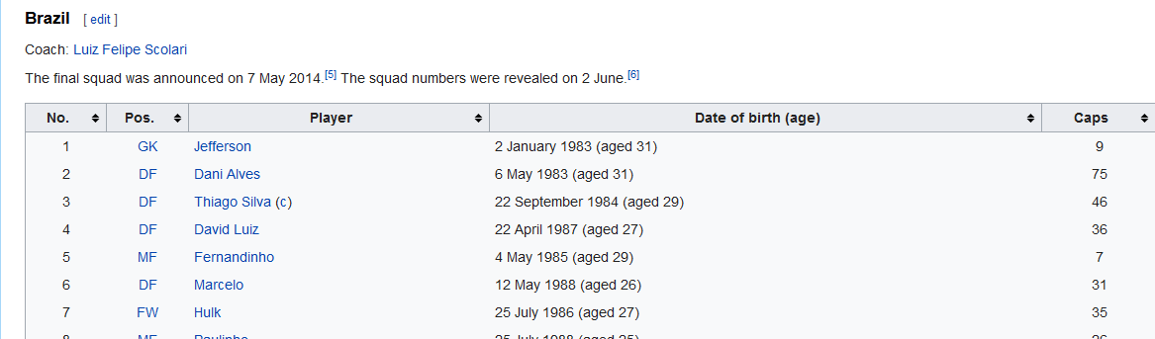
2) Data Collection
Data:
  Wikipedia web pages:
    https://en.wikipedia.org/wiki/2015_FIFA_Women%27s_World_Cup_squads
    https://en.wikipedia.org/wiki/2014_FIFA_World_Cup_squads
  → FIFA world cups from 2014 and 2015
    consists of all national teams and players
https://en.wikipedia.org/wiki/2014_FIFA_World_Cup_squads
July 11, 2018

Slide 5
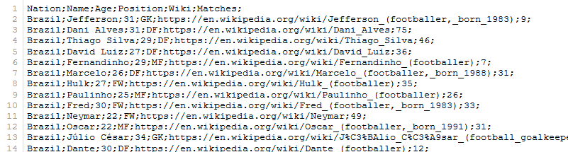
2) Data Collection
Call Wikipedia URLs
Classes „Player“ and „NationalTeam“
Get the attributes from teams and players
Results:
  two .csv-files (men and women)
  Name, age, Wikipedia URL and number of matches
July 11, 2018

Slide 6
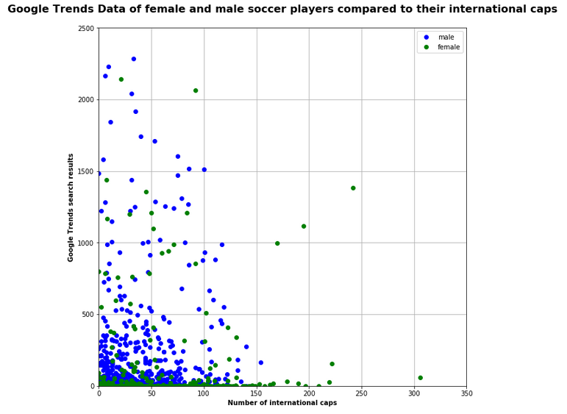
3) Results - Google Trends:
July 11, 2018

Slide 7
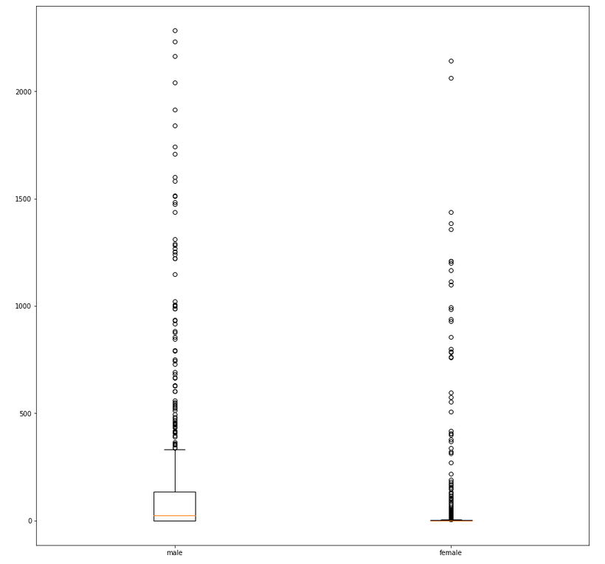
3) Results google trends:
July 11, 2018

Slide 8
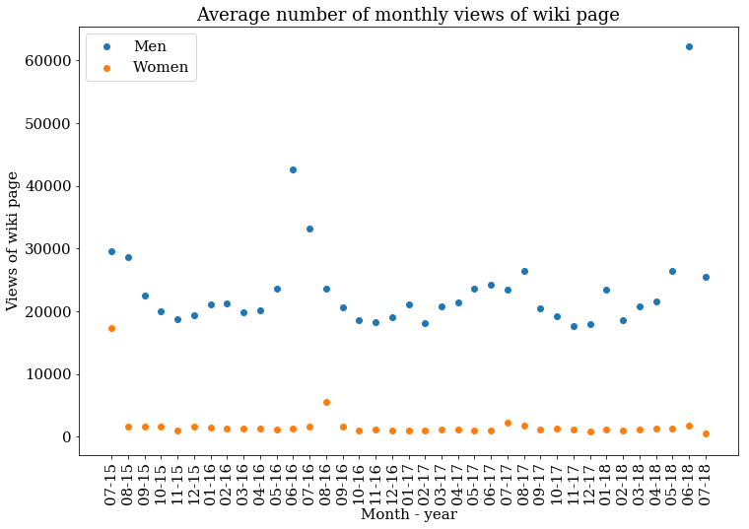
3) Results – Wikipedia pageviews
July 11, 2018

Slide 9
3) Results – youtube videos
 | Men | Women
# videos | 31714173 | 7725584
# players | 735 | 551
average | 43149 | 14021
3 : 1

Slide 10
3) Related work
LeFeuvre et al. (2013)
  effect of the World Cup in 2011 on Women's Professional Soccer attendance
  match-level data
  researched variables that may influence the attendances:
    World Cup 2011, outcome matches, weather condition, superstar effects (Google searches)
  Results: significant higher attendance
Mutz et al. (2014):
  athletic performance and physical attractiveness as determinants of public interest
  Google search requests for male and female players
  Results: significantly influence the public attention, independent from gender
Bens et al. (2014):
  representation of women’s soccer in the German media
  empirical investigations
  Results: Trend: higher reporting (World Cup 2011), positive assessment, less use of words like “power” and “endurance”
July 11, 2018

Slide 11
Thank you for your attention!

Slide 12
Resources
Bens, J., Kleinfeld, S. and Noack, K. (2014) Fußball. Macht. Politik.: Interdisziplinäre Perspektiven auf Fußball und Gesellschaft. transcript Verlag. Available at: https://books.google.de/books?id=gHNEBQAAQBAJ&pg=PA102&dq=analyse+beliebtheit+frauenfußball&hl=de&sa=X&ved=0ahUKEwjFpNnlwbDbAhUmGZoKHTJaC1YQ6AEINDAC#v=onepage&q=analyse beliebtheit frauenfußball&f=false.
LeFeuvre, A. D., Stephenson, E. F. and Walcott, S. M. (2013) ‘Football Frenzy: The Effect of the 2011 World Cup on Women’s Professional Soccer League Attendance’, Journal of Sports Economics, 14(4), pp. 440–448. doi: 10.1177/1527002513496012.
Mutz, M. and Meier, H. E. (2014) ‘Successful, sexy, popular: Athletic performance and physical attractiveness as determinants of public interest in male and female soccer players’, International Review for the Sociology of Sport, 51(5), pp. 567–580. doi: 10.1177/1012690214545900.
July 11, 2018

