Slide 1
Prophage analysis
Identification, characterization and analysis of prophages within bacterial strains in the bee gut microbiota
⢀⡴⠑⡄⠀⠀⠀⠀⠀⠀⠀⣀⣀⣤⣤⣤⣀⡀⠀⠀⠀⠀⠀⠀⠀⠀⠀⠀⠀⠀
⠸⡇⠀⠿⡀⠀⠀⠀⣀⡴⢿⣿⣿⣿⣿⣿⣿⣿⣷⣦⡀⠀⠀⠀⠀⠀⠀⠀⠀⠀
⠀⠀⠀⠀⠑⢄⣠⠾⠁⣀⣄⡈⠙⣿⣿⣿⣿⣿⣿⣿⣿⣆⠀⠀⠀⠀⠀⠀⠀⠀
⠀⠀⠀⠀⢀⡀⠁⠀⠀⠈⠙⠛⠂⠈⣿⣿⣿⣿⣿⠿⡿⢿⣆⠀⠀⠀⠀⠀⠀⠀
⠀⠀⠀⢀⡾⣁⣀⠀⠴⠂⠙⣗⡀⠀⢻⣿⣿⠭⢤⣴⣦⣤⣹⠀⠀⠀⢀⢴⣶⣆
⠀⠀⢀⣾⣿⣿⣿⣷⣮⣽⣾⣿⣥⣴⣿⣿⡿⢂⠔⢚⡿⢿⣿⣦⣴⣾⠁⠸⣼⡿
⠀⢀⡞⠁⠙⠻⠿⠟⠉⠀⠛⢹⣿⣿⣿⣿⣿⣌⢤⣼⣿⣾⣿⡟⠉⠀⠀⠀⠀⠀
⠀⣾⣷⣶⠇⠀⠀⣤⣄⣀⡀⠈⠻⣿⣿⣿⣿⣿⣿⣿⣿⣿⣿⡇⠀⠀⠀⠀⠀⠀
⠀⠉⠈⠉⠀⠀⢦⡈⢻⣿⣿⣿⣶⣶⣶⣶⣤⣽⡹⣿⣿⣿⣿⡇⠀⠀⠀⠀⠀⠀
⠀⠀⠀⠀⠀⠀⠀⠉⠲⣽⡻⢿⣿⣿⣿⣿⣿⣿⣷⣜⣿⣿⣿⡇⠀⠀⠀⠀⠀⠀
⠀⠀⠀⠀⠀⠀⠀⠀⢸⣿⣿⣷⣶⣮⣭⣽⣿⣿⣿⣿⣿⣿⣿⠀⠀⠀⠀⠀⠀⠀
⠀⠀⠀⠀⠀⠀⣀⣀⣈⣿⣿⣿⣿⣿⣿⣿⣿⣿⣿⣿⣿⣿⠇⠀⠀⠀⠀⠀⠀⠀
⠀⠀⠀⠀⠀⠀⢿⣿⣿⣿⣿⣿⣿⣿⣿⣿⣿⣿⣿⣿⣿⠃⠀⠀⠀⠀⠀⠀⠀⠀
⠀⠀⠀⠀⠀⠀⠀⠹⣿⣿⣿⣿⣿⣿⣿⣿⣿⣿⡿⠟⠁⠀⠀⠀⠀⠀⠀⠀⠀⠀
⠀⠀⠀⠀⠀⠀⠀⠀⠀⠉⠛⠻⠿⠿⠿⠿⠛⠉
Julien, Léo, Gabriel, Douhan

Slide 2
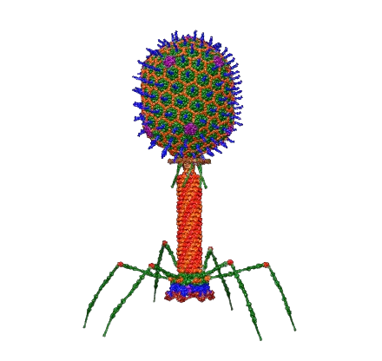
What is a bacteriophage ?
Viruses that only infect bacteria
Prevalent in the whole biosphere
Abundant in bacteria rich environment
Inject their genetic material into host bacteria
Notes:
Dr. Victor Padilla-Sanchez, PhD https://www.drvictorpadillasanchez.com — Travail personnel
Atomic structural model of bacteriophage T4 in UCSF Chimera software using pdbs of the individual proteins.

Slide 3
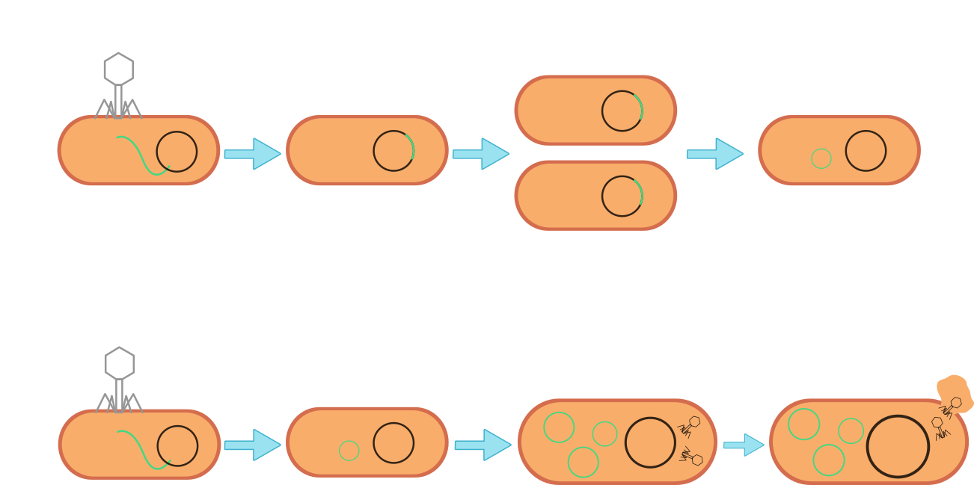
Replication Strategies
Lysogenic/temperate cycle:
Integrates their genome into the bacterial chromosome without producing virions → prophage
Can exit the chromosome and switch to a lytic cycle under specific conditions
Lytic/virulent cycle:
Uses host's machinery to replicate and translate the viral genome to produce numerous virions
Will be released during bacterial lysis
Notes:
https://www.biorender.com/template/bacteriophage-lytic-vs-lysogenic-cycle Samiha Afroze

Slide 4
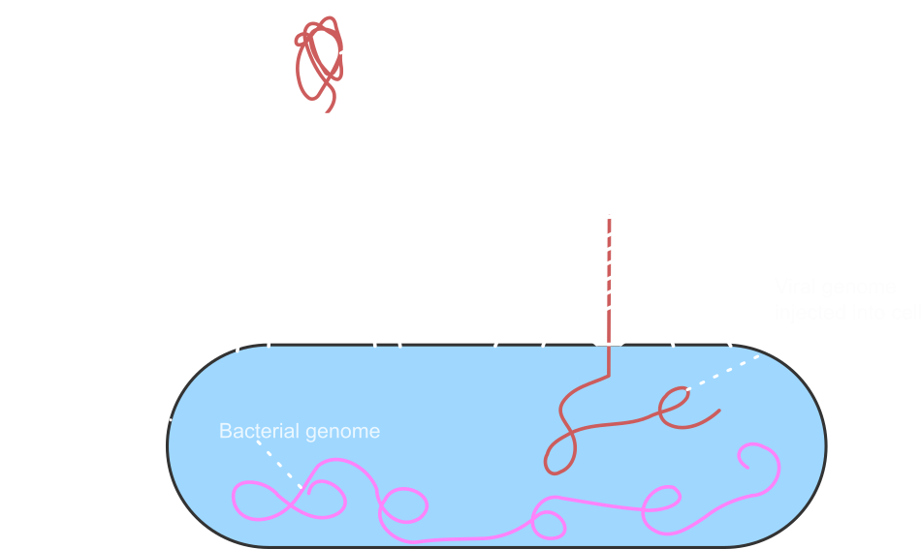
Phage structure
Capsid head: Contain and protect the viral genetic material used for replication and infection
Body: Help for recognition, attachment and anchoring to the bacterium to break into the cell wall and inject the genetic material into the host
→ Phages vary greatly in size and complexity, with structures tailored to their specific bacterial targets
Notes:
https://www.whatisbiotechnology.org/index.php/science/summary/phage-therapy/phage-therapy-uses-viruses-that-attack-bacteria-to-treat
https://viralzone.expasy.org/4076

Slide 5
Why is it important to study phages ?
Play a significant role in horizontal gene transfer
Contributes to genetic diversity, allows the spread of antibiotic resistance and virulence factors
Prophage regions are usually the regions of a bacterial genome which evolve rapidly
Auxiliary Metabolic Genes (AMG)
Control of the bacterial community

Slide 6
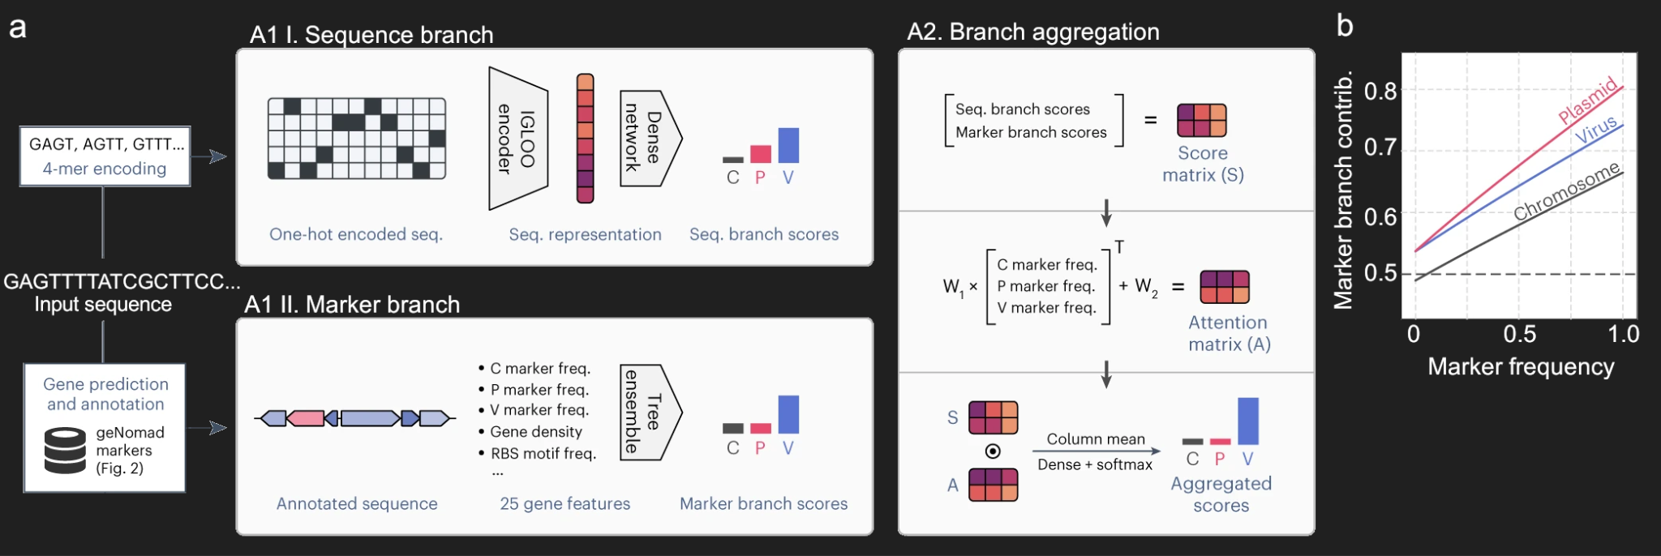
Prophage detection - geNomad
Notes:
geNomad was the primary tool we used to identify and annotate the phage community within the bee microbiota. It employs a hybrid classification framework with two complementary branches: one that leverages an extensive database of gene markers specific to phages, bacteria, and plasmids, and another that focuses solely on sequence patterns using the IGLOO neural network. The contribution of each branch to the final identification depends on the number of markers detected, enabling the tool to adapt to varying sequence characteristics. By integrating these branches, geNomad generates aggregated scores that enhance prediction accuracy and reliably classify phages.

Slide 7
Prophage detection - geNomad
37 total hits
Prophages found in all the outgroup samples, and in 31 out of 48 bee samples (~65%)
To predict and annotate proteins, geNomad uses a modified version of Prodigal
Taxonomy estimate not really helpful, all leading to Caudoviricetes, aka tailed bacteriophages

Slide 8
Prophage classification TaxmyPhage (fail)
Tried to have a more precise classification than geNomad, but:
No hits were found with our genomes
Test has been done with reference phage genomes and the program worked
The issue likely comes from the absence of our phages genomes in the databases used by TaxmyPhage
Notes:
Tried to have a more precise classification than geNomad, but:
No hits werefound with our genomes
Test has been done with reference phage genomes and the program worked
The issue likely comes from the absence of our phages genomes in the databases used by TaxmyPhage.
tax_myPHAGE/README.md at main · amillard/tax_myPHAGE · GitHub

Slide 9
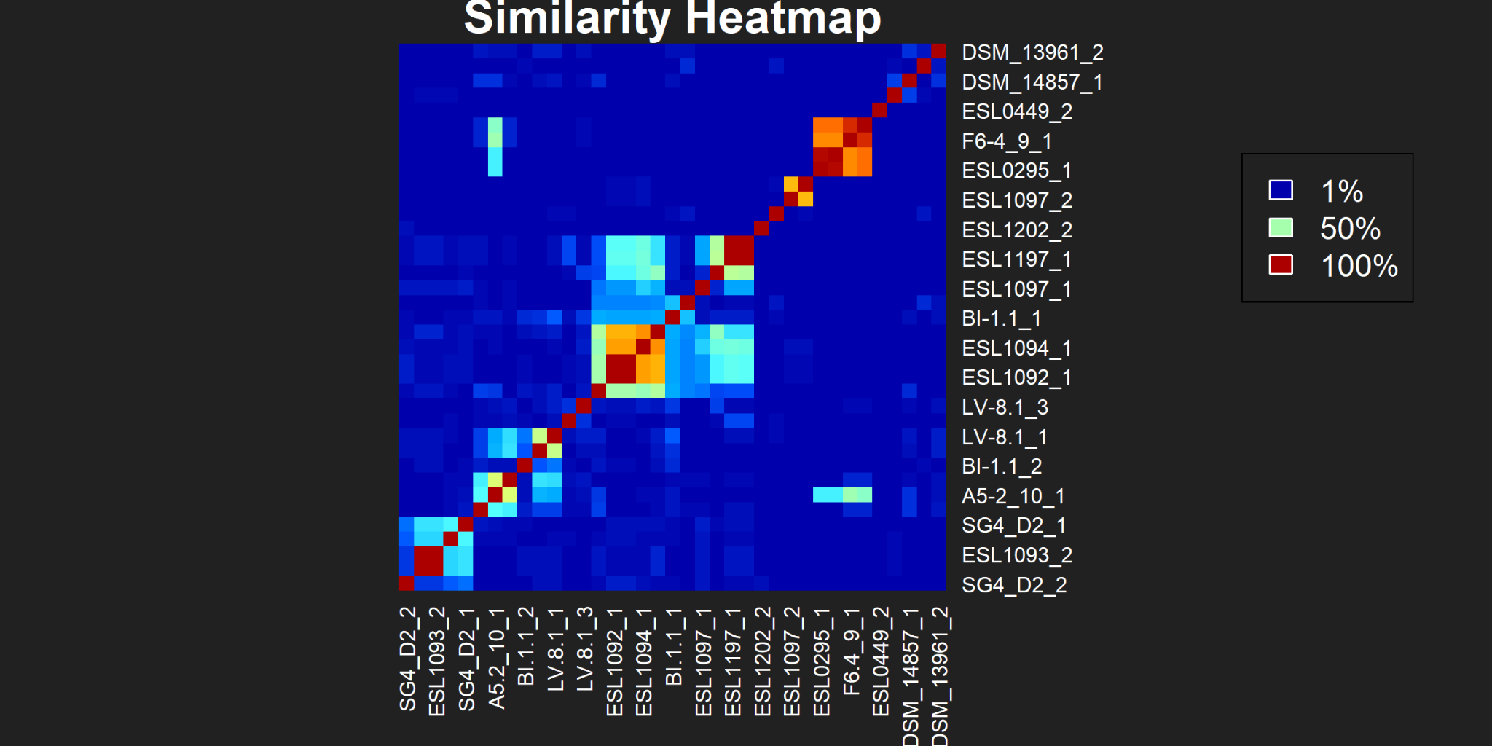
Similarity between Phages - VIRIDIC
Notes:
Using a program named VIRIDIC we were able to obtain a matrix of similarity between the phages based on their sequences. we displayed it as heatmap. knowing that for phages even 30% of similarity can be a pretty significant similarity we can see that some phages show similarity. but the question is, does some cluster emerge ?

Slide 10
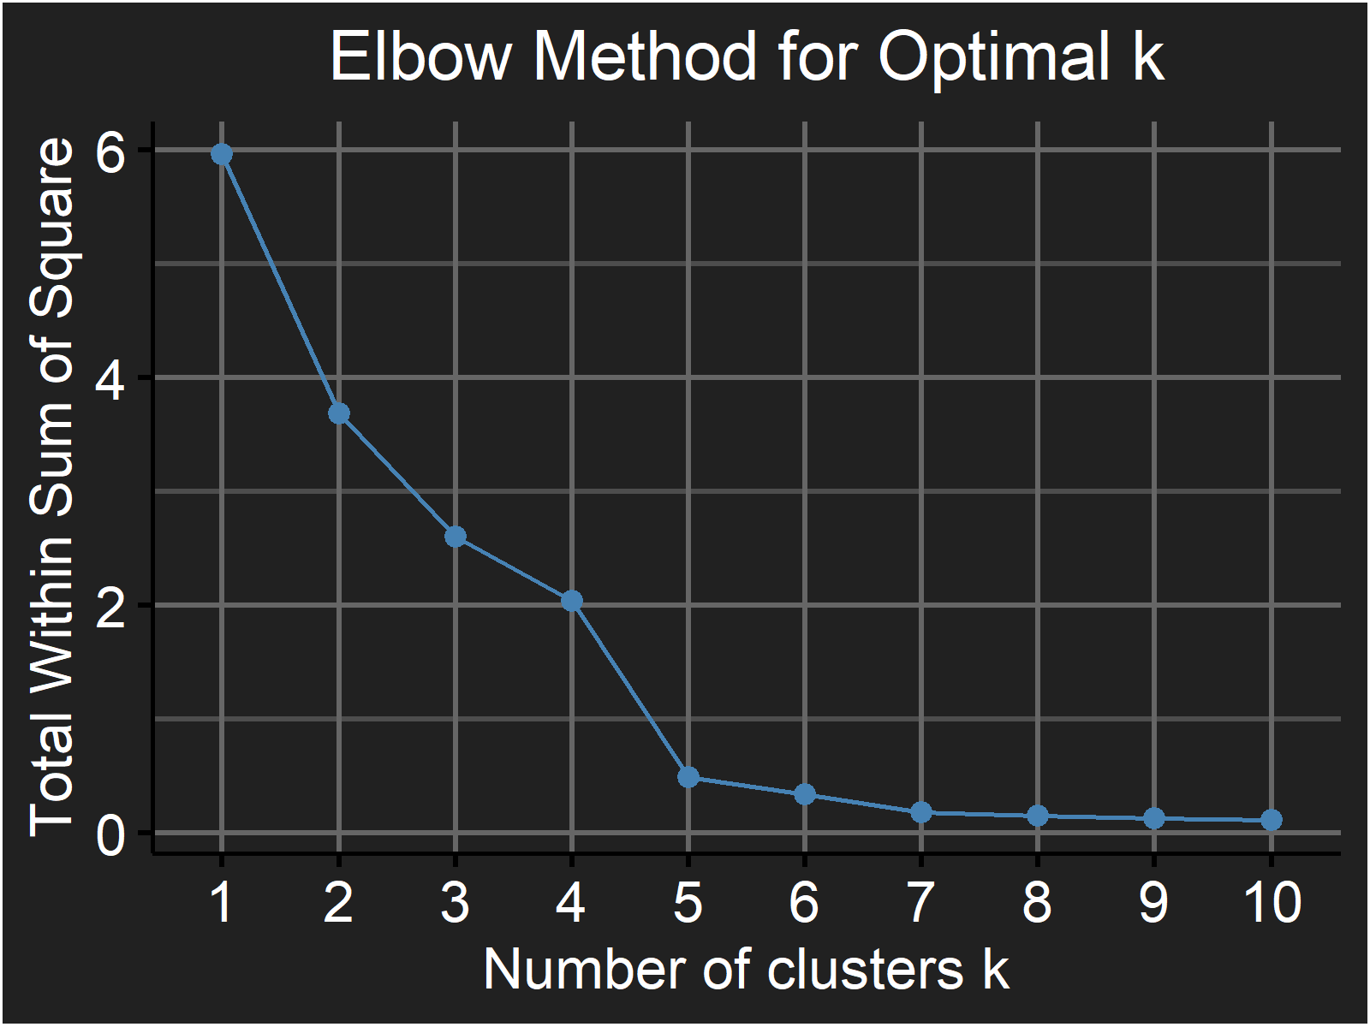
K-means clustering
Notes:
in order to find if there are clusters of phages we used the k-means clustering approach. In order to do that we used the multidimensional scaling technique to obtain euclidian coordinate from the inverse of the similarity matrix or the dissimilarity matrix. to chose a good numberof cluster we did the elbow method to minimize the within variance and settled for 7.

Slide 11
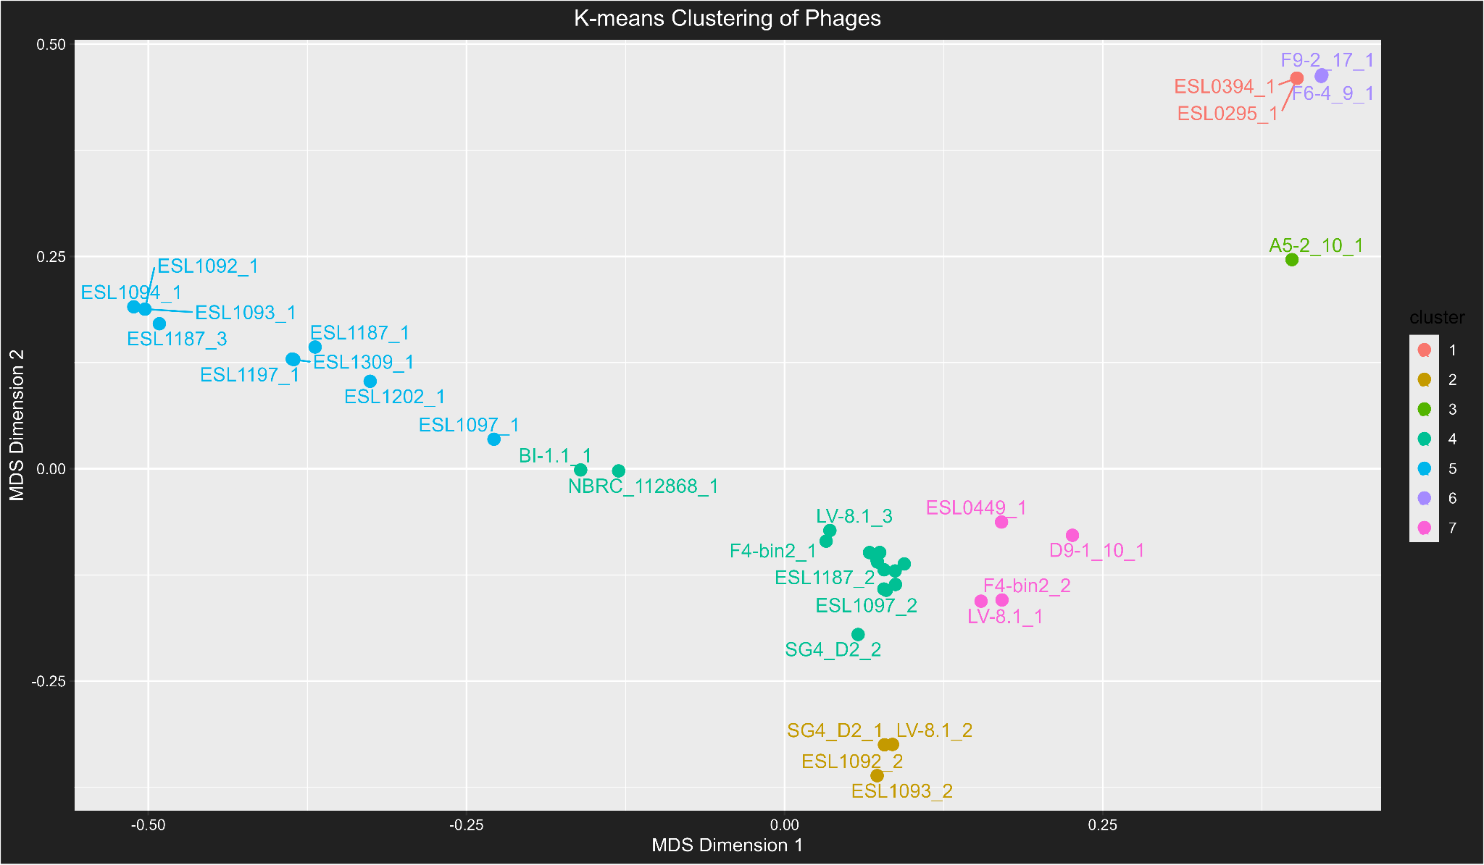
K-means clustering
Notes:
Here is the result of the clustering. We can see that there seem to be some tendencies but the line between some cluster are a bit blurry. We can’t extract a lot of knowledge from that, but we wanted to know if some cluster appeared if we label the phages with their host bacteria and their host bees.

Slide 12
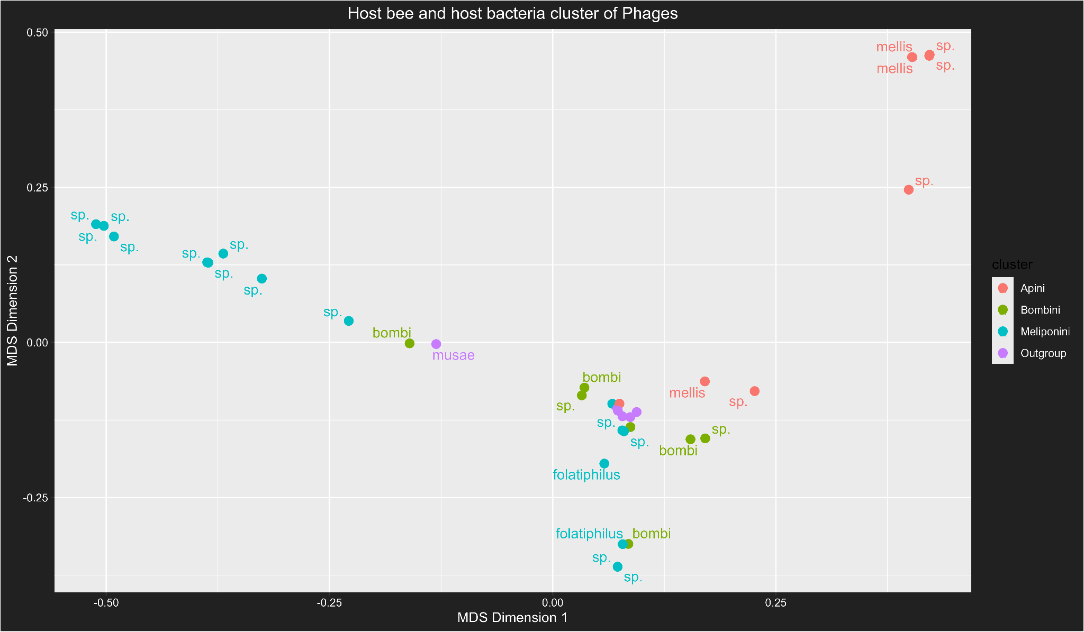
Host bee and bacteria clustering
Notes:
This is the same plot but this time the color represent the host tribe and the labels on the points are the host bacteria.
there seems to be a difference between the Apini bees phages and the meliponini bees phages. but we have some undefined host bacteria that prevent us from assuming that the difference is also bacteria wise

Slide 13
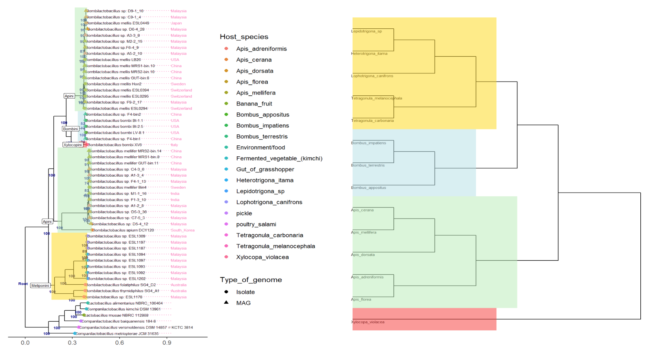
Host bee and bacteria clustering
Notes:
to cope with that we used the work from the group of rahel, sydney, larissa and tian to hypothesis the the host bacteria based on their taxonomic analysis.

Slide 14
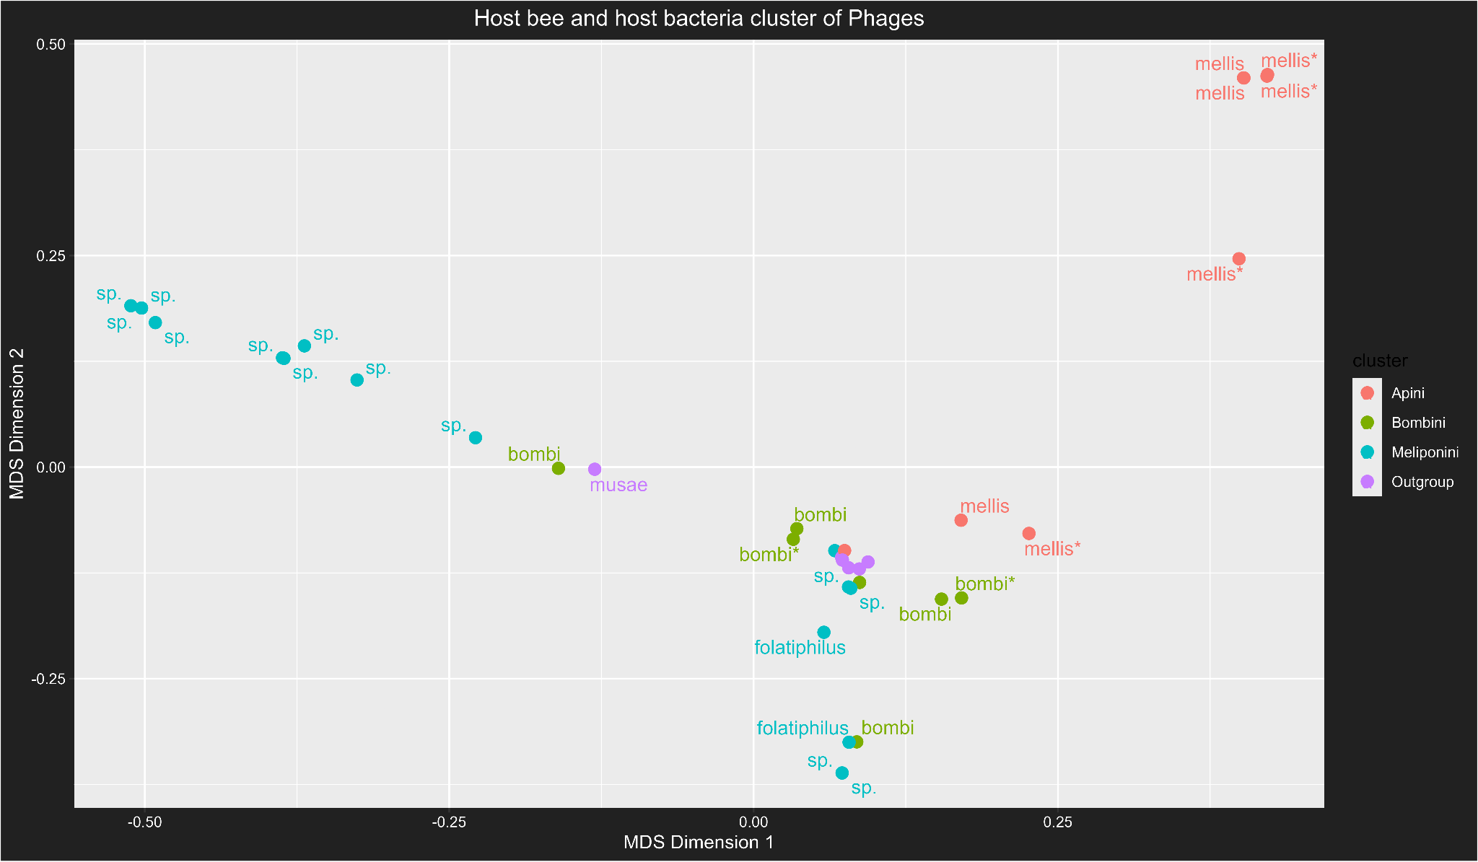
Host bee and bacteria clustering
Notes:
after doing that we were able to assume that the unknown here might be mellis bacteria or at least closely related bacteria, and that all the sp here are from the same taxonomic branch. (the one with an asterix are the one that we assumed). Based on that we propose the hypothesis that some bacteria in the Apini and meliponini bees are specific these tribes and that within these bacteria some phages can specifically infect these bacteria. but this would need further study.

Slide 15
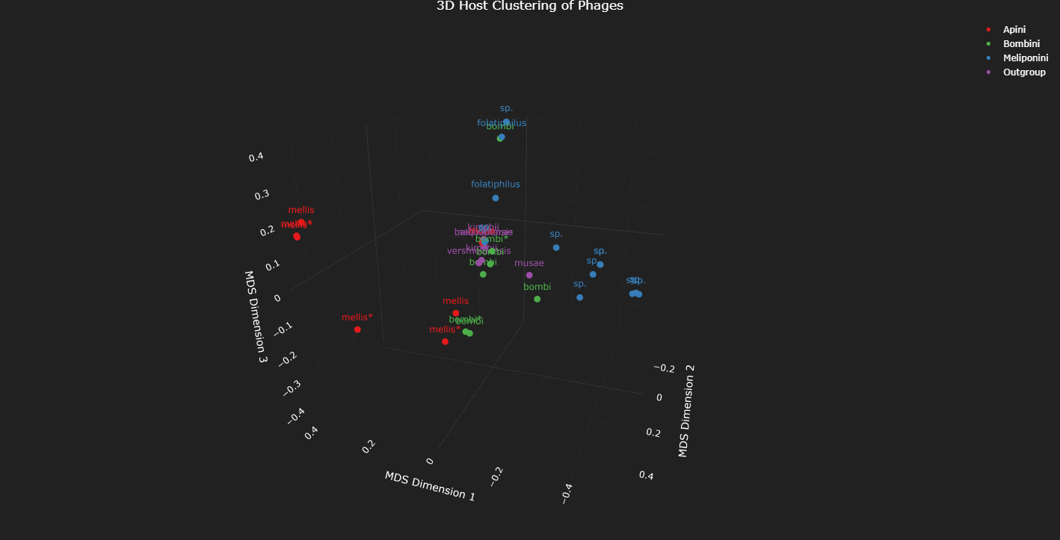
Do they cluster for the Host bee and target bacteria ?
Notes:
we also plotted the distances in the third dimensions to see if the pack in the middle clustered better but it’s not the case, then we hypothesis that there are phages that are not specific and that can infect a lot of different bacteria.

Slide 16
VIPTree proteomic study
Generates a proteomic tree of viral genome sequences based on genome-wide sequence similarities computed by tBLASTx
Can help to do assumptions based on virus similarity scores → scores were too low in our case
Best hits for similarity were found between our phages
Notes:
Generates a proteomic tree of viral genome sequences based on genome-wide sequence similarities computed by tBLASTx
Is informative to find virus similarity scores -> hits were often correlated to one virus but the score was too low to do assumptions about it (ca 60% mean identity for a length of 10% -> top low)
best hits for similarity were between the phages we found -> indicates that they are acting similarly (one similar host with similar functions)
It does gene annotation and protein similarity but we used other tools to look at this

Slide 17
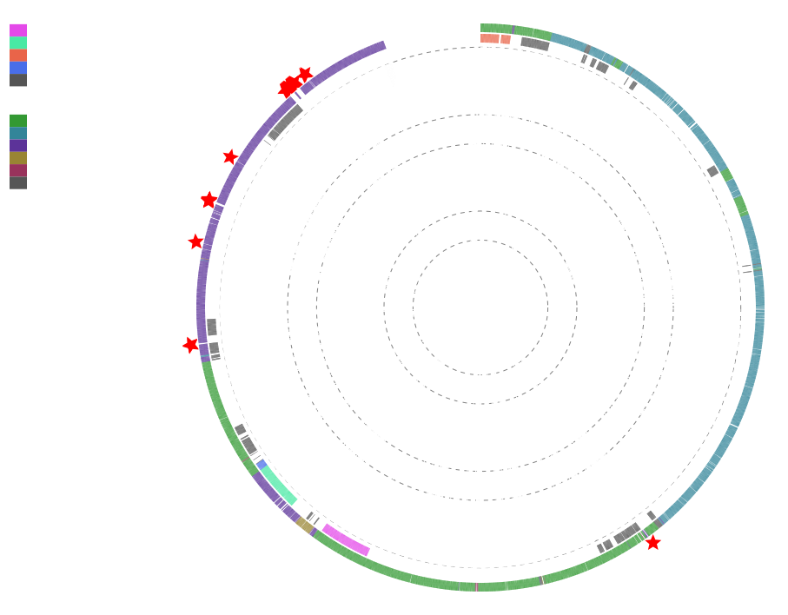

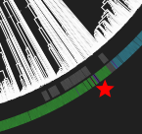
Proteomic tree
Bacillota → bacteria residing in the human gut
Most are clustered together
Some are spread out → could indicate that these phages carry sightly different functions that distinguish them between host species
One is isolated in the Pseudomonadota cluster but still in Bacillota host group:
Horizontal gene transfer: the phage may have adapted to infect Bacillota despite originating from the Pseudomonadota cluster → potential phylum shift
Our genomes
Notes:
Red star are our genomes
We found them in similar Host group Bacillota (so bacteria that live in the human gut) and mostly clustered on the same branch, we see some star alone and a small cluster -> being in the same family they have their differences and similarities, it could indicate that phages in a similar host carry similar functions
-> coherent with the study
There’s an isolated star in the Pseudomonadota cluster, if you look close, we see that it is still included between violet stripes (= Bacillota family) it can be due to:
shared core genomic characteristics with Pseudomonadota phages
a rare evolutionary lineage linking Bacillota and Pseudomonadota phages
Or a missanotation, but it doesn’t seem to be the case
https://www.genome.jp/viptree/u/2bv8eJ_GbjwCGBYEt0Aklw

Slide 18
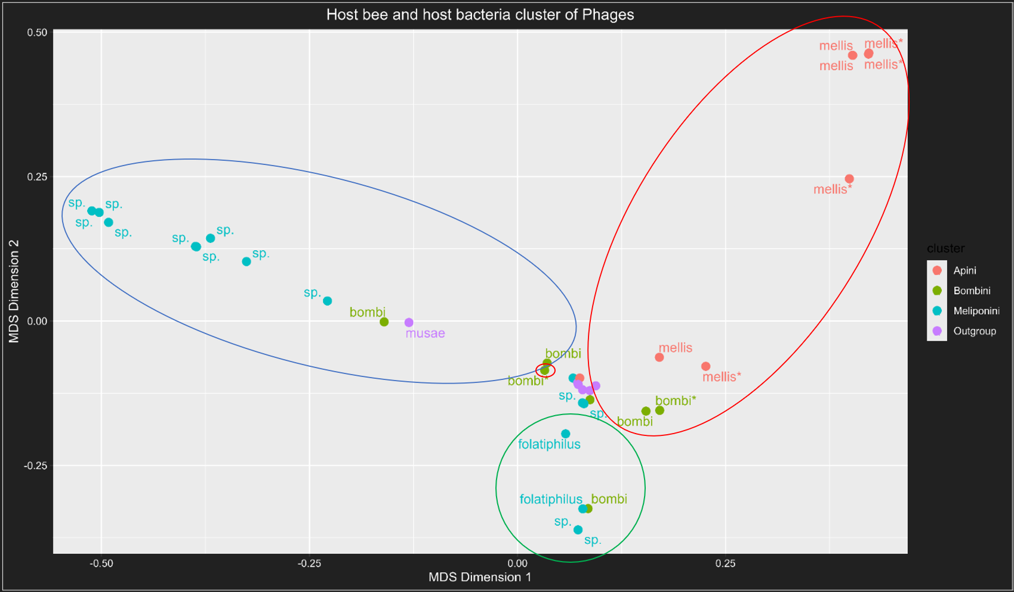
Closely related phages in the proteomic tree match clusters
Clusters
Notes:
We can see that the clusters made with the VIRIDIC genomic analysis and VIPTree proteomic analysis follow a similar trend, we can see similarities in clusters between 2 methods and we found that in a cluster we found related specie

Slide 19
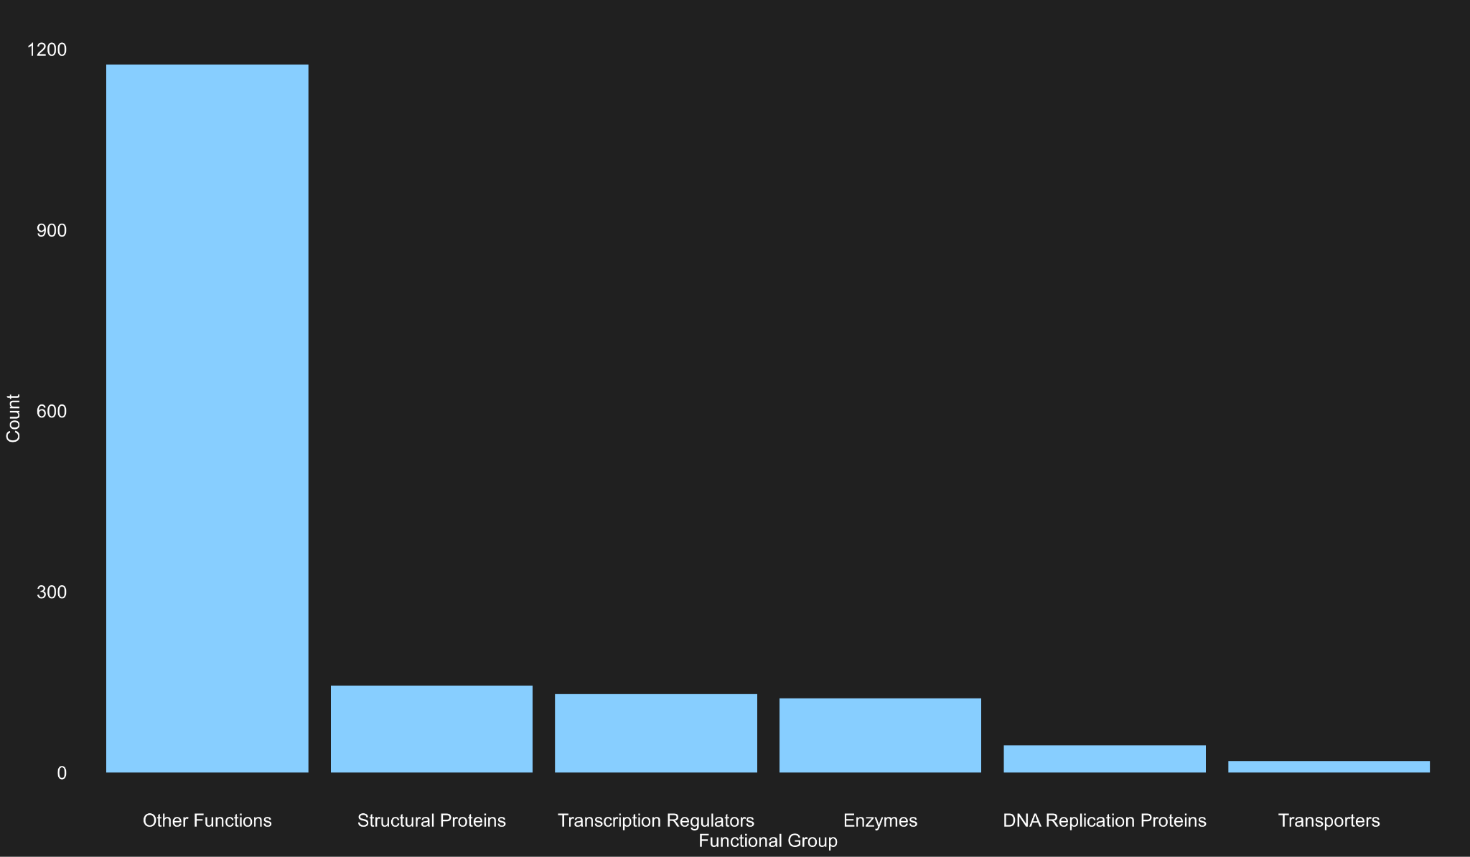
Analysis of gene functions
Functional distribution predicted phage genes based on
Annotations
External database mappings (KEGG)
Very little known functions

Slide 20

Prediction of phage lifestyle - bacphlip
Expected results as lytic phages do not integrate in the genome
Lytic hits most likely result either from a pseudo-lysogenic phage or an incomplete phage genome
Classification | Virulent (lytic) phages | Temperate phages
Count | 4 | 33
Percentage | 10.81% | 89.19%

Slide 21
Prevalence
No phages were found for bacteria residing in Xylocopini and B. thymidiphilus. Lytic phages were found in Apini and Meliponini, but not in Bombini.
Host tribe | Apini, Bombini, Meliponini (Bees) | Outgroup
Count | 31 | 6
Lytic phage percentage | 12.9 | 0
Target bacteria genus | Bombilactobacillus | Companilactobacillus
Target species | B. bombi (5), B. folatiphilus (2), B. mellis (4) and unknown sp (20). | All bacterial species in the outgroup

Slide 22
Wrap up of what we learned
Since there is limited research on Bombilactobacillus and even less on our phages, tools struggle to perform taxonomic classification and precise gene characterization
Even with this problem, we can still detect phages, look at their similarity between hosts and look at their lifestyle and prevalence
Most genes are unknown → their function could be predicted using AlphaFold

Slide 23
Thank you for your attention !
Do you have any questions ?

Slide 24
Annexes

Slide 25
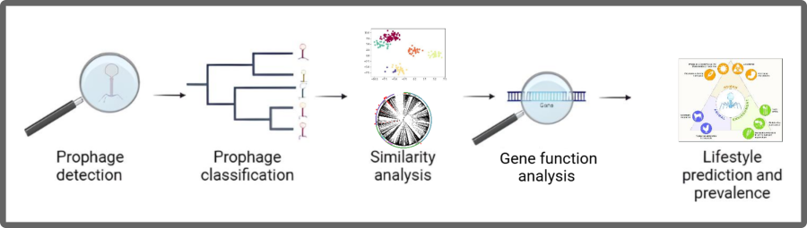
The tools we used
Prophages detection (GeNOMAD)
Prophages classification (GeNOMAD and TaxMyphage)
Phage similarity analysis and comparison with a proteomic tree analysis (VIRIDIC and VIPTree)
Analysis of gene function
Prediction of phages lifestyle and prevalence (Bacphlip)
Notes:
Images: Biorender
https://ithelp.ithome.com.tw/articles/10194172
Potential phage therapy applications from the One Health perspective... | Download Scientific Diagram

Slide 26
Values of threshold for identity
Thresholds for determining phage similarity are outlined by various standards, including those from the International Committee on Taxonomy of Viruses (ICTV). The common criteria involve:
Average Nucleotide Identity (ANI): A threshold of 95% ANI is typically used to define species.
Percentage of Shared Proteins (PSP): Phages sharing ≥50% of their proteins, often calculated using tools like VIRIDIC, are considered similar.
Genome Alignment: Whole-genome nucleotide sequence identity of 70-80% also serves as a marker.

Slide 27
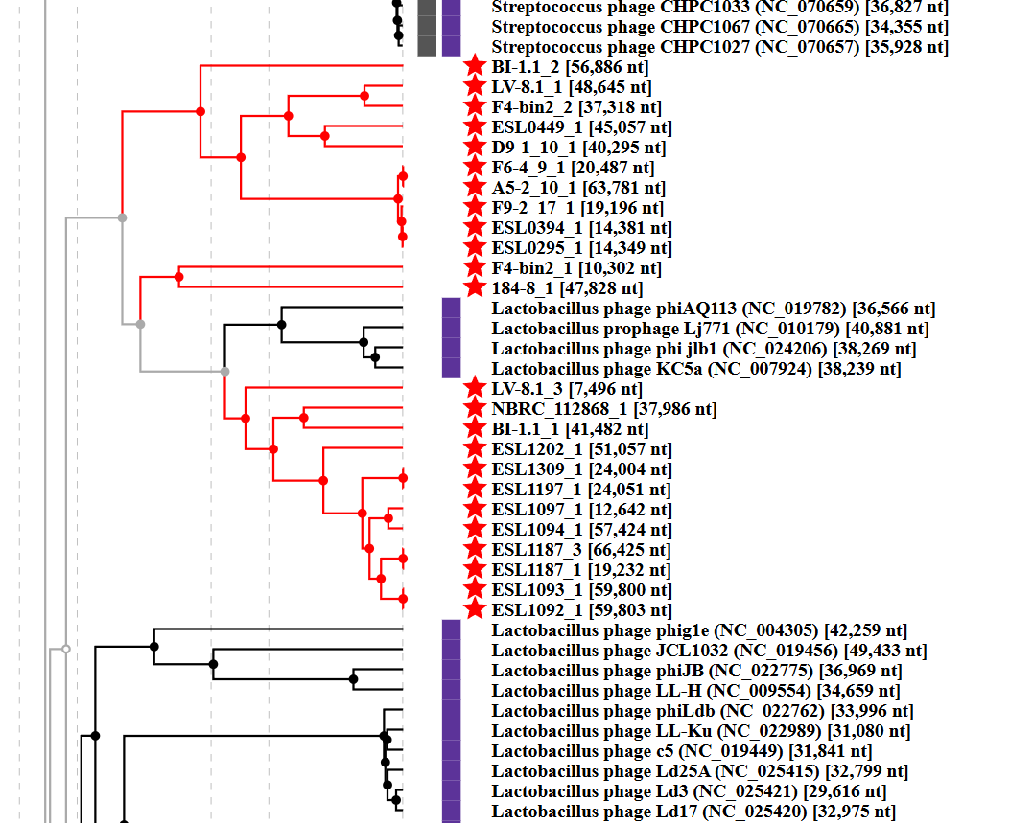
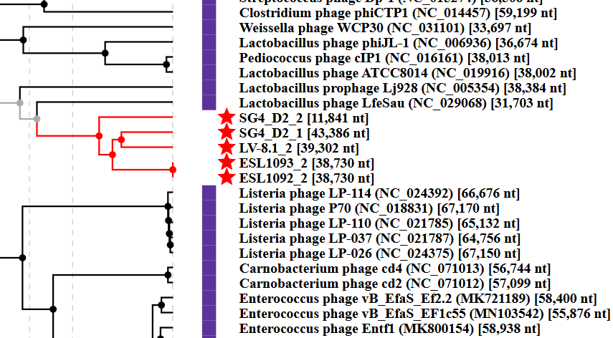
Closely related phages in the proteomic tree

