Slide 1
CLOUD COMPUTING ARCHITECTURE
DR. JOHN KWAO DAWSON

Slide 2
Cloud architecture refers to how various cloud technology components, interact and connect to create cloud computing environments.
It acts as a blueprint that defines the best way to strategically combine resources to build a cloud environment for a specific business need.
Examples; hardware, virtual resources, software capabilities, and virtual network systems

Slide 3
Cloud Computing architecture comprises of many cloud components, which are loosely coupled.
We can broadly divide the cloud architecture into two parts:
Front End
Back End

Slide 4
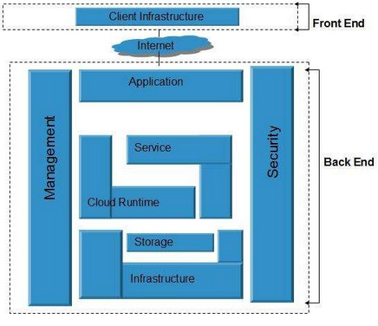
Each of the ends is connected through a network, usually Internet.
The following diagram shows the graphical view of cloud computing architecture:
Cloud Computing Architecture

Slide 5
Front End
The front end refers to the client part of cloud computing system.
It consists of interfaces and applications that are required to access the cloud computing platforms
Example - Web Browser, thin & fat clients, tablets, and mobile devices.

Slide 6
Back End
The back End refers to the cloud itself.
The back end is used by the service provider.
It manages all the resources that are required to provide cloud computing services.
It includes a huge amount of data storage, security mechanism, virtual machines, deploying models, servers, traffic control mechanisms
The server employs certain protocols known as middleware, which help the connected devices to communicate with each other.

Slide 7
Service
Service in backend refers to the major three types of cloud based services like SaaS, PaaS, IaaS and CaaS.
Also manages which type of service the user accesses.

Slide 8
Runtime Cloud
Runtime cloud in backend provides the execution and Runtime platform/environment to the Virtual machine.
Storage
Storage in backend provides flexible and scalable storage service and management of stored data.

Slide 9
Infrastructure
Cloud Infrastructure in backend refers to the hardware and software components of cloud
Example; servers, storage, network devices, virtualization software
Management
Management in backend refers to management of backend components
Example; application, service, runtime cloud, storage, infrastructure, and other security mechanisms etc.

Slide 10
Security
Security in backend refers to implementation of different security mechanisms in the backend for secure cloud resources, systems, files, and infrastructure to end-users.
Internet
Internet connection acts as the medium or a bridge between frontend and backend and establishes the interaction and communication between frontend and backend.

Slide 11
Database
Database in backend refers to provide database for storing structured data, such as SQL and NOSQL databases
Example of Databases services include Amazon RDS, Microsoft Azure SQL database and Google CLoud SQL.
Networking
Networking in backend services that provide networking infrastructure for application in the cloud
Examples; load balancing, DNS and virtual private networks.

Slide 12
Analytics
Analytics in backend service that provides analytics capabilities for data in the cloud, such as warehousing, business intelligence and machine learning.

Slide 13
Benefits of Cloud Computing Architecture
Makes overall cloud computing system simpler.
Improves data processing requirements.
Helps in providing high security.
Makes it more modularized.
Results in better disaster recovery.
Gives good user accessibility.
Reduces IT operating costs.
Provides high level reliability.
Scalability.

Slide 14
How does cloud architecture work?
A cloud computing platform provides users with on-demand access to resources and services.
The back end contains all the cloud computing resources
A network is used to connect the frontend and backend cloud architecture components
When users interact with the front end (or client-side interface), it sends queries to the back end using middleware where the service model carries out the specific task or request.
There is a significant workload shift.
Cloud computing can handle that much heavy load easily and automatically.
Hardware and software demands on the user's side decrease.
Cloud computing interface software of the system

