Slide 1
INFT 413: ADVANCED INFORMATION SECURITY
JACOB MENSAH
Department of Computer Science and Informatics
2023

Slide 2
Lecture One
1

Slide 3
Security
“The quality or state of being secure—to be free from danger”
A successful organization should have multiple layers of security in place:
Physical security
Personal security
Operations security
Communications security
Network security
Information security

Slide 4
Security
The goal of a security plan is to find the balance between protection, usability, and cost.
Additionally, when securing an asset, system, or environment, we must also consider how the level of security relates to the value of the item being secured.

Slide 5
Security
When we discuss security issues, it is often helpful to have a model or framework that we can use as a foundation or a baseline.
This gives us a consistent set of terminology and concepts that we, as security professionals, can refer to when security issues arise.

Slide 6

Information Security
Information security: a “well-informed sense of assurance that the information risks and controls are in balance.” —Jim Anderson, Inovant (2002).
Information security is defined as protecting information and information systems from unauthorized access, use, disclosure, disruption, modification, or destruction.

Slide 7
Information Security
The concepts, techniques, technical measures, and administrative measures used to protect information assets from deliberate or inadvertent(unintended) unauthorized acquisition, damage, disclosure, manipulation, modification, loss, or use.
Information security means protecting information and information systems from unauthorized access, use, disclosure, disruption (interruption/disorder), modification or destruction (damage).

Slide 8
What is Information Security?
The protection of information and its critical elements, including systems and hardware that use, store, and transmit that information.
Necessary tools: policy, awareness, training, education, technology
C.I.A. triangle was standard based on confidentiality, integrity, and availability
C.I.A. triangle now expanded into list of critical characteristics of information

Slide 9
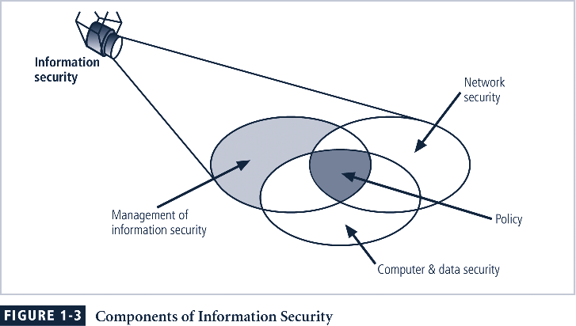

Slide 10
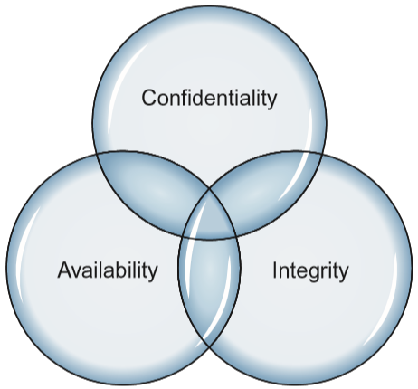
The confidentiality, integrity, and availability triad
Three of the primary concepts in information security are Confidentiality, Integrity, and Availability

Slide 11
When is any System Secure?
Confidentiality: computer-related assets are accessed only by authorized parties. Confidentiality is sometimes called secrecy or privacy
Integrity: assets can be modified only by authorized parties or only in authorized ways
Availability: assets are accessible to authorized parties at appropriate times

Slide 12
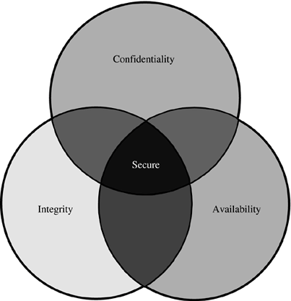
When is any System Secure

Slide 13
Confidentiality
It is not trivial to ensure confidentiality. For example,
Who determines which people or systems are authorized to access the current system?
By "accessing" data, do we mean that an authorized party can access a single bit? pieces of data out of context?
Can someone who is authorized disclose those data to other parties?

Slide 14
Integrity
It is much harder to ensure integrity. One reason is that integrity means different things in different context
For example, if we say that we have preserved the integrity of an item, we may mean that the item is:
precise
accurate
unmodified
modified only in acceptable ways
modified only by authorized people and processes
consistent

Slide 15
Availability
Availability applies both to data and to services (i.e., to information and to information processing), and it is similarly complex
We say a data item, service, or system is available if
There is a timely response to our request
There is a fair allocation of resources, so that some requesters are not favored over others
The service or system involved are fault tolerant - hardware or software faults lead to graceful cessation of service or to work-a rounds rather than to crashes and abrupt loss of information
The service or system can be used easily and in the way it was intended to be used

Slide 16
Availability
The security community is just beginning to understand what availability implies and how to ensure it
A small, centralized control of access is fundamental to preserving confidentiality and integrity, but it is not clear that a single access control point can enforce availability
Much of computer security's past success has focused on confidentiality and integrity; full implementation of availability is security's next great challenge

Slide 17
Relationship of Security Goals
A secure system must meet all three requirements.
The challenge is how to find the right balance among the goals, which often conflict:
For example, it is easy to preserve a particular object's confidentiality in a secure system simply by preventing everyone from reading that object
However, this system is not secure, because it does not meet the requirement of availability for proper access
=> There must be a balance between confidentiality and availability

Slide 18
Critical Characteristics of Information
The value of information comes from the characteristics it possesses:
Timeliness
No value if it is too late
Availability
No interference or obstruction
Required format
Accuracy
Free from mistakes
Authenticity
Quality or state of being genuine, i.e., sender of an email
Confidentiality
Disclosure or exposure to unauthorized individuals or system is prevented
Notes:
Critical Characteristics Of Information
The value of information comes from the characteristics it possesses.
Availability - enables users who need to access information to do so without interference or obstruction and in the required format. The information is said to be available to an authorized user when and where needed and in the correct format.
Accuracy- free from mistake or error and having the value that the end-user expects. If information contains a value different from the user’s expectations due to the intentional or unintentional modification of its content, it is no longer accurate.
Authenticity - the quality or state of being genuine or original, rather than a reproduction or fabrication. Information is authentic when it is the information that was originally created, placed, stored, or transferred.
Confidentiality - the quality or state of preventing disclosure or exposure to unauthorized individuals or systems.
Integrity - the quality or state of being whole, complete, and uncorrupted. The integrity of information is threatened when the information is exposed to corruption, damage, destruction, or other disruption of its authentic state.
Utility - the quality or state of having value for some purpose or end. Information has value when it serves a particular purpose. This means that if information is available, but not in a format meaningful to the end-user, it is not useful.
Possession - the quality or state of having ownership or control of some object or item. Information is said to be in possession if one obtains it, independent of format or other characteristic. While a breach of confidentiality always results in a breach of possession, a breach of possession does not always result in a breach of confidentiality.

Slide 19
Critical Characteristics of Information
Integrity
Whole, completed, uncorrupted
Cornerstone
Size of the file, hash values, error-correcting codes, retransmission
Utility
Having value for some purpose
Possession
Ownership
Breach of confidentiality results in the breach of possession, not the reverse

Slide 20
Components of an Information System
Information System (IS) is entire set of software, hardware, data, people, procedures, and networks necessary to use information as a resource in the organization
Software
Perhaps most difficult to secure
Easy target
Exploitation substantial portion of attacks on information
Hardware
Physical security policies
Securing physical location important
Laptops
Flash memory

Slide 21
Components of an Information System
Data
Often most valuable asset
Main target of intentional attacks
People
Weakest link
Social engineering
Must be well trained and informed
Procedures
Threat to integrity of data
Networks
Locks and keys won’t work

Slide 22
Threats, Vulnerabilities and Controls
Threats: Something that can potentially cause damage to information assets.
Vulnerabilities: A weakness in the organization, computer system, or network that can be exploited by threat.
Control: an action, device, procedure, or technique that remove or reduce a vulnerabilities.

Slide 23
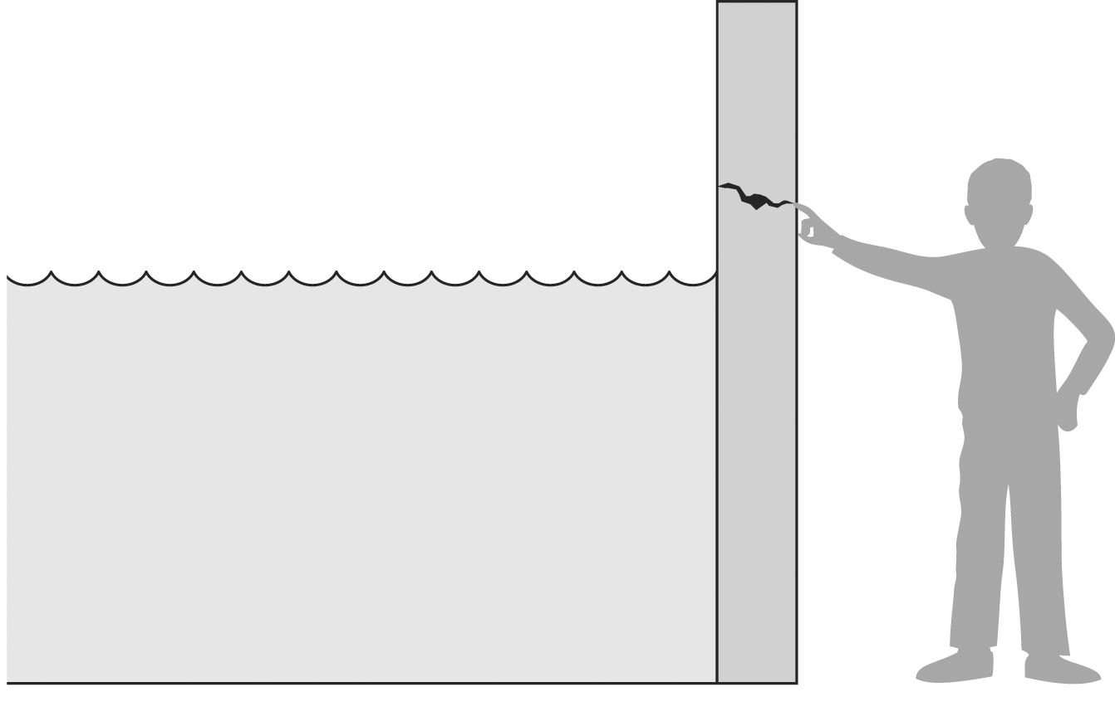
Threats, Vulnerabilities and Controls
A threat is blocked by control of a vulnerability

Slide 24
Threats
Definition: Something that can potentially cause damage to information assets.
A malicious attacker must have three things:
Method: the skills, knowledge, tools, and other things with which to be able to pull off the attack.
Opportunity: the time and the access to accomplish the attack.
Motive: a reason to want to perform this attack against this system.

Slide 25
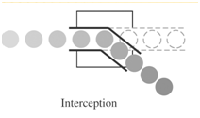
Threats: Types
Interception: some unauthorized party has gained access to an asset, the outside party can be a person, a program, or computing system.
Example: illicit copying of program or data files, or wiretapping to obtain data in a network
~ an attack on confidentiality

Slide 26
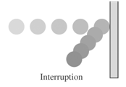
Threats: Types
Interruption: an asset of the system becomes lost, unavailable, or unusable.
Example: malicious destruction of a hardware device, erasure of a program or data file, denial of service attacks
~ an attack on availability

Slide 27
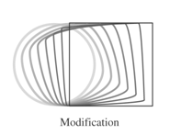
Threats: Types
Modification: alteration the values in a database, or programs to perform additional computation, or modify data being transmitted electronically.
Example: someone might change the values in a database, alter a program so that it performs an additional computation
~ an attack on integrity

Slide 28
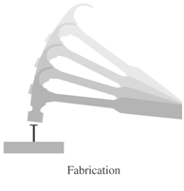
Threats: Types
Fabrication: An unauthorized party might create a fabrication of counterfeit objects on a computing system.
Example: the intruder may insert spurious transactions to a network communication system, or add records to an existing database
~ an attack on authenticity

Slide 29

Threats: Examples
Steal, alter, or delete confidential files
Steal hardware devices
Internet
Virus infection
Unauthorized access from the Internet
Operation mistake
Unauthorized break-in
Unauthorized access to the Internet

Slide 30
Vulnerabilities
Definition: A weakness in the organization, computer system, or network that can be exploited by threat.
Examples:
Security policy is not set.
Roles and responsibilities are vague(unclear).
Security training of employees are inadequate (insufficient).
Building entrance are not checked thoroughly.
There is not protection against computer viruses.
A software bug exists in the server OS.
No password rules are set.
Confidential data are sent over the network.
Organization
Computer System
Network

Slide 31
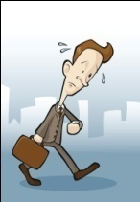
C.2. Vulnerabilities: Example 1: Building
1. Entering with stolen ID cards
2. Following a person who unlocks the door
3. Entering with a stolen uniform of a deliveryman

Slide 32
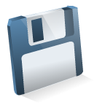

C.2. Vulnerabilities: Example 2: Within the Office
1. Theft of documents or disks
2. Theft of computers
3. Picking up documents from a trash box
Notes:
Unauthorized access using networks is increasing, but people within an organization commit many of the data destruction and leakage. Building security is usually the main concern, but information management within an office is less strict. Therefore, it is often easy for insiders to gain access without permission to company information. Examples of threats are:
Theft of printed documents, disks (floppy, CD, hard disk), and/or copying them.
Theft of hardware (computer, peripheral devices).
Theft of documents discarded in a trash box (Scavenging).
Important printed documentation should be kept in a locked place, and in some cases, the number of copies should also be managed. When discarding old but important documents, instead of throw them out in a trashcan, always shred them using a shredder. In the case of (2), some notebook PCs have a built-in loop for a cable and lock to prevent theft.
Vulnerabilities in these cases may be:
1) Sensitive documents/disks are not stored in locked cabinet.
2) Computers are not locked to desks. Computer’s hard disk is not locked.
3) Sensitive documents are not shredded properly.

Slide 33
C.2. Vulnerabilities: Example 3: Computer System
Vulnerabilities:
Computers are left unattended in a logged-in state.
No password is set.
Easy passwords are set on server.
3. Change a user account
XXXX: user
administrator
1. Illegal use of logged-in computers.
Personnel Database
2. Theft of information on the disk

Slide 34
C.2. Vulnerabilities: Example 4: Software
1. When receiving IDs that are too long, the system stops. (overflow)
2. When a mail infected with a computer virus is opened
3. With too much access, the server stops
ID: aaaaa-aaaaa
To: %%%
From: $$$
--------
--------
--------
Attach: xxx
virus

Slide 35
Controls
Definition: an action, device, procedure, or technique that remove or reduce a vulnerabilities
Harm occurs when a threat is realized against a vulnerability. To protect against harm, we can neutralize the threat, close the vulnerability, or both
The possibility for harm to occur is called risk

Slide 36
C.3. Controls: Methods of Defense
SOFTWARE/HARDWARE CONTROLS
ENCRYPTION
Encryption provides
~ confidentiality for data
~ integrity
~ basis for protocol
S/W controls:
~ Internal program ctrls
~ Operating system ctrls
~ Development ctrls
H/W controls:
~ h/w devices :
- smartcard (encryption)
- circuit board ctrl disk
drives in PCs
METHODS OF
DEFENSE
POLICIES
~ frequent changes
of password
~ training
~ codes of ethics
PHYSICAL CONTROLS
~ locks of doors
~ backup copies of important s/w and data
~ physical site planning (reduce natural disasters)

Slide 37
C.3. Controls: What makes a system secure?
1. System Access Control: Ensuring that unauthorized users don’t get into the system.
2. Data Access Controls: Monitoring who can access what data, and for what purpose.
3. System and Security Administration: Performing the offline procedures that make or break a secure system
~ by clearly stated system administrator responsibilities,
~ by training users appropriately etc.
4. System Design: Taking advantage of basic h/w and s/w security characteristics.

Slide 38
Approaches to Information Security Implementation: Bottom-Up Approach
Grassroots effort: systems administrators attempt to improve security of their systems
Key advantage: technical expertise of individual administrators
Seldom works, as it lacks a number of critical features:
Participant support
Organizational staying power

Slide 39
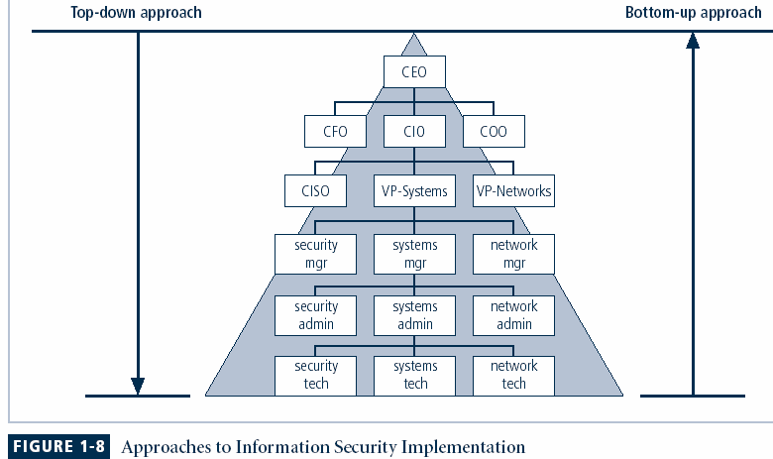

Slide 40
Approaches to Information Security Implementation: Top-Down Approach
Initiated by upper management
Issue policy, procedures and processes
Dictate goals and expected outcomes of project
Determine accountability for each required action
The most successful also involve formal development strategy referred to as systems development life cycle

Slide 41
The Systems Development Life Cycle
Systems development life cycle (SDLC) is methodology and design for implementation of information security within an organization
Methodology is formal approach to problem-solving based on structured sequence of procedures
Using a methodology
ensures a rigorous process
avoids missing steps
Goal is creating a comprehensive security posture/program
Traditional SDLC consists of six general phases

Slide 42
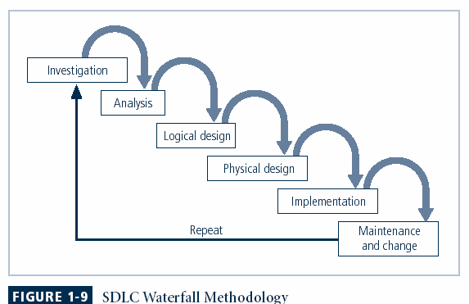

Slide 43
The Security Systems Development Life Cycle
The same phases used in traditional SDLC may be adapted to support specialized implementation of an IS project
Identification of specific threats and creating controls to counter them
SecSDLC is a coherent program rather than a series of random, seemingly unconnected actions

Slide 44
The Security Systems Development Life Cycle
Investigation
Identifies process, outcomes, goals, and constraints of the project
Begins with enterprise information security policy
Analysis
Existing security policies, legal issues,
Perform risk analysis

Slide 45
The Security Systems Development Life Cycle
Logical Design
Creates and develops blueprints for information security
Incident response actions: Continuity planning, Incident response, Disaster recovery
Feasibility analysis to determine whether project should continue or be outsourced
Physical Design
Needed security technology is evaluated, alternatives generated, and final design selected

Slide 46
The Security Systems Development Life Cycle
Implementation
Security solutions are acquired, tested, implemented, and tested again
Personnel issues evaluated; specific training and education programs conducted
Entire tested package is presented to management for final approval
Maintenance and Change
Most important
Constant changing threats
Constant monitoring, testing updating and implementing change

Slide 47
Summary
Information security is a “well-informed sense of assurance that the information risks and controls are in balance.”
Computer security began immediately after first mainframes were developed
Successful organizations have multiple layers of security in place: physical, personal, operations, communications, network, and information.

Slide 48
QUIZ 1
1. Define Threats, Vulnerabilities, Controls
2. What are the types of Threats?
3. What are the methods of defense from Threats

