Slide 1

V&V of WMLES
Maochao Xiao
08/02/2024

Slide 2
Channel
RETAU180
Both Neumann and wall model yield acceptable profiles
The DNS grid and the finest wall model grid produce the same results, but show difference from the DNS results, demonstrating imperfection of the wall model

Slide 3
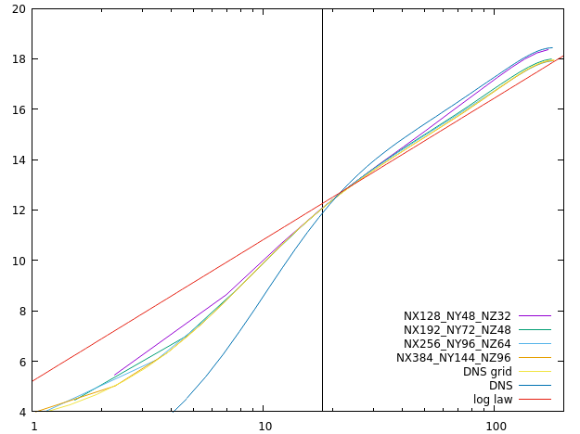
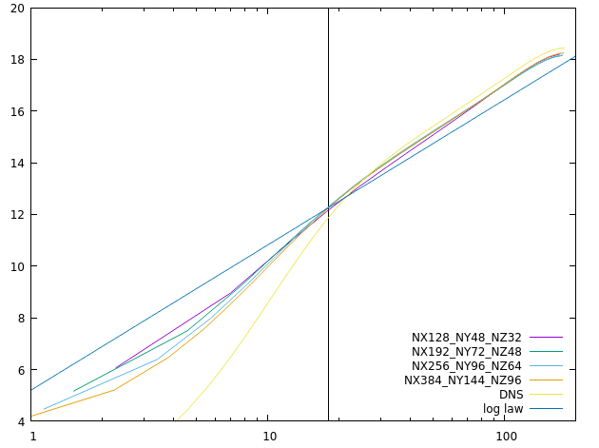
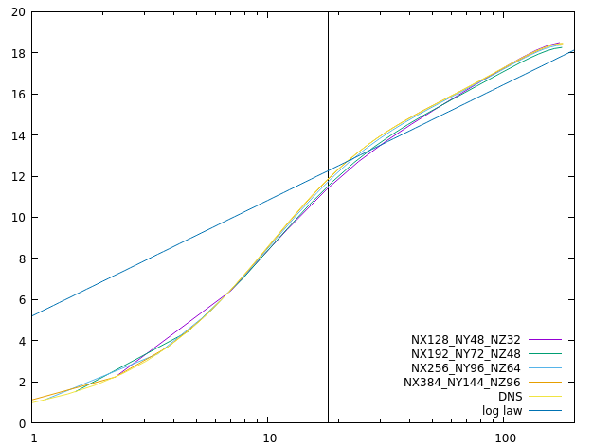
Channel
RETAU180
Wall model
Neumann
No-slip

Slide 4
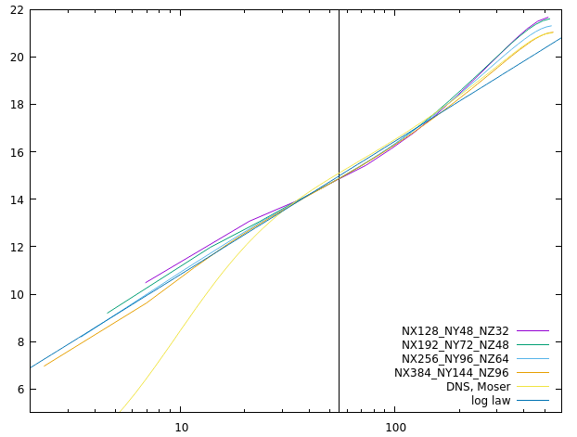
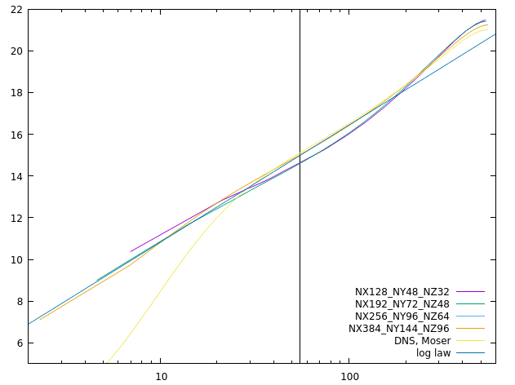
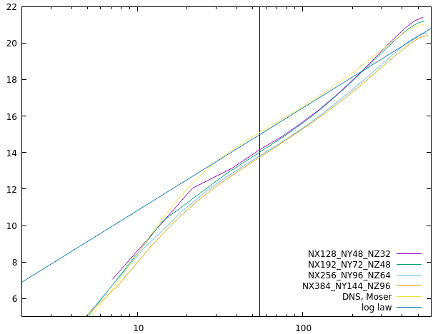
Channel
RETAU550
Wall model
Neumann
No-slip

Slide 5
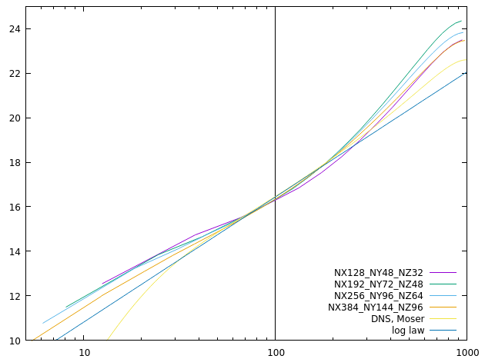
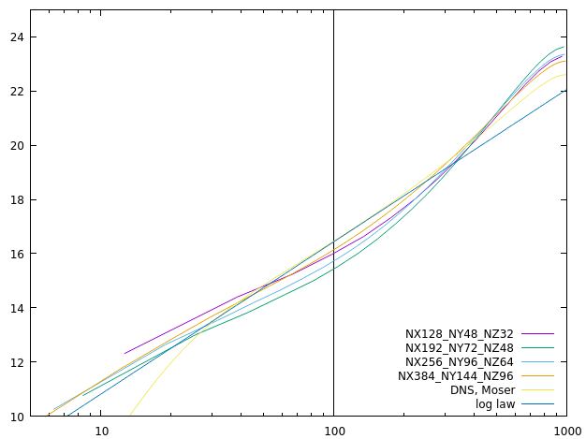
Channel
RETAU1000
Wall model
Neumann

Slide 6
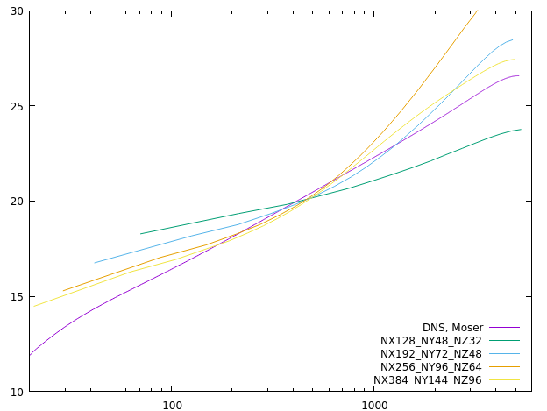
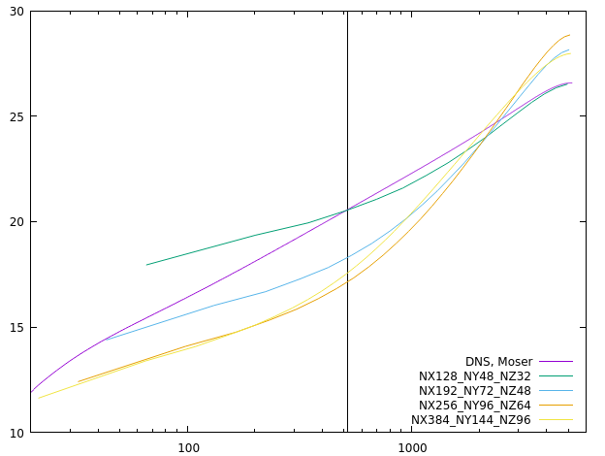
Channel
RETAU5200
Neither Neumann nor wall model yields acceptable profiles
Resolutions are insufficient
Wall model
Neumann

Slide 7
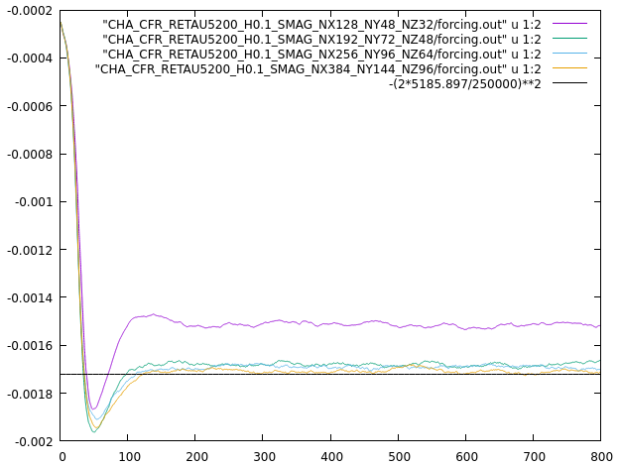
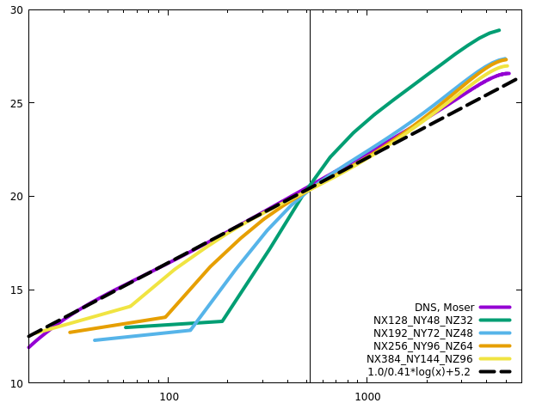
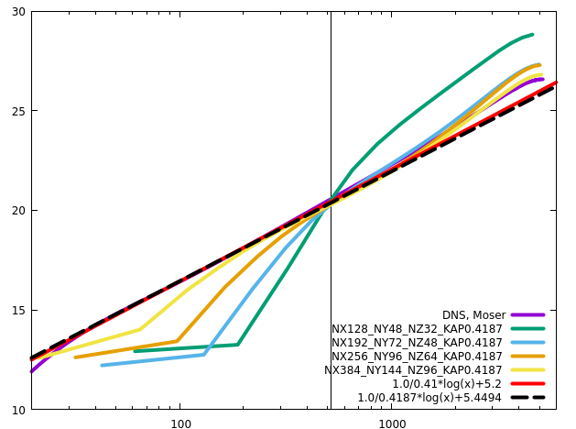
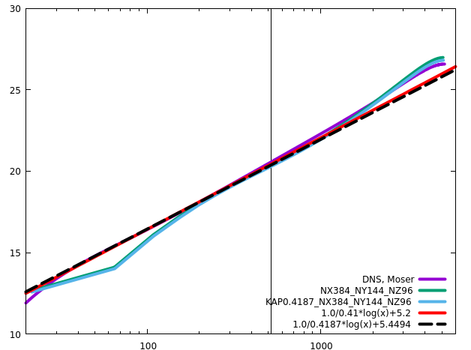
Channel
RETAU5200
Two sets of (KAP, B) have almost the same results, although KAP0.41 is negligibly better

Slide 8
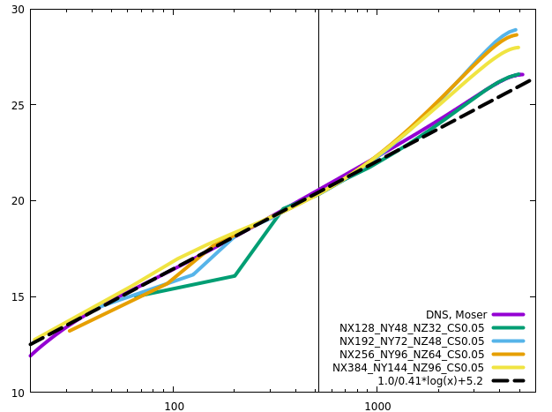
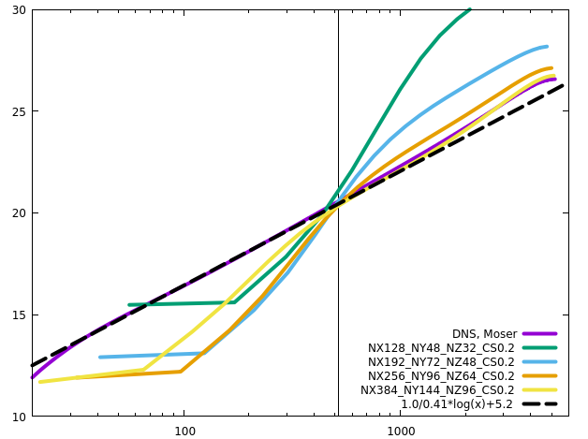
Channel
RETAU5200
Two sets of (KAP, B) produce the same results. KAP0.41 is negligibly better
CS0.11 is optimum. CS0.05 is too small, especially in the core region.

Slide 9
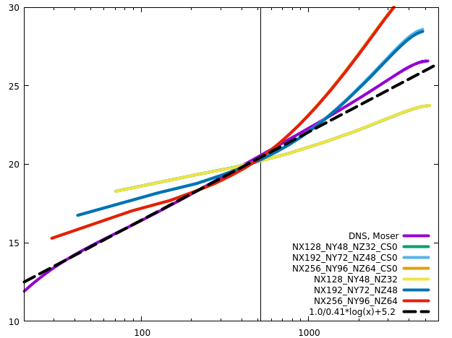
Channel
RETAU5200
CS0 does reproduce the results with no SGS

Slide 10
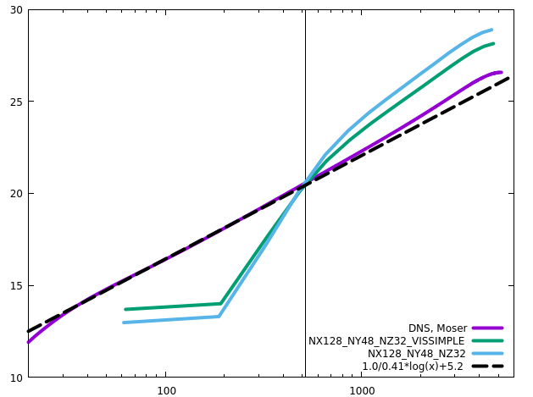
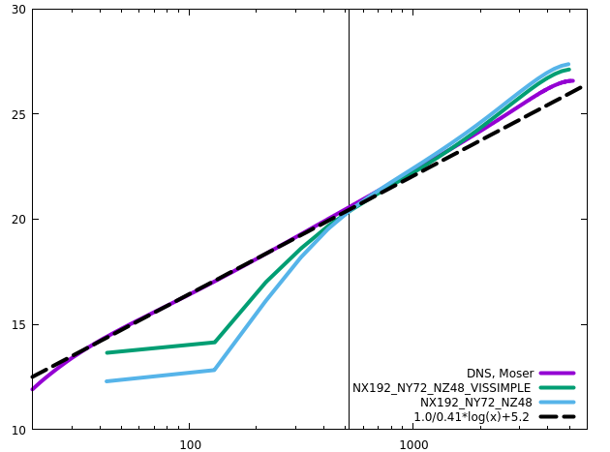
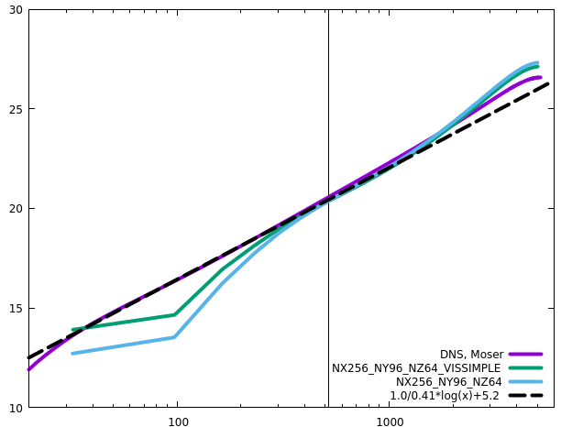
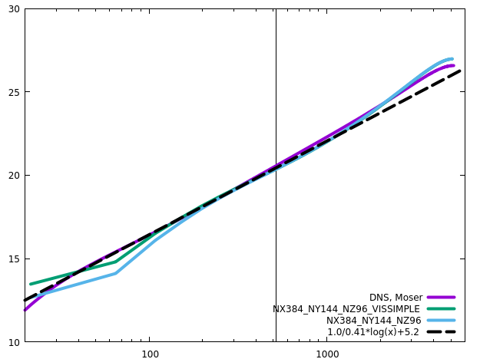
Channel
RETAU5200
CS0 does reproduce the results with no SGS

Slide 11
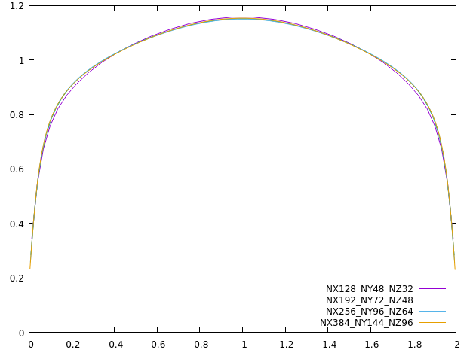
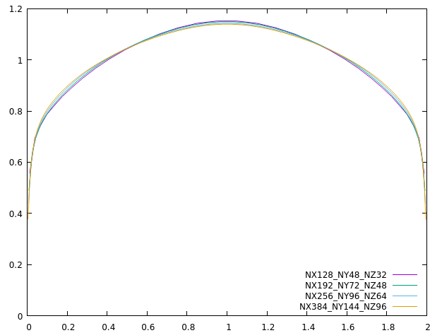
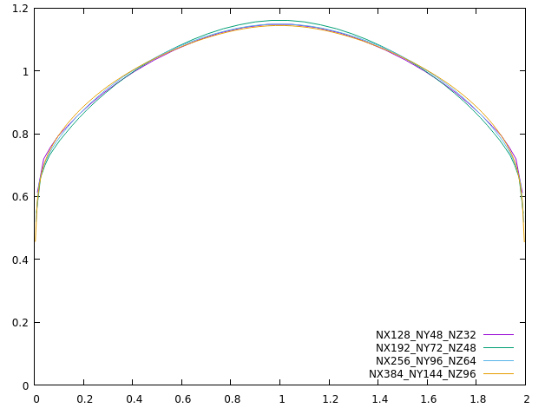
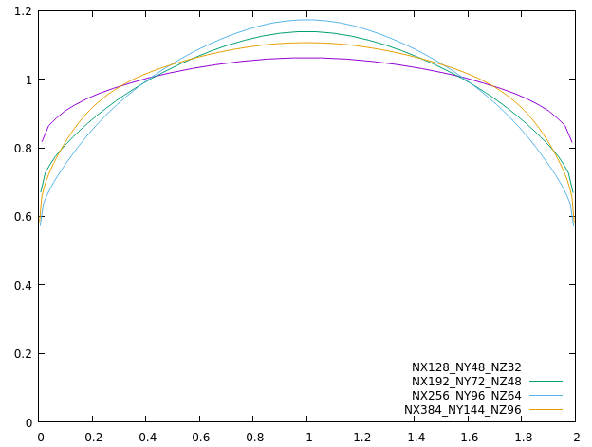
Channel
Wall model
RETAU180
RETAU550
RETAU1000
RETAU5200

Slide 12
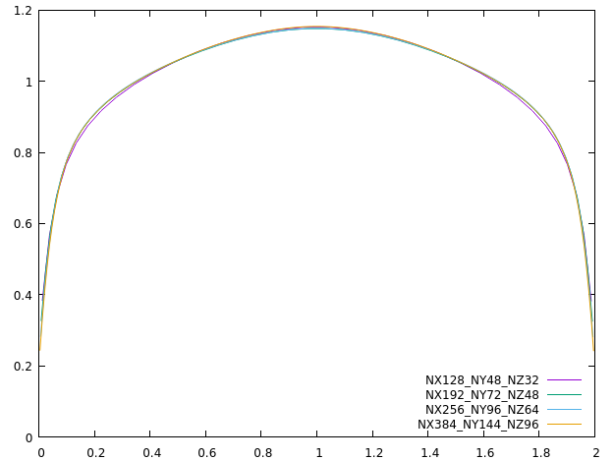
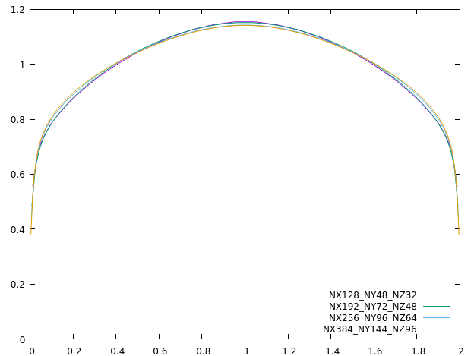
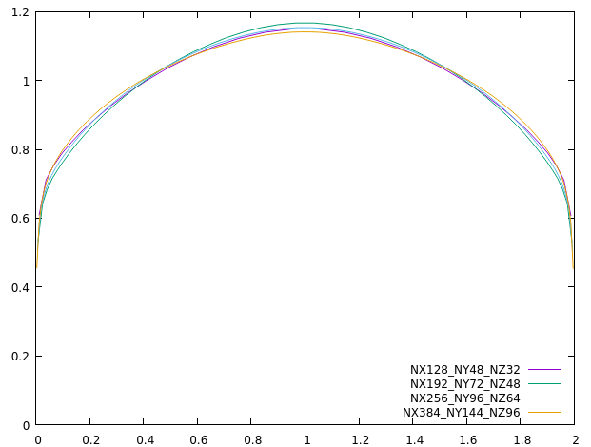
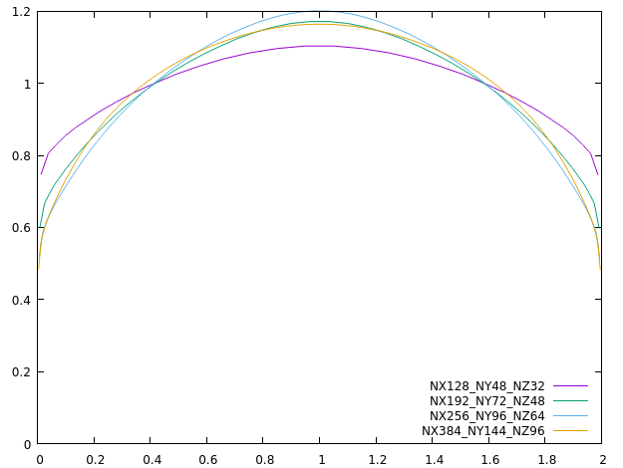
Channel
Neumann
RETAU180
RETAU550
RETAU1000
RETAU5200

Slide 13
Channel
No-slip
No-slip bc leads to higher RETAU on coarse grids when there is no numerical dissipation on the scales near the cut-off scale

Slide 14
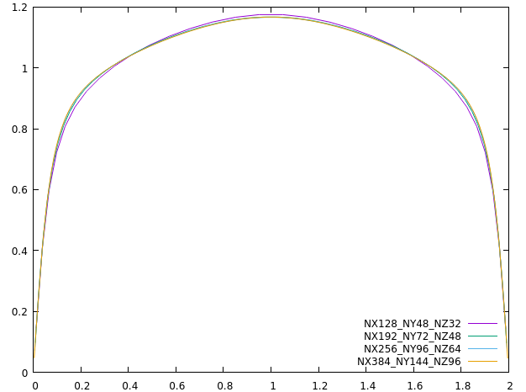
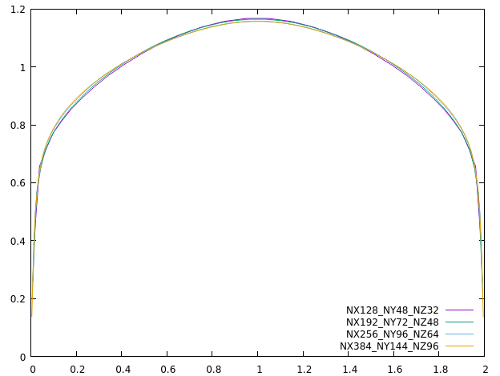
Channel
No-slip
RETAU180
RETAU550
RETAU1000
RETAU5200

Slide 15
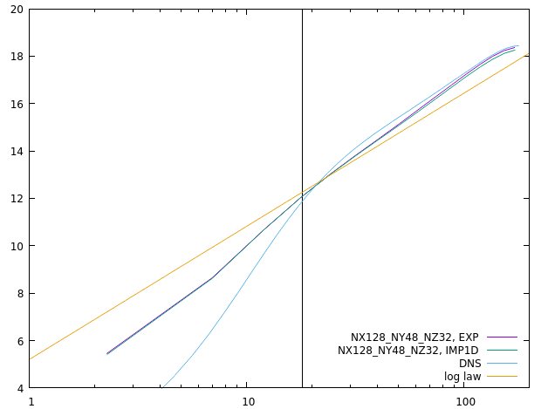
Channel
EXP vs IMP1D, CHA_CFR_RETAU180_H0.1_NX128_NY48_NZ32
The results from the explicit and the implicit1D schemes are almost the same
Neumann
Wall model

Slide 16

Square Duct
High-Reynolds-number wall-bounded turbulence is common in industrial engineering, but is inaccessible to DNS/LES
LES of a whole aircraft will be ready in 2045
The highest computable ${Re}_{τ}$ ~ 10⁴ for channel

