Slide 1

V&V of Wall-Modeled LES in CaNS-2.0
Maochao Xiao
08/02/2024

Slide 2
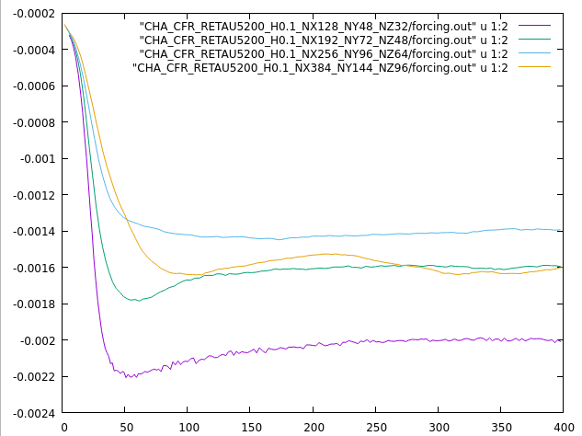
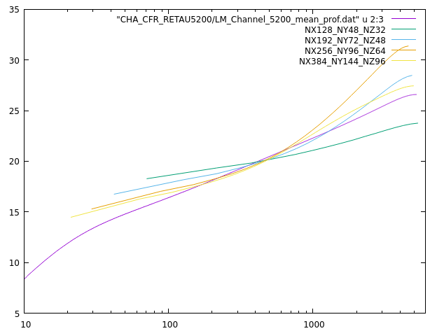
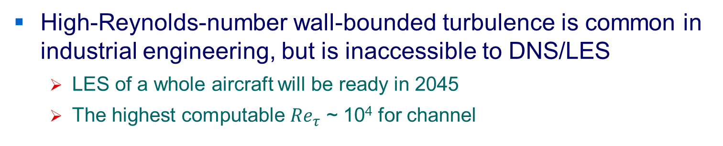
Channel
High-Reynolds-number wall-bounded turbulence is common in industrial engineering, but is inaccessible to DNS/LES
LES of a whole aircraft will be ready in 2045
The highest computable ${Re}_{τ}$ ~ 10⁴ for channel
Notes:
Log-law and stresses

Slide 3
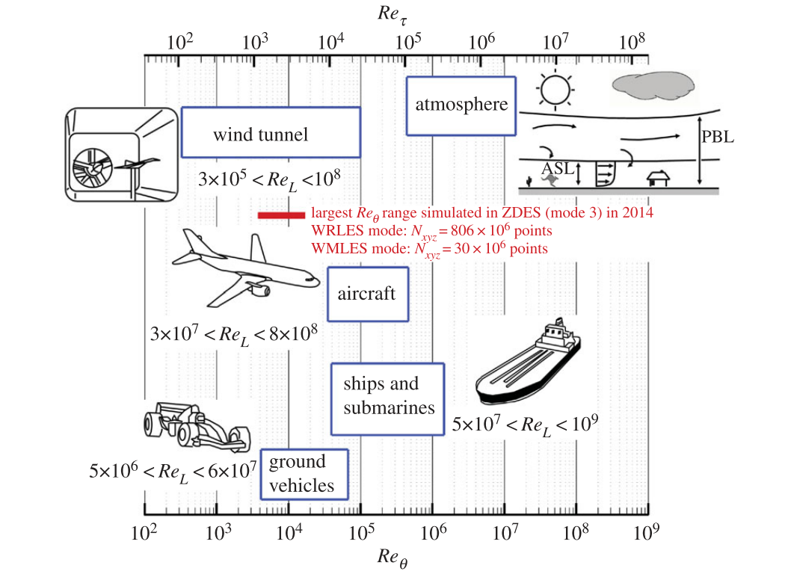
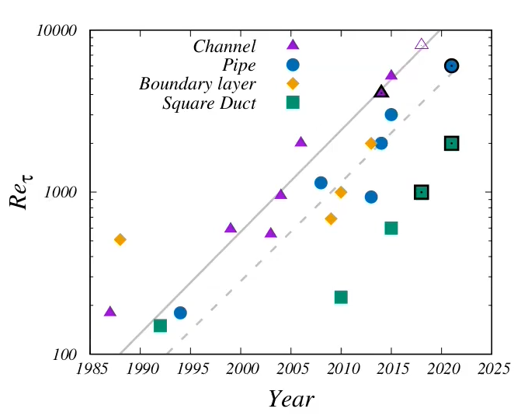

Square Duct
High-Reynolds-number wall-bounded turbulence is common in industrial engineering, but is inaccessible to DNS/LES
LES of a whole aircraft will be ready in 2045
The highest computable ${Re}_{τ}$ ~ 10⁴ for channel
Wall-modelled LES
The expensive inner layer (~0.1δ) is modelled by eddy viscosity or modified wall-shear stress and heat flux
Deck et al. (2014)
Pirozzoli (2022)
1/12
Notes:
High Reynolds turbulence examples inaccessible (how much cost) wmles modeled two methods
Grids requirements

Slide 4
Outline
Background
Content
RLTurb
RLWM-IC
RLWM
Drag reduction of pipe flow
Past research
AMD-IDDES
Iced wing flow
Notes:
^{Add} one background picture

Slide 5
Thank you！

