Slide 1

V&V of WMLES
Maochao Xiao
08/02/2024

Slide 2
Channel
RETAU180
Both Neumann and wall model yield acceptable profiles
The DNS grid and the finest wall model grid produce the same results, but show difference from the DNS results, demonstrating imperfection of the wall model

Slide 3
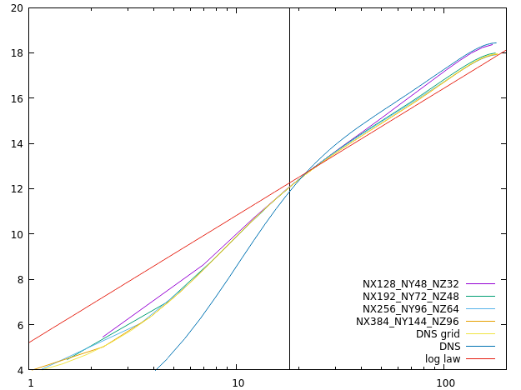
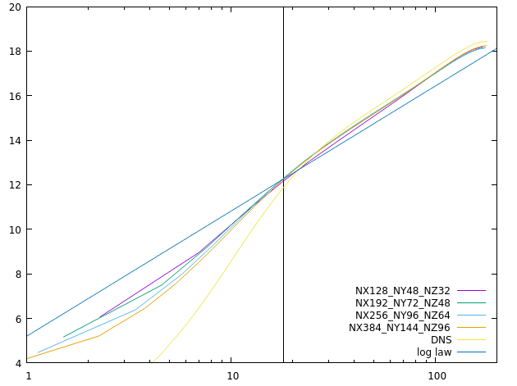
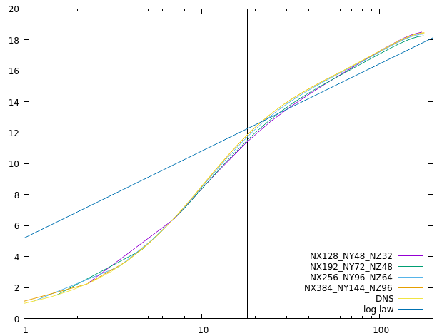
Channel
RETAU180
Wall model
Neumann
No-slip

Slide 4
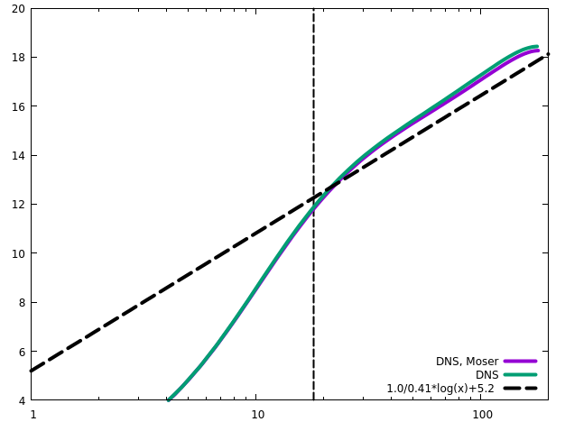
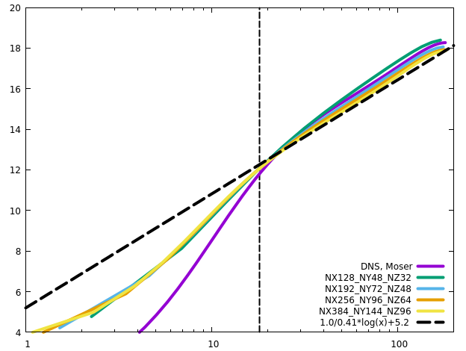
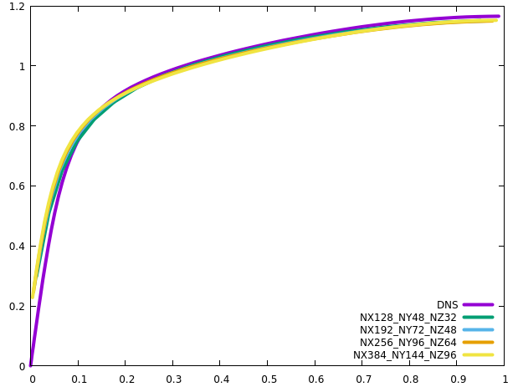
Channel
RETAU180

Slide 5
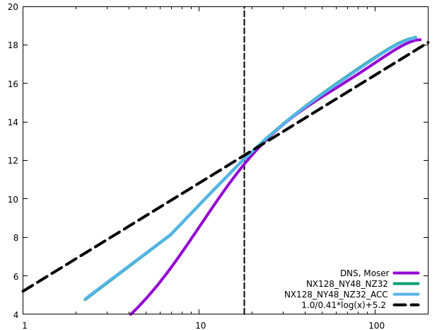
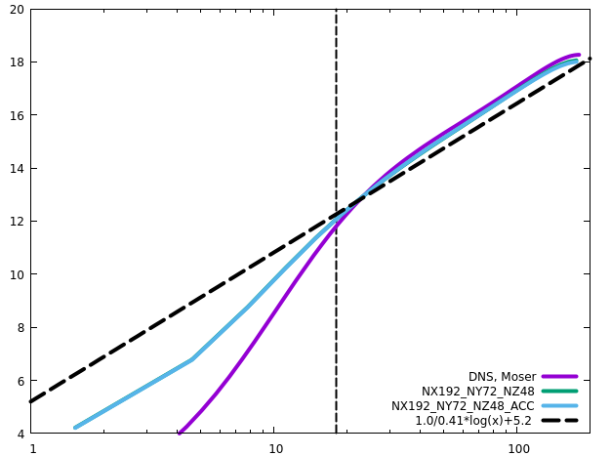
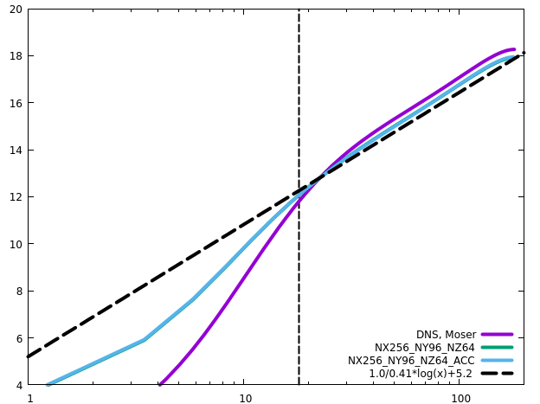
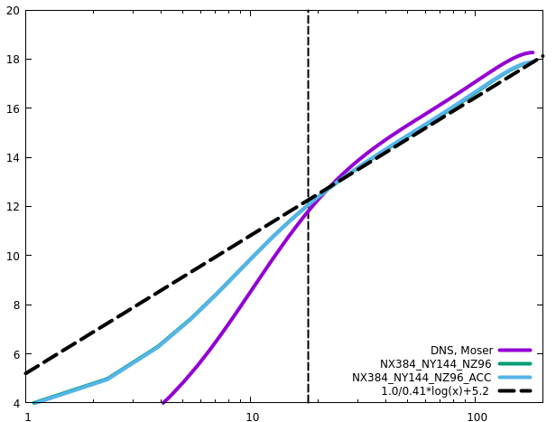
Channel
RETAU180
ACC does not influence the statistics

Slide 6
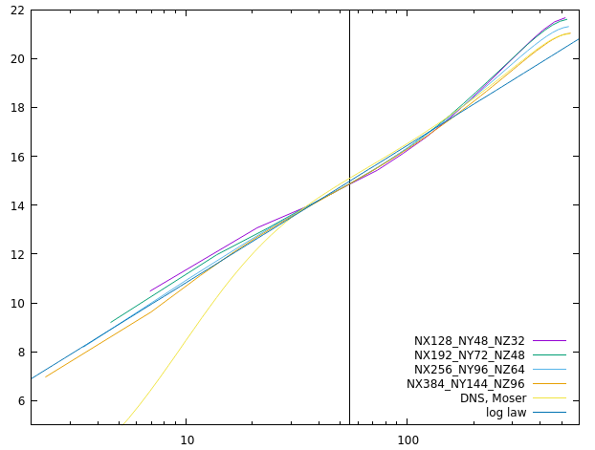
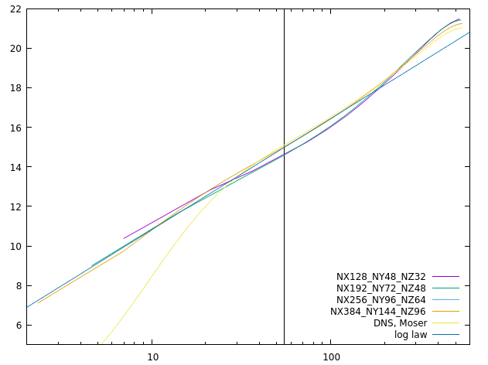
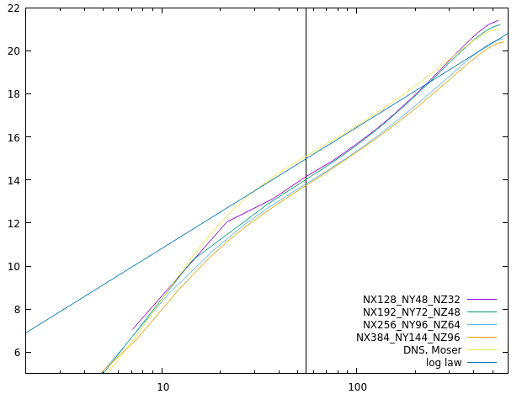
Channel
RETAU550
Wall model
Neumann
No-slip

Slide 7
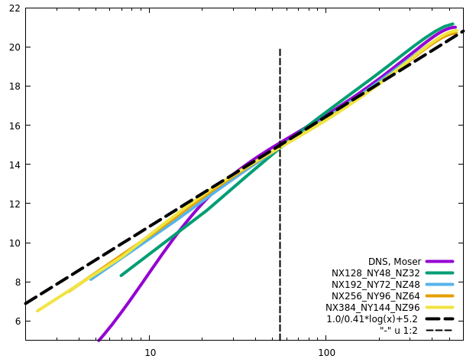
Channel
RETAU550

Slide 8
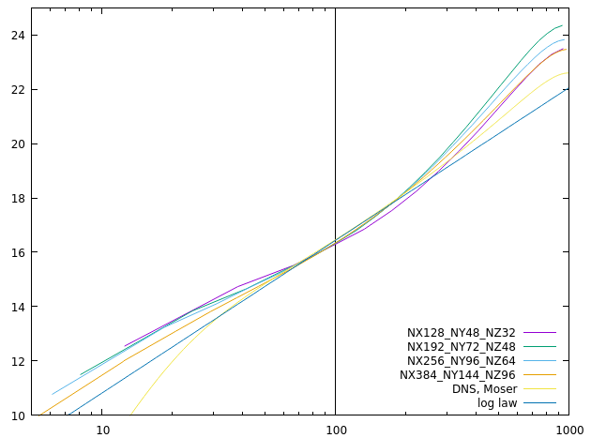
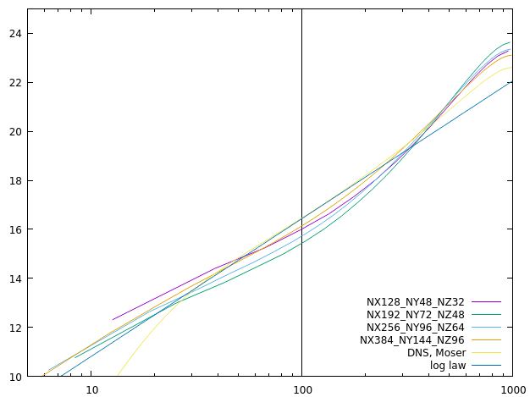
Channel
RETAU1000
Wall model
Neumann

Slide 9
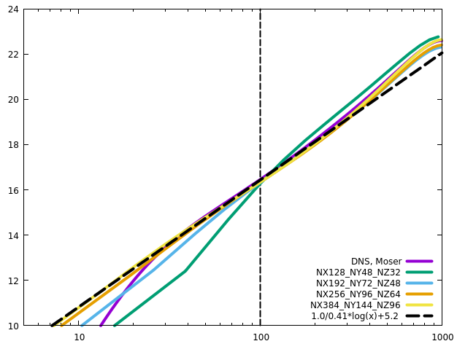
Channel
RETAU1000

Slide 10
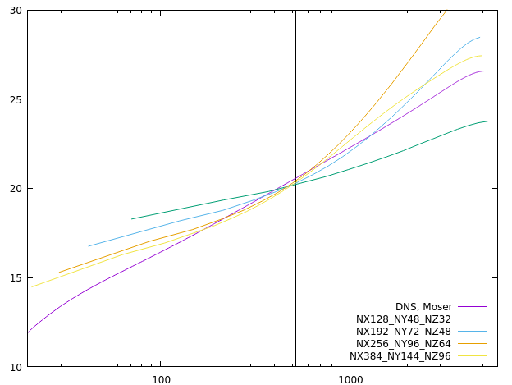
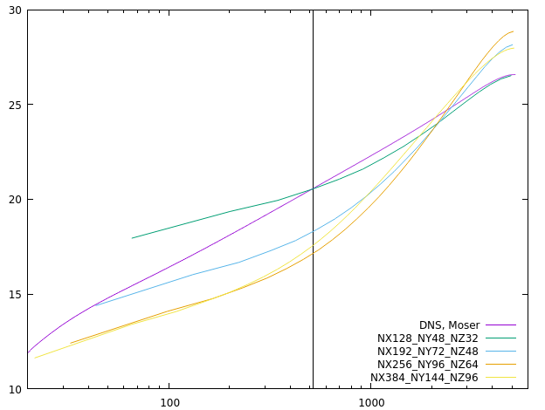
Channel
RETAU5200
Neither Neumann nor wall model yields acceptable profiles
Resolutions are insufficient
Wall model
Neumann

Slide 11
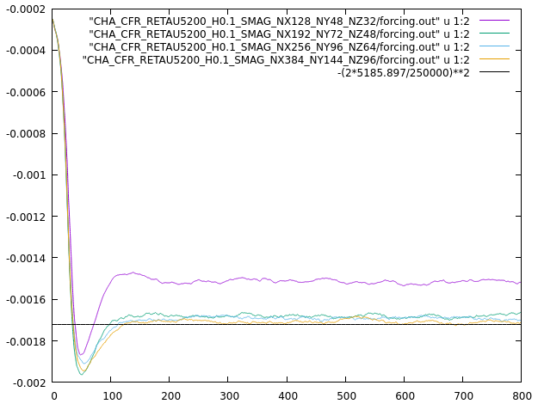
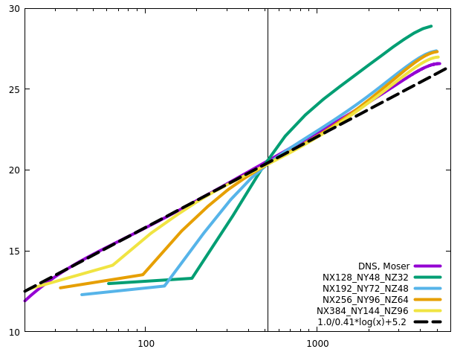
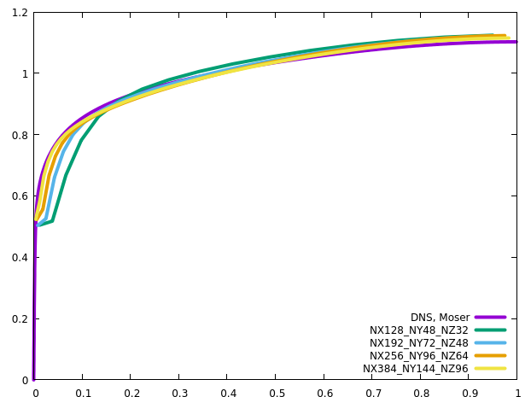
Channel
RETAU5200
KAP=0.41 and 0.4187 produce almost the same results, although KAP0.41 is negligibly better

Slide 12
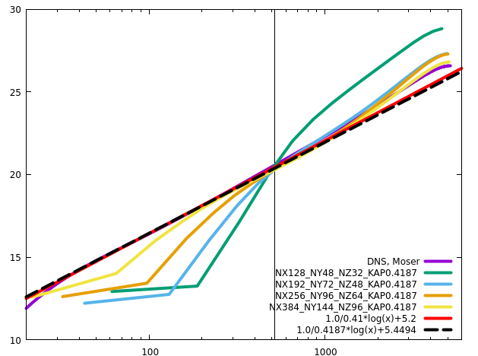
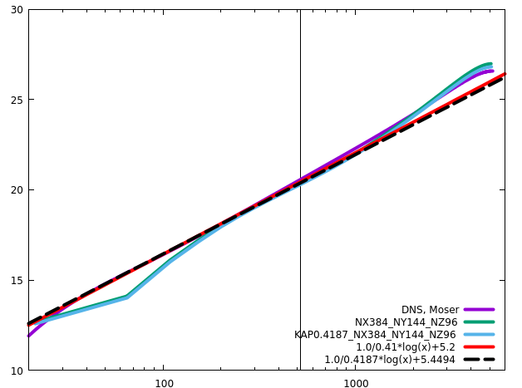
Channel
RETAU5200
KAP=0.41 and 0.4187 produce almost the same results, although KAP0.41 is negligibly better

Slide 13
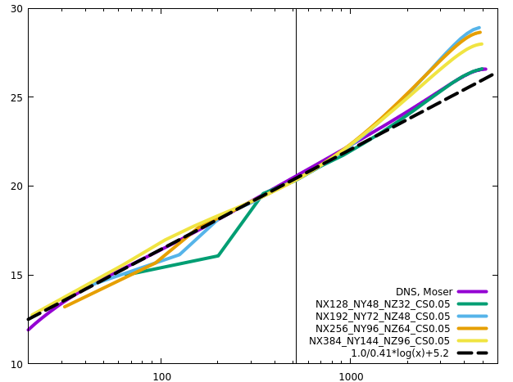
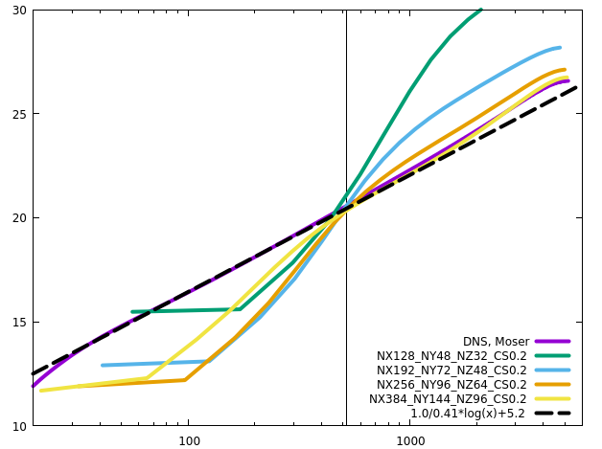
Channel
RETAU5200
CS0.11 is optimal, and CS0.05 is too small, especially in the core region.

Slide 14
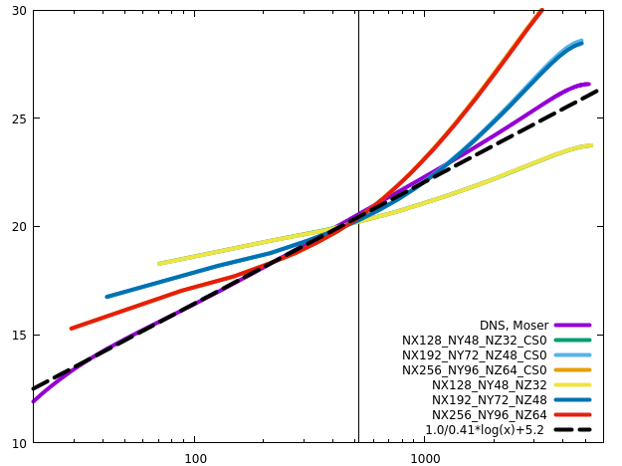
Channel
RETAU5200
CS0 reproduces the results without SGS

Slide 15
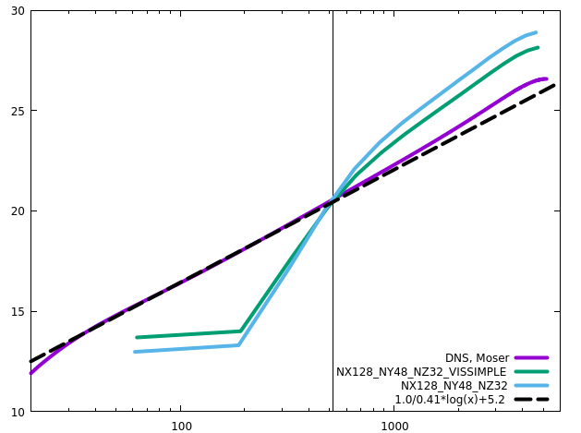
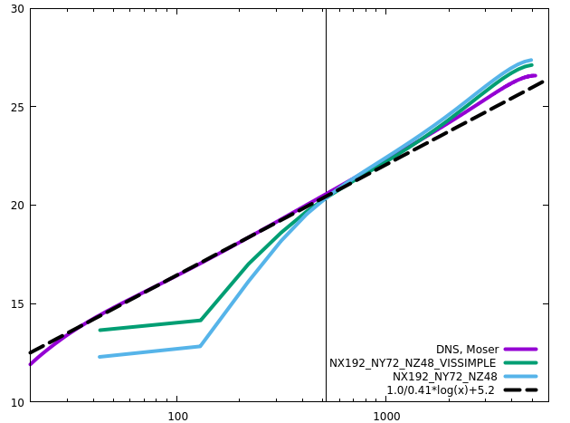
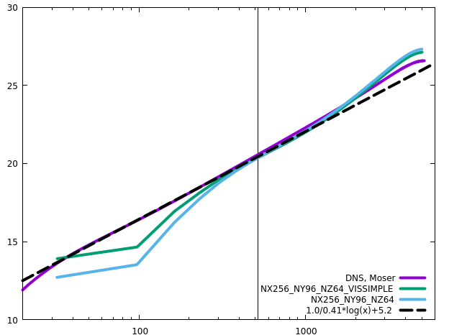
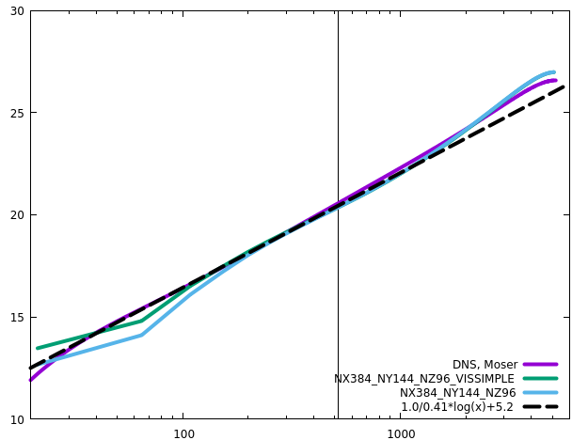
Channel
RETAU5200
Simplified viscous terms produce a bit better results on coarse grids

Slide 16
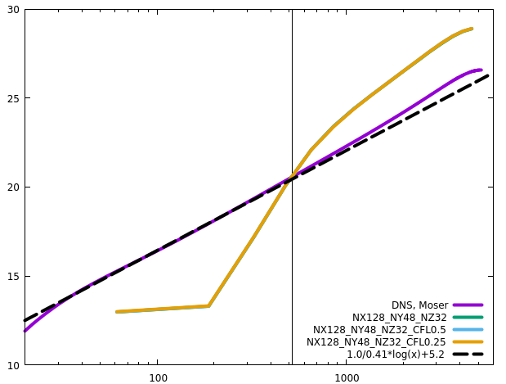
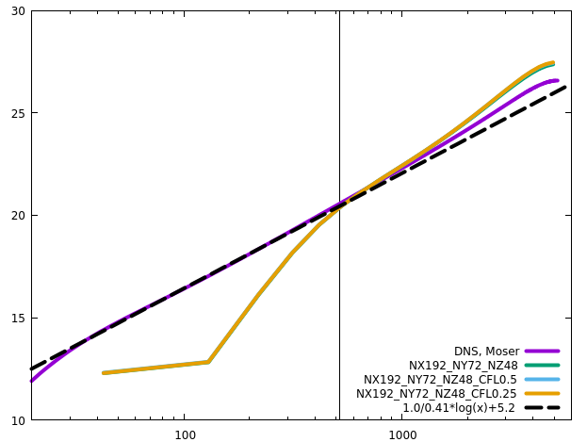
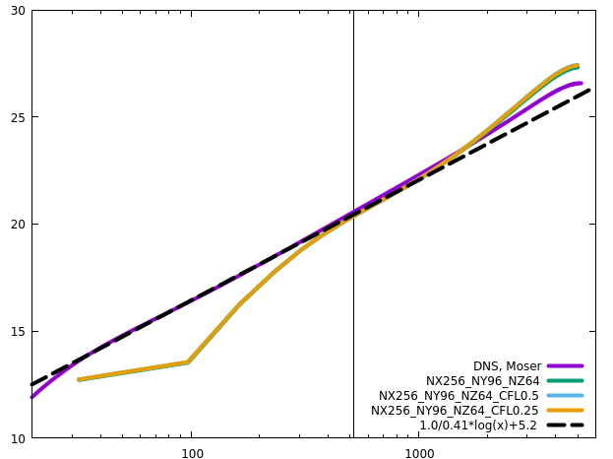
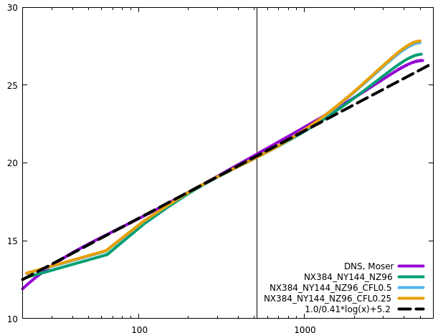
Channel
RETAU5200
CFL

Slide 17
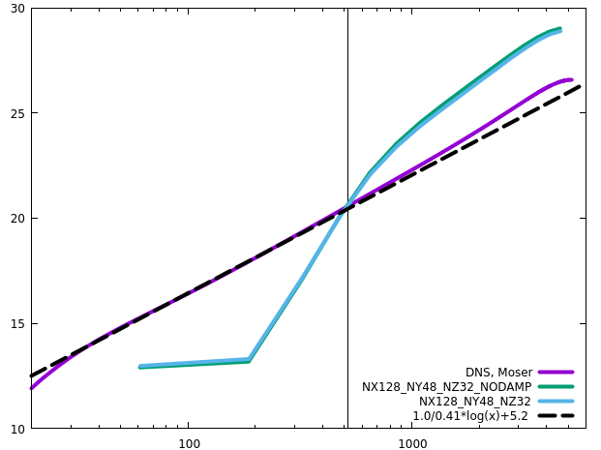
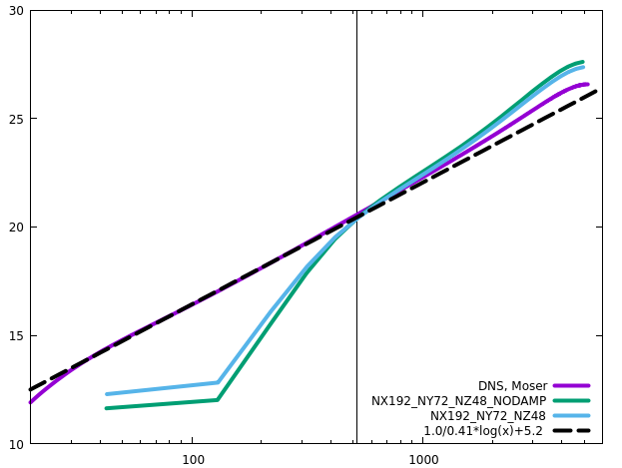
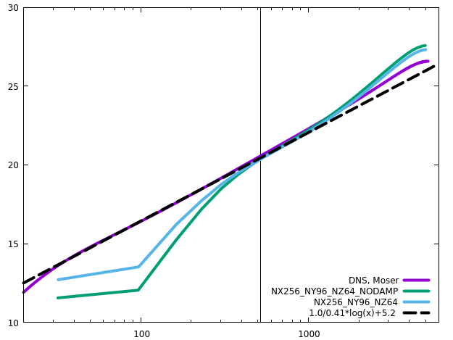
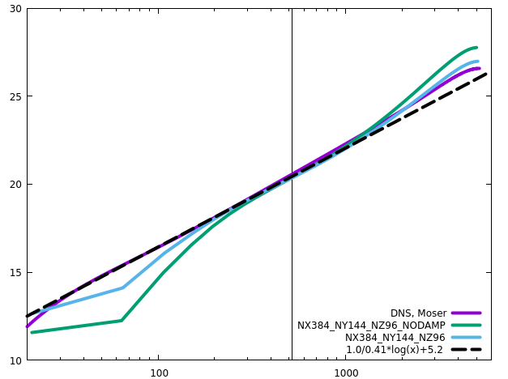
Channel
RETAU5200
The effect of damping function increases with mesh refinement

Slide 18
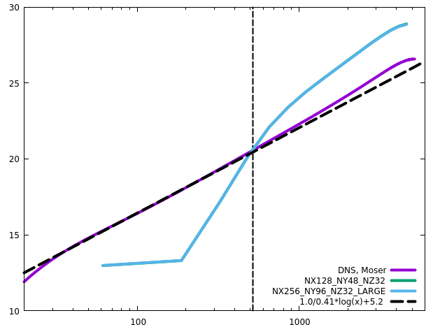
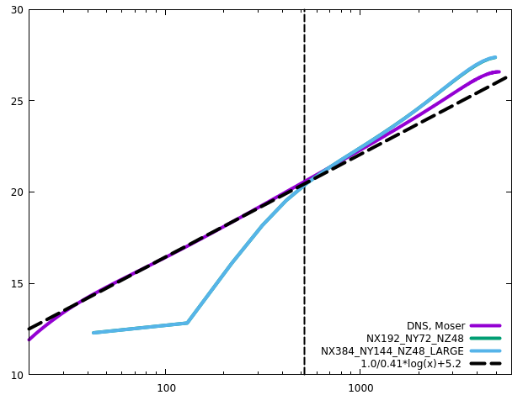
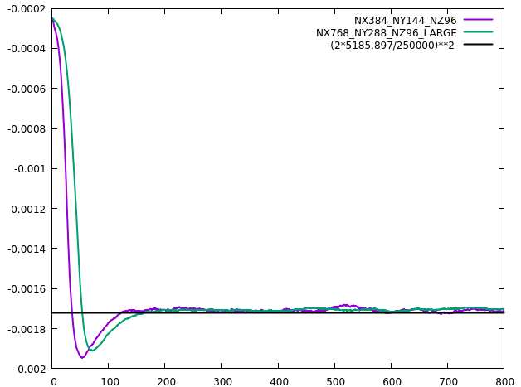
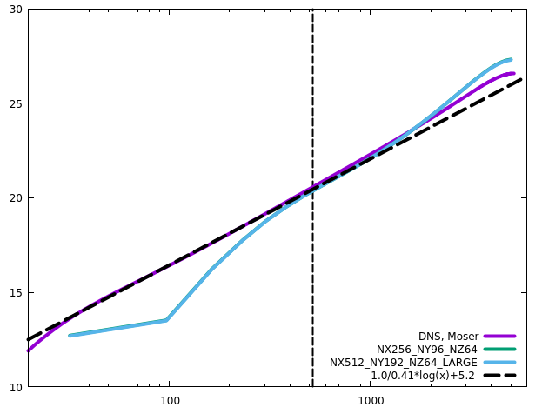
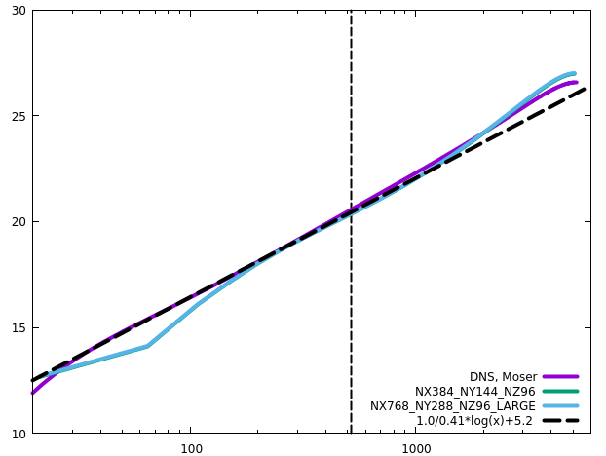
Channel
RETAU5200
Domain size hardly influences the results. The outer layer is negligibly influenced
Longer domain needs longer transient time (larger structures resolved, longer periods?)

Slide 19
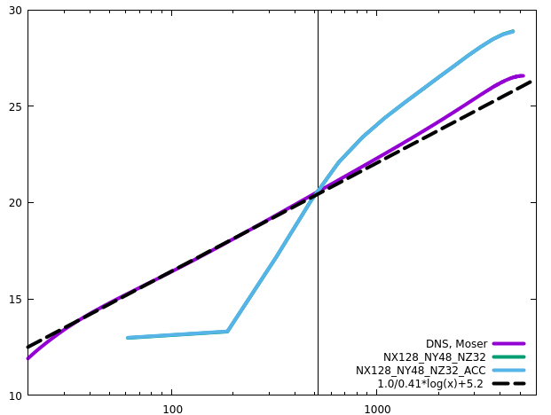
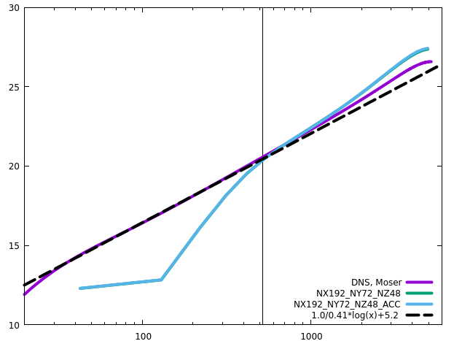
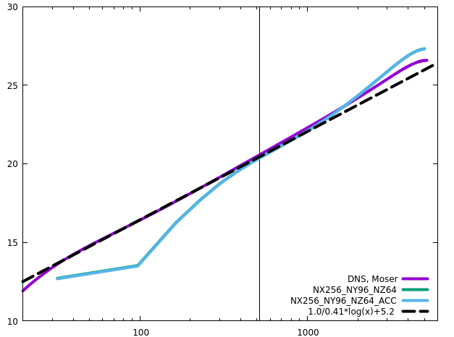
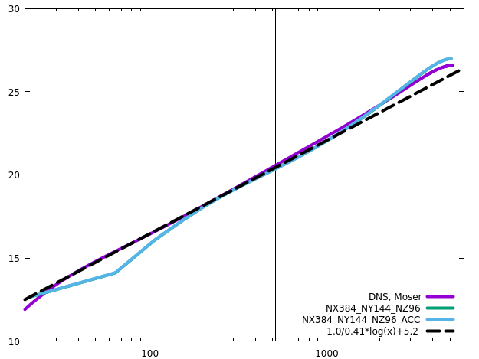
Channel
RETAU5200
ACC does not influence the statistics

Slide 20
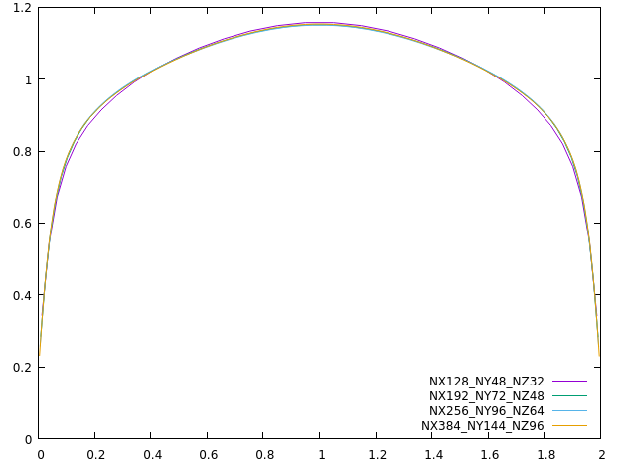
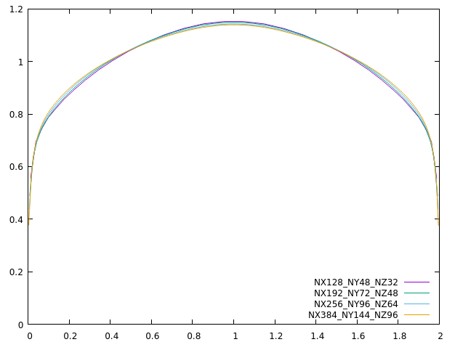


Channel
Wall model
RETAU180
RETAU550
RETAU1000
RETAU5200

Slide 21




Channel
Neumann
RETAU180
RETAU550
RETAU1000
RETAU5200

Slide 22
Channel
No-slip
No-slip bc leads to higher RETAU on coarse grids when there is no numerical dissipation on the scales near the cut-off scale

Slide 23


Channel
No-slip
RETAU180
RETAU550
RETAU1000
RETAU5200

Slide 24

Channel
EXP vs IMP1D, CHA_CFR_RETAU180_H0.1_NX128_NY48_NZ32
The results from the explicit and the implicit1D schemes are almost the same
Neumann
Wall model

Slide 25

Square Duct
High-Reynolds-number wall-bounded turbulence is common in industrial engineering, but is inaccessible to DNS/LES
LES of a whole aircraft will be ready in 2045
The highest computable ${Re}_{τ}$ ~ 10⁴ for channel

