Slide 1

V&V of WMLES
Maochao Xiao

Slide 2
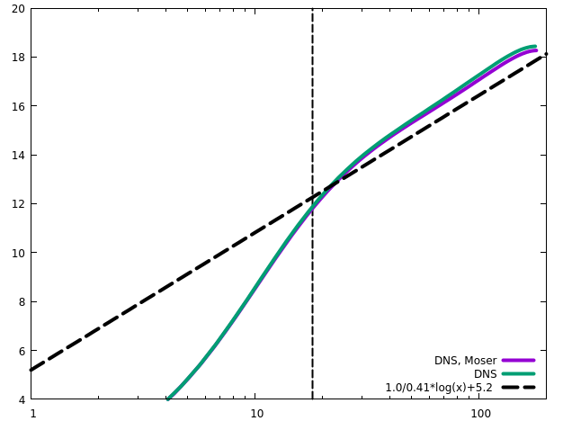
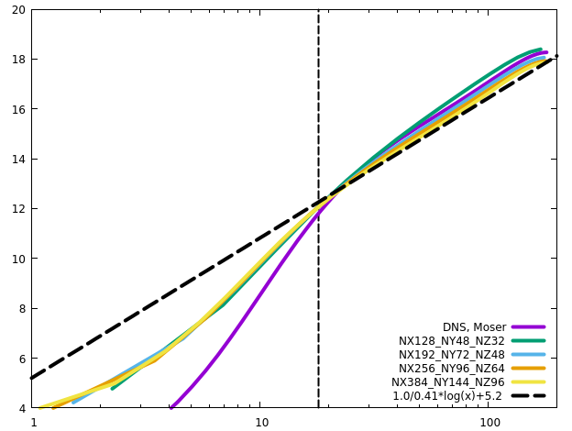
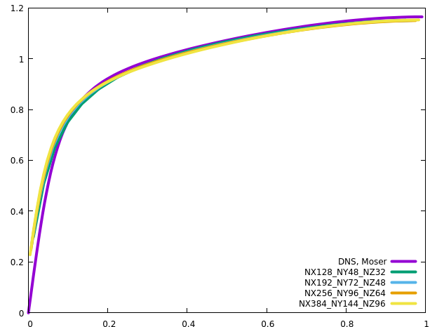
Channel
RETAU180

Slide 3
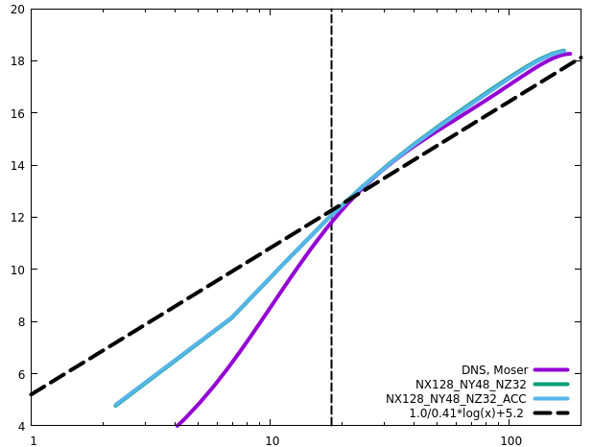
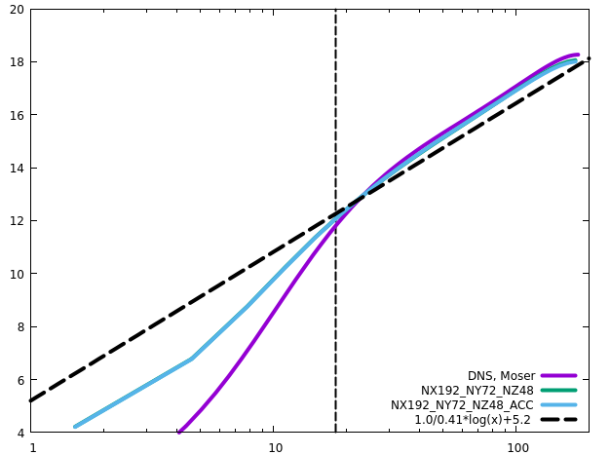
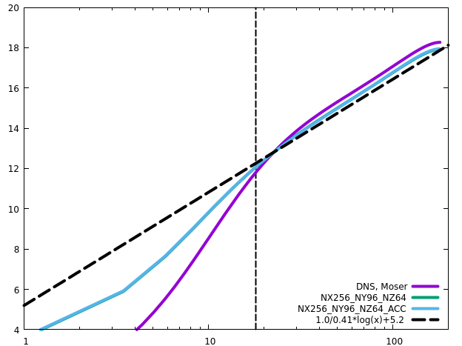
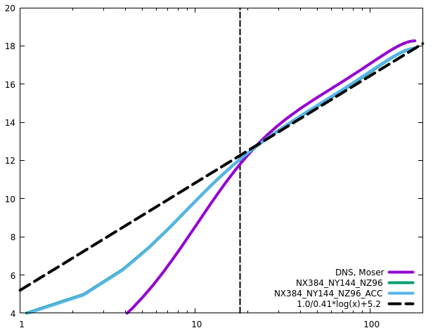
Channel
RETAU180
ACC does not influence the statistics

Slide 4
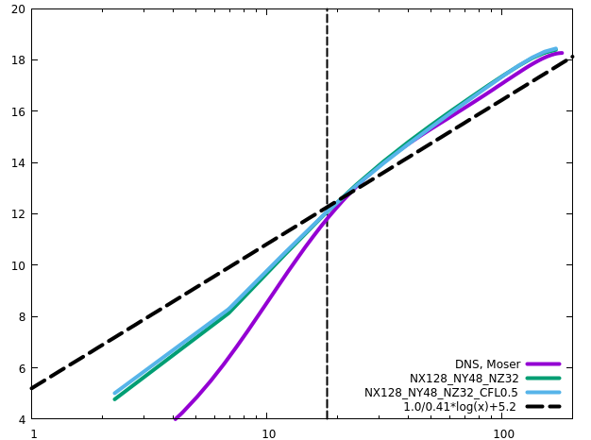

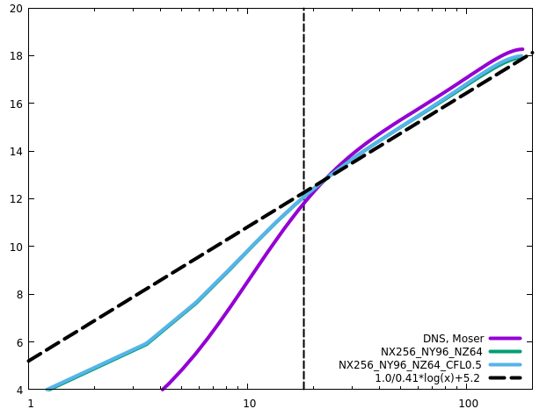

Channel
RETAU180
CFL has negligible influence on the statistics

Slide 5
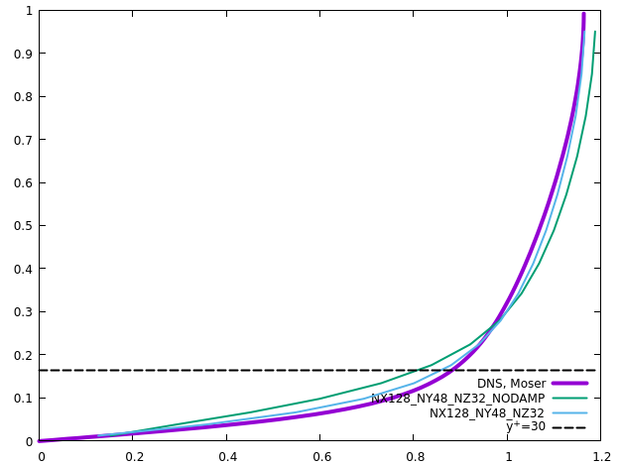
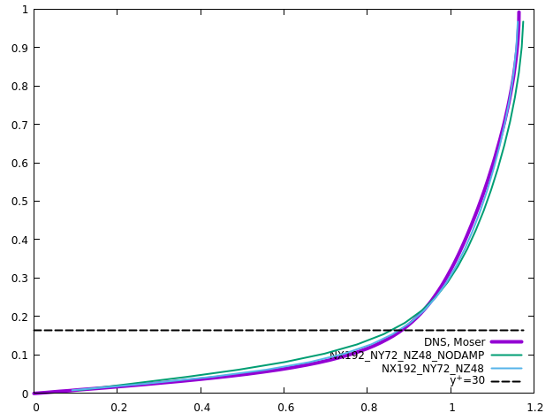
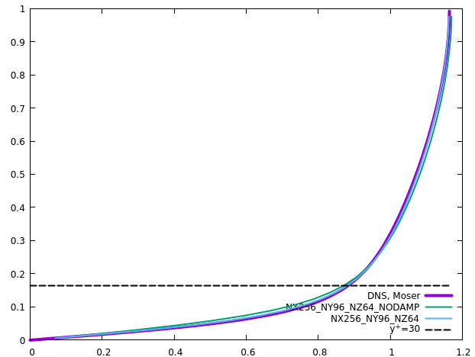
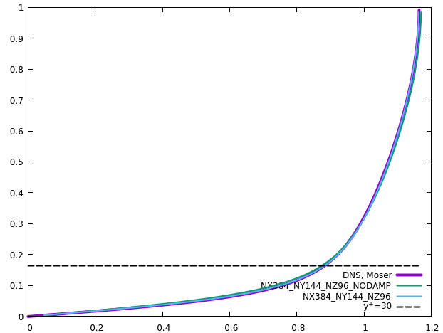
Channel
RETAU180
No-slip wall: damping produces larger (more accurate) velocity gradient near the wall

Slide 6
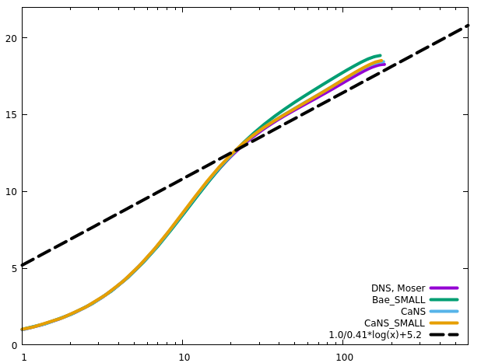
Channel
RETAU180
DNS comparison with Bae’s code. We do not expect very accurate results since the geometry and grid number are insufficient
Bae’s code produces lower wall friction. The reason is not due to time step, or grid resolutions
Notes:
Compare with Bae’s code, RETAU180
LES+DSMAG RETAU395&550

Slide 7
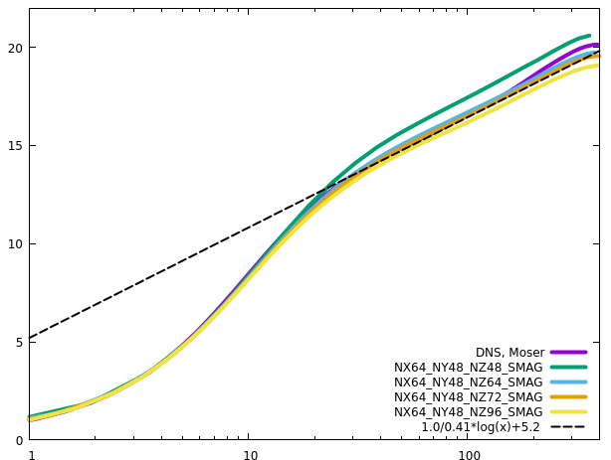
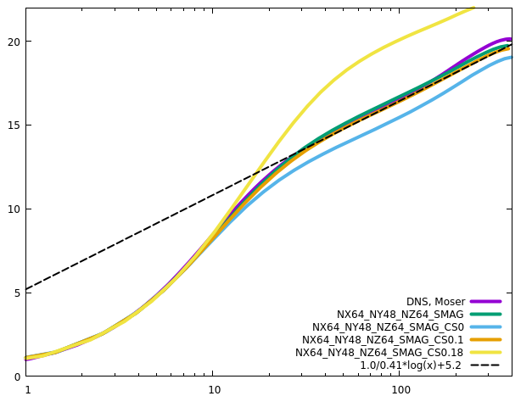
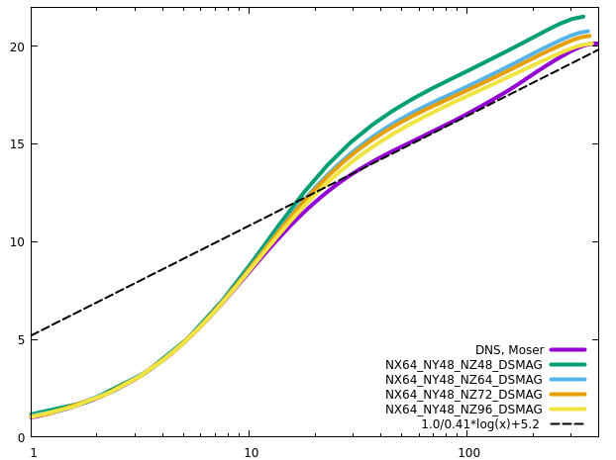
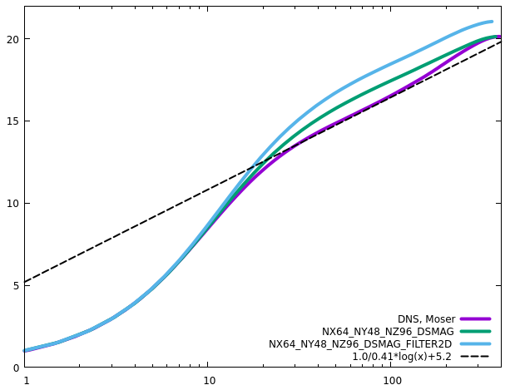
Channel
RETAU395
Similar to Orlandi’s setting (Reb=13750)
2D filter yields more dissipation, very close to Orlandi’s results

Slide 8
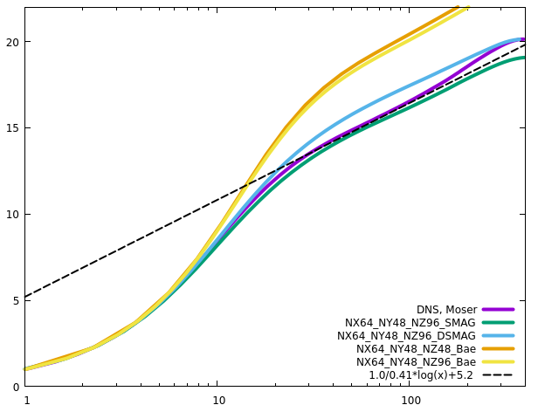
Channel
RETAU395
Compare with Bae’s code. Bae’s code is very dissipative

Slide 9
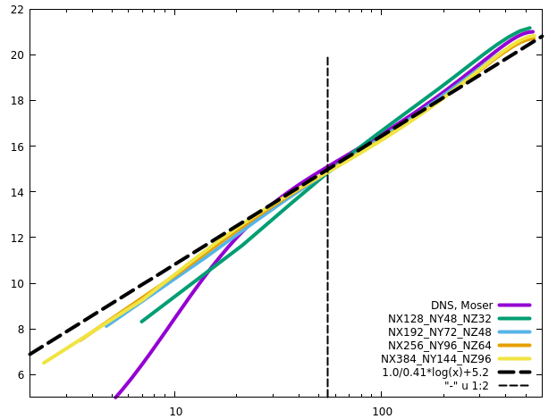
Channel
RETAU550

Slide 10
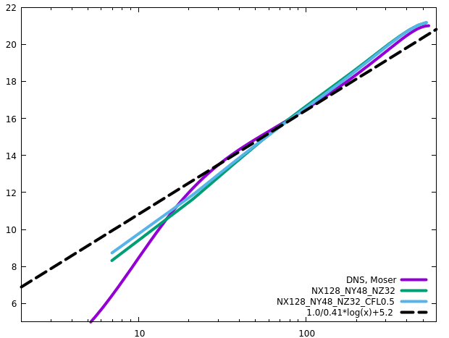
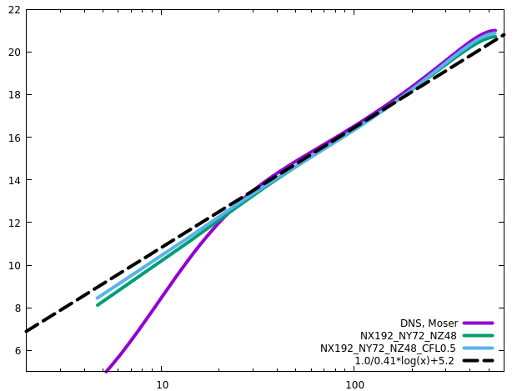
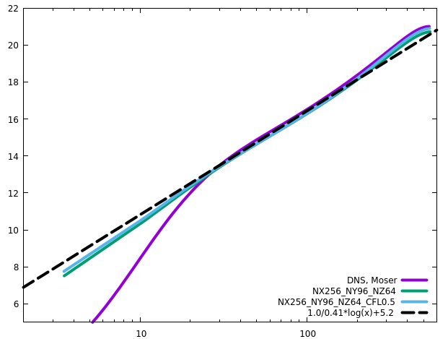
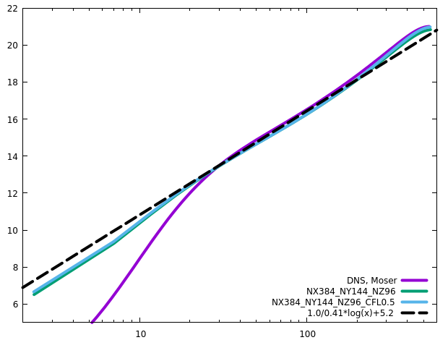
Channel
RETAU550
CFL has negligible influence on the statistics

Slide 11
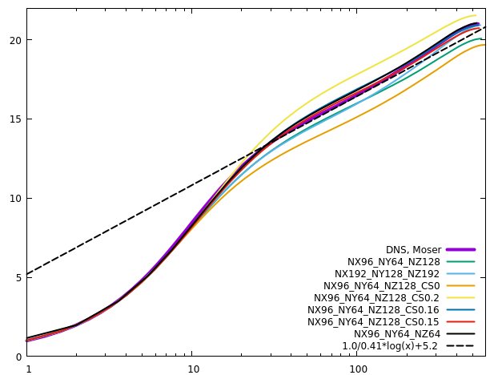
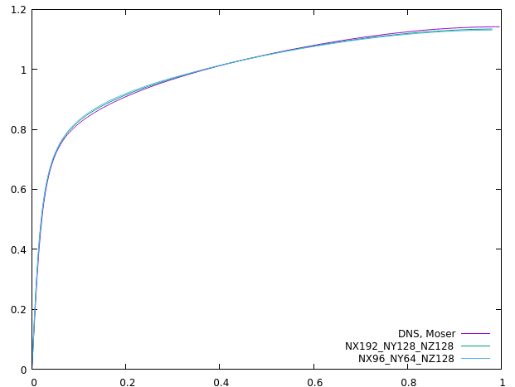
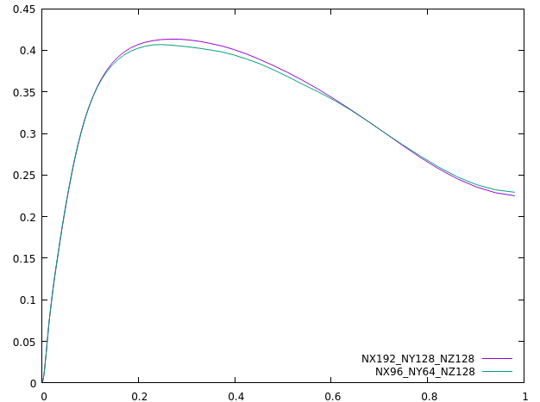
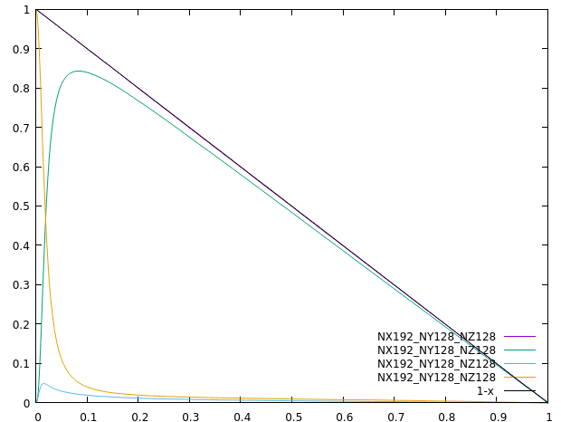
Channel
RETAU550
(Lx, Ly)=(6.4, 2.4) produces almost the same results as (Lx, Ly)=(12.8, 4.8)
CS0.16 produces the best overall results (CS0.15, best log law)
CS0.11 produces the best results with coarse resolutions in the wall-normal direction

Slide 12
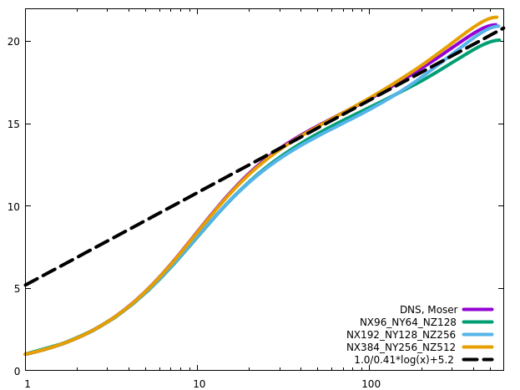
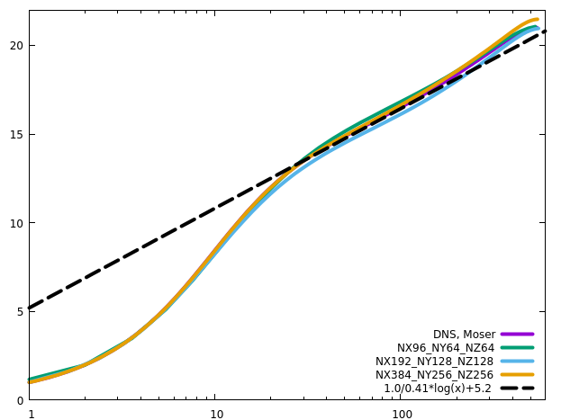
Channel
RETAU550
Grid convergence

Slide 13
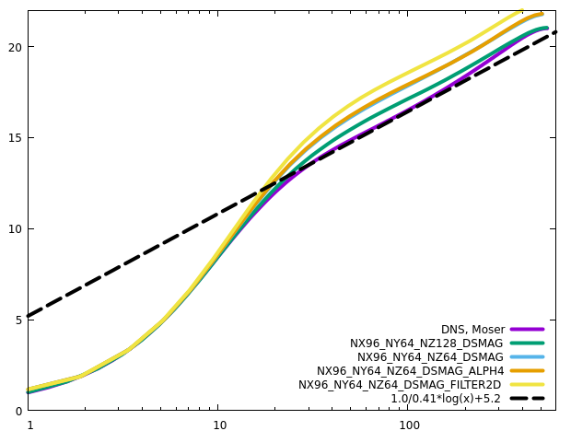
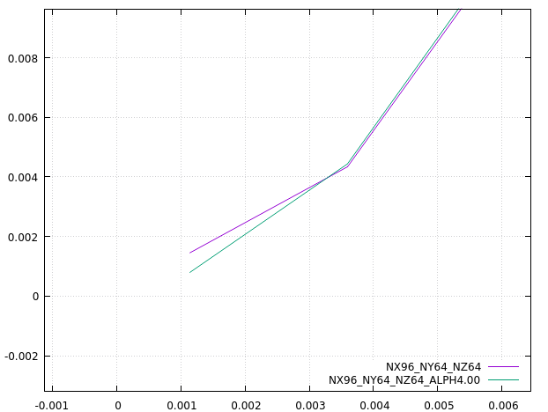
Channel
RETAU550
Dynamic Smagorinsky
Alph2=2.52 for the first off-wall layer of cells fits the first principle

Slide 14
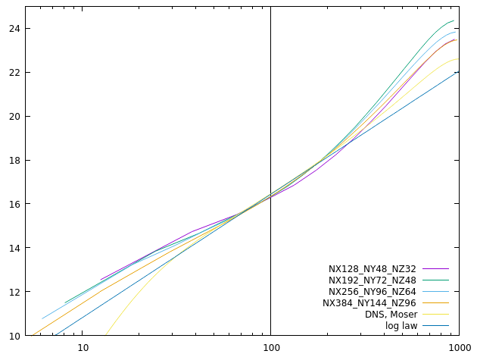
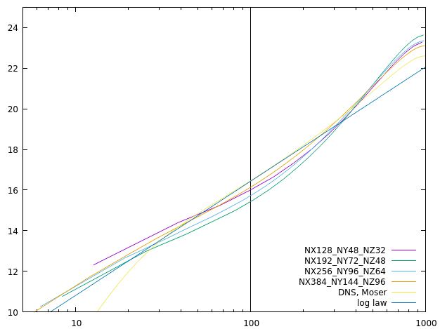
Channel
RETAU1000
Wall model
Neumann

Slide 15
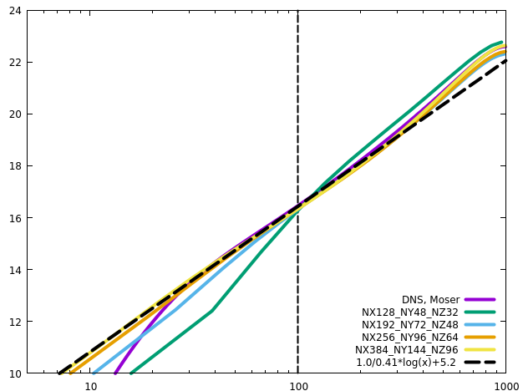
Channel
RETAU1000

Slide 16
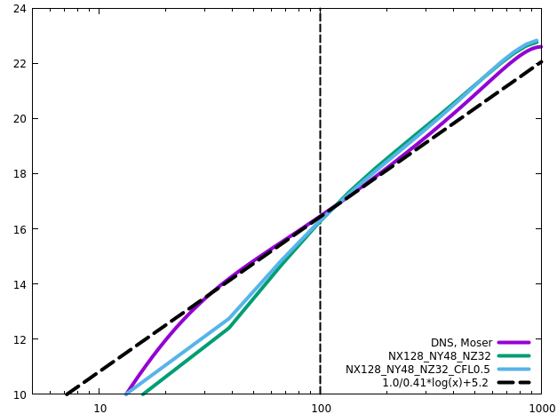
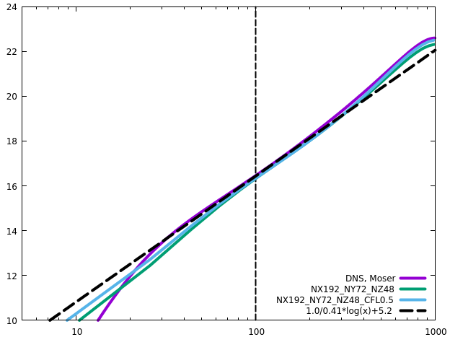
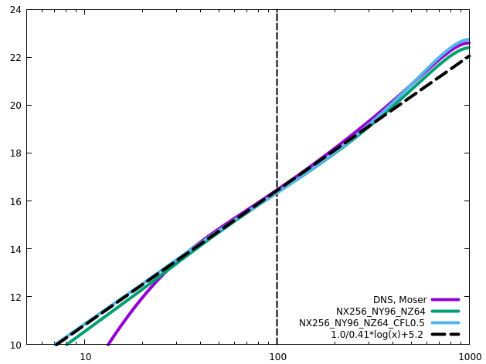
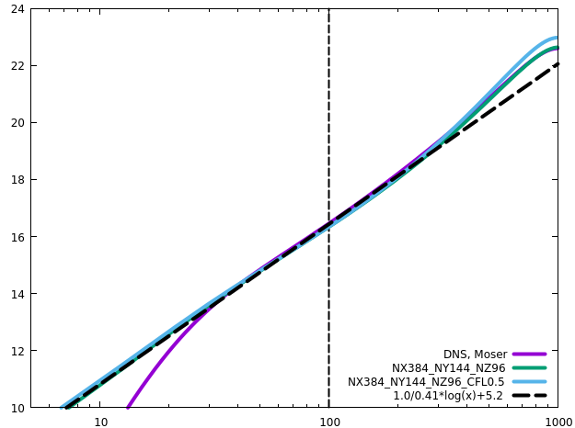
Channel
RETAU1000
CFL has influence on the statistics

Slide 17
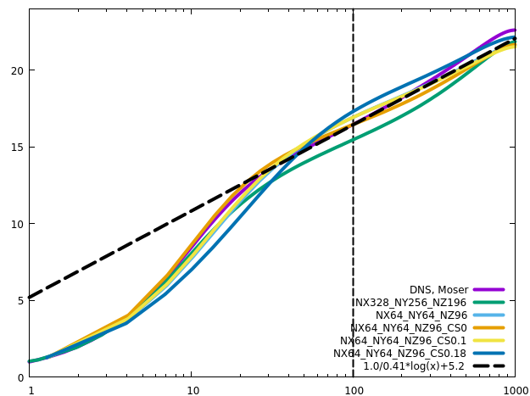
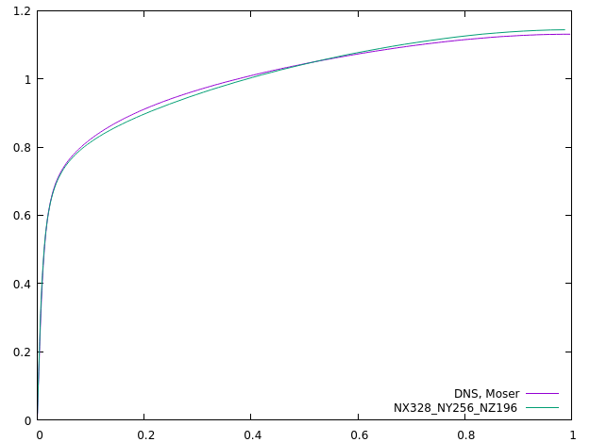
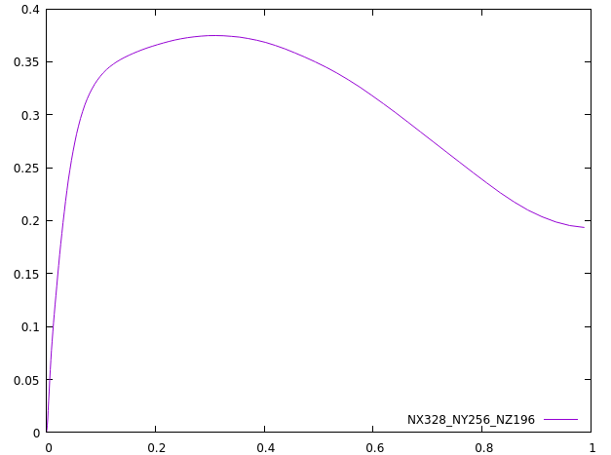
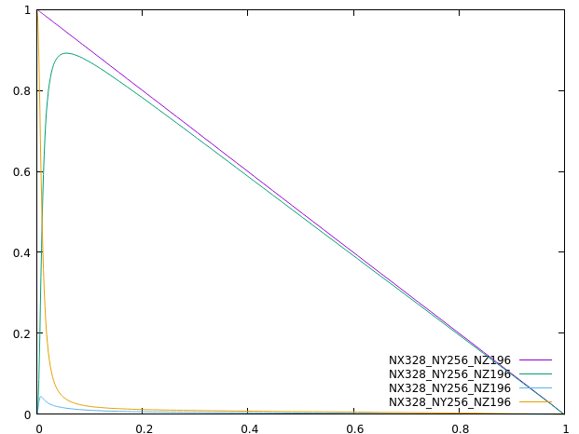
Channel
RETAU1000
Linear variation of tau_tot should also apply in LES/RANS
As Re increases, the influence of Cs is less

Slide 18
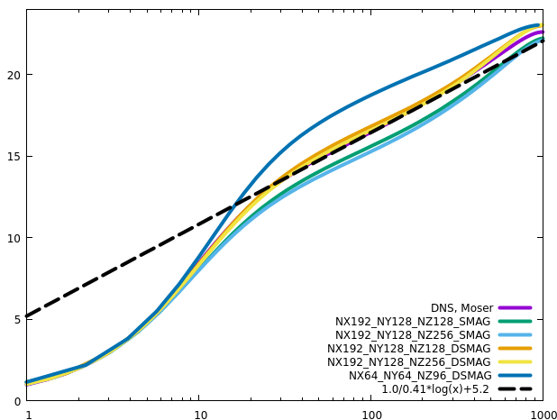
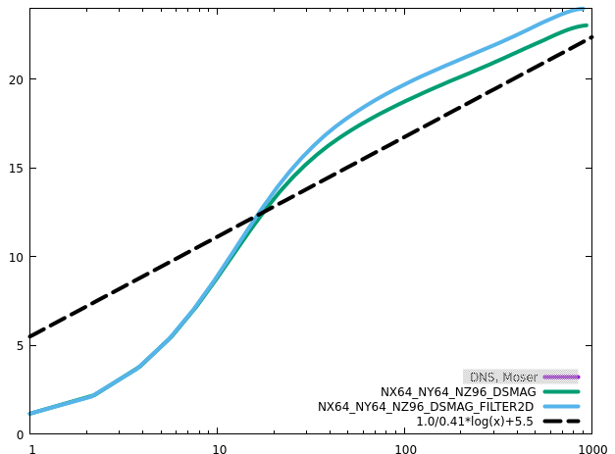
Channel
RETAU1000
Dynamic SMA produces more accurate results, than the static version, when the grid meets the requirements of LES
2D filter yields more dissipation, and the results are very close to Orlandi’s results, demonstrating that the current implementation of DSMAG is correct

Slide 19
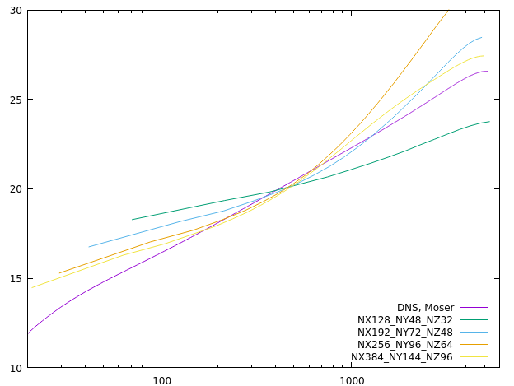
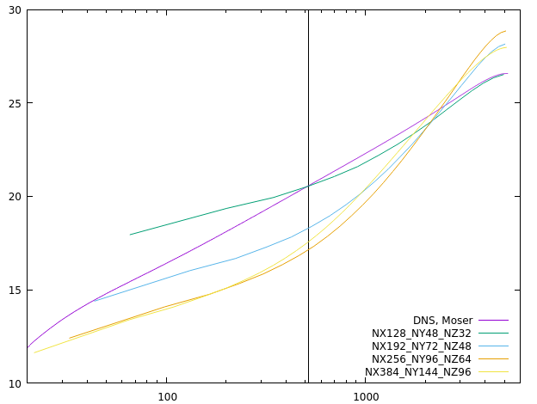
Channel
RETAU5200
Neither Neumann nor wall model yields acceptable profiles
Resolutions are insufficient
Wall model
Neumann

Slide 20
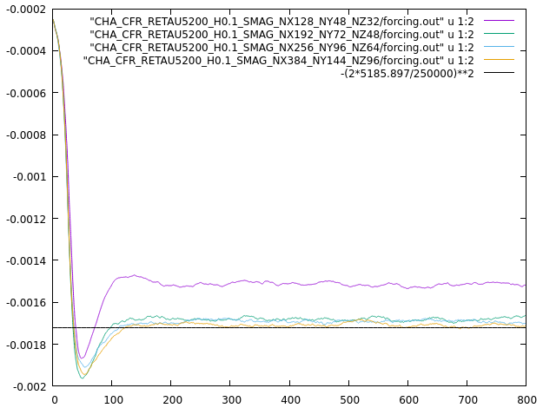
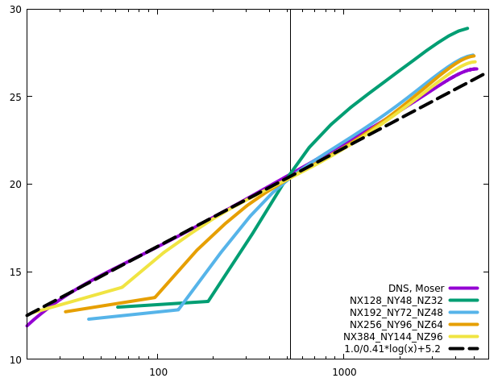
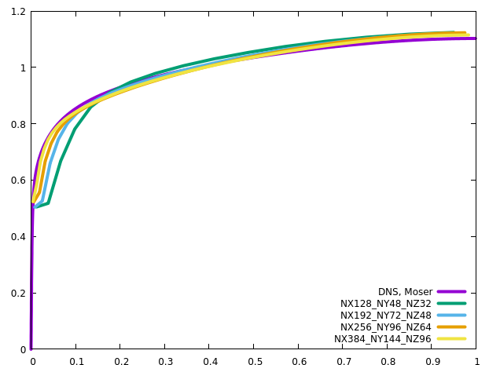
Channel
RETAU5200
Standard implementation
Slow velocity increase between the first and the second cell centers? More accurate to use the second and the third cell centers for the velocity gradient & extrapolation?

Slide 21


Channel
RETAU5200
Two kappa values produce almost the same results, although 0.41 is negligibly better

Slide 22




Channel
RETAU5200
CS0.11 is optimal, and CS0.05 is too small, especially in the core region

Slide 23

Channel
RETAU5200
CS0 reproduces the statistics without SGS

Slide 24




Channel
RETAU5200
Simplified viscous terms produce a bit better results on coarse grids, but nearly the same results on the finest grid

Slide 25




Channel
RETAU5200
Simplified viscous terms produce a bit better results on coarse grids

Slide 26




Channel
RETAU5200
CFL has influence on the statistics

Slide 27




Channel
RETAU5200
CFL

Slide 28





Channel
RETAU5200
Domain size hardly influences the results. The outer layer is negligibly influenced
Longer domain needs longer transient time (larger structures resolved, longer periods?)

Slide 29




Channel
RETAU5200
ACC does not influence the statistics

Slide 30




Channel
RETAU5200
The effect of damping function increases with mesh refinement

Slide 31




Channel
RETAU5200
No-slip wall: damping produces larger (more accurate) velocity gradient near the wall

Slide 32
Channel
No-slip
No-slip bc leads to higher RETAU on coarse grids when there is no numerical dissipation on the scales near the cut-off scale

Slide 33

Channel
Explicit vs implicit1D
The results from the explicit and the implicit1D schemes are almost the same
Neumann
Wall model

Slide 34

Channel
Explicit vs implicit1D
The results from the explicit and the implicit1D schemes are almost the same

