Slide 1
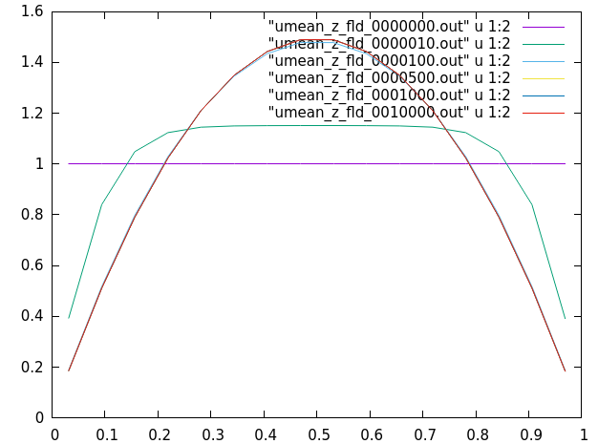
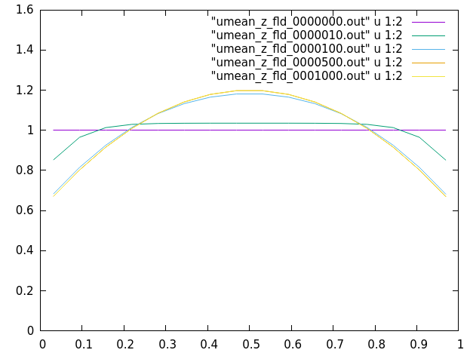
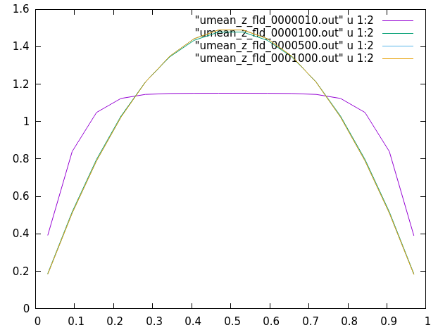
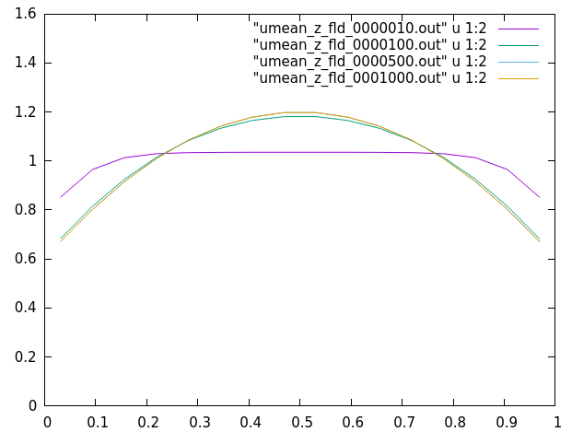
Nz=16
parabolic
Nz=16
log-law
Notes:
laminar flow: using fine grid to see if Neumann results=laminar results (YES) using other initializations to test the current code new and old give the same results when starting from random initializations, indicating that new is also correct
considering old gives accurate converged results, so new also gives accurate converged results
still need to rethink about the reasonability of the old

Slide 2
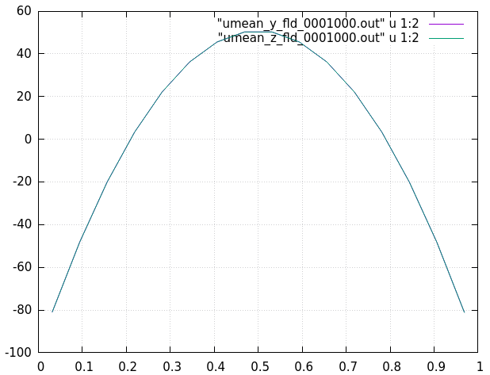
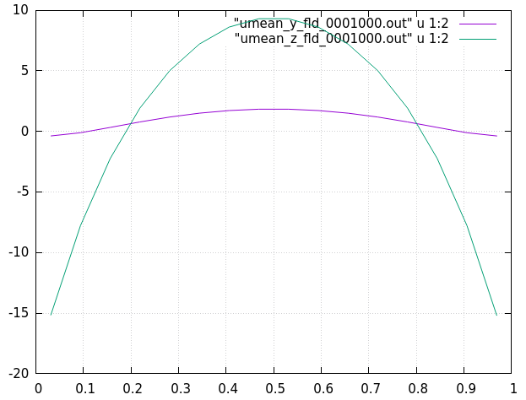
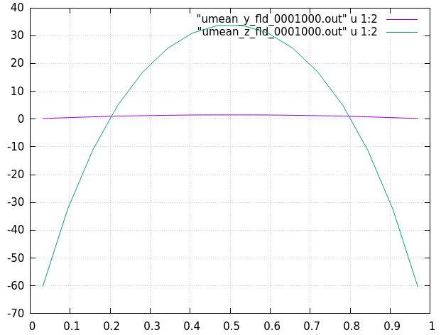
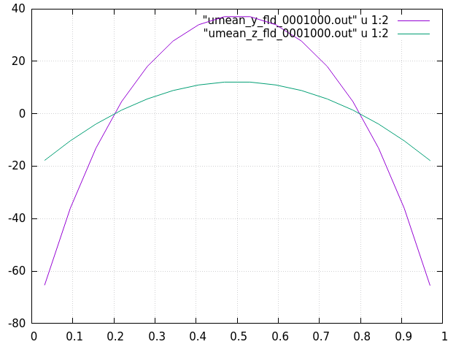
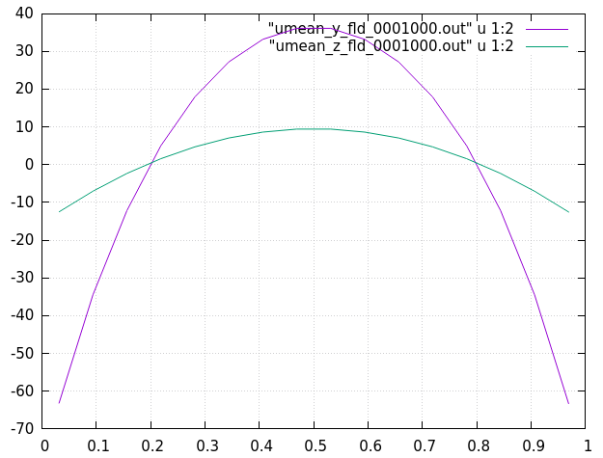
yz wall model
y wall model
z wall model

