Slide 1

V&V of WMLES
Maochao Xiao

Slide 2
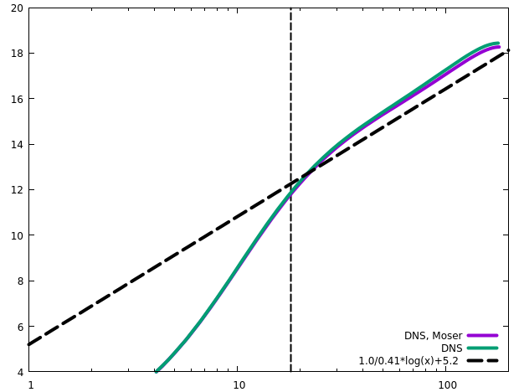
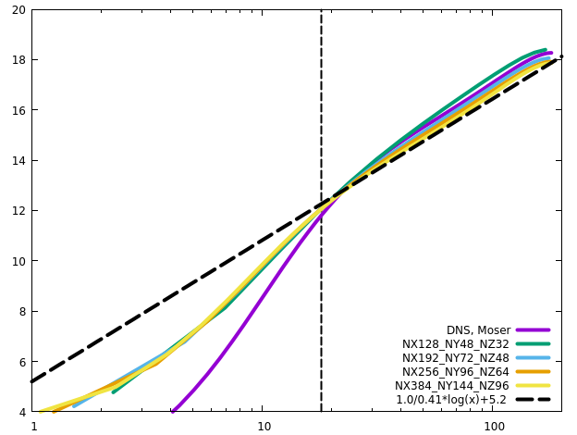
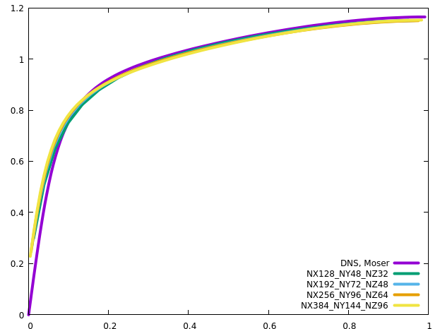
Channel
RETAU180

Slide 3
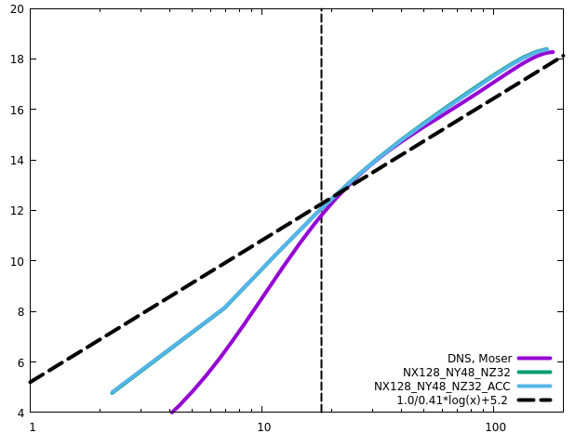
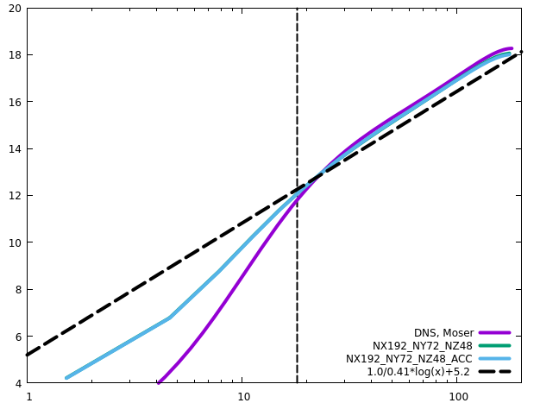
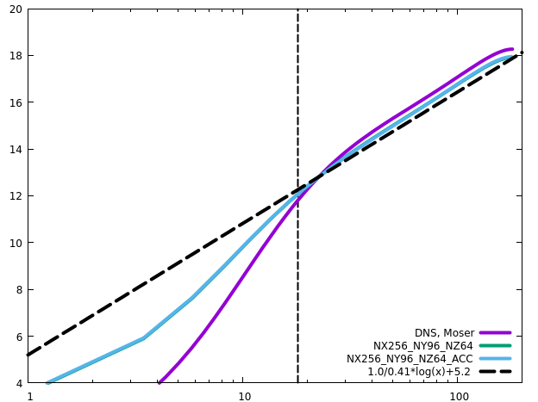
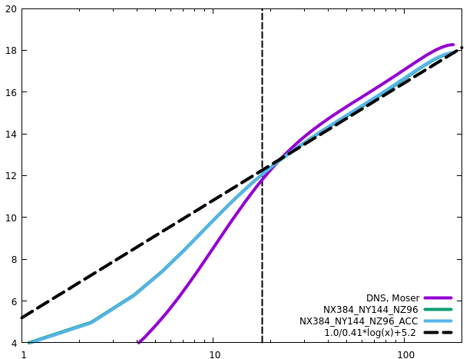
Channel
RETAU180
ACC does not influence the statistics

Slide 4
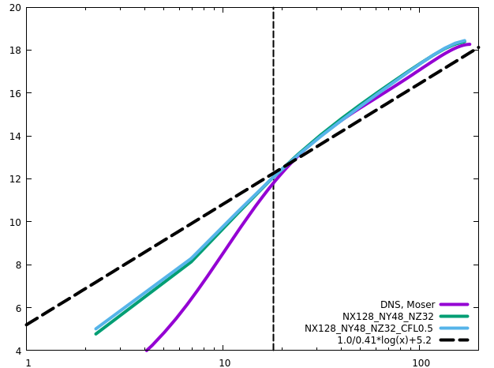

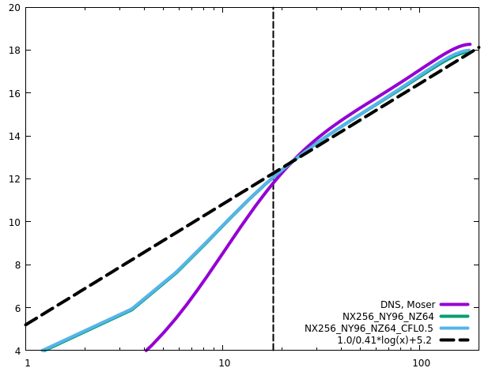

Channel
RETAU180
CFL has negligible influence on the statistics

Slide 5
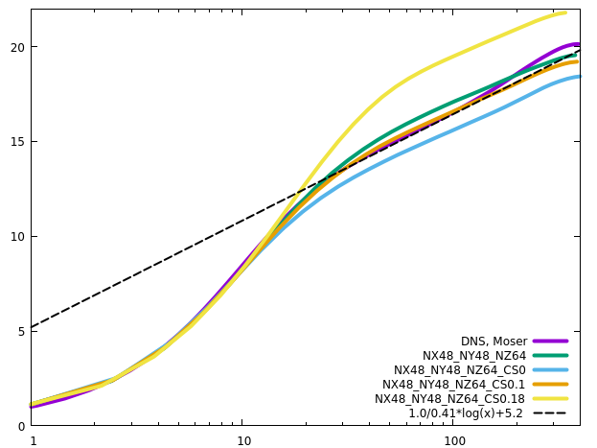
Channel
RETAU395
Orlandi’s setting, Reb=13750

Slide 6
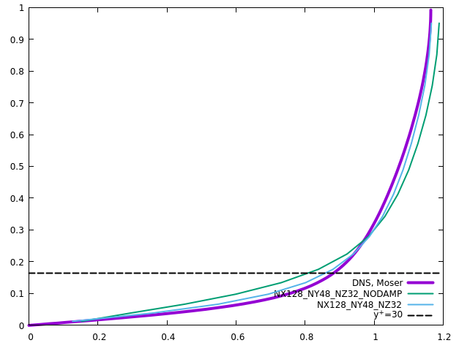
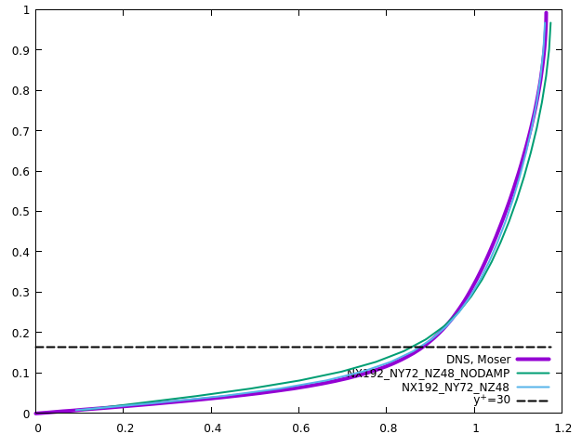
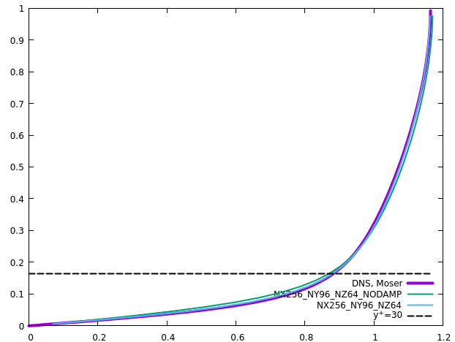
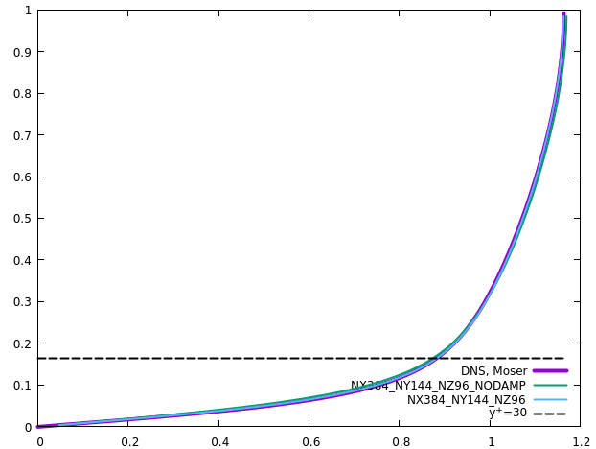
Channel
RETAU180
No-slip wall: damping produces larger (more accurate) velocity gradient near the wall

Slide 7
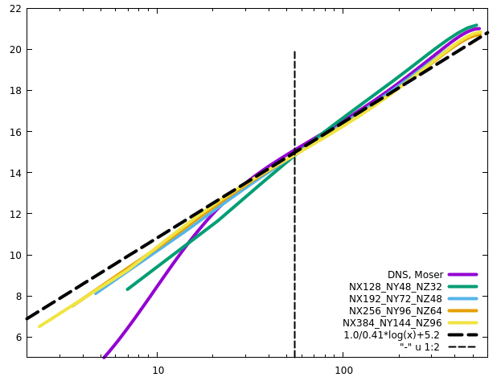
Channel
RETAU550

Slide 8
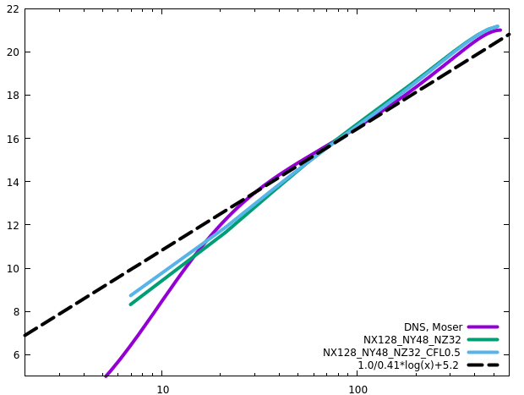
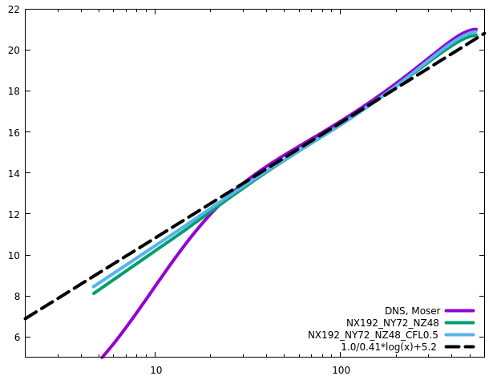
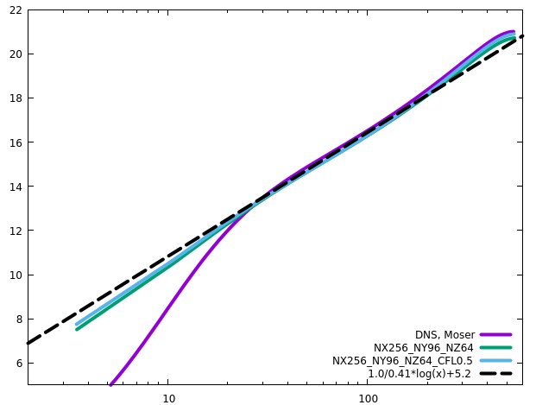
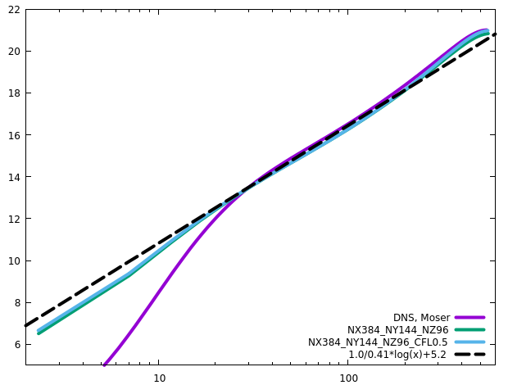
Channel
RETAU550
CFL has negligible influence on the statistics

Slide 9
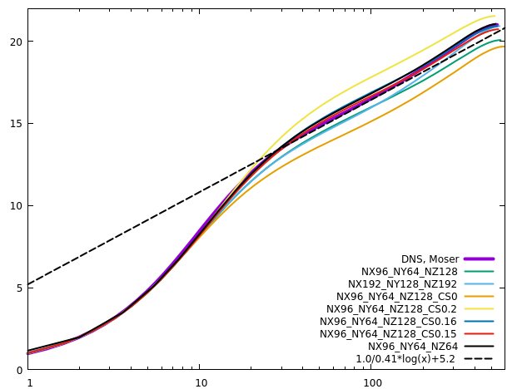
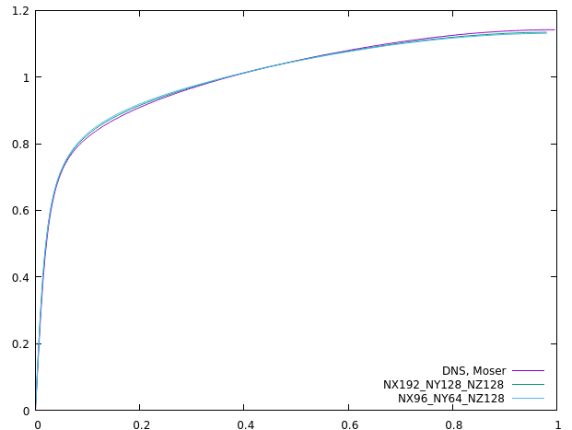
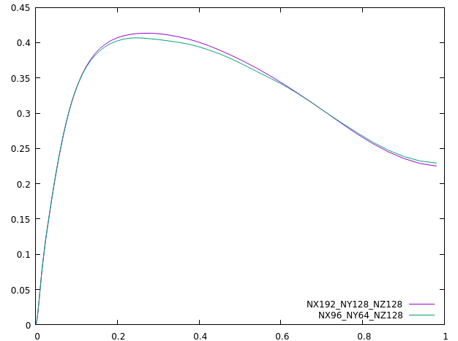
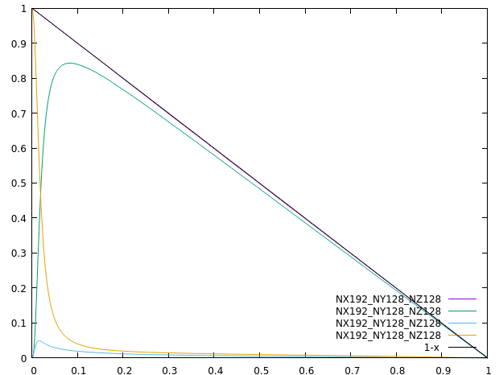
Channel
RETAU550
(Lx, Ly)=(6.4, 2.4) produces almost the same results as (Lx, Ly)=(12.8, 4.8)
CS0.16 produces the best overall results (CS0.15, best log law)
CS0.11 produces the best results with coarse resolutions in the wall-normal direction

Slide 10
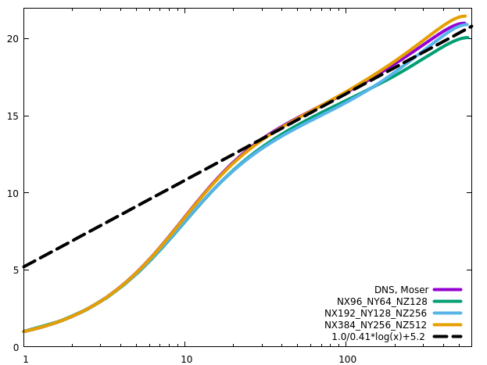
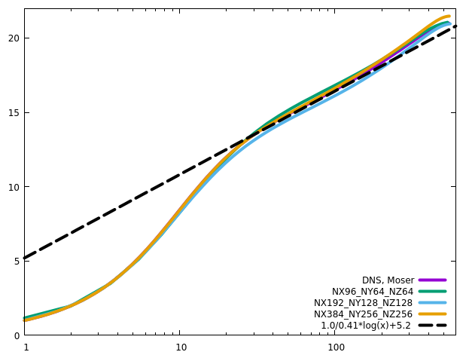
Channel
RETAU550
Grid convergence

Slide 11
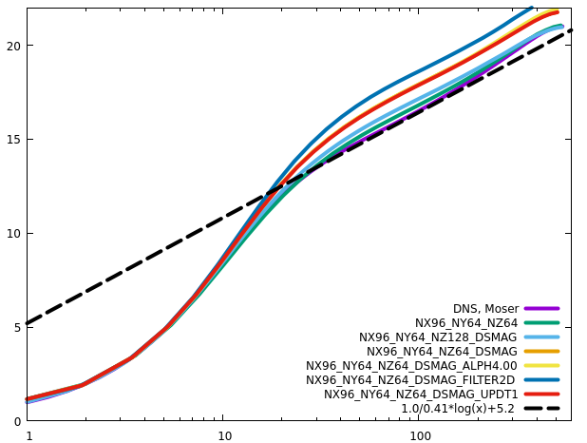
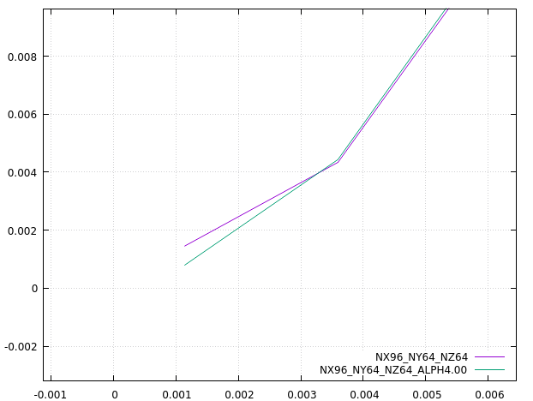
Channel
RETAU550
Dynamic Smagorinsky
Set alpha2=2.52 for the first off-wall layer of cells fits the first principle

Slide 12
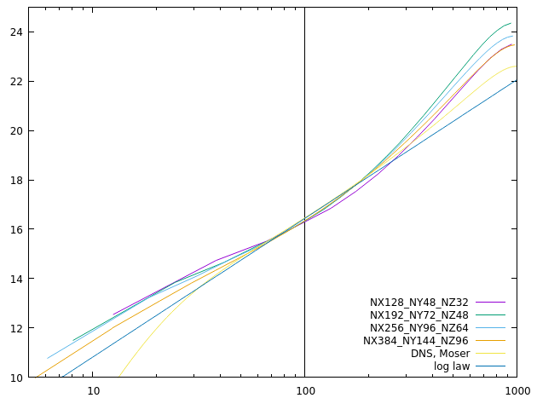
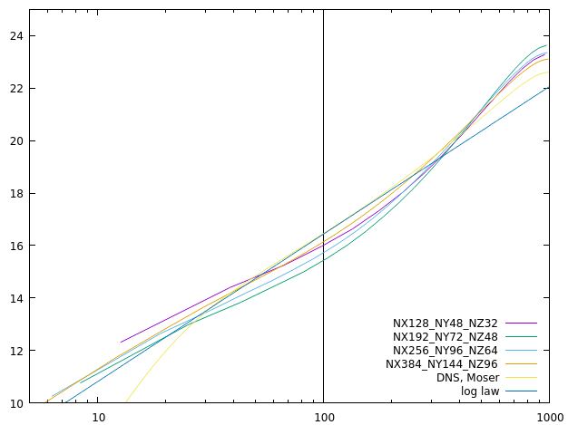
Channel
RETAU1000
Wall model
Neumann

Slide 13
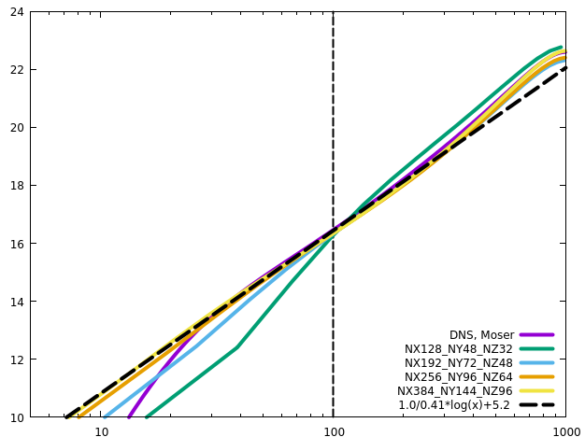
Channel
RETAU1000

Slide 14
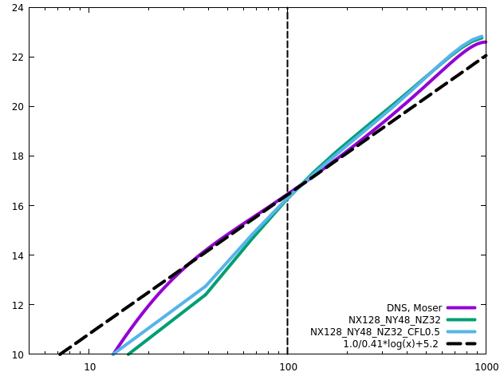
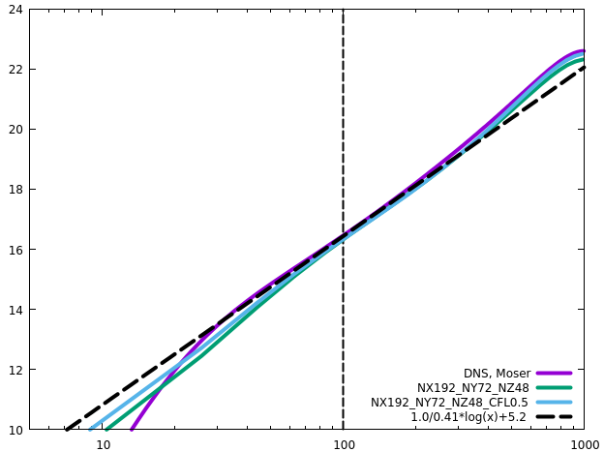
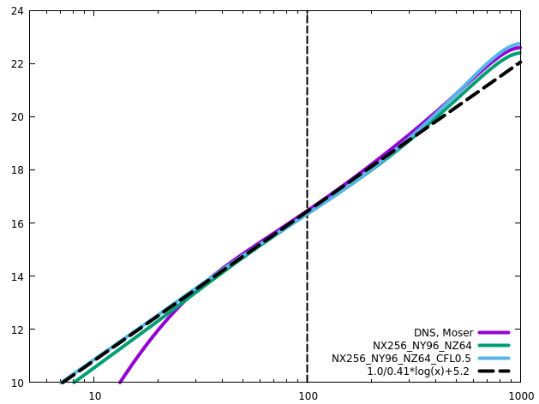
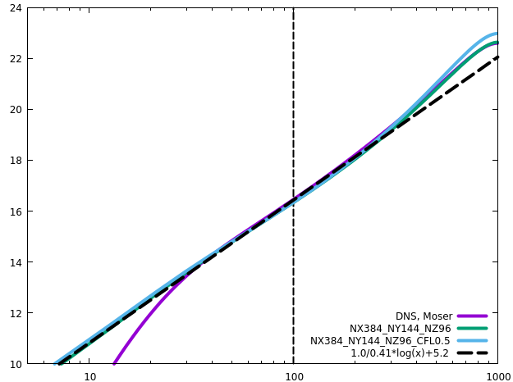
Channel
RETAU1000
CFL has influence on the statistics

Slide 15
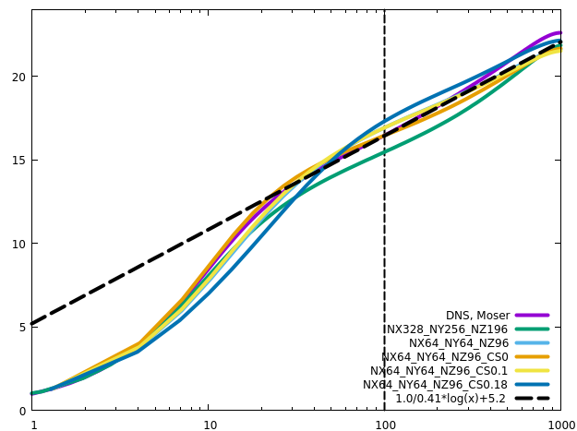
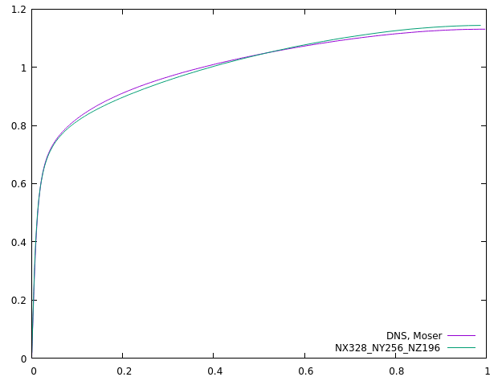
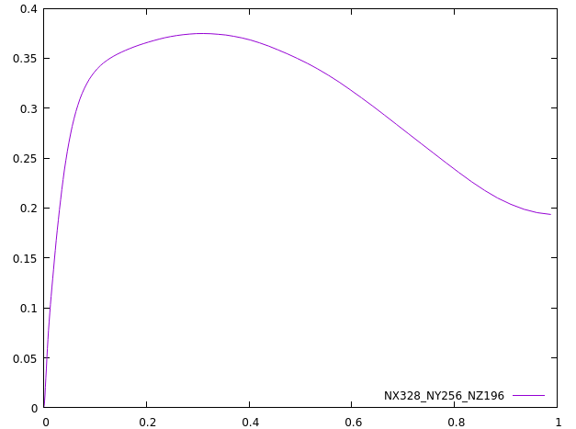
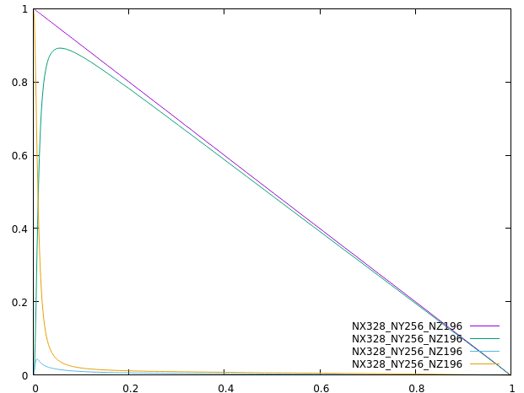
Channel
RETAU1000
Linear variation of tau_tot also applies in LES/RANS
As Re increases, the influence of Cs is less

Slide 16
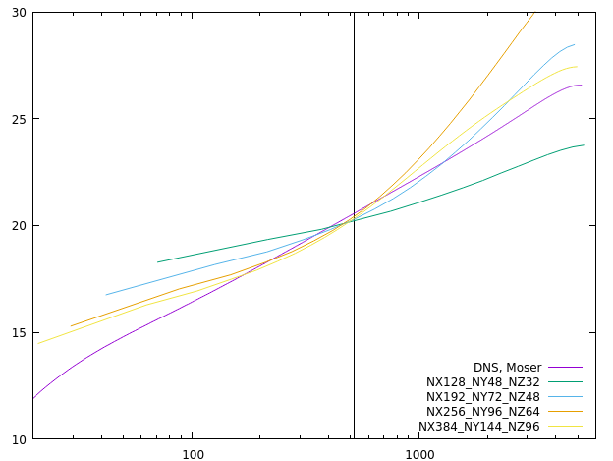
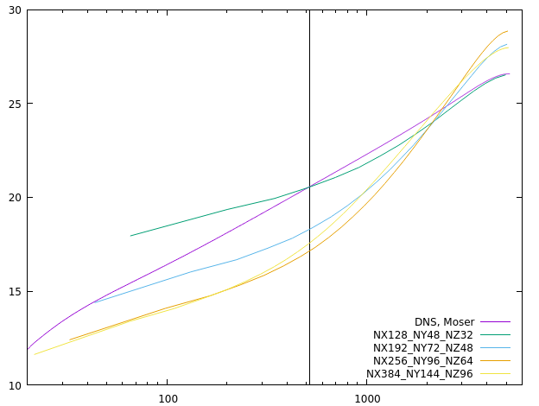
Channel
RETAU5200
Neither Neumann nor wall model yields acceptable profiles
Resolutions are insufficient
Wall model
Neumann

Slide 17
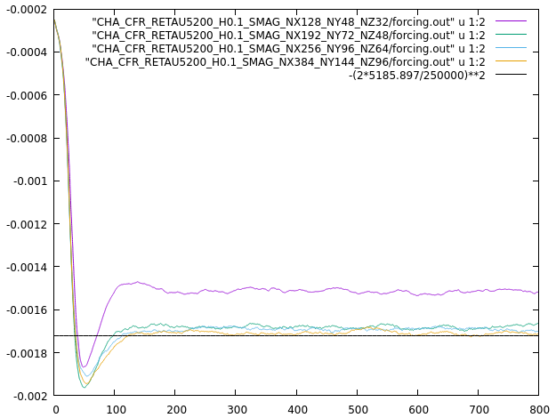
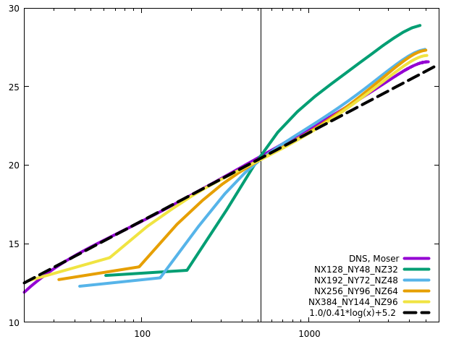
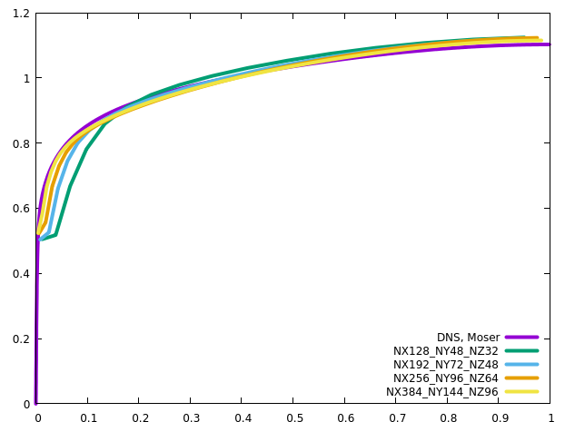
Channel
RETAU5200
Standard implementation
Slow velocity increase between the first and the second cell centers? More accurate to use the second and the third cell centers for the velocity gradient & extrapolation?

Slide 18
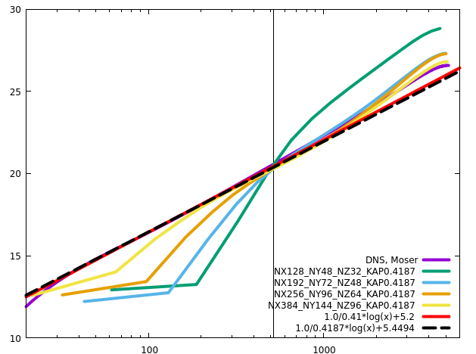
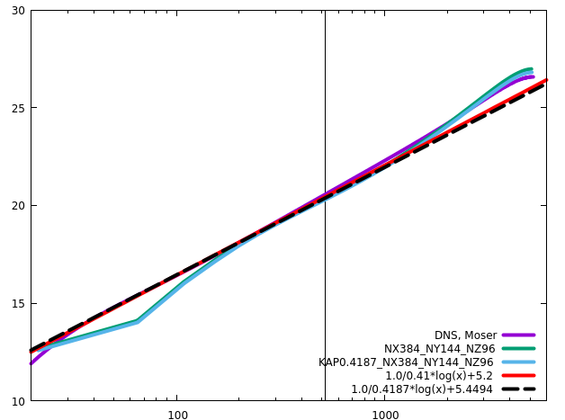
Channel
RETAU5200
Two kappa values produce almost the same results, although 0.41 is negligibly better

Slide 19
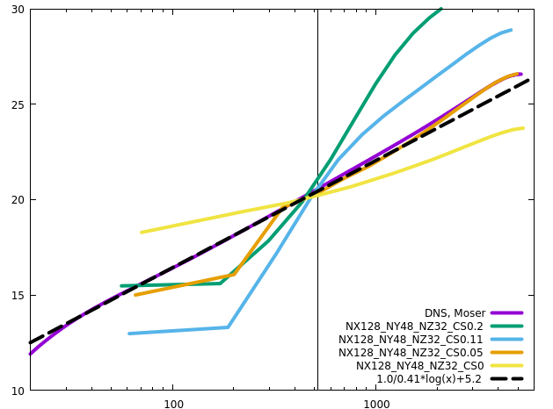
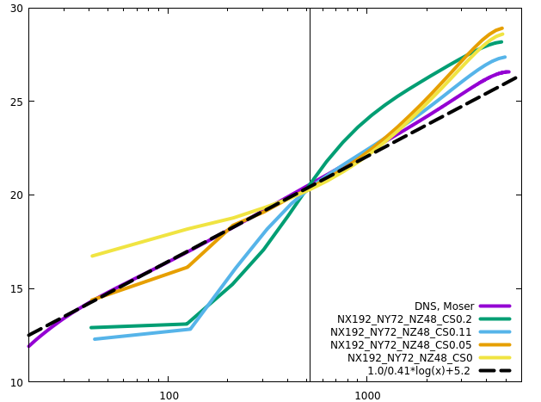
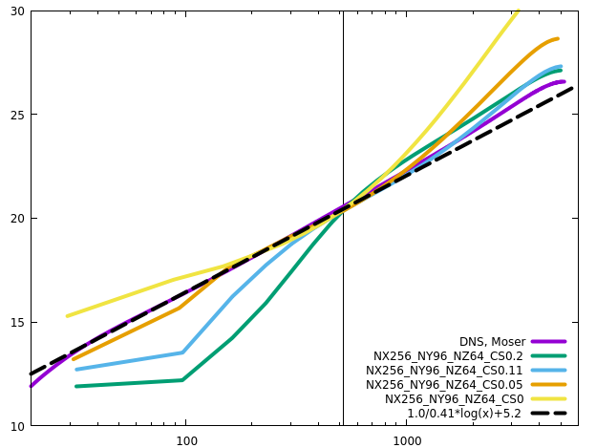
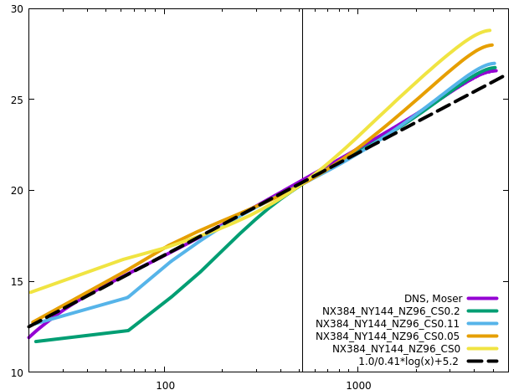
Channel
RETAU5200
CS0.11 is optimal, and CS0.05 is too small, especially in the core region

Slide 20
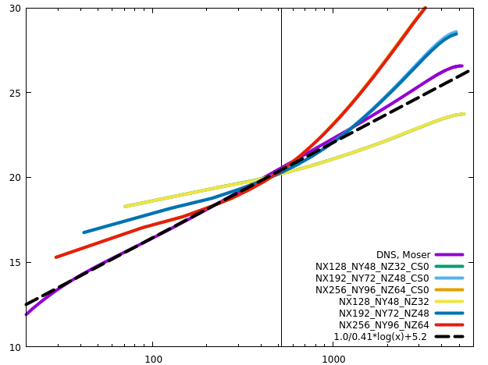
Channel
RETAU5200
CS0 reproduces the statistics without SGS

Slide 21




Channel
RETAU5200
Simplified viscous terms produce a bit better results on coarse grids, but nearly the same results on the finest grid

Slide 22




Channel
RETAU5200
Simplified viscous terms produce a bit better results on coarse grids

Slide 23




Channel
RETAU5200
CFL has influence on the statistics

Slide 24




Channel
RETAU5200
CFL

Slide 25





Channel
RETAU5200
Domain size hardly influences the results. The outer layer is negligibly influenced
Longer domain needs longer transient time (larger structures resolved, longer periods?)

Slide 26




Channel
RETAU5200
ACC does not influence the statistics

Slide 27




Channel
RETAU5200
The effect of damping function increases with mesh refinement

Slide 28




Channel
RETAU5200
No-slip wall: damping produces larger (more accurate) velocity gradient near the wall

Slide 29
Channel
No-slip
No-slip bc leads to higher RETAU on coarse grids when there is no numerical dissipation on the scales near the cut-off scale

Slide 30

Channel
Explicit vs implicit1D
The results from the explicit and the implicit1D schemes are almost the same
Neumann
Wall model

Slide 31

Channel
Explicit vs implicit1D
The results from the explicit and the implicit1D schemes are almost the same

