Slide 1

V&V of WMLES in CaNS-2.0
Maochao Xiao
08/02/2024

Slide 2
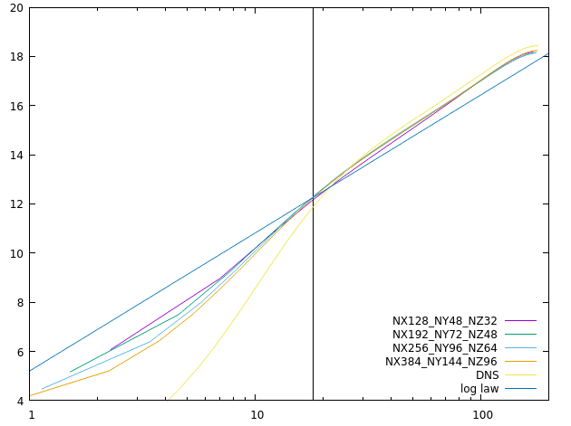
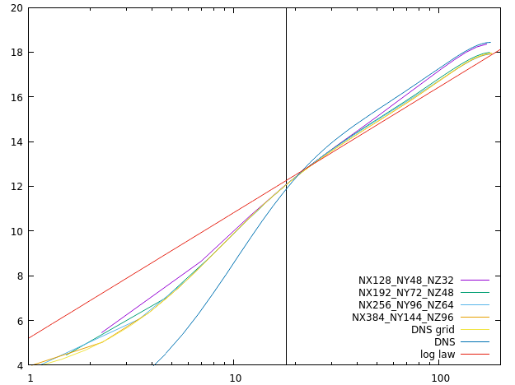
Channel
RETAU180
Both Neumann and wall model yield acceptable profiles
The DNS grid and the finest wall model grid produce the same results, but show difference from the DNS results, demonstrating imperfection of the wall model
Neumann
Wall model

Slide 3
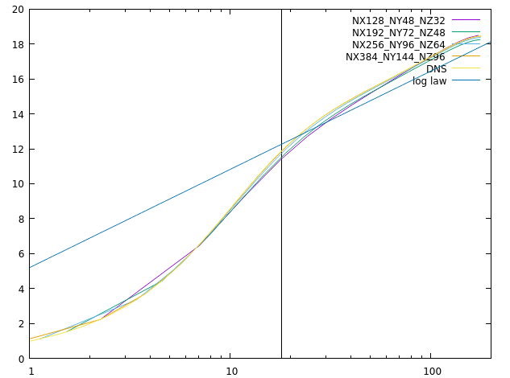
Channel
RETAU180
The results
No-slip

Slide 4
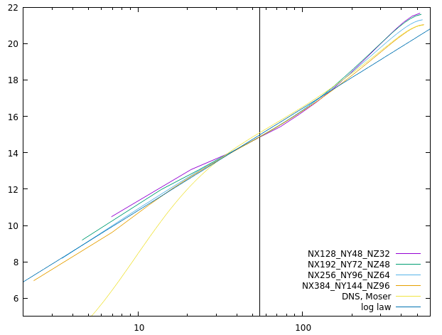
Channel
RETAU550
Both
Neumann
Wall model

Slide 5
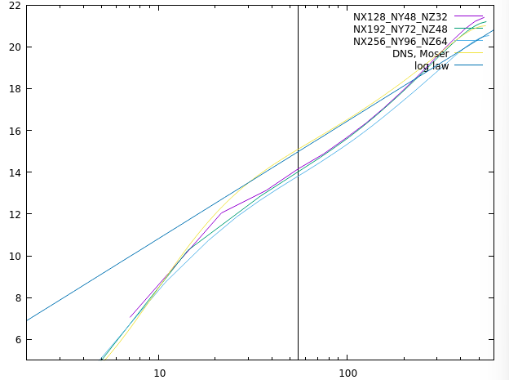
Channel
RETAU550
Both
No-slip
Wall model

Slide 6
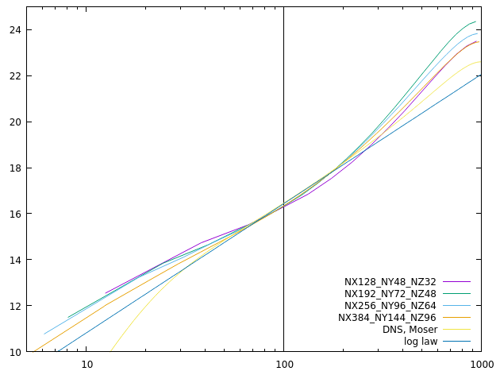
Channel
RETAU1000
Both
Neumann
Wall model

Slide 7
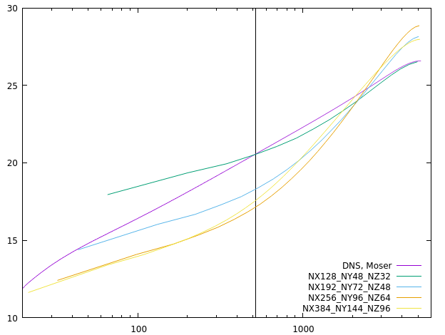
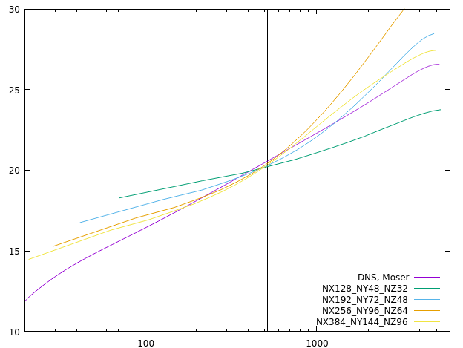
Channel
RETAU5200
Neither Neumann nor wall model yields acceptable profiles
Resolutions are insufficient
Neumann
Wall model
Notes:
Check the results of using constant wall stress in the wall model using debug mode ok
Compare implicit1D results with explicit results
Check numerical instability using Q value numerical oscillation

Slide 8
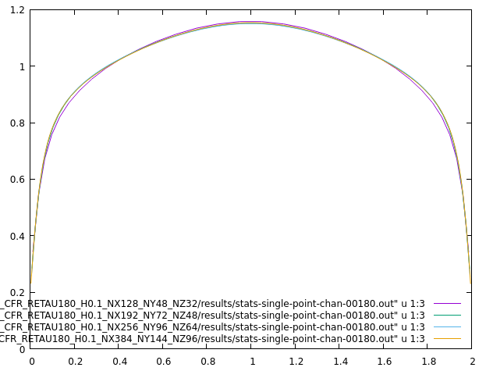
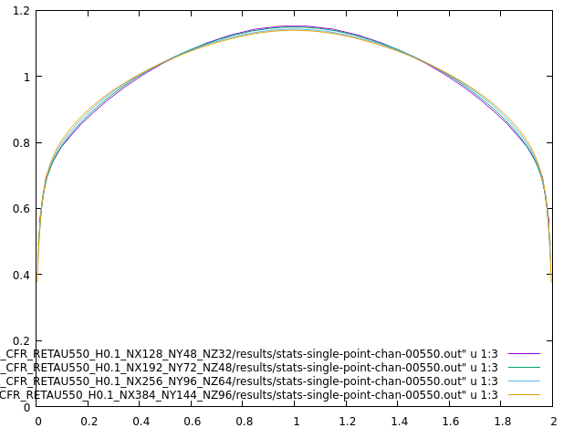
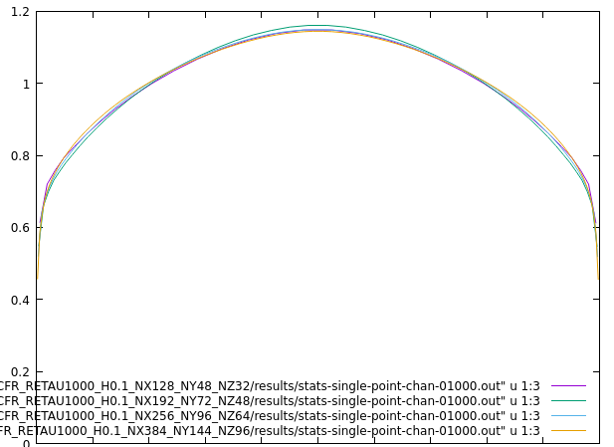
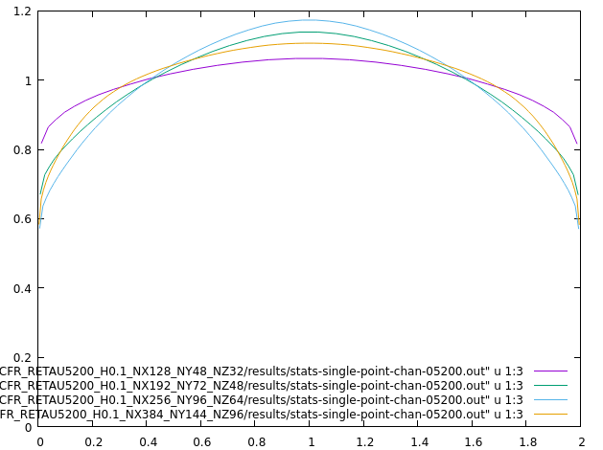
Channel
Wall model
s
RETAU180
RETAU550
RETAU1000
RETAU5200
Notes:
Check the results of using constant wall stress in the wall model using debug mode ok
Compare implicit1D results with explicit results
Check numerical instability using Q value numerical oscillation

Slide 9
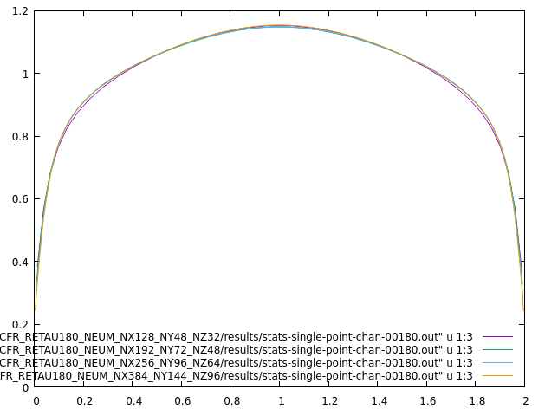
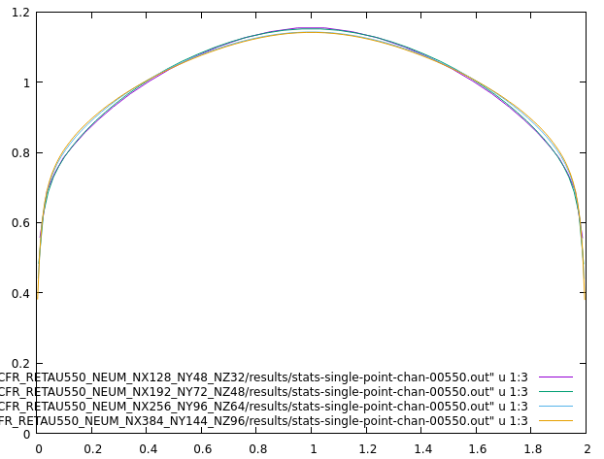
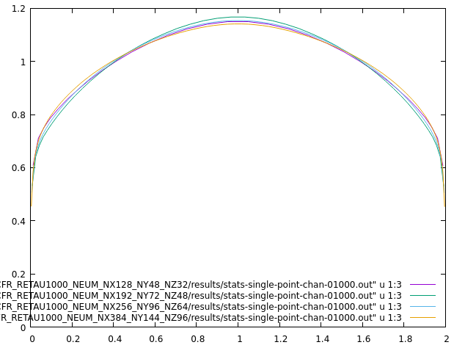
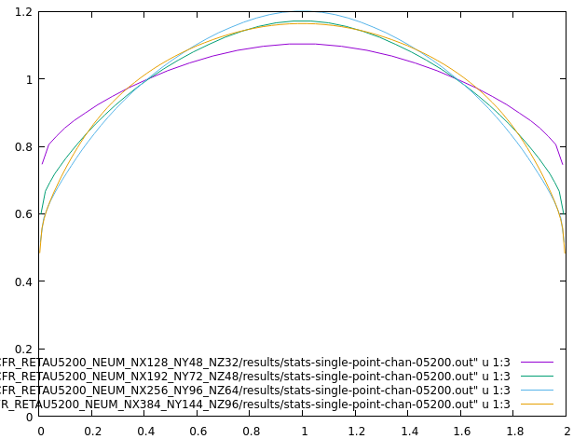
Channel
Neumann BC with fixed shear stress
s
RETAU180
RETAU550
RETAU1000
RETAU5200
Notes:
Check the results of using constant wall stress in the wall model using debug mode ok
Compare implicit1D results with explicit results
Check numerical instability using Q value numerical oscillation

Slide 10
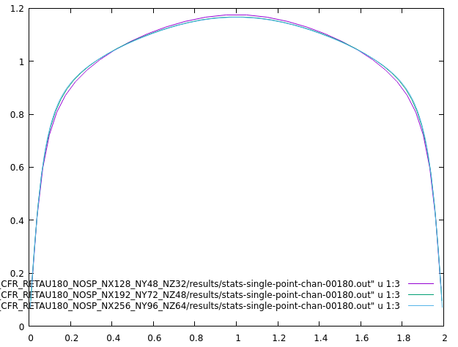
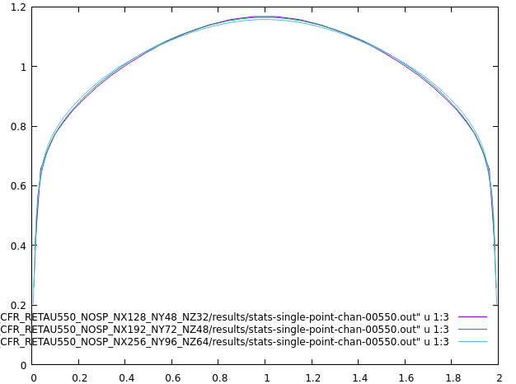
Channel
No-slip BC
s
RETAU180
RETAU550
RETAU1000
RETAU5200
Notes:
Check the results of using constant wall stress in the wall model using debug mode ok
Compare implicit1D results with explicit results
Check numerical instability using Q value numerical oscillation

Slide 11
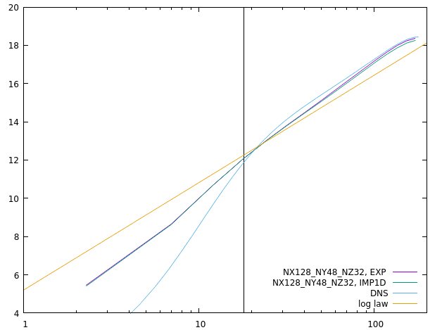
Channel
EXP vs IMP1D, CHA_CFR_RETAU180_H0.1_NX128_NY48_NZ32
The results from the explicit and the implicit1D schemes are almost the same
Neumann
Wall model

Slide 12

Square Duct
High-Reynolds-number wall-bounded turbulence is common in industrial engineering, but is inaccessible to DNS/LES
LES of a whole aircraft will be ready in 2045
The highest computable ${Re}_{τ}$ ~ 10⁴ for channel
Notes:
High Reynolds turbulence examples inaccessible (how much cost) wmles modeled two methods
Grids requirements

